Slide 1
Hands-on workshop
Chemistry & Materials with the ADF Modeling Suite
Exercises part I: electronic structure
DFT, DFTB, periodic DFT
Spectroscopy, band structures
KIER, Daejeon, 9 February 2018
Fedor Goumans, goumans@scm.com
SCM support: support@scm.com

Slide 2
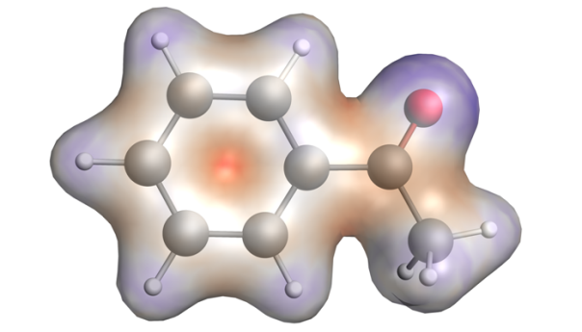
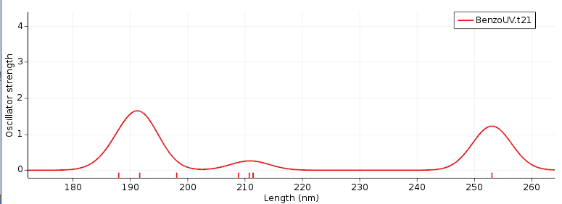
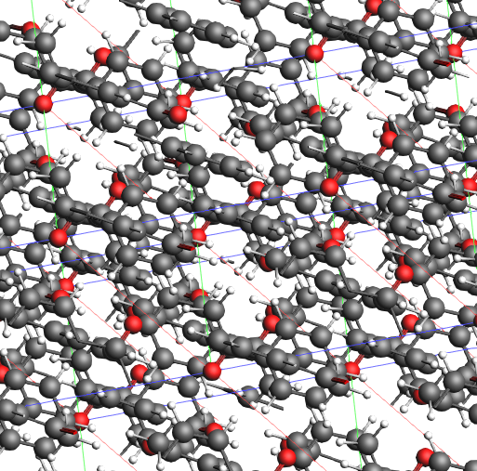
Program
Introduction
  SCM & ADF
  Computational chemistry& materials science
UV/VIS, IR, charge transfer, bonding analysis
  Fast methods: DFTB
Periodic DFT: plane waves & atomic orbitals
ReaxFF: reactive MD large, complex systems
  Monte Carlo methods to speed up time / equilibrium
(COSMO-RS: activity, solubility, VLE)
Further exercises & discussion

Slide 3
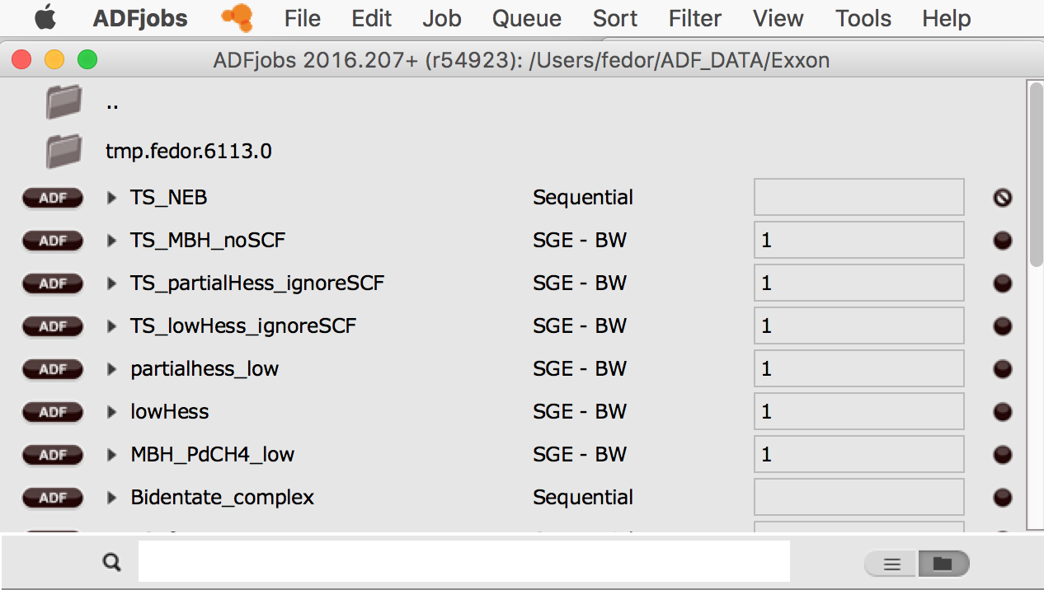
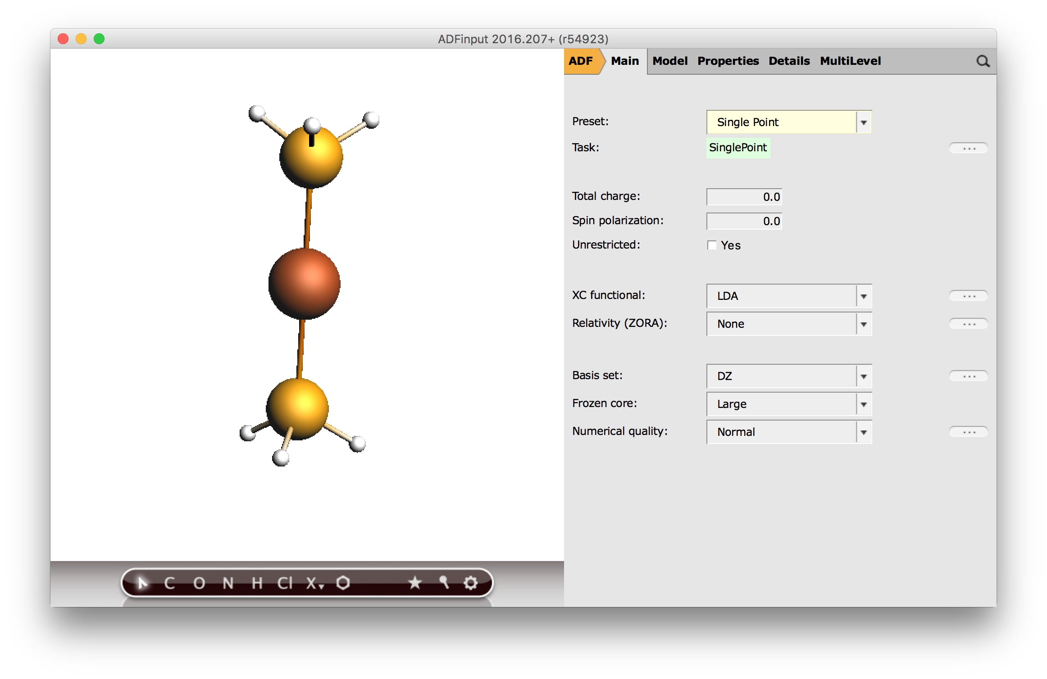
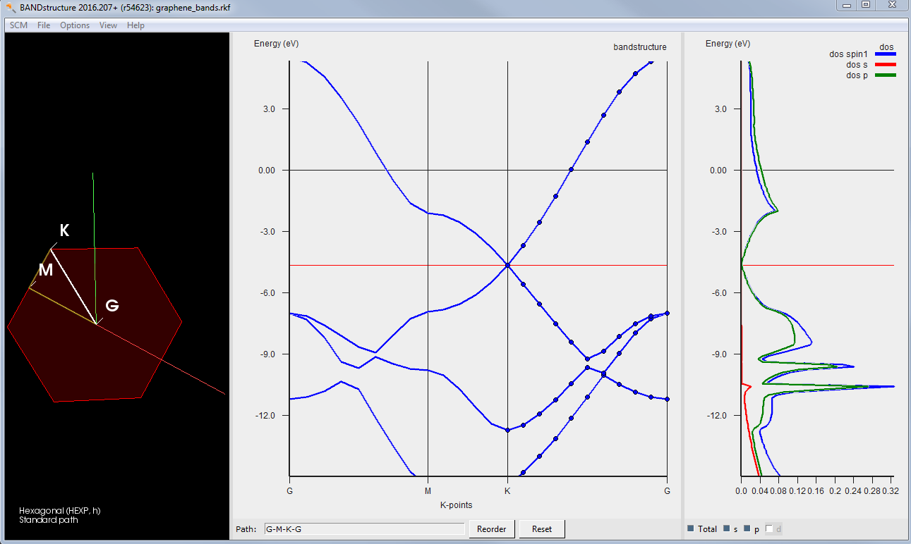
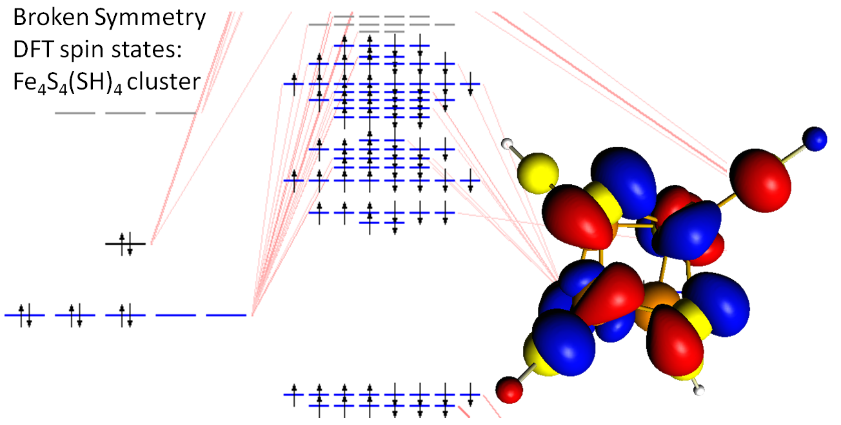
Getting started with the GUI
Starting ADFjobs: job bookkeeping tool
Win: dbl-click desktop item
Mac: open Application
Linux: run $ADFBIN/adfjobs
Other GUI modules: (Input, View, Levels, Movie, Spectra, Band Structure, COSMO-RS, …)
  Can be opened by dbl-clicking ‘.exe’ (Win) or opening e.g. ‘$ADFBIN/adfinput’

Slide 4
ADFjobs: job bookkeeping
switch GUI functionality
define & switch queues
reports & templates
change default
e.g. cores / nodes
see files for this job
job status
queue
search
all jobs / folder view

Slide 5
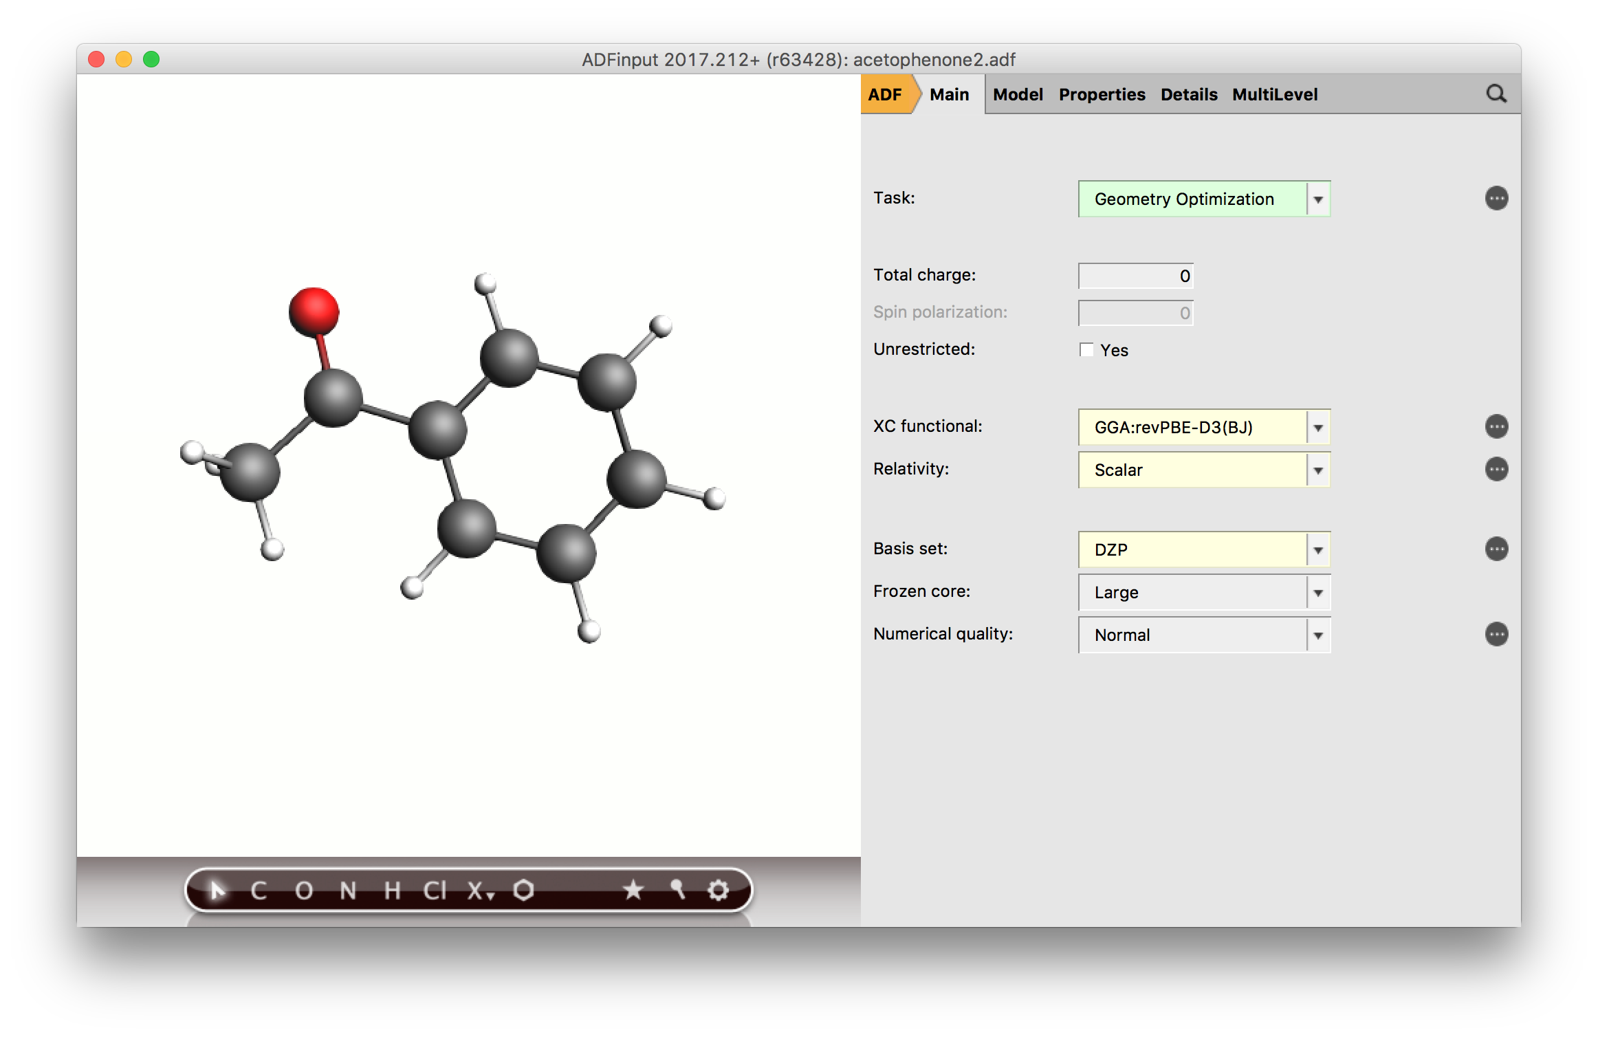
Basic calculations & settings
switch modules
job types & set up
search
job type
charge/spin
functional &
relativistic appr
basis & numerical
accuracy
builder tools
preoptimize
… = more details
symmetryze

Slide 6
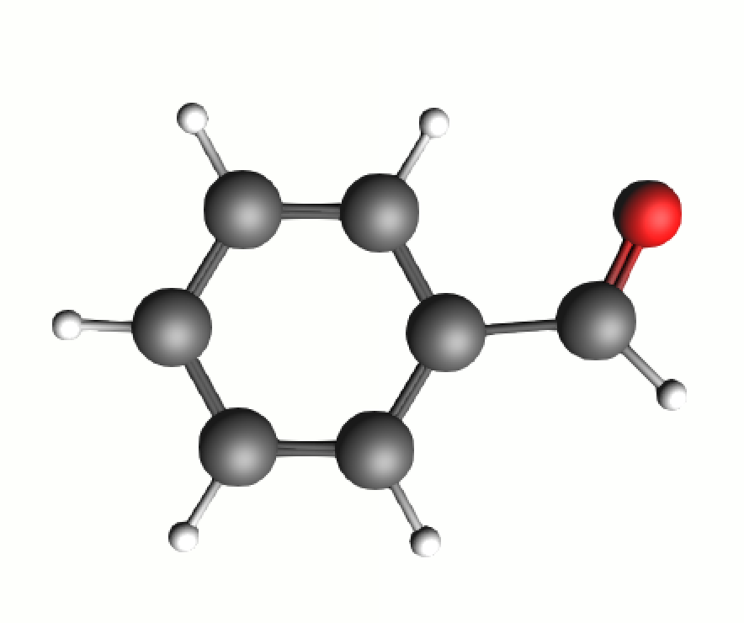

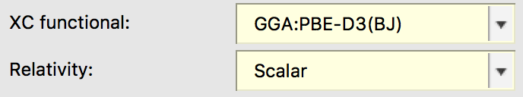
Building molecules
www.scm.com/doc/Tutorials/GUI_overview/Building_Molecules.html
NB: tutorials also offline with your ADF!
Import: SMILES, xyz, cif, pdb, …
Included library + building
Excercise 1: Build acetophenone
  By searching for it in the GUI
  By starting from the benzene template (press 2 for double bond, Ctrl+E to add Hs)
  By importing smiles CC(=O)c1ccccc1 (e.g. from Wikipedia or Chemspider)
Exercise 2: Symmetrize, pre-opt & optimize: SR-ZORA-PBE-D3(BJ)/DZP

Slide 7

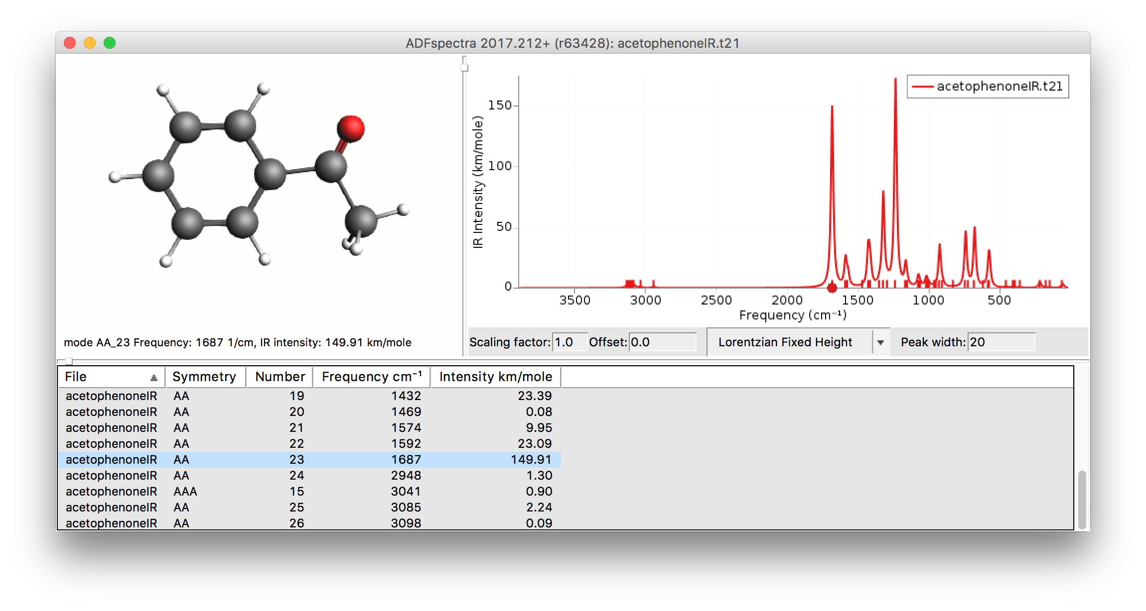
Spectra: IR
www.scm.com/doc/Tutorials/ADF/ADF-GUI_tutorials.html#spectroscopy
Excercise 3: Calculate & visualize frequencies
  NB analytical frequencies available for most GGAs, not for hybrids
  Go to spectra, visualize the CO stretch at ~1690cm⁻¹
  Increase the line width to ~20
  Compare to NIST data

Slide 8
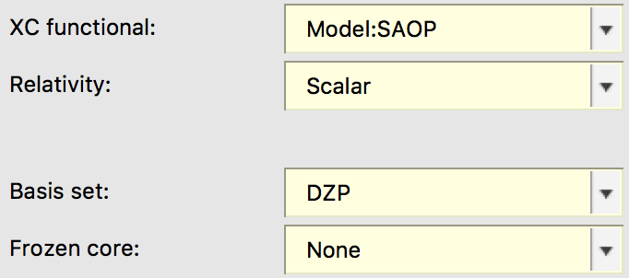
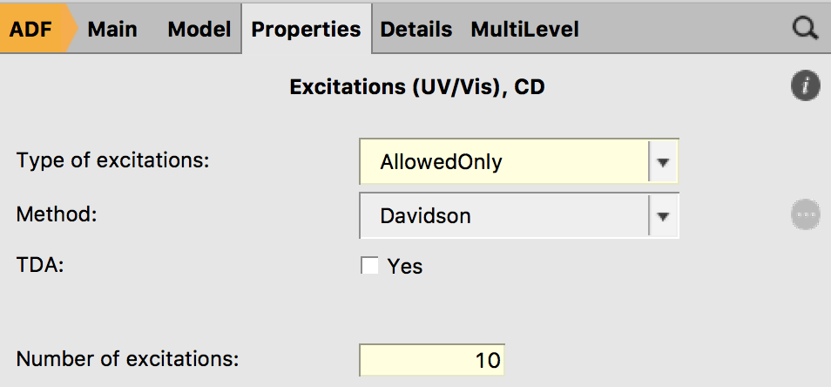
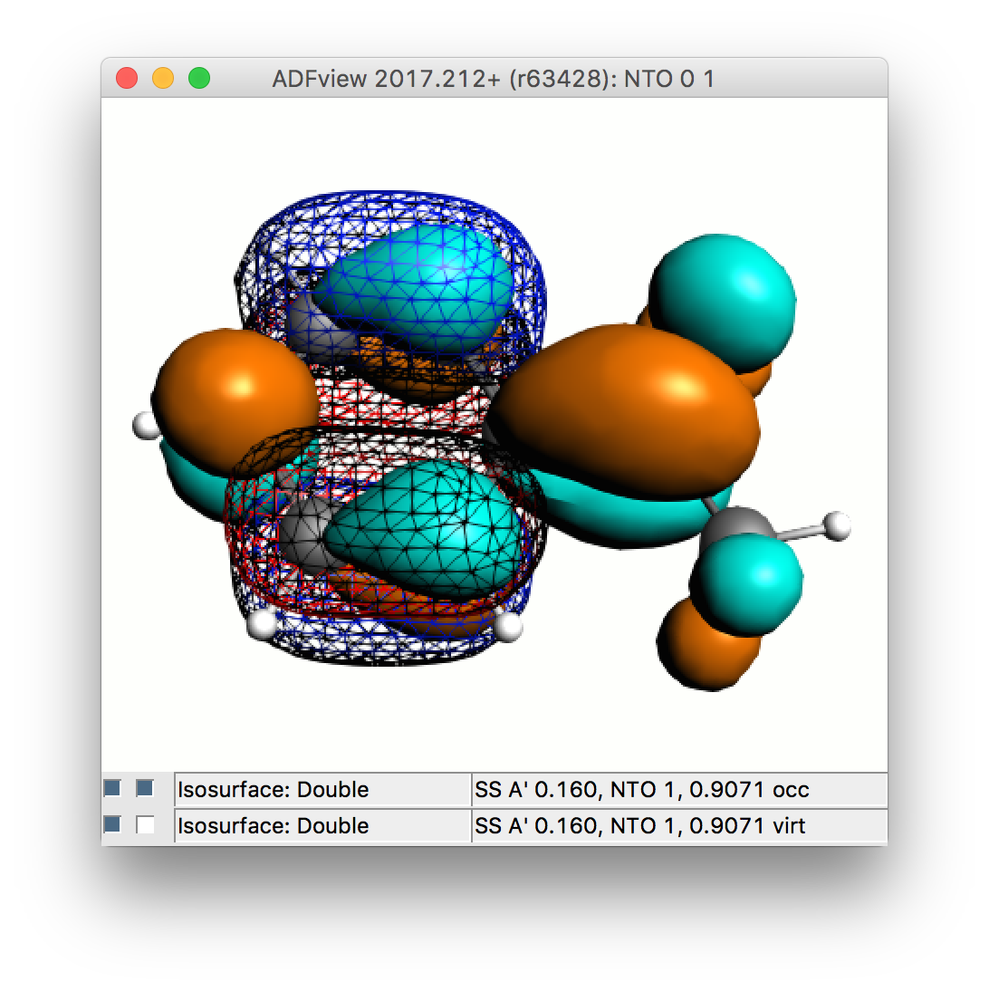
Spectra: UV/VIS
Exercise 4: Calculate 10 allowed excitations with the SAOP model potential
  See also UV/VIS FAQ for more tips
  Go to spectra, change x-axis to nm
  Increase the line width to ~10
  Visualize the pi-pi* NTOs at ~250 & 285nm
  Compare to NIST data
  Now rerun with method ‘sTDA’ and tick TDA
  Compare timings & spectra (File -> add spectra

Slide 9
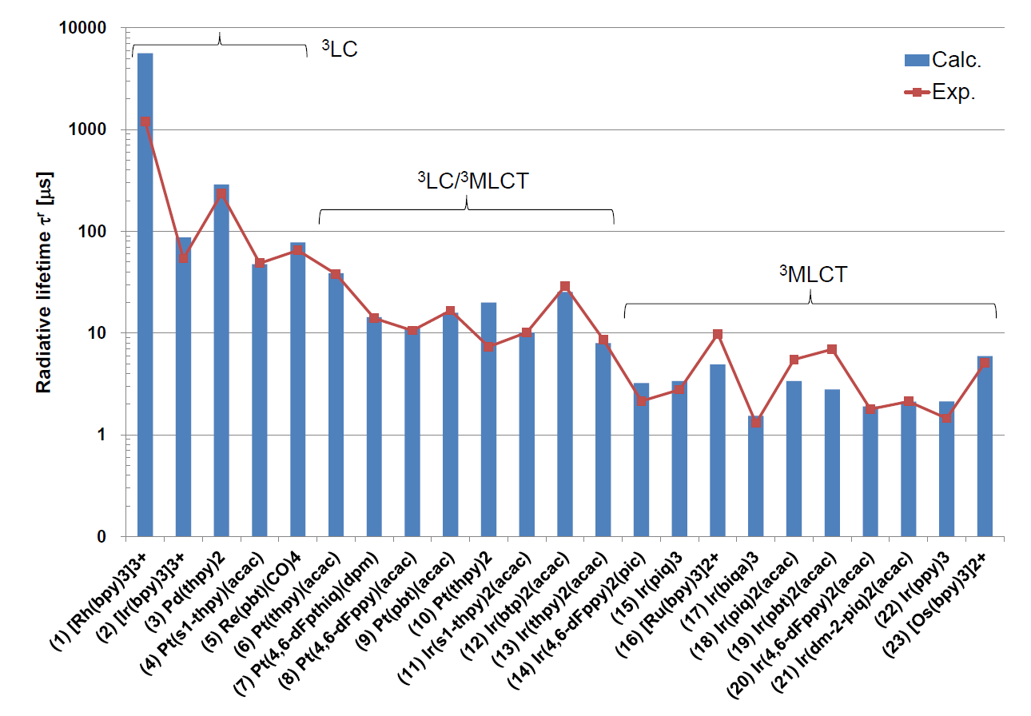
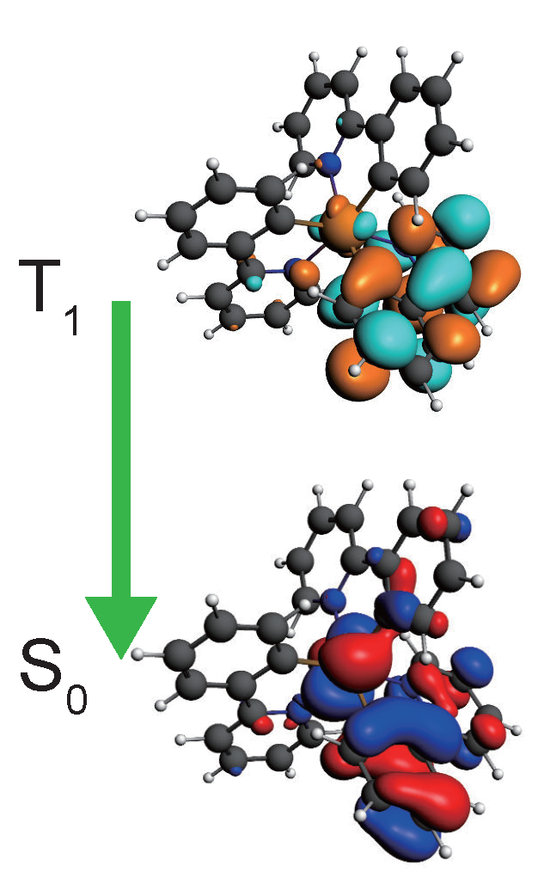
Phosphorescent OLED emitters
Optimize OLED performance
  Phosphorescence T₁→ S₀
  TADF: min. S-T, max. SOCME
  Fast ISC: S_{n}→T₁
  High charge mobility
ADF features
  SOC-TDDFT: k_{phos}
  SOCME: k_{ISC}
  Transfer integrals (mobilities)
  Other couplings (FDE)
  Vibrationally resolved abs/em
23 Ir, Rh, Ru, Os, Pt, Re complexes
K. Mori, T. P. M. Goumans, E. van Lenthe, F. Wang, PCCP 16, 14523 (2014)
ADF tutorial online

Slide 10
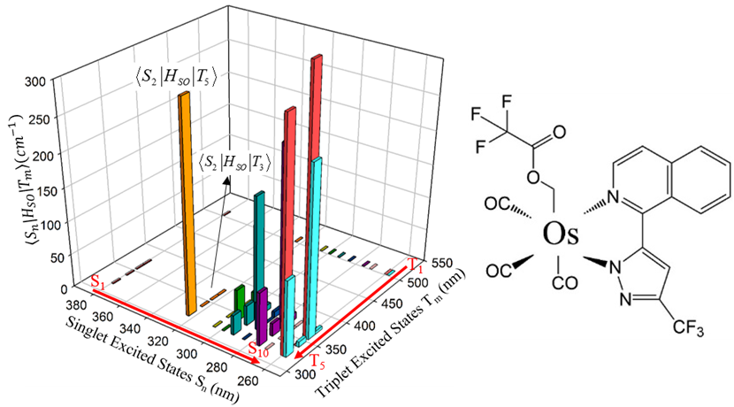
Intersystem crossing: spin-orbit coupling
El-Sayed for organometallics:
SOC is largest when:
both S (¹dπ*) and T (³d’π*) are MLCT
different d-orbitals are involved (d ≠ d’).
Surface-Hopping Dynamics Ru(bpy)₃²⁺
Interface SHARC-ADF with ISC (SOC)
ISC from higher S_{n} states within 26 ± 3 fs
λ_{exc}-dependent quantum yield
SOCME negligible for S₁-T_{n}
ISC from higher S_{n} states
Phys. Chem. Chem. Phys. 16, 26184-26192 (2014)
NB: See also full k_{ISC} Paul et al. JPCL, 2017, 8, 4893
Atkins & Gonzalez
J. Phys. Chem. Lett.,, 8, 3840–3845 (2017)
Notes:
The Os(fipz)(tfa)(CO)₃ (tfa = trifluoroacetate, fipz=3-trifluoromethyl-5-(1-isoquinolinyl)-1,2-pyrazole) complex shows excitation-dependent emission quantum yield. The higher-energy excitation (< 340 nm) contributes more to phosphorescence than fluorescence, implying stronger intersystem crossing (ISC) for highly excited singlet states. Theoretical calculations confirm that the spin-orbit coupling (SOC) integrals between the lowest singlet excited state, S₁, and the low-lying triplet excited states T_{n} (n=1-10), are negligibly small, whereas the higher singlet states show much stronger SOC with triplet excited states.

Slide 11
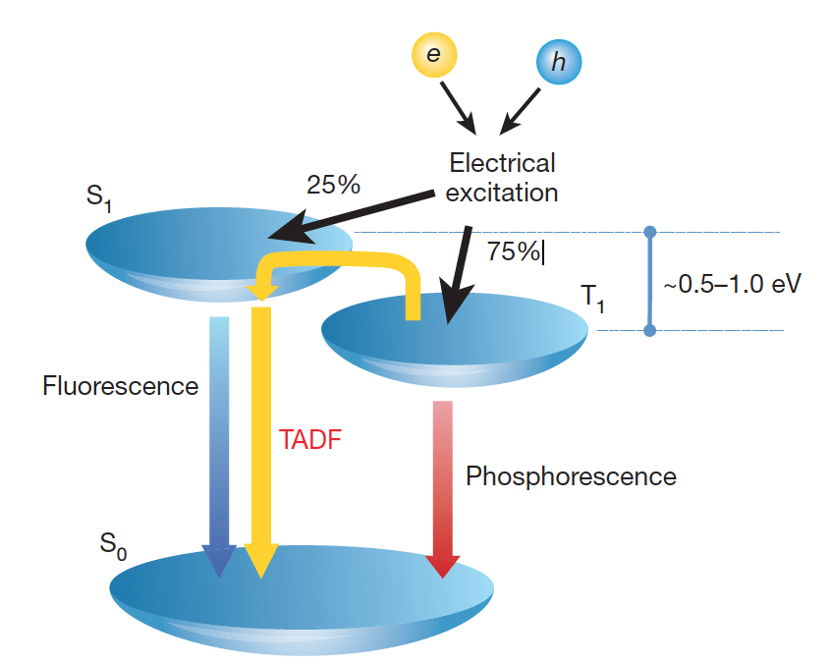
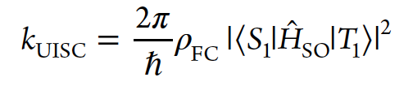
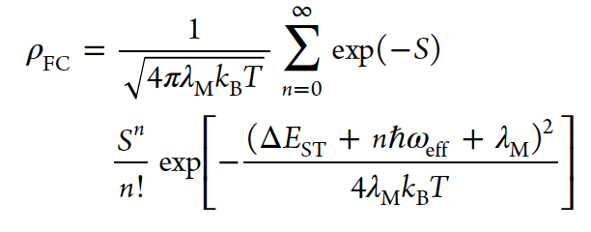
Thermally Activated Delayed Fluorescence
Optimize radiative rate
Minimize S1-T1 gap
Maximize SOC
Maximize k_{phos} & k_{TADF}
Z.-M. su et al. Dyes & Pigments 145, 277-2847 (2017)
Bredas et al. J. Am. Chem. Soc. 139, 4042−4051 (2017)
ADF tutorial in progress

Slide 12
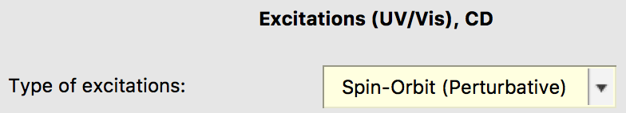
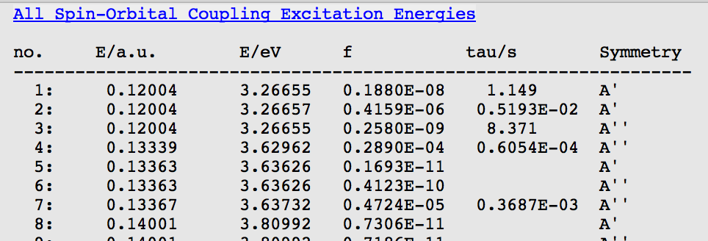
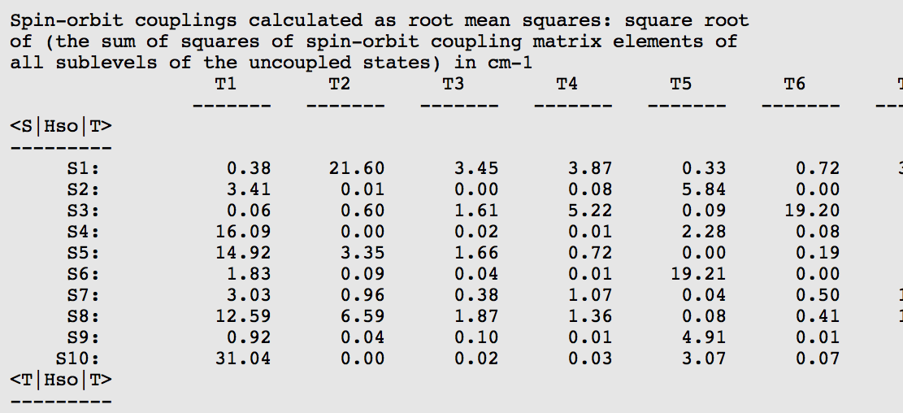
Spin-orbit coupling TDDFT
Exercise 5: Calculate the SOC spectrum and the SOCME
  Switch to perturbative Spin-Orbit and tick SOCM
    ADF can do full and perturbative SOC
    SOCME useful for (R)ISC, e.g. TADF/OLEDs
  Visualize the spectrum: any effect?
    SOC small for purely organic
  Check SCM -> Output
  Go to Response Properties -> All Singlet-Singlet Excitations. Compare with All Spin-Orbital Coupling Excitation Energies. Go to -> SO Matrix. This is the full matrix. Further down you will find the averaged spin-orbit coupling matrix elements (SOCMEs)

Slide 13
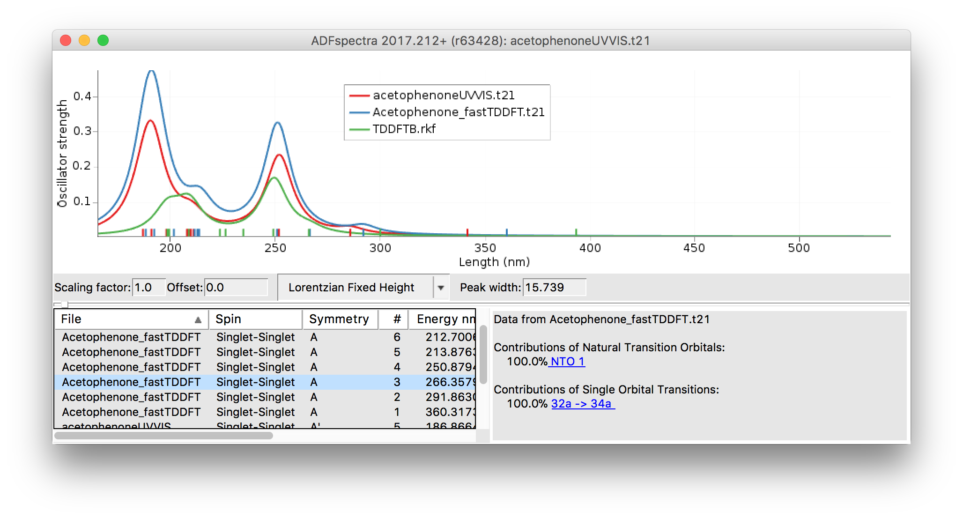
Speeding it up: DFTB
www.scm.com/doc/Tutorials/DFTB/DFTB-GUI_tutorials.html
Exercise 6: Switch to DFTB and re-run the spectra
  The default SCC-DFTB method is fine
  Chose the 3ob-3-1 parameter set
  Re-optimize, recalculate frequencies, recalculate UV/VIS spectrum
  How do the spectra compare: TDDFT, sTDA, TDDFTB? Timings?
  Also try the IR spectrum with DFTB & MOPAC
To visualize DFTB MOs: single point SCC-DFTB/QuasiNano15 !

Slide 14
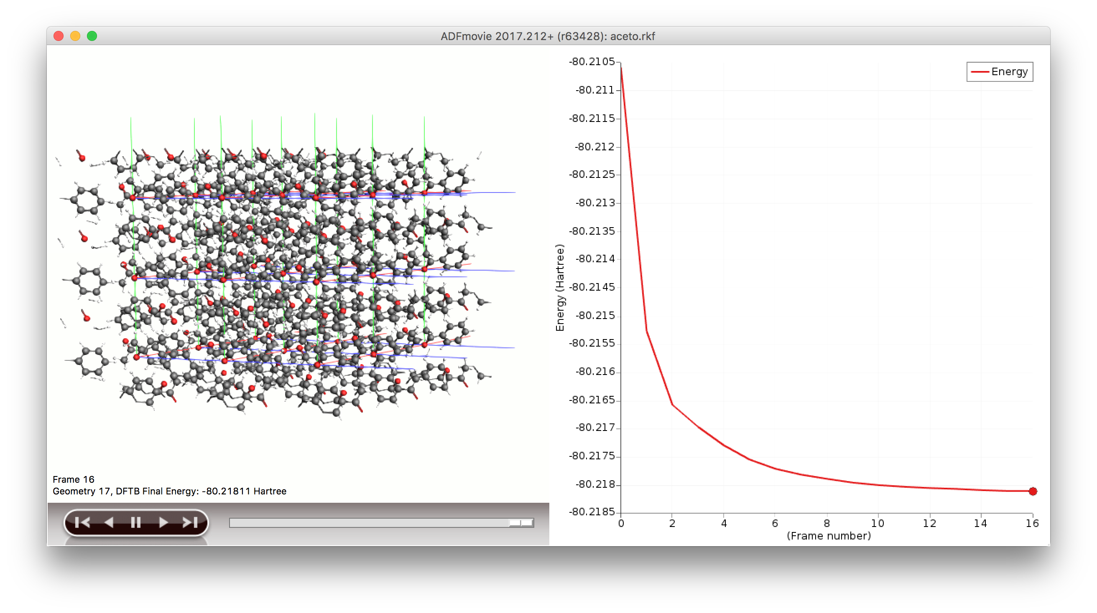
Going periodic with DFTB
Exercise 7: Acetophenone crystal
  Make a new input, search for acetophenone, and select the crystal (optimized with MOPAC)
  Ignore the small unit cell warning
    NB: it is faster in DFTB to go to a larger supercell than to turn on k-point sampling
    You may also consider optimizing the lattice (slow)
  Switch from BAND to DFTB and choose D3-BJ dispersion and the 3-ob-3-1 parameter set
  Check progress with SCM -> Movie

Slide 15
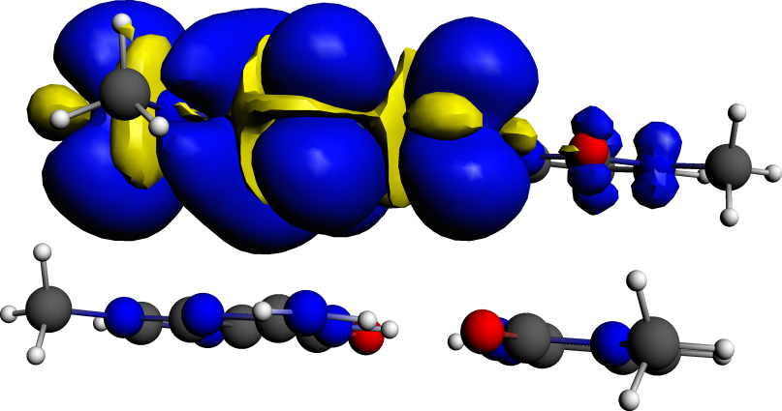
Methods to calculate charge mobilities
Hopping transport:
  Charge transfer integrals (FO) - easy
  Electronic couplings from FDE
Band transport: effective mass tensors in BAND
  Simulating excited state: create a core hole
Non-equilibrium Green’s Function (NEGF)
  transmission probabilities for single-molecule junctions
  quick calculation: wide-band limit
  also in BAND (periodic structures, fully self-consistent, bias) and in DFTB
    See online tutorials
h⁺

Slide 16
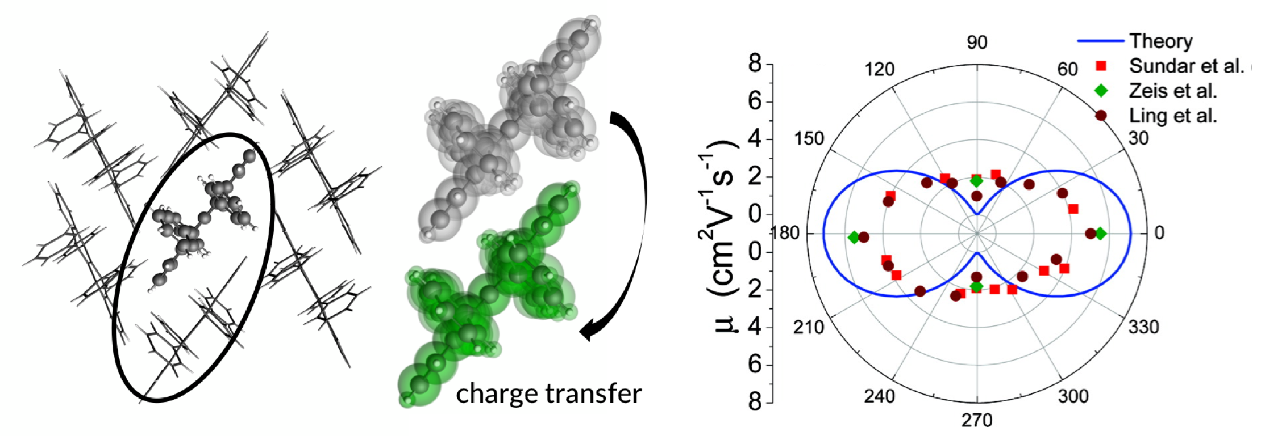

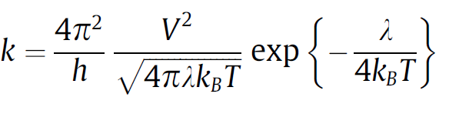
Effective transfer integral J_{eff} = electronic coupling V
extract dimers
Anisotropic mobility:
S.-H. Wen et al., J. Phys. Chem. B 113, 8813 (2009)
ADF tutorial online, ADF prints V / J_{eff} => use with Marcus theory for hopping rates
Notes:
直行変換

Slide 17
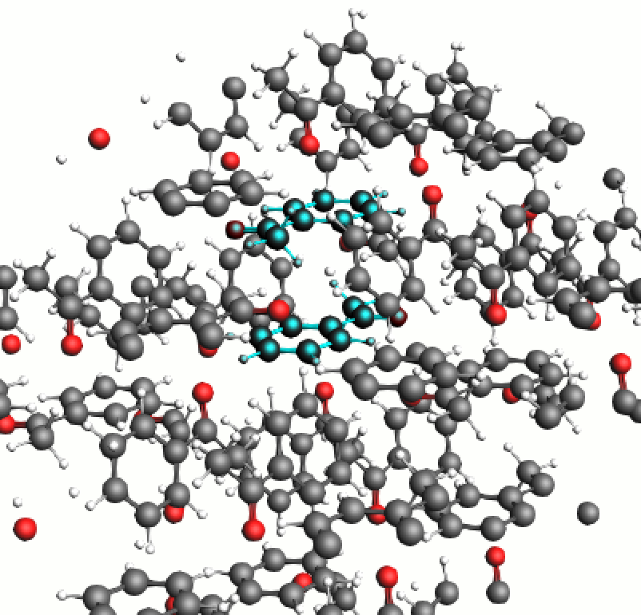
Charge transfer integrals
Exercise 8: Select the dimer for the charge transfer event
  Update the geometry from your DFTB run
  Make a 2x2x2 supercell (Edit-> Crystal -> Generate Supercell)
  Switch from DFTB to ADF
  Select 1 atom from the middle ‘flat’ acetophenone and one from the molecule above
  Press Ctrl+M to select both molecules

Slide 18
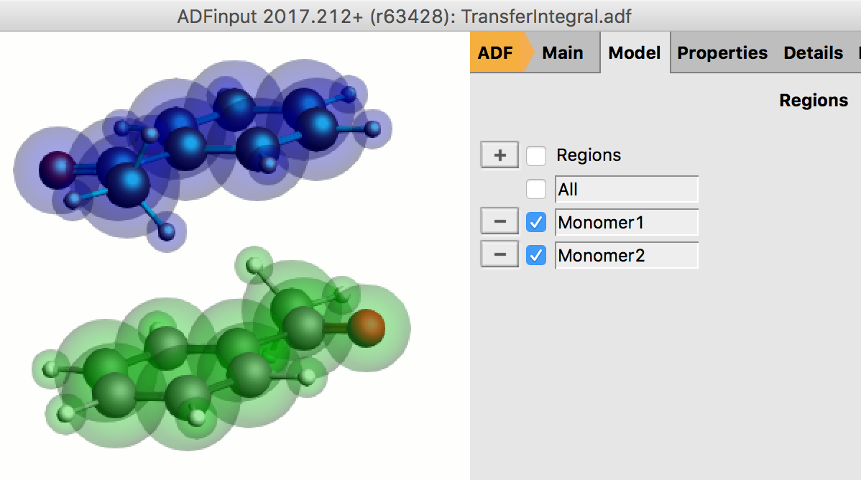
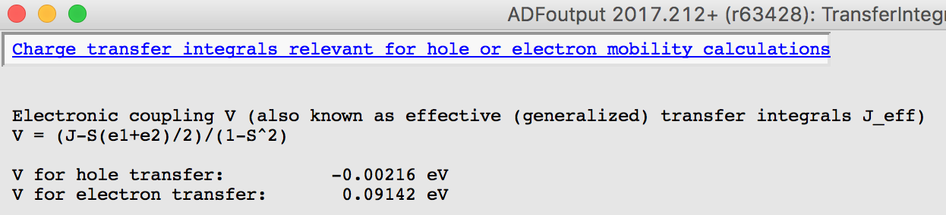
Charge transfer integrals
Exercise 8: Calculate the charge transfer integral
  Select -> Invert selection. Delete all other atoms
  In the Model Region Panel select each molecule as a new region (delete the crystal region):
  Select PW91 functional (often used) with a DZP basis
    Frozen cores are incorrect in principle; in practice usually fine
  Find ‘transfer integral’ in the GUI search, and tick it.
  In Multilevel -> Fragments pane, tick ‘Use fragments’
  SCM-> Output
  Properties -> Charge transfer integrals
  ADF tutorial: how to get mobilities

Slide 19
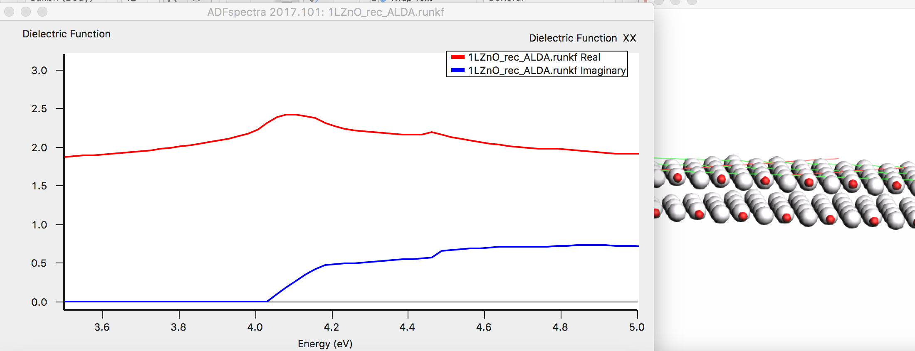
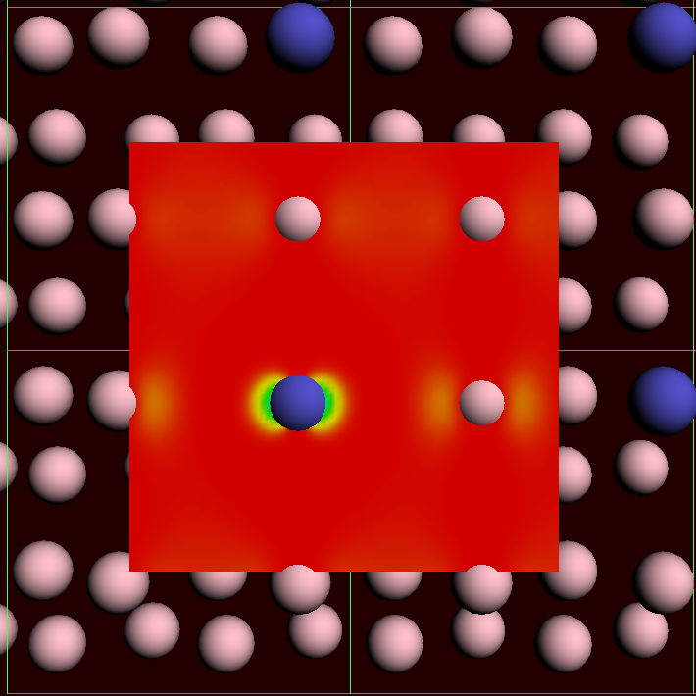
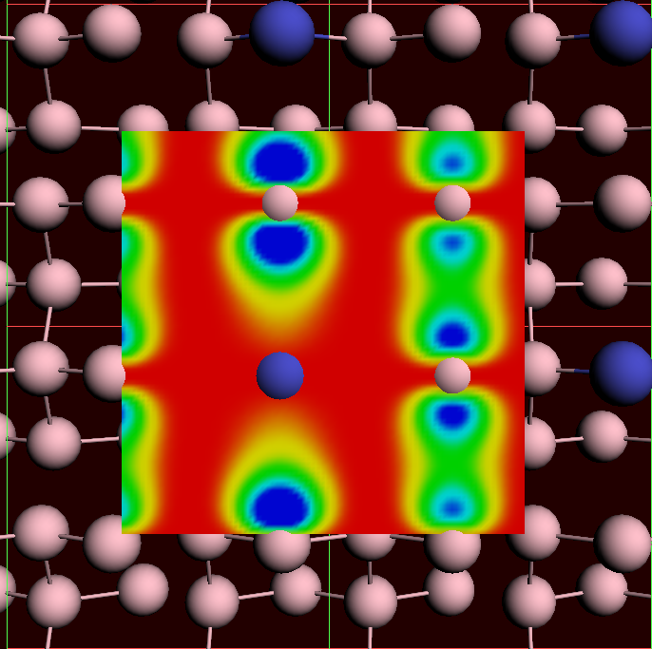
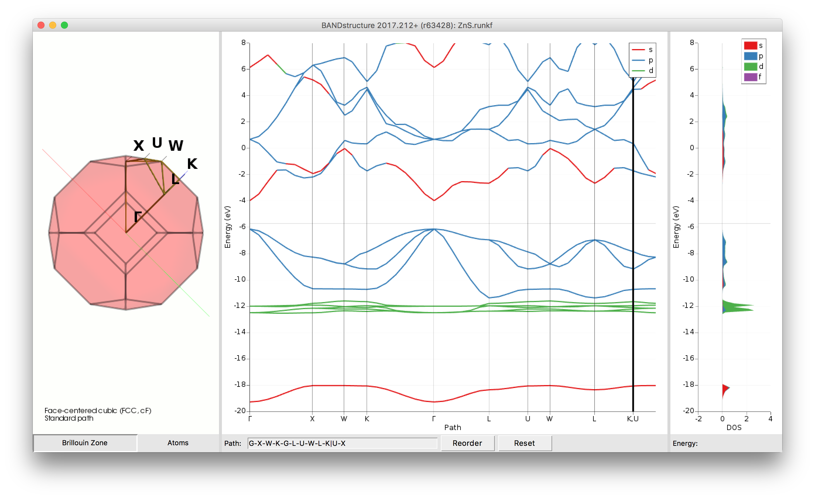
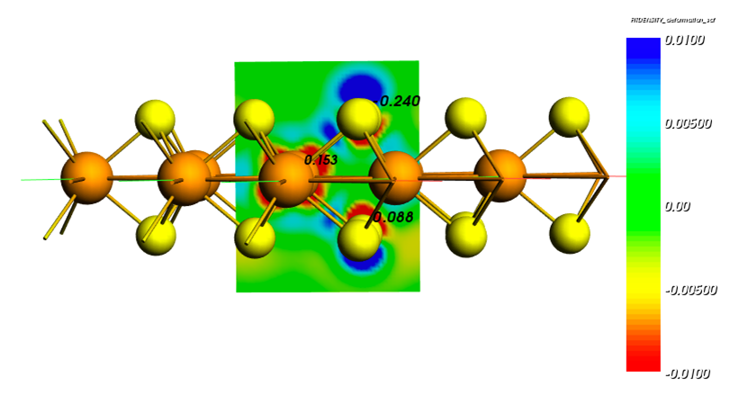
BAND & QE : Periodic DFT
bias = 0
bias = 0.1
Dielectric function ML ZnO
STM PtGe(100)
Band structure, pDOS, fat bands ZnS
Polarizing MoS₂ with an electric field

Slide 20
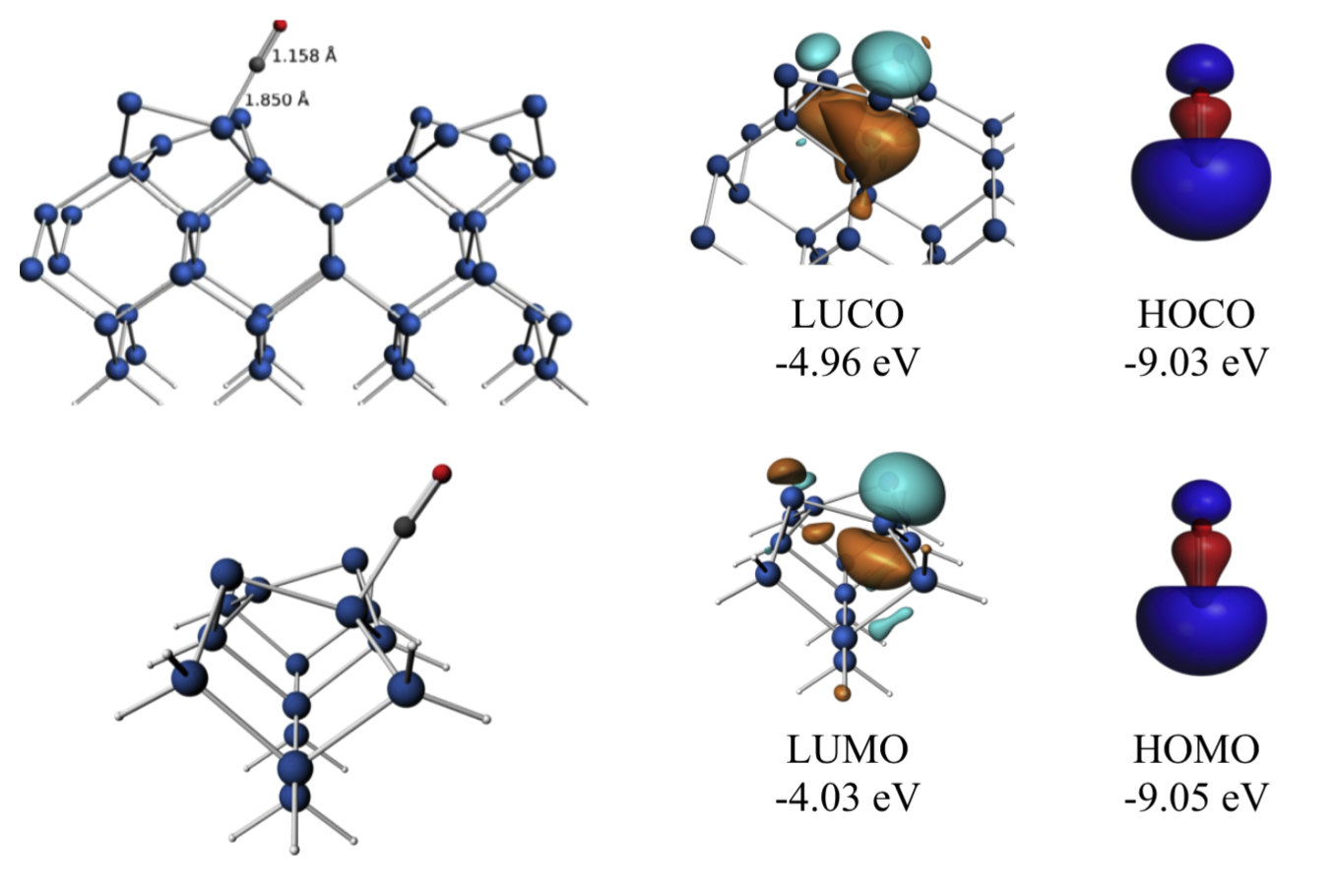
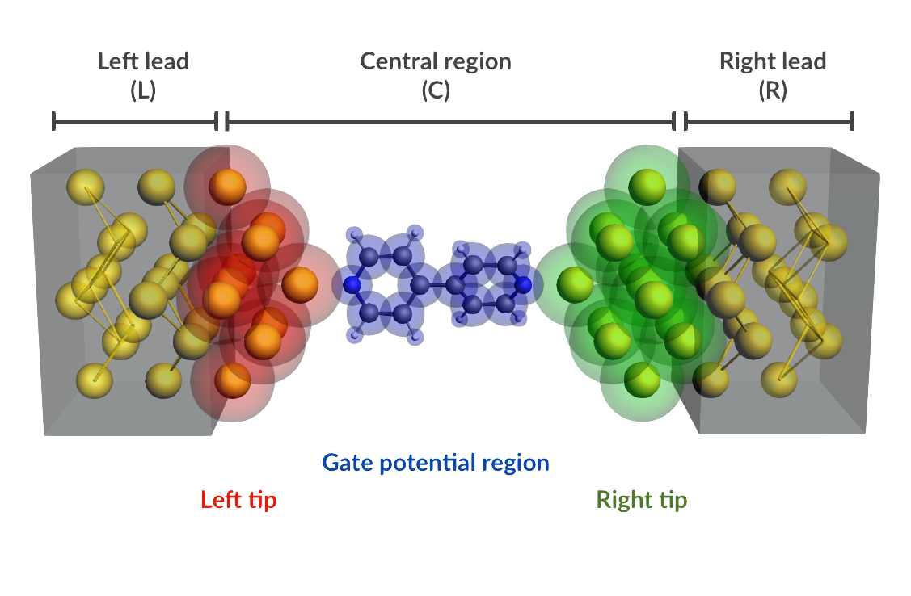
BAND vs. Plane Wave codes (QE)
Atom centered basis functions, STO or NAO
  Compare cluster with periodic
  No pseudopotentials, all elements
  Core spectroscopy (core holes)
  Easy (orbital, density) analysis with GUI
  Fast for empty (1D, 2D, porous)
  xc: SCAN, MN15-L, HSE06, GLLB-sc, D3(BJ), ...
  Self-consistent NEGF
    Gate & bias potential
    Spin transport
True 2D surfaces, 1D polymers
  Het. catalysis: polarization, COSMO
  2D electronics (homogeneous E field)
  Nanotubes
Integrated Graphical Interface:
  Easy set up & analysis
  Switch: ADF, BAND & Quantum Espresso
crystal orbitals, periodic energy decomposition analysis
M. Raupach and M. Tonner, J. Chem. Phys. 142, 194105 (2015)

Slide 21
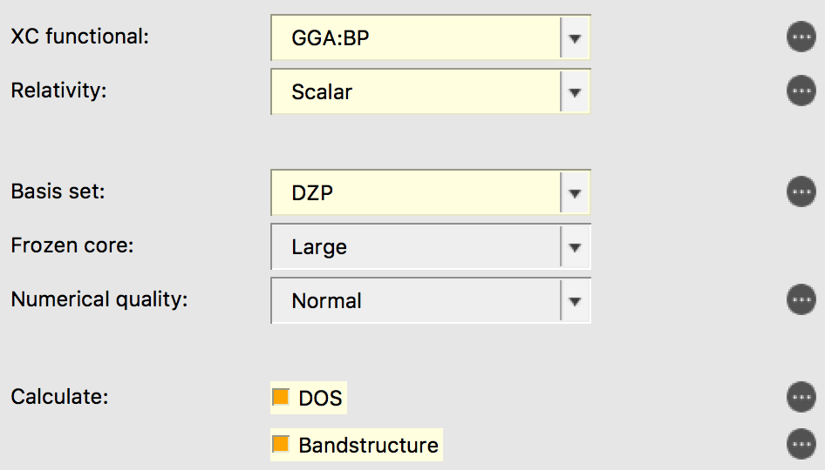
Band structure, pDOS, fat bands, COOP
Exercise 9: ZnS bulk
  New input, go to BAND
  click on the ‘crystal’ builder tool in the bottom
  select cubic -> Zincblende and accept the default
  Settings: BP, SR-ZORA, and DZP
  Select DOS and Bandstructure (default interpolation)
  Run it!

Slide 22

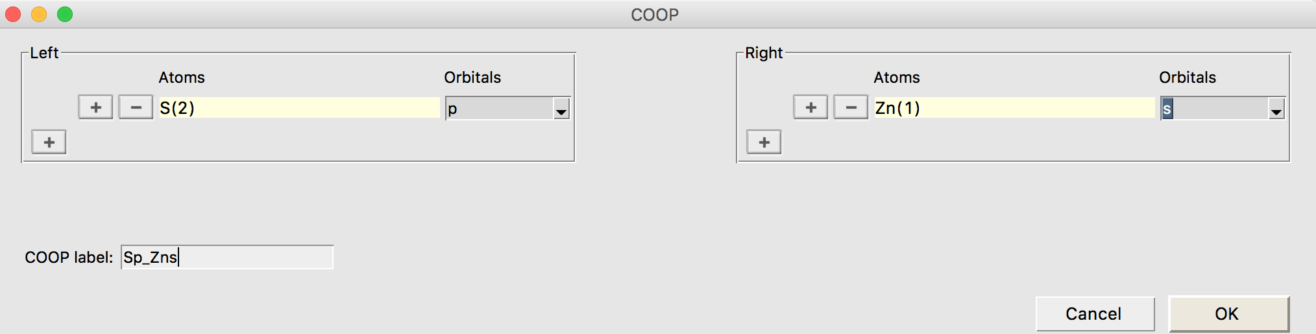
Band structure, pDOS, fat bands, COOP
Exercise 9: ZnS bulk
  Visualize the band structure (SCM Menu). You will automatically see the pDOS and ‘fat bands’
  ZnS is a direct band gap semiconductor (p-s transition
    Check the logflie and output for band gap info and kmesh
    Low band gap: try model potentials (TB-mBJ, GLLB-sc) and HSE06? see benchmark study.
    Should also be converged wrt kpoints, basis, etc.
  Restart the calculation from SCF and in the DOS details tick ‘COOP’
    Visualize the crystal orbital overlap population between the Zn s and S p orbitals

Slide 23
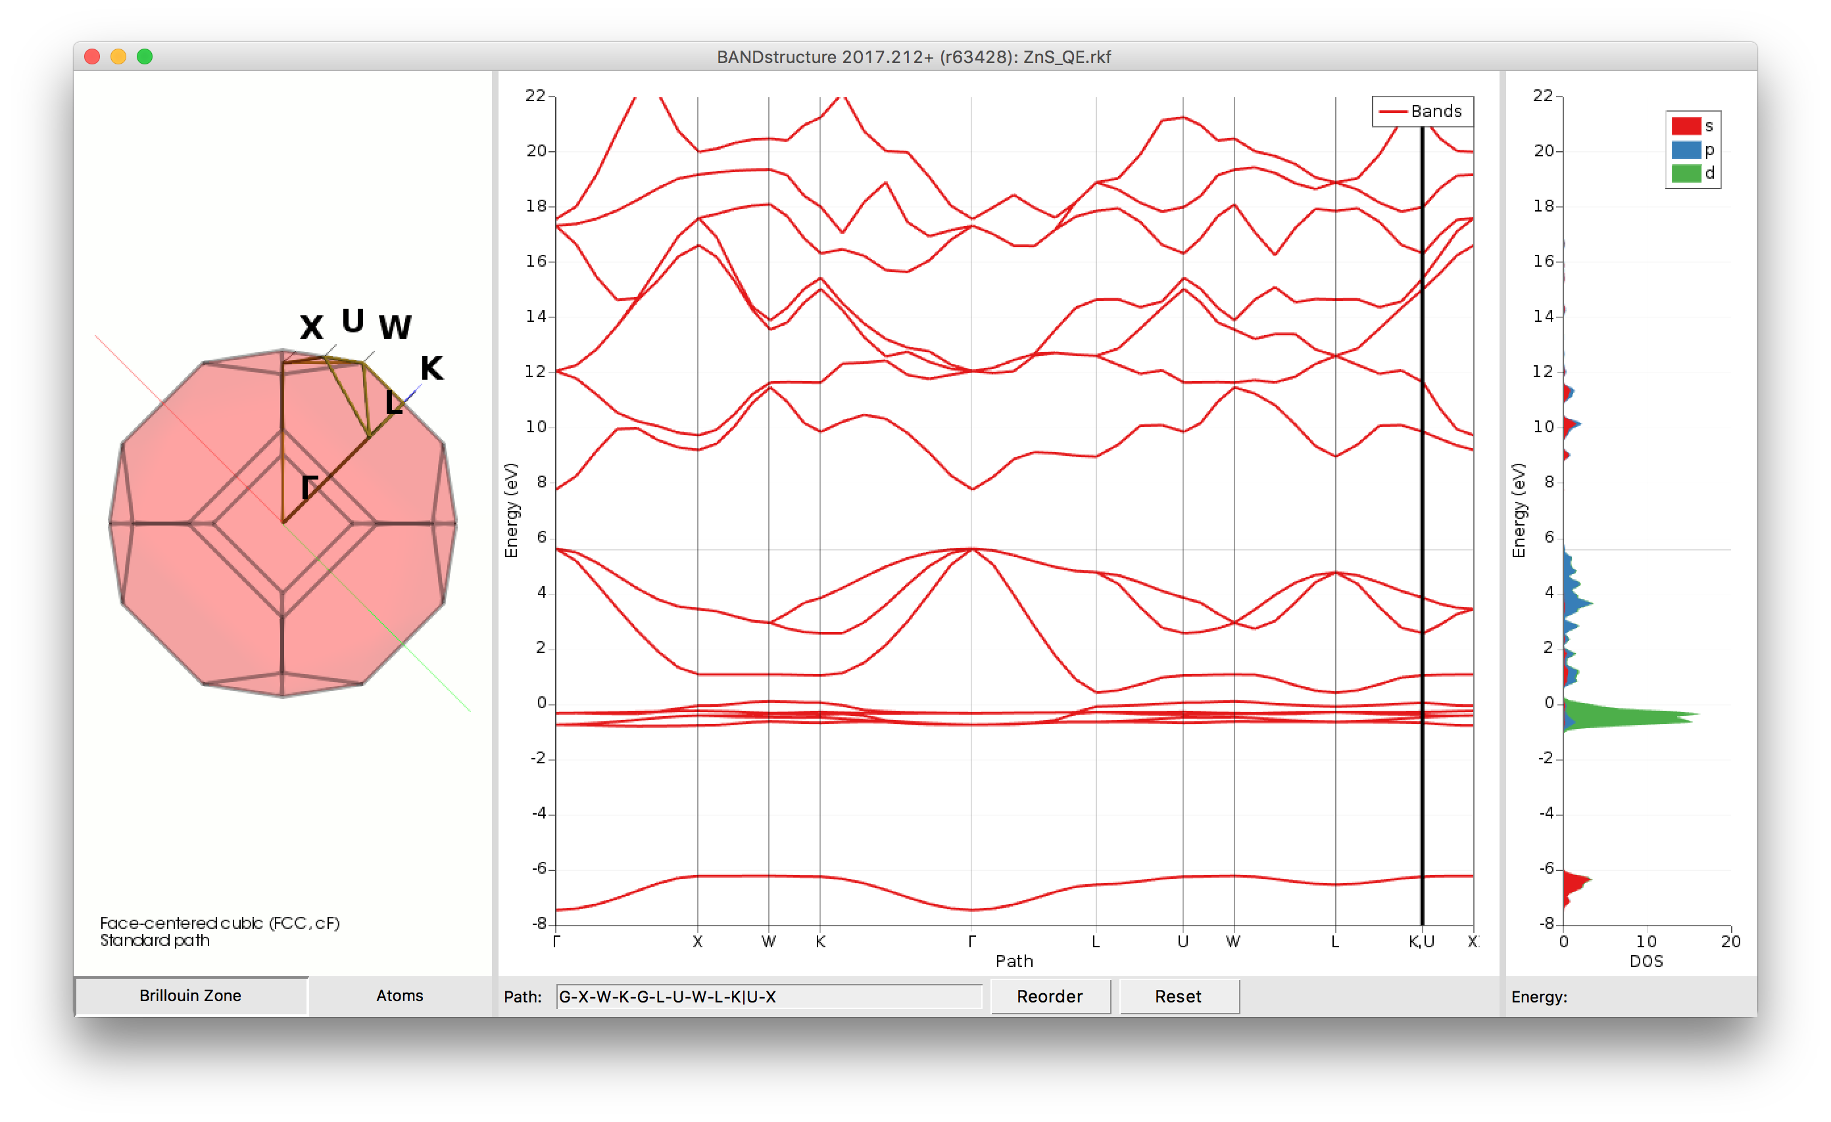
Band structure, pDOS with QE
Exercise 10: ZnS bulk with QE
  Switch from BAND to Quantum ESPRESSO
  Choose the same k-mesh (5x5x5), functional and Vanderbilt pseudopotentials
  You will see a similar band structure, but they aren’t colored according to character
    DOS can be projected by QE

Slide 24
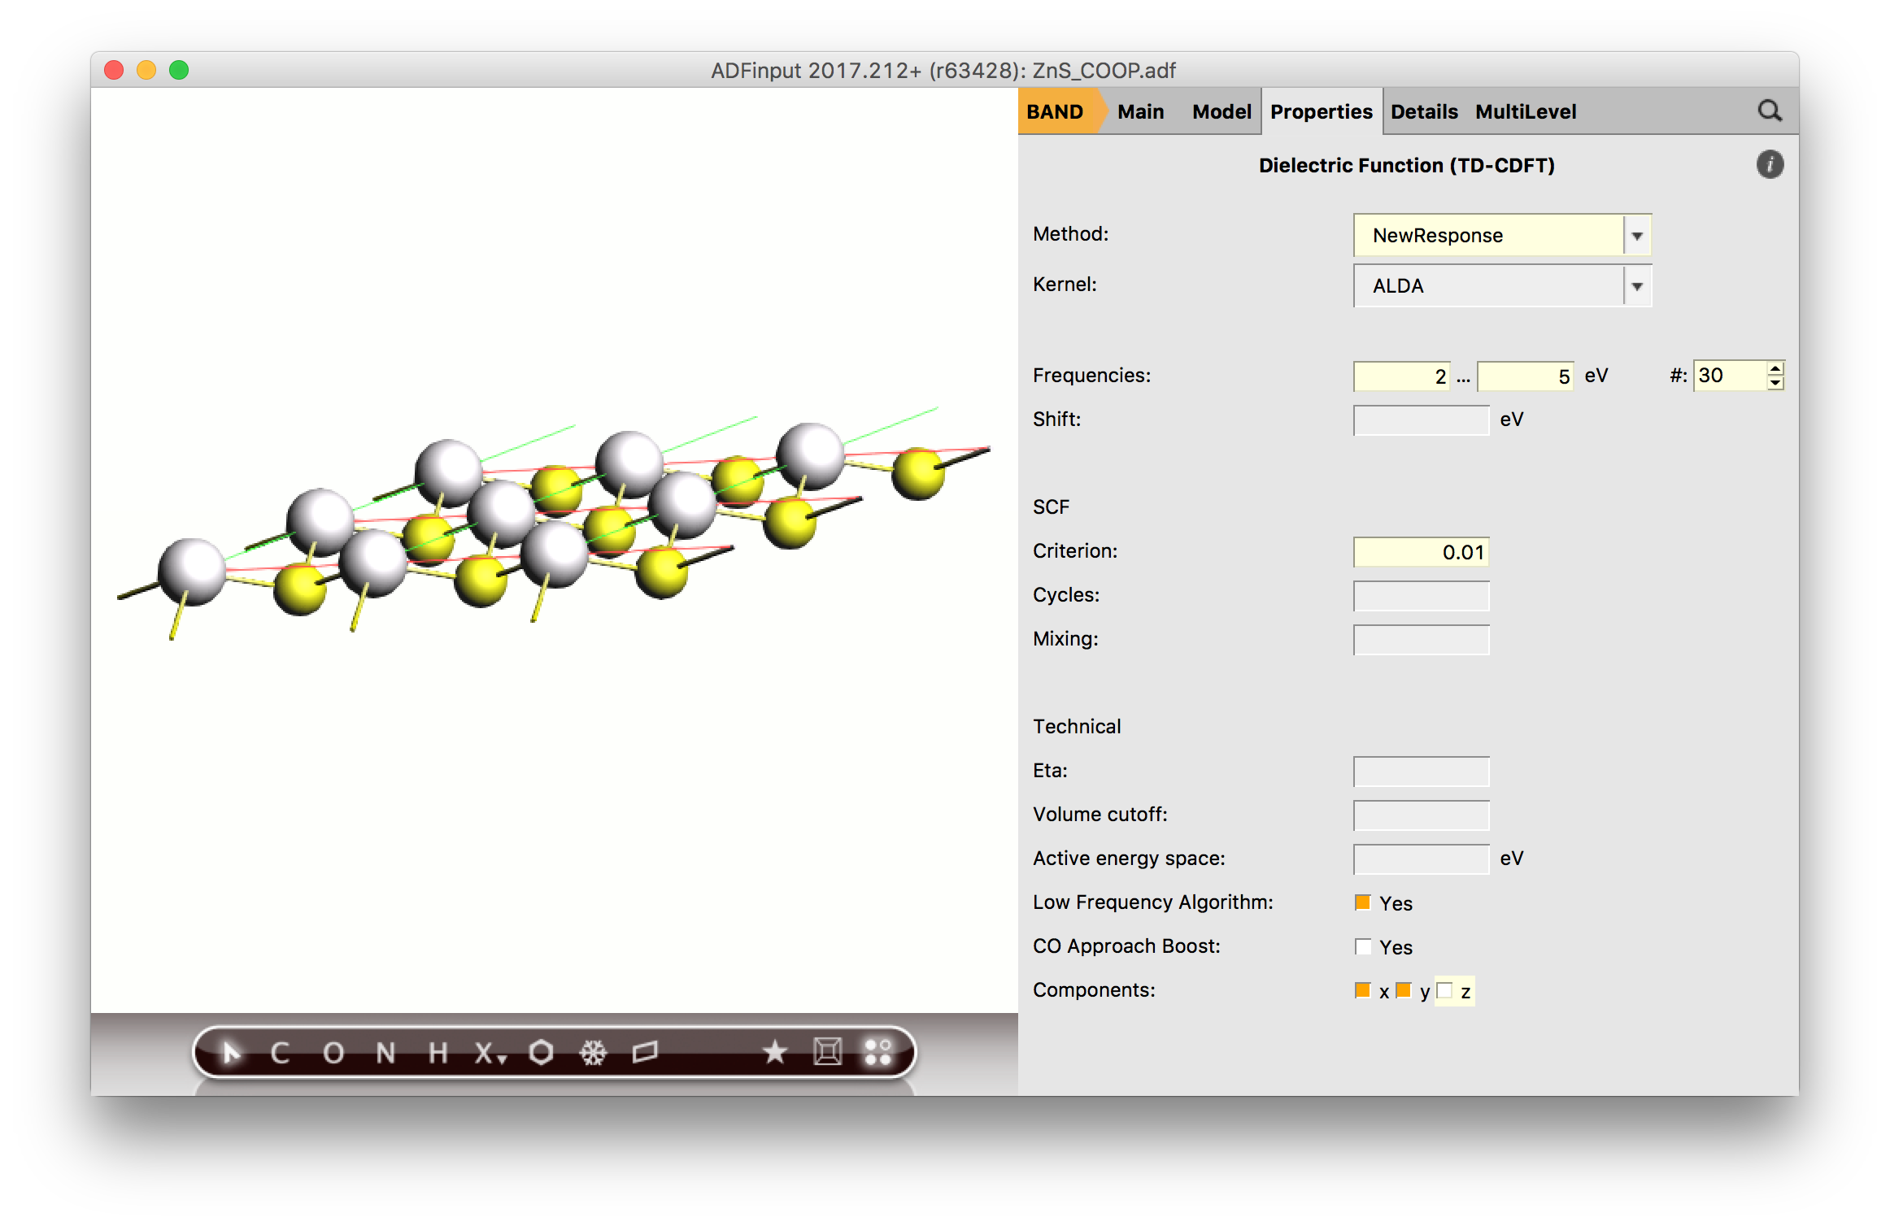
Surfaces, dielectric function
Exercise 11: ZnS monolayer: 2D-TDCDFT
  Cut the 111 surface with the slicer tool, and choose 1 layer
  From properties -> dielectric function choose NewResponse
  Calculate 30 frequencies between 2-5 eV
  Set the SCF convergence criterion to 0.01 and switch off the z-component
  Run it (you will prompted Nosymm is used)

Slide 25
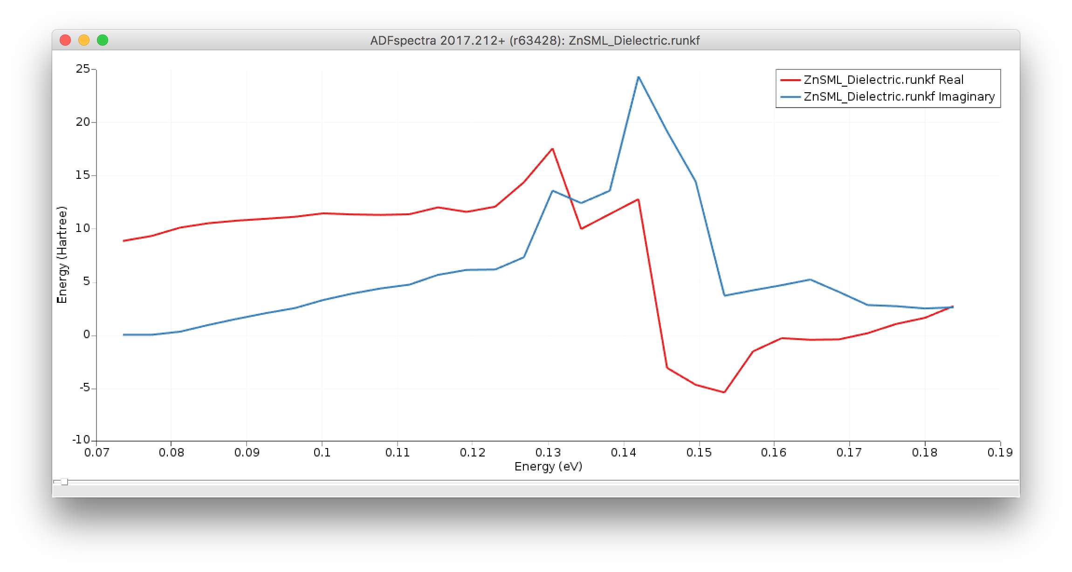
Surfaces, dielectric function
Exercise 11: ZnS monolayer: 2D-TDCDFT
  SCM -> Spectra will show the averaged dielectric function
  Look at the susceptbility, polarizability and refractive index in Spectra->TDCDFT
  You could use a ‘scissor’ shift to upshift the virtuals
  Converge with respect to k-points!
  Geometry of the ions should be optimized, this will effect electronic properties
    For free-standing ML, also optimize lattice ?!

Slide 26
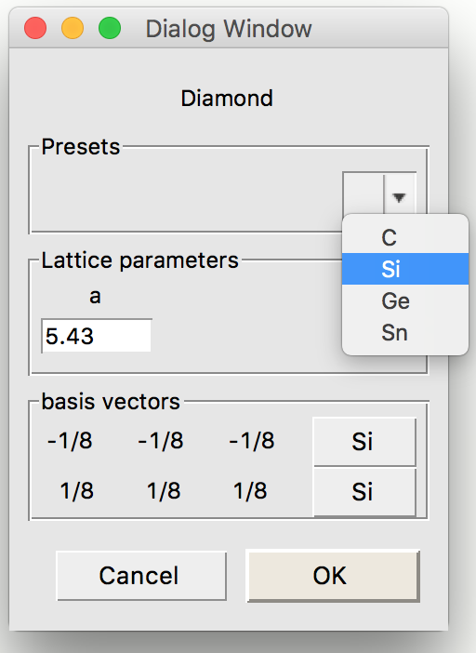
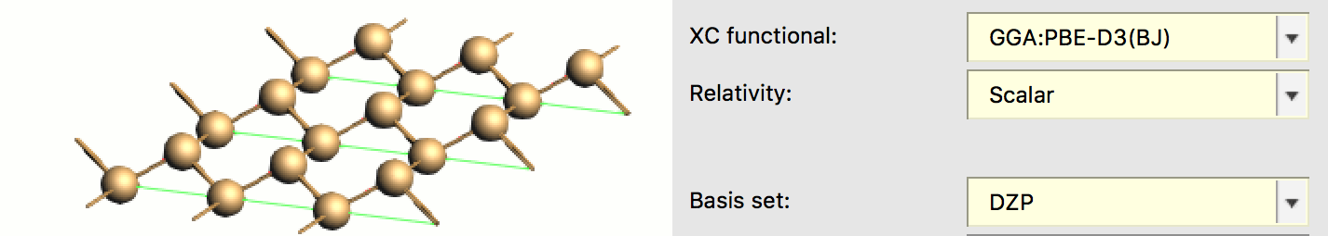
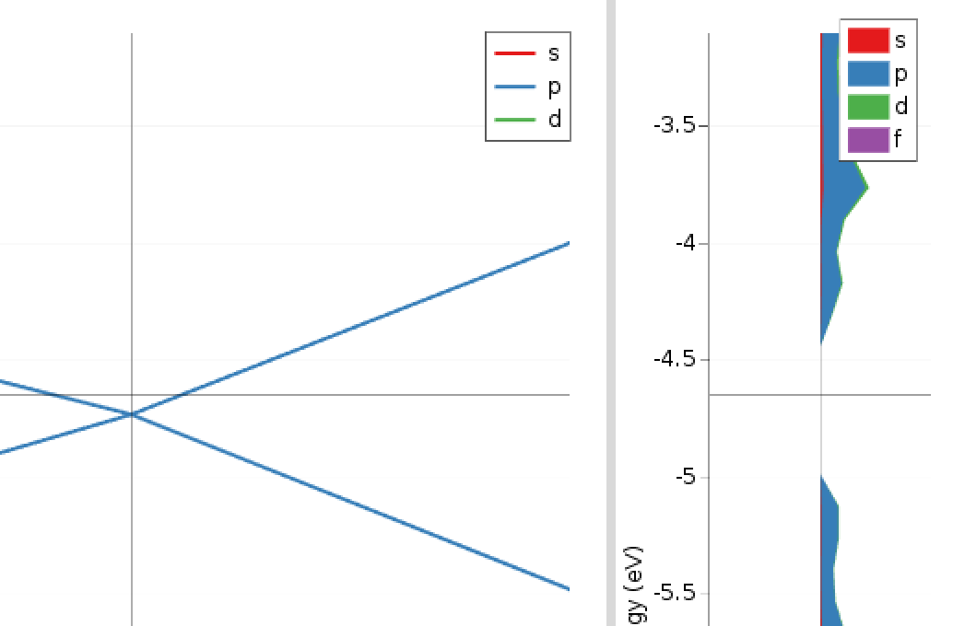
Surface adsorption: analysis
Exercise 12: Silicene monolayer
  New BAND input. Edit -> Crystal -> cubic -> diamond. Preset drop-down -> Si
  Slice a 1-layer 111 Surface to create the boat-shaped silicene
  Optimize with SR-PBE-D3(BJ)/DZP and otherwise default settings
  Do a single point calculation with ‘Good’ quality and calculate band structure & DOS
  Have a look at the characteristic Dirac cone in the K point, with no DOS (semi-metal)

Slide 27
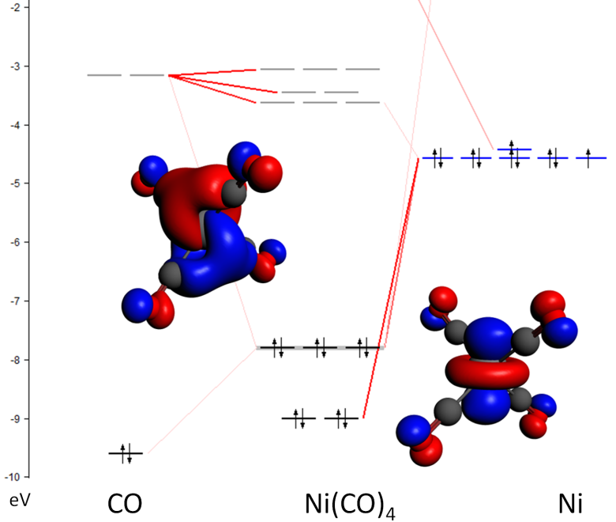
Energy decomposition analysis
∆E = ∆E_{prep} + ∆E_{int}
Chem. Soc. Rev. 2014, 43, 4953;
WIRES Comput. Mol. Sci. 2015, 5, 324
Oline tutorial & teaching materials
∆E_{prep} = geometry ’deformation’ energy
∆V_{elstat} + ∆E_{Pauli} + ∆E_{oi} + ∆E_{disp}
∆E_{steric} = ∆V_{elstat} + ∆E_{pauli}
∆E_{oi} = decomposed in irreps.
Extensions:
Periodic EDA: M. Raupach & R. Tonner, J. Chem. Phys. 142, 194105 (2015)): molecule-surface interactions
Ziegler, Michalak, Mitoraj: ETS-NOCV
Notes:
The term ΔV_{elstat} corresponds to the classical electrostatic interaction between the unperturbed charge distributions of the prepared (i.e. deformed) fragments and is usually attractive. The Pauli repulsion ΔE_{Pauli} comprises the destabilizing interactions between occupied orbitals and is responsible for any steric repulsion. The orbital interaction ΔE_{oi} in any MO model, and therefore also in Kohn-Sham theory, accounts for charge transfer (i.e., donor-acceptor interactions between occupied orbitals on NH₃ with unoccupied orbitals of BH₃, including the HOMO-LUMO interactions) and polarization (empty/occupied orbital mixing on one fragment due to the presence of another fragment).

Slide 28


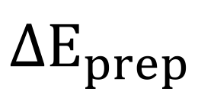









EDA/ETS-NOCV: bond & density decomposition
Molecule built from fragments
Bond analysis with meaningful terms:
Combine with NOCV (webinar)
  Orbital interactions / charge transfer
Also periodic 1D, 2D, 3D (tutorials)
  (Ad)sorption nanotbues, surfaces, MOFs etc.
  Raupach &Tonner, J. Chem. Phys. 142, 194105 (2015)
$${\text{Ψ}}_{A}^{GS}$$
$${\text{Ψ}}_{B}^{GS}$$
$$ΔE_{prep}$$
$${\text{Ψ}}_{A}^{}$$
$${\text{Ψ}}_{B}^{}$$
$$ΔE_{elstat}$$
$$ΔE_{int}$$
$$\left\{{\text{Ψ}}_{A}^{}{\text{Ψ}}_{B}^{}\right\}$$
$$ΔE_{Pauli}$$
$${\text{Ψ}}_{}^{0}=NA\left\{{\text{Ψ}}_{A}^{}{\text{Ψ}}_{B}^{}\right\}$$
$$ΔE_{orb}$$
$${\text{Ψ}}_{}^{AB}$$

Slide 29


Catalyst design: activation strain model
TS
Chem. Eur. J. (communication) 2009, 15, 6112
Org. Biomol. Chem. 2010, 8, 3118
Nature Chem. 2010, 2, 417
EDA along the reaction path
Bite-Angle Effect: Activation Strain analyses:
• HOMO–LUMO interaction marginally improved
• But: strain reduced by building it into catalyst
Latest reviews:
Chem. Soc. Rev. 2014, 43, 4953
WIRES Comput. Mol. Sci. 2015, 5, 324

Slide 30


Catalyst natural selection: survival of the weakest
Increased bite angle dppe → dppb
Improved electronic interaction and larger repulsive strain
Strain outweighs electronic interactions → dppb most destabilized → best catalyst
J. Wassenaar, et al. Catalyst selection based on intermediate stability measured by mass spectrometry. Nature Chem. 2, 417 (2010)
Notes:
We introduce a new selection method that focuses on the stability of catalytic intermediates measured by mass spectrometry (ESI-MS), competition experiment. The stability of the intermediate relates inversely to the reactivity of the catalyst, which forms the basis of a catalyst-screening protocol in which less-abundant species represent the most-active catalysts, ‘the survival of the weakest’. We demonstrate this concept in the palladium-catalysed allylic alkylation reaction using diphosphine and IndolPhos ligands and support our results with high-level density functional theory calculations.
High-level DFT calculations show that destabilization of the intermediate Pd-allyl complexes is caused by steric repulsion between the ligand and the substrate for the diphosphine ligands, which overrules the counterbalancing electronic effect. Energy decomposition, strain energy

Slide 31


Surface adsorption: analysis
Exercise 13: O₂ on Silicene monolayer
  Add O2 (search for it in the GUI or just click O and connect to an O)
  Change the Model -> Coordinates as follows
  Re-optimize with SR-PBE-D3(BJ)/DZP and otherwise default settings (as per exc. 12)
  Let’s decompose the O₂ – surface interaction:
    Switch to single point (also tick band structure & DOS to analyze those)
    Model -> Regions: select the two Si atoms and click + to define a new region
    In the Multi-level panel tick the ‘Yes’ box to use fragments
  After running go to Output; Properties -> PEDA Energy Terms. Considerations:
    Large bonding energy
    Large steric term & orbital interaction
    Large preparation term (O₂=triplet!)

Slide 32


Opening the Dirac cone
Exercise 13: O₂ on Silicene monolayer
  Check out the band structure -> a band gap has been created!
    May disappear at lower coverage (create supercell before adsorbing. See also this paper.
Bonus: Can you create a band gap with an Electric field? (Yes, at high field!)
  For optimized silicene: Single point. Model -> Electric field (check out MoS₂ tutorial)
Charge transfer analysis
  Tick the ‘NOCV’ box in Properties -> PEDA-NOCV
  Select ‘gamma only’ in Details -> k-points
  Run & check output. Bonding energy will be different!
  1 term dominates the orbital interactions
  Visualize deformation densities & CM5 charges

