Slide 1
Hands-on workshop Chemistry & Materials with the ADF Modeling Suite
Introduction to computational chemistry & materials science
KIER, Daejeon, 9 February 2018
Fedor Goumans, goumans@scm.com

Slide 2
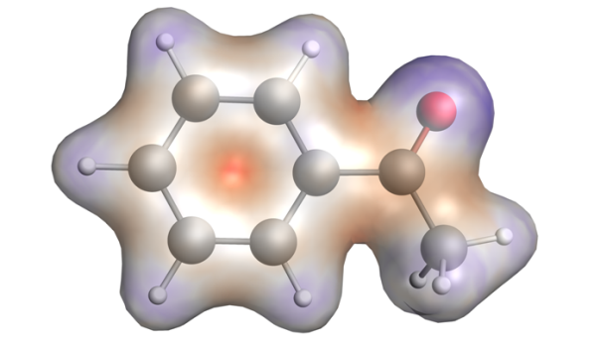
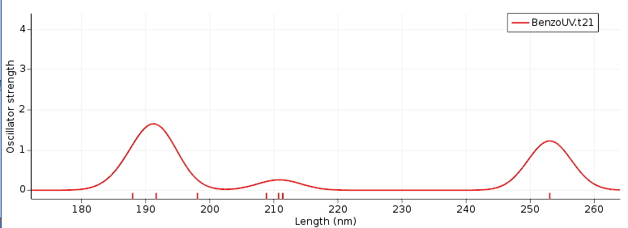
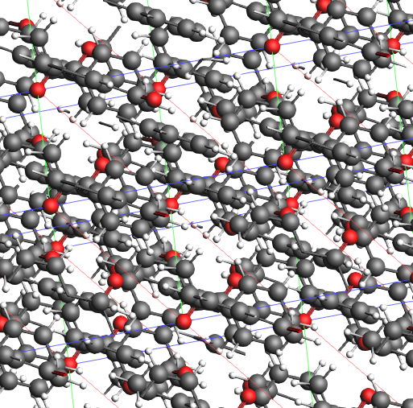
Program
Introduction
SCM & ADF
Computational chemistry& materials science
UV/VIS, IR, charge transfer, bonding analysis
Fast methods: DFTB
Periodic DFT: plane waves & atomic orbitals
ReaxFF: reactive MD large, complex systems
Monte Carlo methods to speed up time / equilibrium
(COSMO-RS: activity, solubility, VLE)
Further exercises & discussion

Slide 3
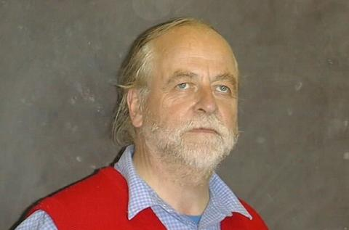
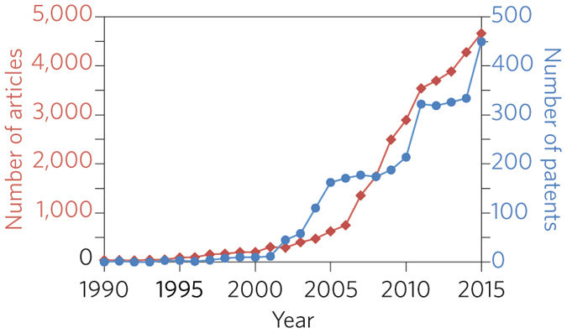
Background: SCM & ADF
ADF = first DFT code for chemistry (1970s)
Baerends@VU (>’73), Ziegler@Calgary✝ (>’75)
SCM: Spin-off company 1995
15 people (10 senior PhD’s) + 5 EU fellows
Many academic collaborators / EU networks
~120 authors
New functionality
SCM: development, debug, port, optimize,
docs & support
articles &patents in materials science with
“density functional theory”, Nat. Mat. 4619

Slide 4
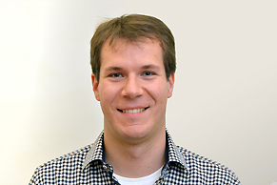
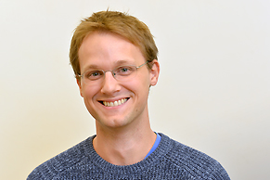
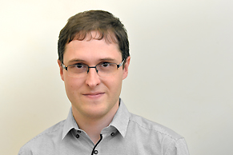
The SCM team
Olivier:
GUI
Alexei:
ADF
ReaxFF
Erik:
ADF
COSMO-RS
Pier:
BAND
Mirko:
ADF
BAND
Hans:
Linux
GPU
Python
Thomas:
DFTB
Scripting
Laurens:
GUI
Ole: Support
Scientist
Evert Jan:
Adviser
Michal:
python scripting
Robert:
DFTB
Anna:
ReaxFF
Nick:
COSMO-RS
Tomas:
ReaxFF
Stan:
CEO
Fedor:
Marketing
Sergio:
Collaborations
Frieda:
Invoices
Licenses
Kitty:
Finance

Slide 5
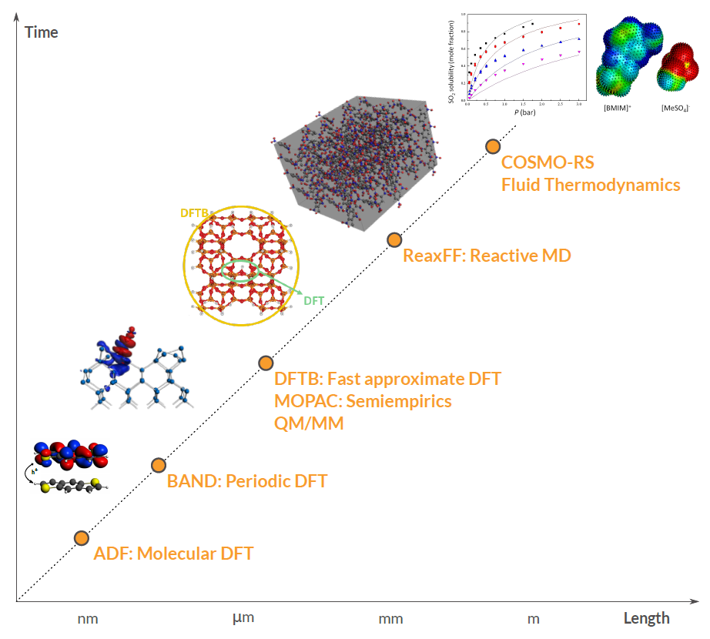
ADF Modeling Suite
ADF: powerful molecular DFT
Spectroscopy: NMR, EPR, VCD, UV, XAS
Advanced solvation / environments
BAND: periodic DFT
(2D) Materials
DFTB: fast approximate DFT
ReaxFF: Reactive MD
Dynamics of large complicated systems
COSMO-RS: fluid thermodynamics
VLE, LLE, logP, solubility
Integrated GUI – use out of the box
Scripting: workflows & automation

Slide 6
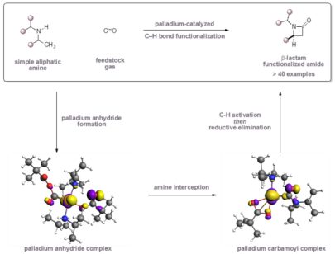
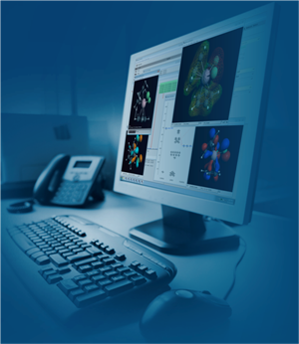
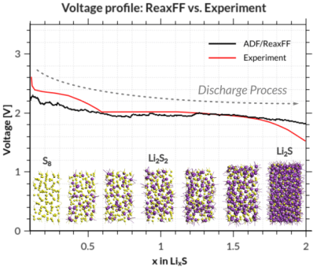
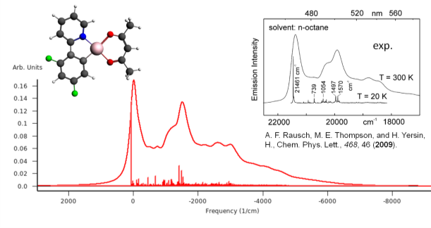
Why bother with calculations?
Computational chemistry & materials modeling
Accelerate research, reduce costs & environmental impact
Reduce experimental search space
Analyze structure-property-reactivity
Models: physics & empiricism
Accuracy?
Synergy experiment-calculations
Ask relevant questions
Limitations model
Constraints experiments
Best catalyst? => mechanism? lowest E_{a} ? best ligand? side reactions?
Best battery? => discharge? voltage? interaction with electrolyte?
Best OLED? => charge & exciton mobility? emission speed & color?
???

Slide 7
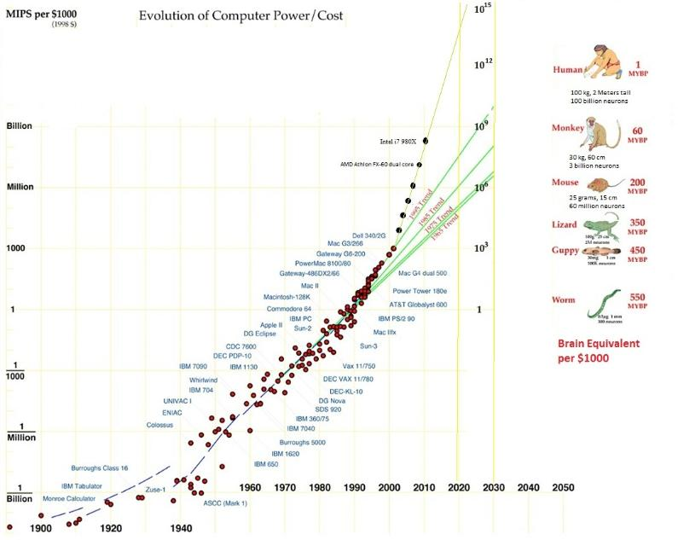
Compute power (r)evolution
http://www.donbot.com/Futurebot/NewTech/NT01370MoravecsGraphUpdated2020.html

Slide 8
Computational Chemistry & Materials
Hψ=Eψ
Electronic structure methods: Schrödinger equation
Electrons in molecules & materials
Expand ψ: atomic orbitals / plane waves
Solve self-consistently
Pragmatic: DFT
Properties: energies (gradients), MOs, densities & related, spectroscopy (EPR, NMR, IR, UV/VIS, ….)

Slide 9
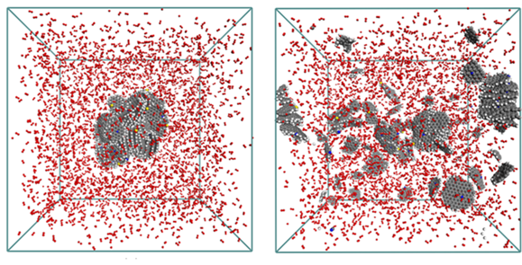
Computational Chemistry & Materials
d²x/dt² = F(x)
F(x) = − dV(x)/dx
Molecular dynamics: Newton’s equations of motion
Movement of atoms: solve numerically + propagate,
Properties: reaction rates, diffusion coefficients, stress-strain, ….

Slide 10
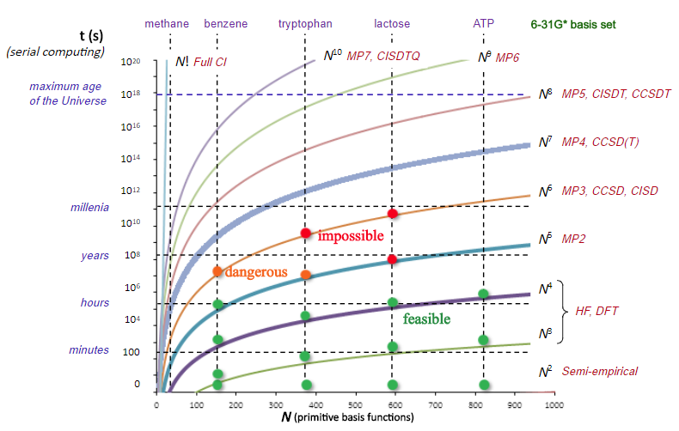
Electronic Structure methods
Hψ=Eψ
ab initio (basis set dependencies!)
Hartree-Fock (HF): mean field (no explicit e-e interaction)
MP2: perturbation theory (if HF = good guess)
CC: coupled cluster
CI: configuration interaction (full CI = max. Accuracy)
Multi-reference / active space
Density Functional Theory (DFT)
‘first principle’ functionals (physics)
empirical functionals (fit to data)
DFT-based tight binding (DFTB)
Fit to DFT data
Nearest neighbor, minimal basis
Semi-empirical (MOPAC: PM7)
Fit to exp. Data
Nearest neighbor, minimal basis
(Houk, 2011)

Slide 11
Computational Methods
Relative costs, scaling & accuracy for computational methods
(* depending also strongly on the system & property!)
Method | ~ max atoms | ~ relative cost | scaling | Typical Accuracy*
Classical force field (UFF, Amber, … ) | 1,000,000 | 0.0005 | N¹ | <20 kcal/mol
Reactive force field (ReaxFF) | 500,000 | 0.001 | N¹ | <15 kcal/mol
Semi-empirical methods (e.g. AM1, PM7) | 5,000 | 1 | N^{1~2} | <10 kcal/mol
DFTB | 5,000 | 1 | N^{1~2} | <10 kcal/mol
DFT | 500 | 500 | N^{3~4} | <5 kcal/mol
MP2 | 100 | 2000 | N⁵ | <5 kcal/mol
CCSD(T)/cc-pVTZ | 30 | 100000 | N⁷ | ~1 kcal/mol

Slide 12
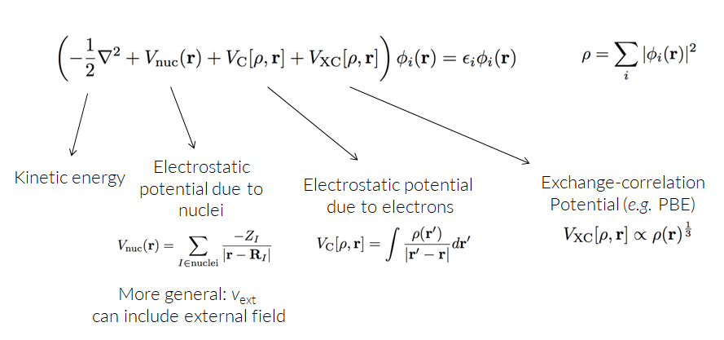
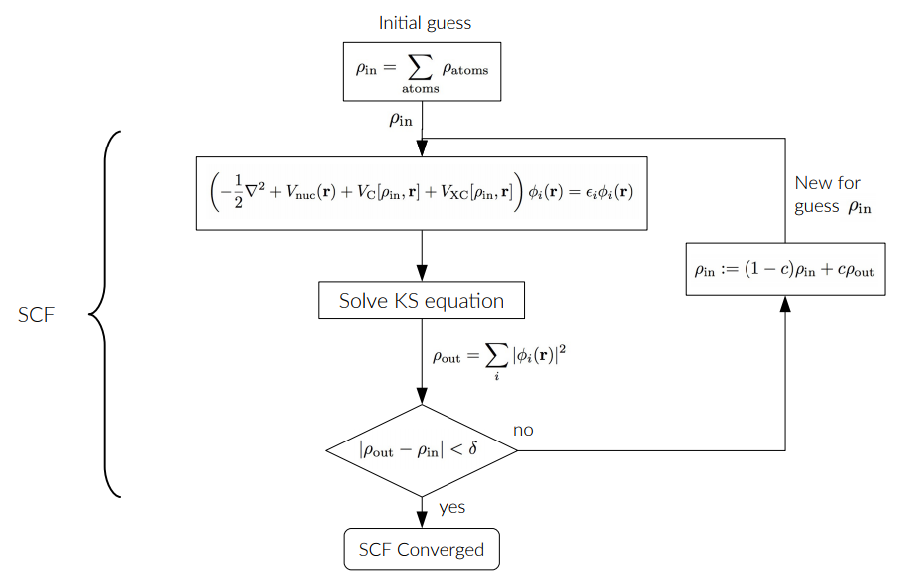
Density Functional Theory
Density ρ = central quantity
Density functional ρ gives E
E[ρ] = T[ρ] + E_{ee}[ρ] + E_{ne}[ρ]
Usually expanded in orbitals
Linear combination of atomic orbitals
Basis set
Kohn-Sham DFT
‘Non-interacting’ reference T_{s}
E[ρ] = T_{s}[ρ] + E_{ee}[ρ] + J[ρ] + E_{xc}[ρ]
Solve self-consistently
v_{xc}[ρ] = E_{xc}[ρ]/dρ = ‘functional’
approximate: LDA, BP86, PBE, M15L, ...
Which basis & functional?
Check literature or benchmark!
See technical ADF slides

Slide 13
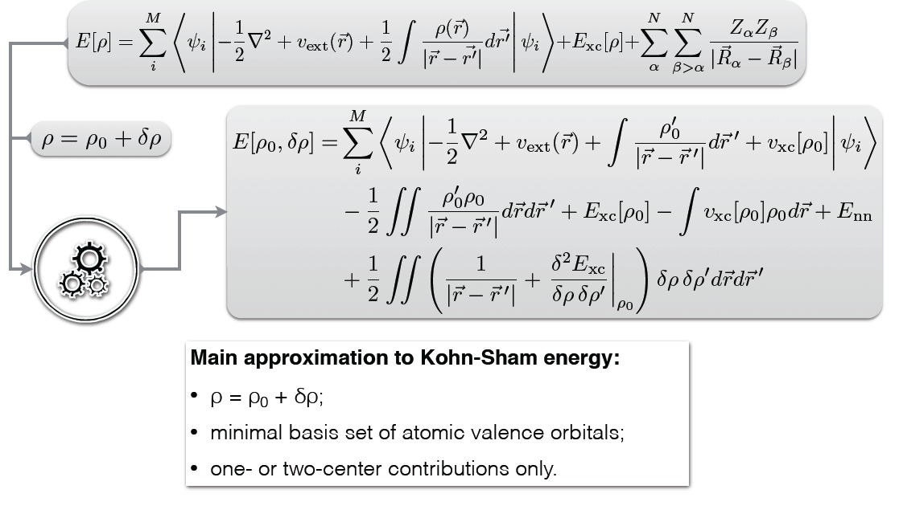
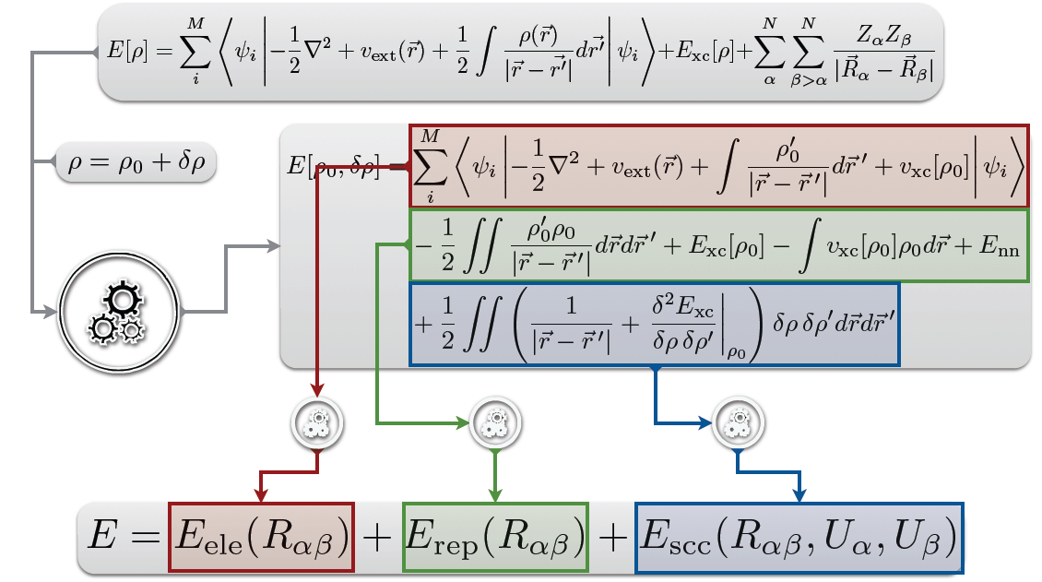
Density-functional Based Tight-Binding (DFTB)
See DFTB slides (Elstner)

Slide 14
DFTB Parameterizations – QuaSiNaNo 2013
Band structures in Si crystals with PBE/TZP, matsci-0-3, QuaSiNaNo 2013
Si (bcc)
Si (fcc)
Si (sc)
Si (dia)

Slide 15
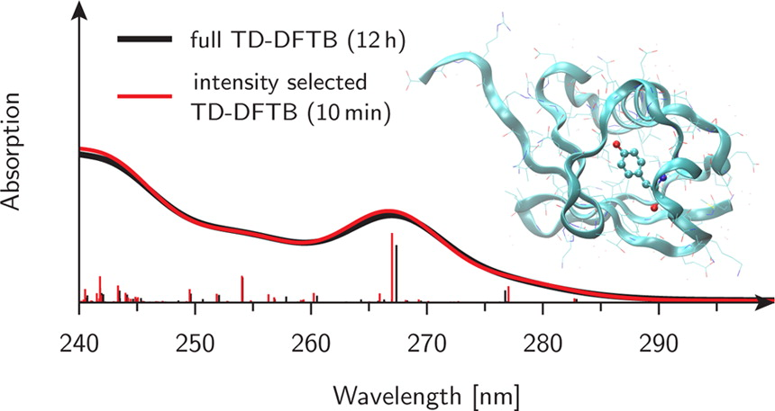
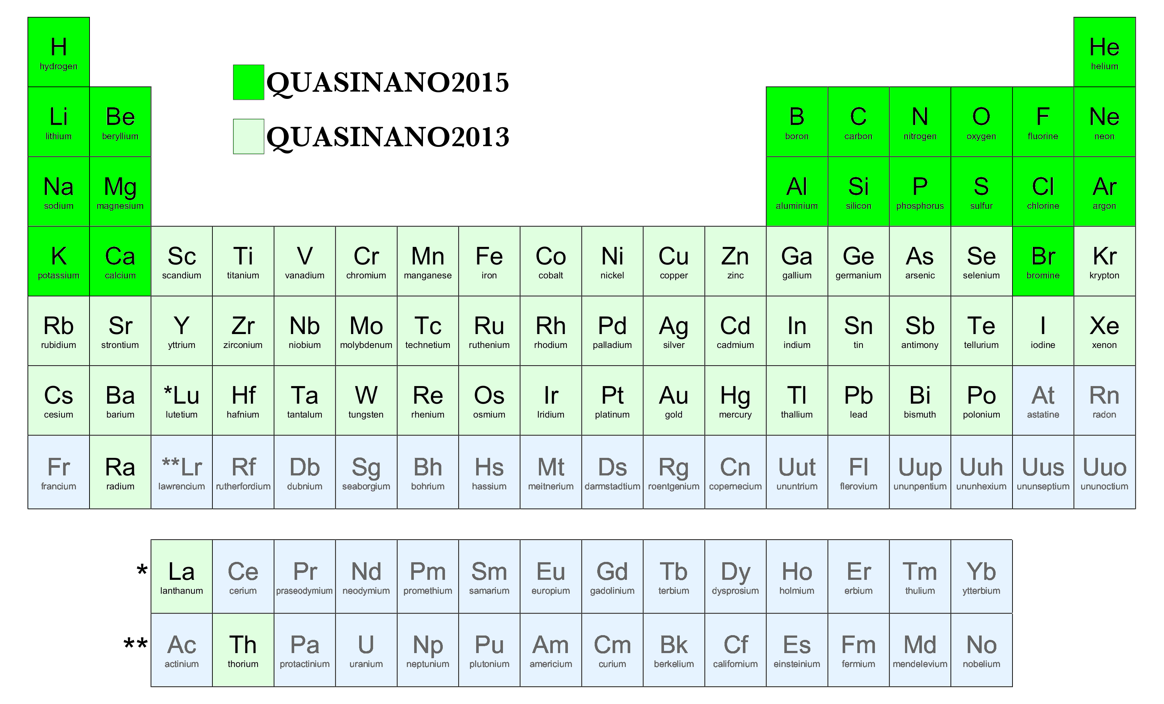
DFTB: approximate DFT
Approximations (to DFT)
Nearest neighbors
Minimal basis
Elec & rep. parameters from table
Capabilities & Features
~500 x faster than DFT
Molecules and periodic
Repulsive
Geometries
Vibrationally resolved excitations
IR, phonons, MD
Electronic
Band structures, MOs (QuasiNano)
UV/VIS
Electron transport (NEGF)
Pre-optimize or pre-screen
Script or chain jobs
QN 2015: rep
QN 2013: ele

Slide 16
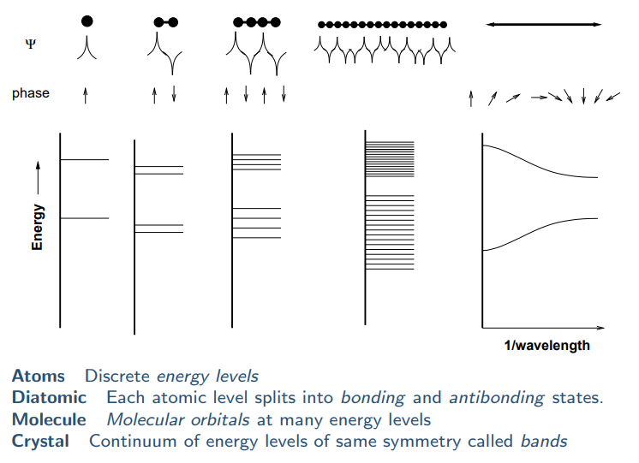
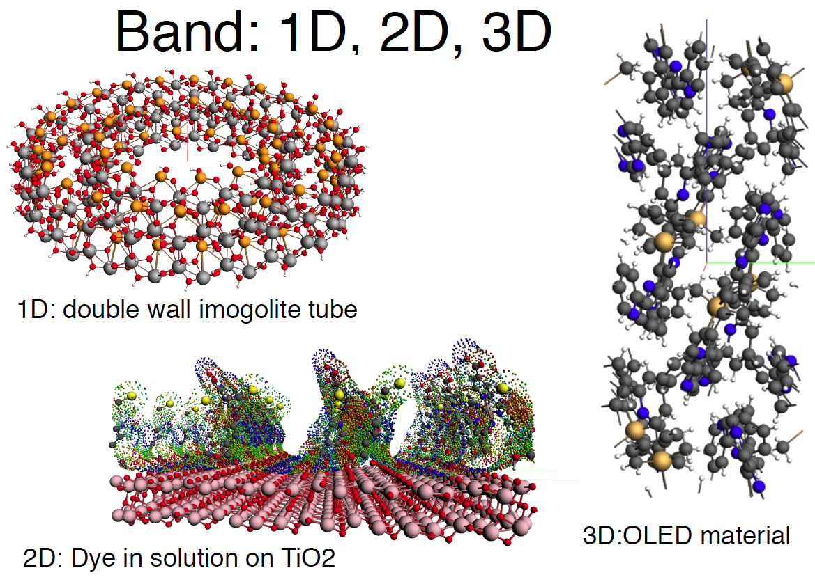
Periodic DFT(B)
1, 2 or 3D systems => nuclei (v_{ext}) repeat periodically
ψ has periodicity: ψ_{k} = e^{ik}u_{k} with Bloch functions u
Sample k in reciprocal space over Brillouin zone
Plane waves e^{iGr}: G_{max} & always 3D!
AOs can be 1 or 2D!
DFTB: large unit cell => Γ point
See slides by Refson

Slide 17
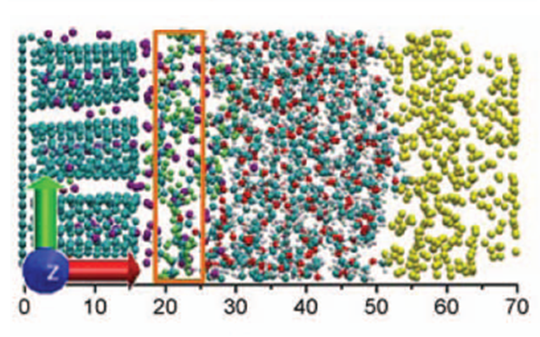
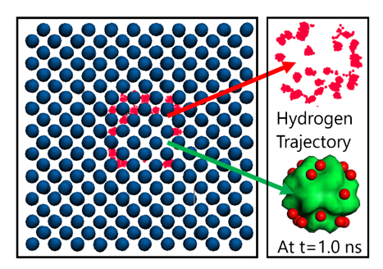
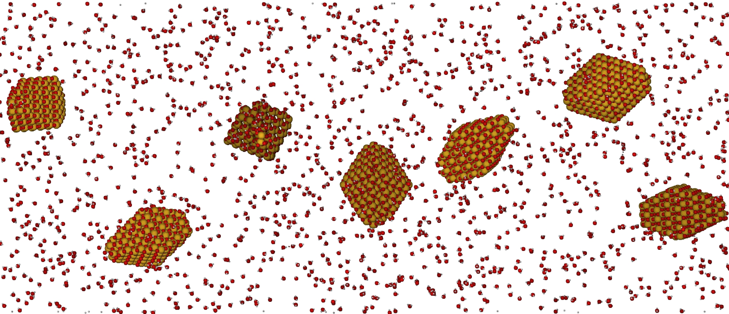
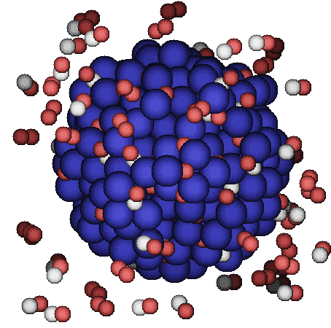
ReaxFF – reactive molecular dynamics
Li battery discharge: J. Electrochem. Soc.
161, E3009 (2014); PCCP, 17, 3383 (2015)
Hydrogen embrittlement of steels
Phys. Chem. Chem. Phys. 18 761-771 (2016)
Afternoon session
Crystallization TiO₂ nano-particles in water Nano Lett. 14, 1836-1842 (2014)
Pd-catalysed CO oxidation GCMC+ReaxFF
J. Chem. Phys., 139 044109 (2013)

Slide 18
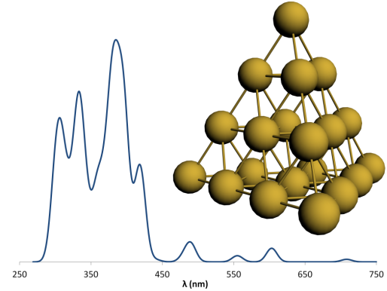
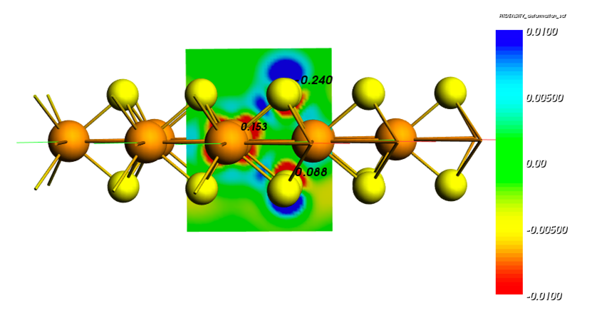
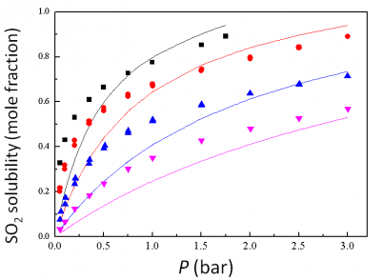
Summary of ADF Modeling Suite
Molecular DFT with ADF
Spectroscopy, reactivity
Organic electronics
BAND: AO-based periodic
Optical and electronic properties of 1D, 2D & 3D systems
Reactivity
DFTB: faster more approximate
Spectroscopy, reactivity, dynamics
ReaxFF: reactive MD large, complex systems
Monte Carlo methods to speed up time / equilibrium
COSMO-RS: activity, solubility, VLE
Synergy between all modules + GUI

