Slide 1
JNU demo/hands-on
Support: support@scm.com
Licenses: license@scm.com
Hands-on session 12 January 2017

Slide 2
Outline
Background & overview
Hands-on / demo
  Getting started: building & optimizing molecules
  Results: MOs & fragment analysis, charges, Fukui functions
  TDDFT and fast approximations
  Transition states (proton transfer)
  MO level diagrams, fragment analysis
  DFTB: fast DFT approximation
  COSMO-RS/SAC: thermodynamic properties

Slide 3
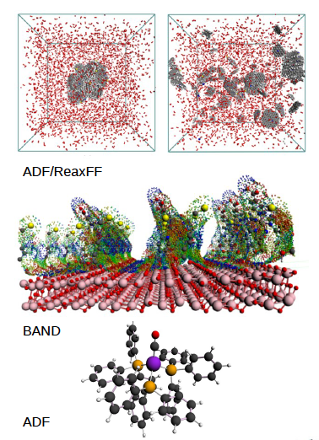
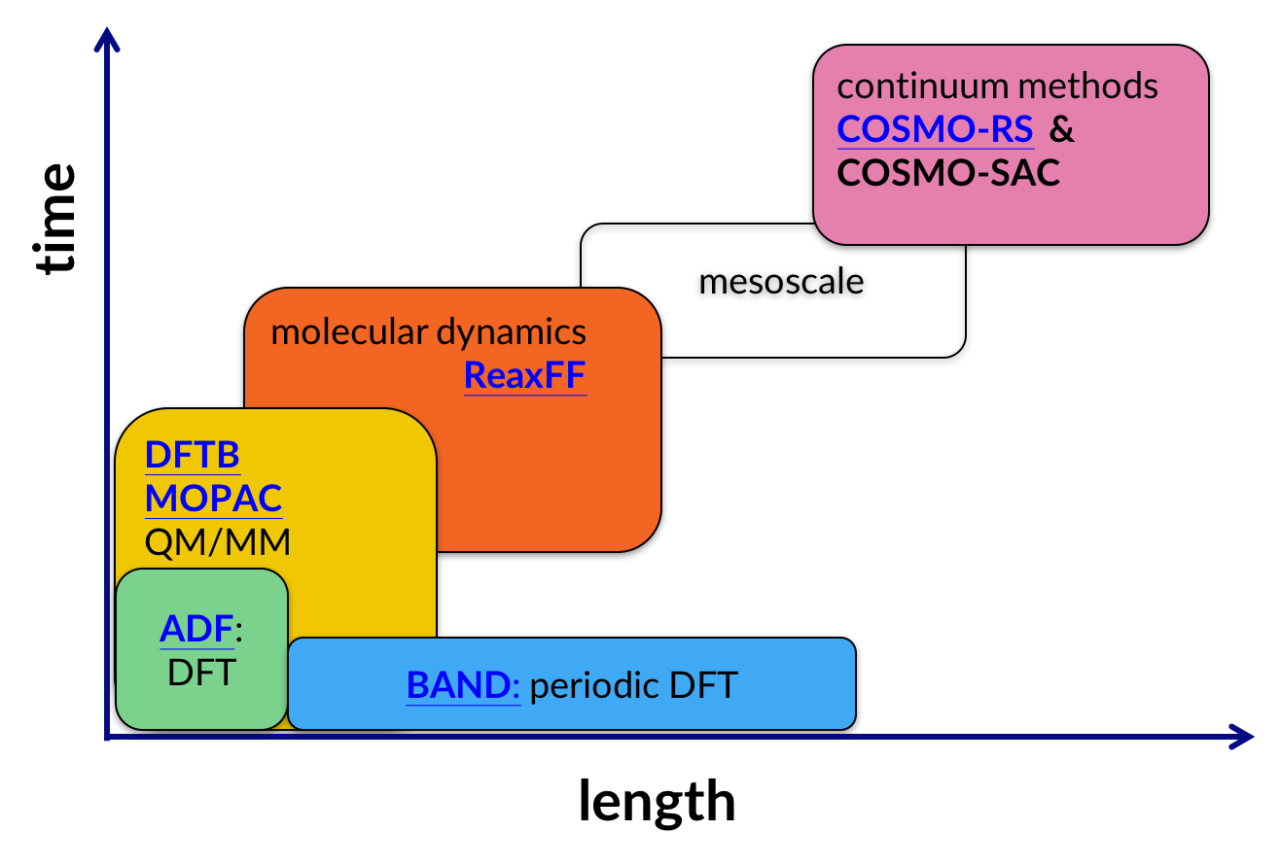
ADF Modeling Suite
Easy to use: 1 GUI, 1 binary

Slide 4









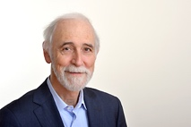








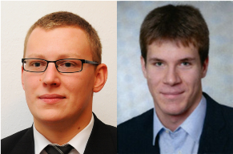
The SCM team
Olivier:
GUI
Alexei:
ADF
ReaxFF
Erik:
ADF
COSMO-RS
Pier:
BAND
Mirko:
ADF
BAND
Developers
Hans:
Linux
GPU
Python
Thomas:
DFTB
Scripting
Laurens:
GUI
Ole:
GUI
ReaxFF
Evert Jan:
Adviser
Business
Stan:
CEO
Fedor:
Marketing
Sergio:
Collaborations
Frieda:
Invoices
Licenses
Kitty:
Finance
Marc:
BAND
Michal,
Robert: QM/MM, excited states MD
EU fellows
Damien:
Scripting
MOFs
Anna:
ReaxFF
MOFs
+ many academic collaborations

Slide 5

Making computational chemistry work for you
Latest computational
chemistry tools
Set up, run & analyze
Cross-platform
1 package: all modules
Passionate scientists
Decades of expertise
support@scm.com
Easy install
Windows, Mac, Linux

Slide 6
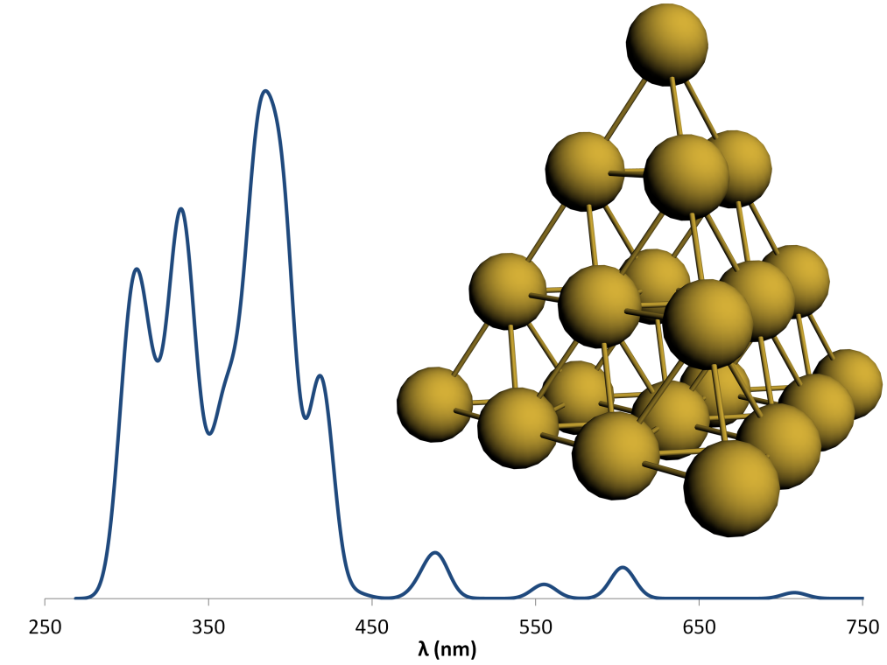
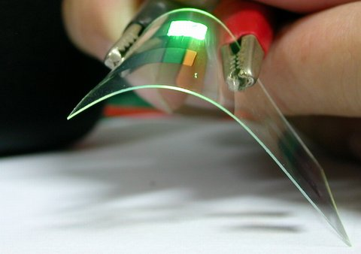
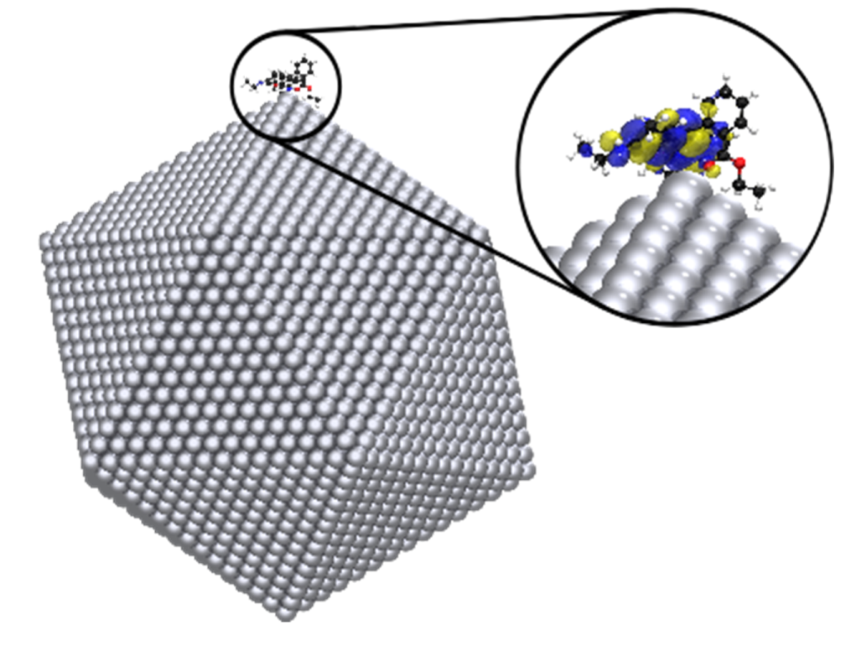
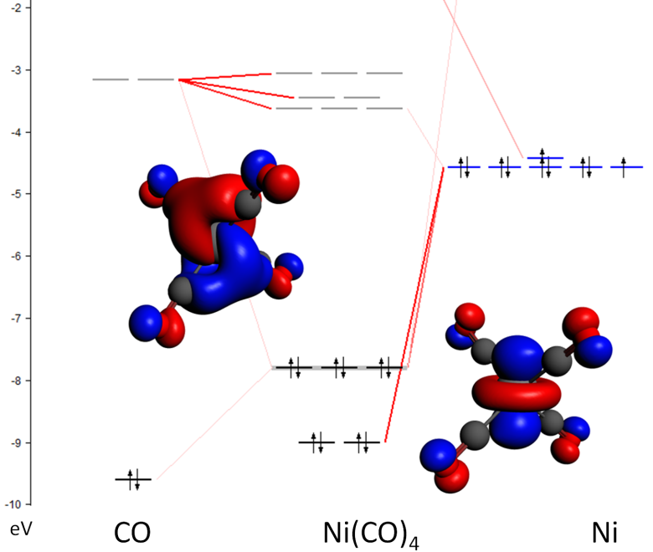
ADF: Molecular DFT
Strong & unique points
All-electron Slaters, H-Og
Relativity: ZORA (SR, SOC)
Spectroscopy
  EPR, NMR, IR (VCD), UVVIS, XAS
Environments
  Subsystem DFT (FDE), DIM/QM, QM/MM
Bonding analysis:
  ETS-NOCV, QTAIM, MO diagrams, NCI, ....

Slide 7
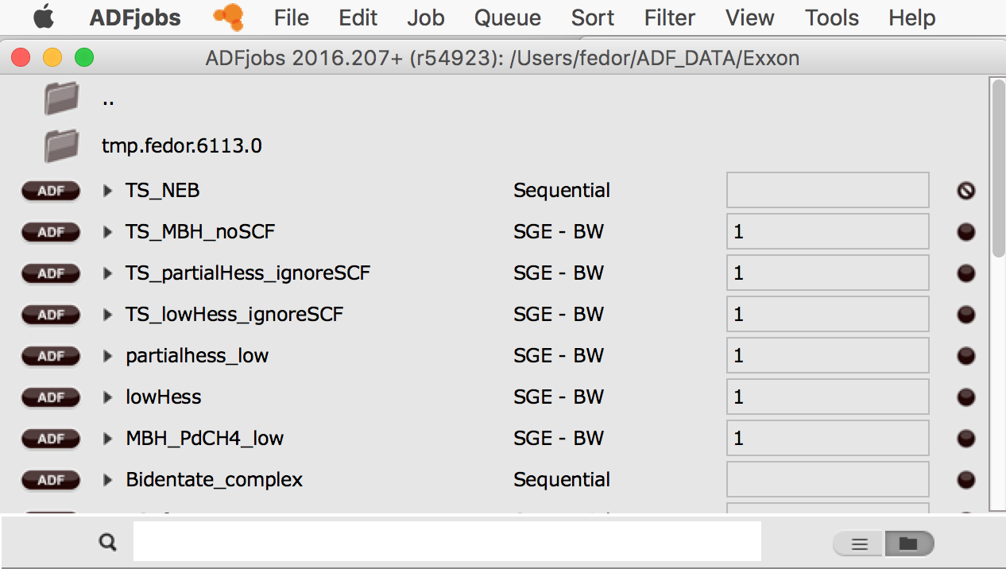
ADFjobs: job bookkeeping
switch GUI functionality
define & switch queues
reports & templates
change default
e.g. cores / nodes
see files for this job
job status
queue
search
all jobs / folder view

Slide 8
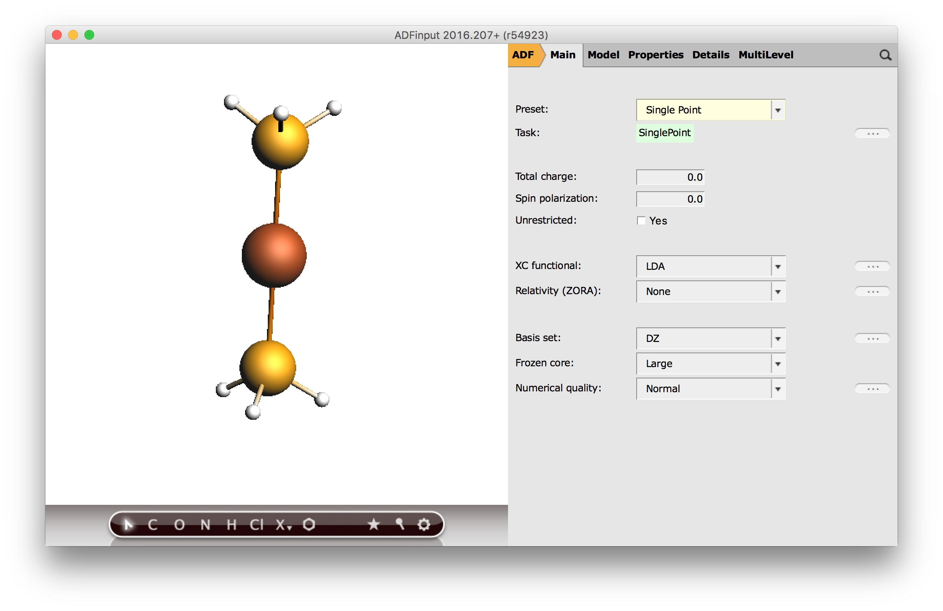
Basic calculations & settings
switch modules
job types & set up
search
job type
/ template
charge/spin
functional &
relativistic appr
basis & numerical
accuracy
builder tools
… = more details

Slide 9
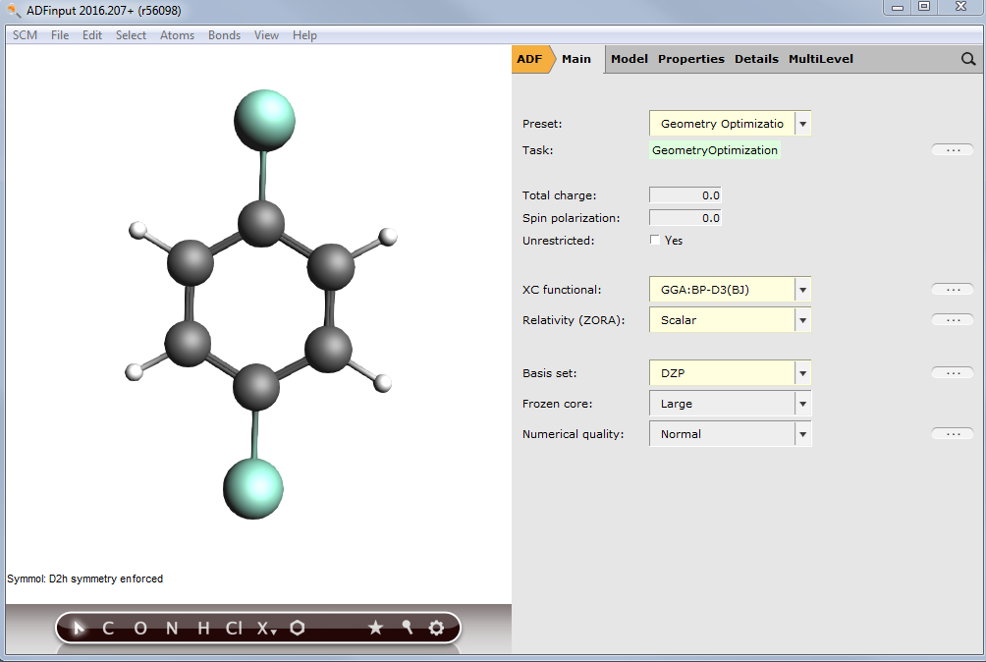
Building molecules
www.scm.com/doc/Tutorials/GUI_overview/Building_Molecules.html
Import: SMILES, xyz, cif, pdb, …
Included library + building / drawing tools tools
Nanoparticles: start from periodic => cut a cluster
Surfaces from bulk ...
Excercise:
Build p-dicholorobenzene
symmetrize & optimize
(SR-BP-D3/DZP)

Slide 10
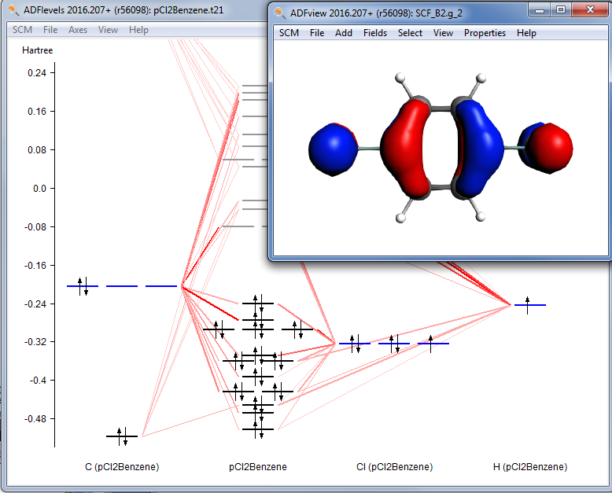
Visualizing results (I)
See also the introductory GUI tutorial
Open ADFlevels to see how the MOs are built up from atomic AOs
  To analyze chemical bonding in detail: define fragments and run an EDA / ETS-NOCV
Visualize the HOMO by right-clicking on it in ADFlevels

Slide 11
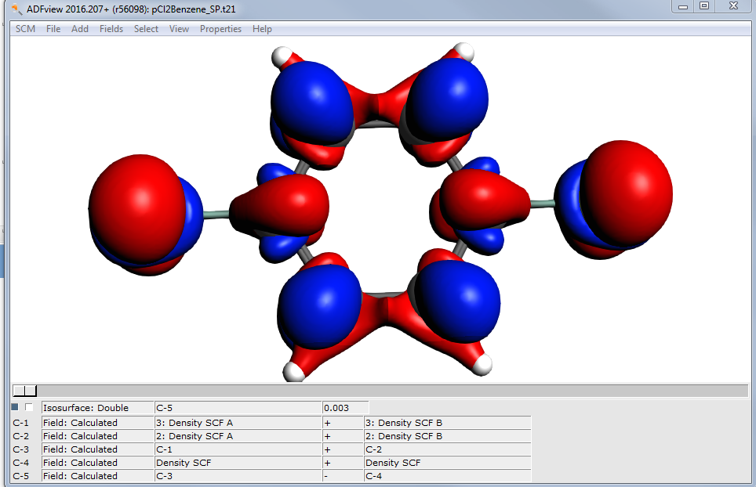
Visualizing results (II)
Single point, select Fukui function as a property (see also tutorial)
Find the condensed Fukui charges and local softness in the output
Visualize the Fukui function(s) and/or dual descriptor
f⁻ and f⁺ describe electrophile / nucleophile reactivity from density change upon adding / removing an electron
f⁻=ρ(N) − ρ(N − 1)
f⁺=ρ(N + 1) − ρ(N)
f(r) = f⁺ − f⁻ Dual Descriptor: >0 (<0) for electrophilic (nucleophilic) sites
Condensed Fukui function f_{k}: partition per atom, based on ‘atomic charges’
Hardness η = I – A ≈ ΔE_{(HOMO-LUMO)}
Softness S = 1/η
Local softness = S* f_{k} = f_{k}/η
See Yang & Parr, VUB, and others

Slide 12
Energy decomposition analysis
∆E = ∆E_{prep} + ∆E_{int}
Rev. Comput. Chem. 2000, 15, 1
∆V_{elstat} + ∆E_{Pauli} + ∆E_{oi} + ∆E_{disp}
∆E_{steric} = ∆V_{elstat} + ∆E_{pauli}
∆E_{oi} = decomposed in irreps.
See tutorial & teaching exercises
Extensions:
ETS-NOCV: orbital interactions + deformation density
M. Mitoraj et al., J. Chem. Theor. Comput. 5, 962 (2009)
Periodic EDA: M. Raupach & R. Tonner, J. Chem. Phys. 142, 194105 (2015): molecule-surface interactions
Notes:
The term ΔV_{elstat} corresponds to the classical electrostatic interaction between the unperturbed charge distributions of the prepared (i.e. deformed) fragments and is usually attractive. The Pauli repulsion ΔE_{Pauli} comprises the destabilizing interactions between occupied orbitals and is responsible for any steric repulsion. The orbital interaction ΔE_{oi} in any MO model, and therefore also in Kohn-Sham theory, accounts for charge transfer (i.e., donor-acceptor interactions between occupied orbitals on NH₃ with unoccupied orbitals of BH₃, including the HOMO-LUMO interactions) and polarization (empty/occupied orbital mixing on one fragment due to the presence of another fragment).

Slide 13
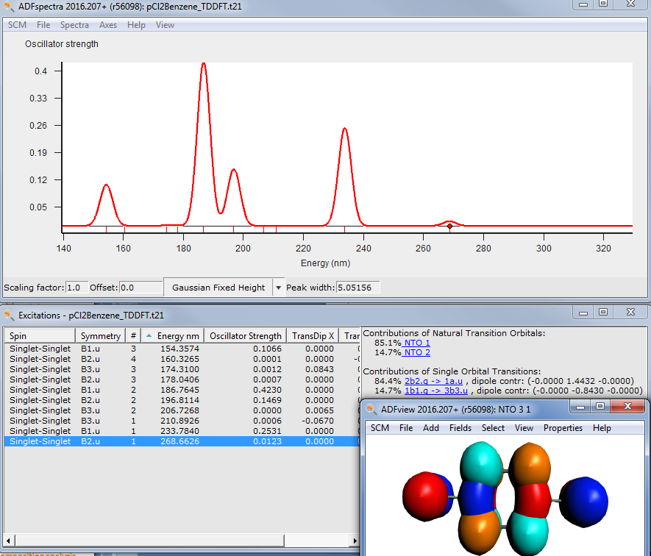
Excited states: TDDFT
Calculate the UVVIS spectrum for p-dichlorobenzene (see also tutorial)
  Under properties select ‘Allowed only’ and the lowest 10 excitations
  Visualize the spectrum, change to nm, and select the NTOs for the lowest E peak (~265nm)

Slide 14
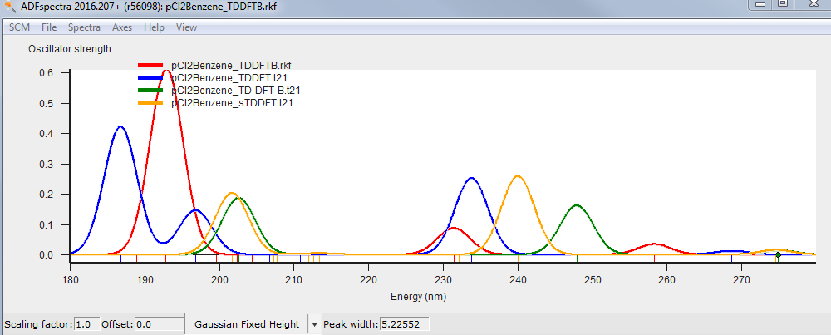
Fast excited states: sTDDFT, TD-DFT+TB, TDDFTB
Calculate again with sTDDFT, TD-DFT+TB and TDDFTB (SCC halorg-0-1)
  Compare timings & spectra
  Why is sTDDFT or TD-DFT+TB not faster than TDDFT in this case?
  Try larger non-symmetric molecules again for a proper comparison!

Slide 15
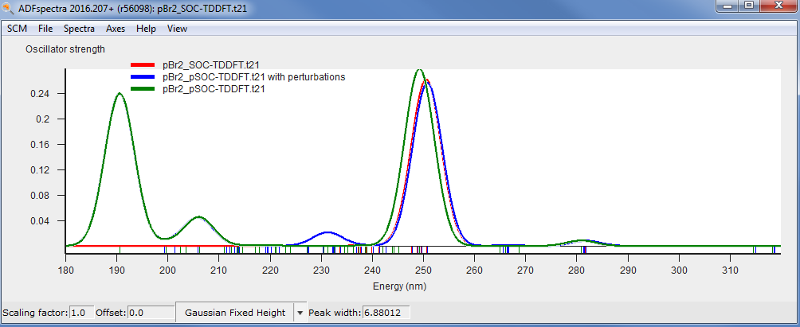
Spin-orbit coupling TDDFT
Calculate again with perturbative and full spin-orbit coupling
  Do you see any difference?
  Try again for dibromo-benzene (reoptimize!)

Slide 16
Transition states
Get close to the transition state
Good guess for the transition mode
See package finding TSs on
the teaching materials pages
How to get a good guess geometry?
Intuition*⁾ + constrained optimization
Linear transit
Nudged elastic band
*⁾ e.g. from literature, geometry from a previous TS
How to get a good guess for the transition mode?
Transition State Reaction Coordinate (TSRC)
Hessian: full, partial, or mobile-block, maybe smaller basis & lower accuracy?
Remember: a TS has 1 and only 1 negative Hessian eigenvalue

Slide 17
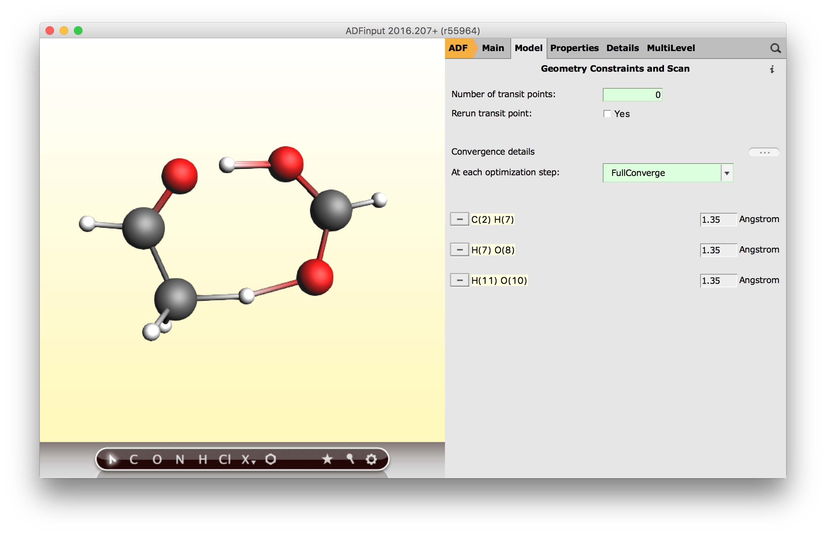
Proton transfer TS: tautomerization
Import acetaldehyde from the database
Add formic acid as catalyst
Optimize with C-H…O & OH distances constrained at 1.35 Å (PBE/DZP)
Stop after ~ a dozen cycles update a ‘good’ geometry in input as TS guess

Slide 18
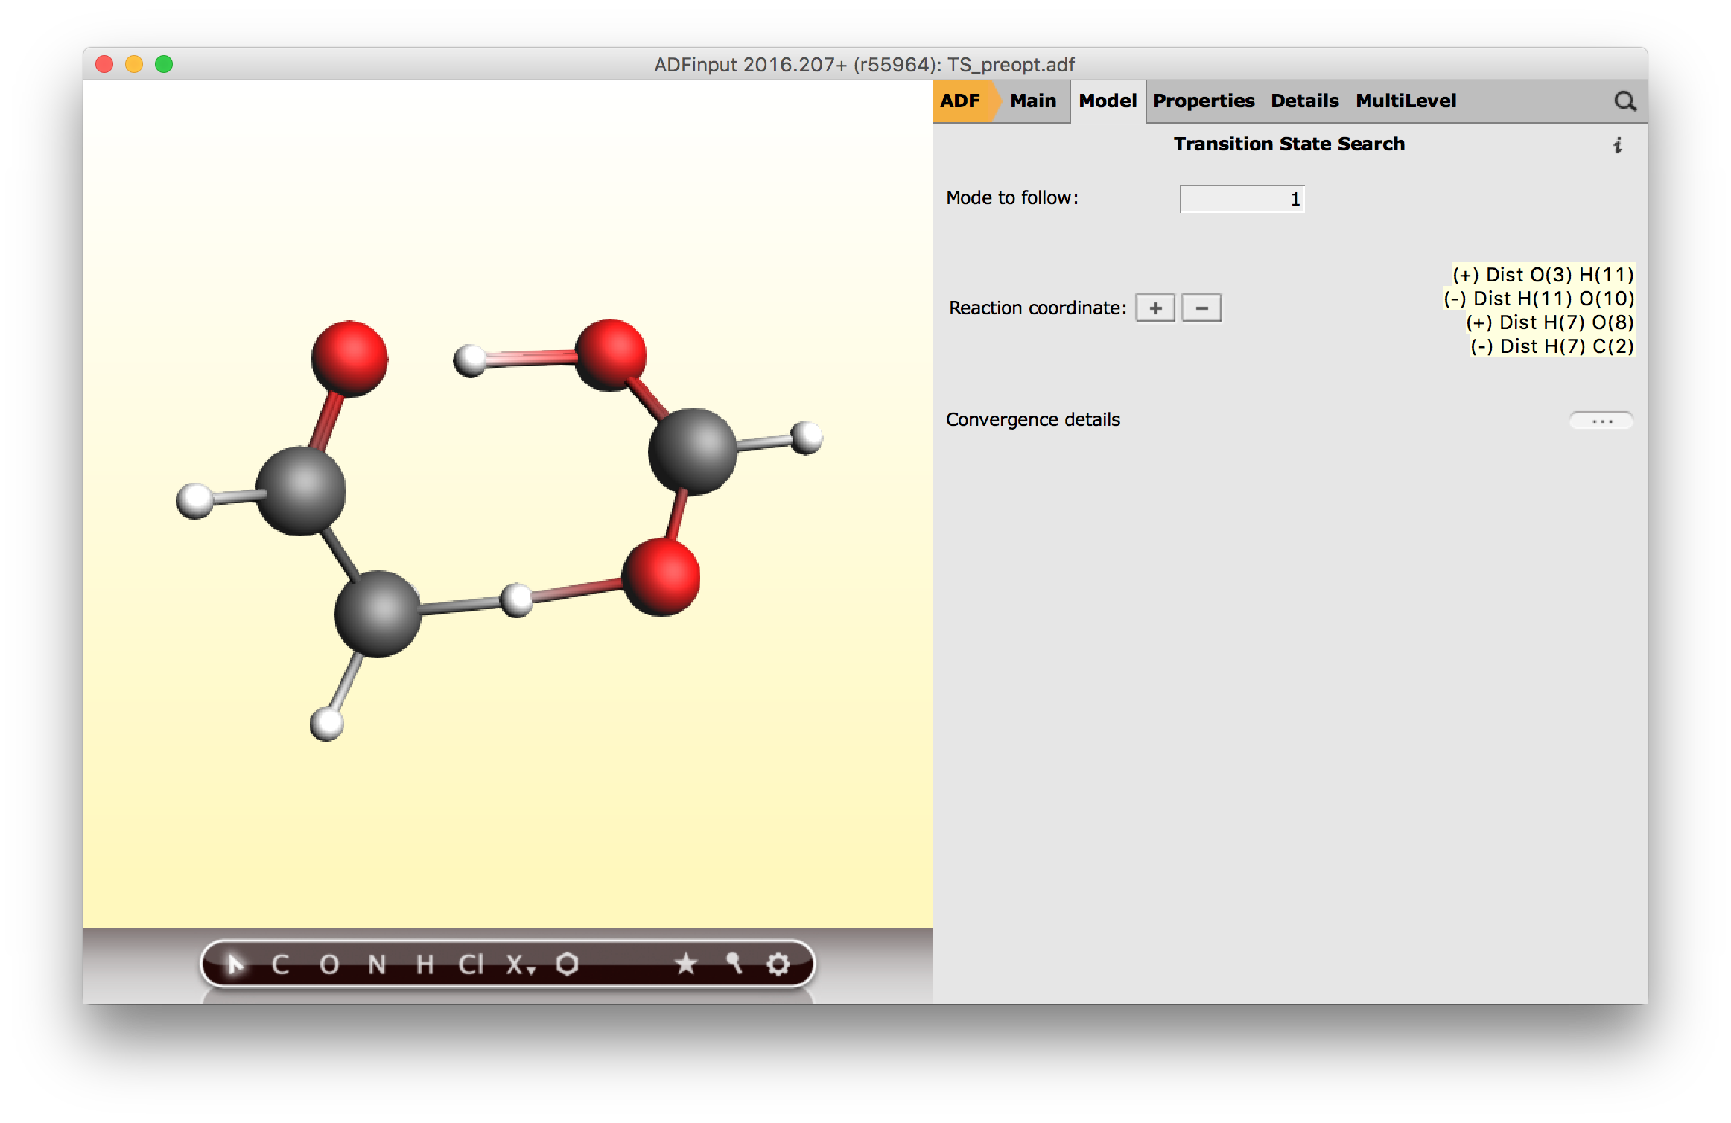
Proton transfer TS: tautomerization
Remove the constraints
Change the preset to TS search (change the numerical quality to good)
Select details & define TSRC as increasing / decreasing proton distances
After the job has finished, calculate frequencies (scan -100 to 0)

Slide 19
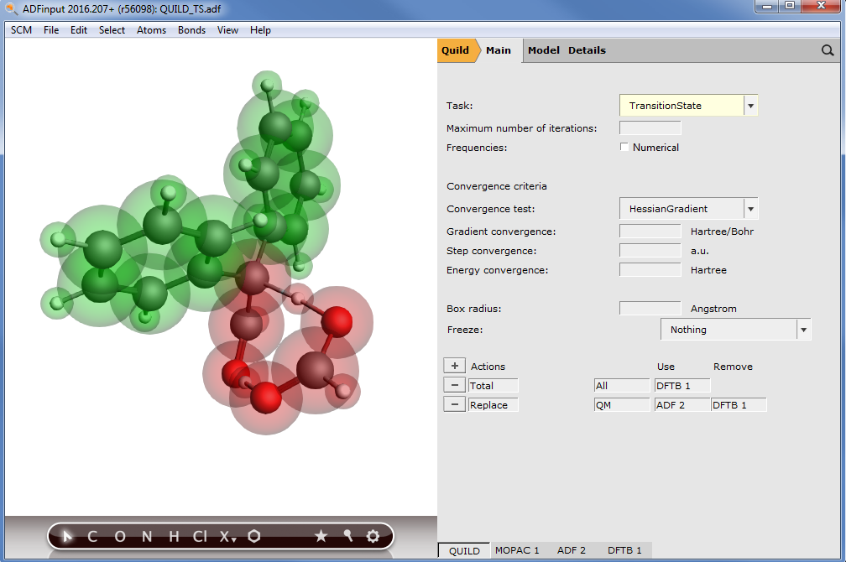
Proton transfer TS multi-layer
Subtractive QM/MM: change ADF to QUILD
Add two phenyl groups to acetaldehyde, define QM and QM’ region
For the total energy choose DFTB (SCC-DFTB)
For the QM region choose ADF & subtract SCC-DFTB
Change task to TransitionState

Slide 20
Multiple jobs, conformers
Within the GUI you can
  average spectra
  generate conformers
  set up a batch of similar jobs (e.g. change functionals, basis set etc.)
See tutorials
With scripting (python or shell using adfprep/adfreport you can do even more advanced things

Slide 21
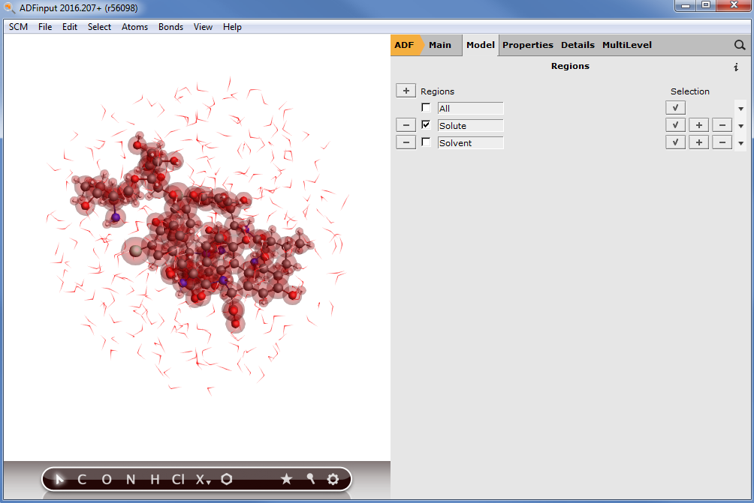
Faster methods: MOPAC, DFTB
Search for vancomycin SMILES and paste it into GUI (will take some time)
Pre-optimize a few times with UFF (cogwheel)
Add water as a solvent with a sphere of 13.5 Å, (~1000 atoms in total)
Run DFTB3/3ob and MOPAC optimizations
  Which is faster?
  Does ‘Mozyme’ help?
Run a MOPAC/COSMO-RS on bare vancomycin

Slide 22
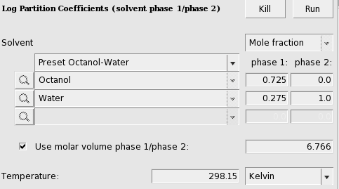
COSMO-RS with MOPAC
Remove the solvent layer
Run a MOPAC/COSMO-RS on bare vancomycin
Calculate the octanol-water partition coefficient (log k_{OW}) with COSMO-RS

