Slide 1
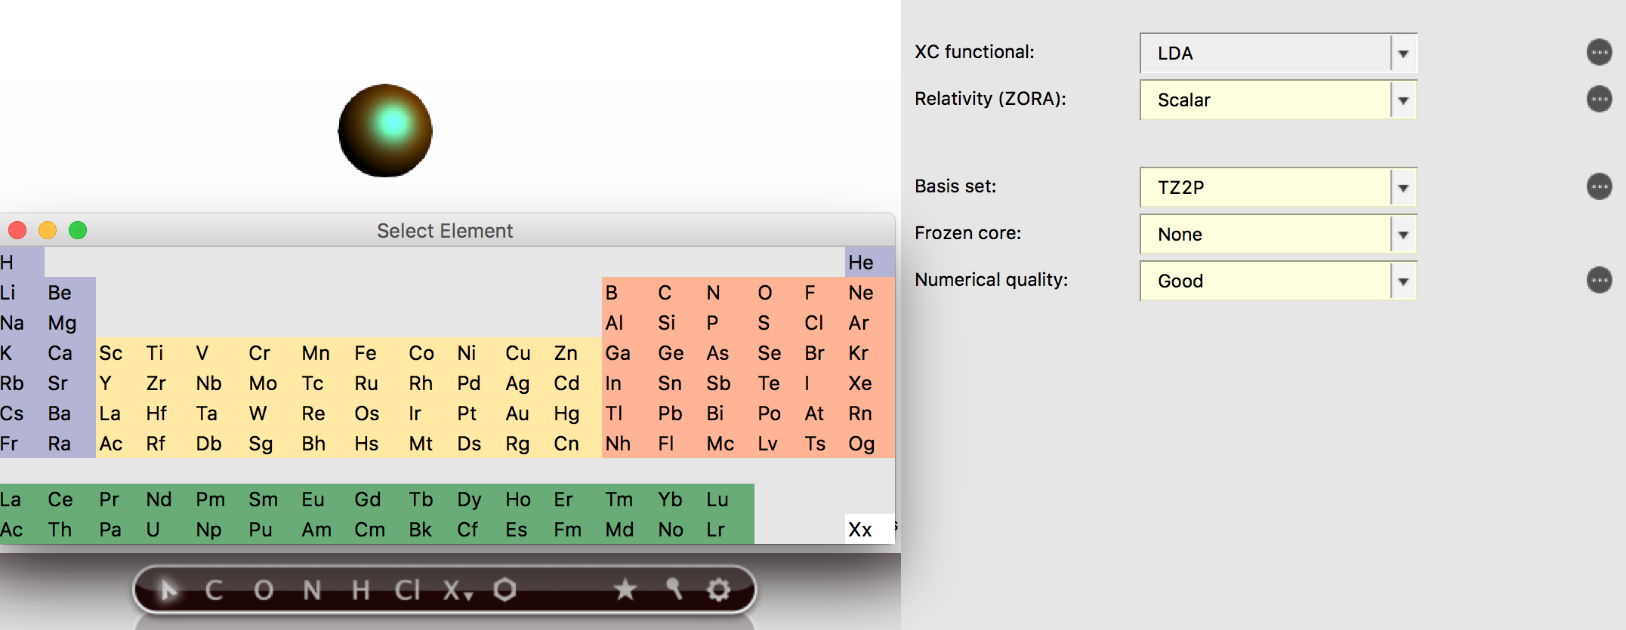
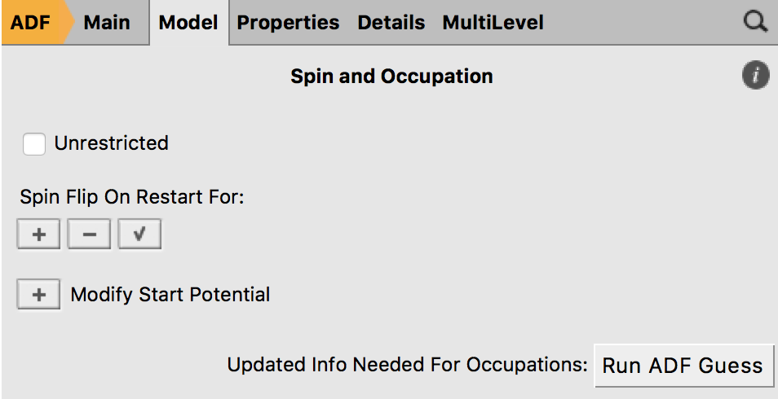
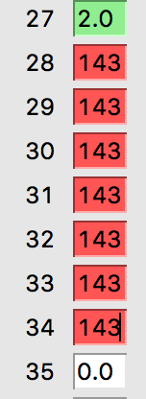
Simply put, Density-Functional Theory based Ligand Field (LFDFT) uses ad hoc configuration interaction to deal with near-degeneracy in open-shell d- and f-systems.
The LFDFT run is preceded by a so-called average-of-configuration (AOC) calculation.
In this example, we will calculate excitations from f² to f¹d¹ for the Pr³⁺ ion
NOTE: Ignore all GUI warnings
A. AOC for 4f²
Add a Pr atom
Select Scalar ZORA
Set TZ2P basis set
No frozen core
Numerical quality Good
Details => Symmetry => Nosymm
Model => Spin & Occupations => Run ADF Guess
Tick ‘Use Following Occupation’ & scroll down
Set 0.2857143 for orbitals 28-34*
File => Run (Save as Pr_f2)
* This creates a 3+ ion and equally
divides the 2 f-electrons over the f-shell
1.3
2.
3.
4.
5.
1.2
1.1
6.
9.
7.
9.
9.
9.

Slide 2
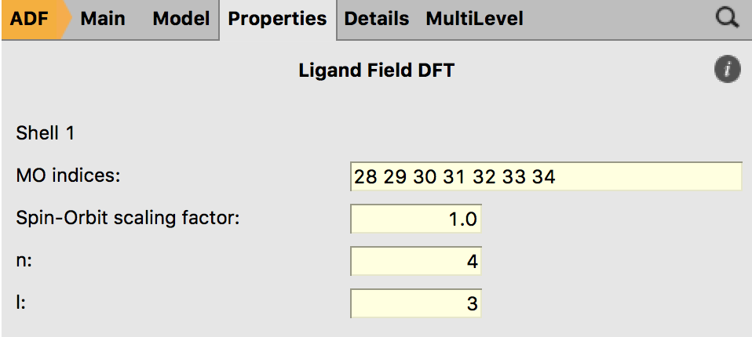
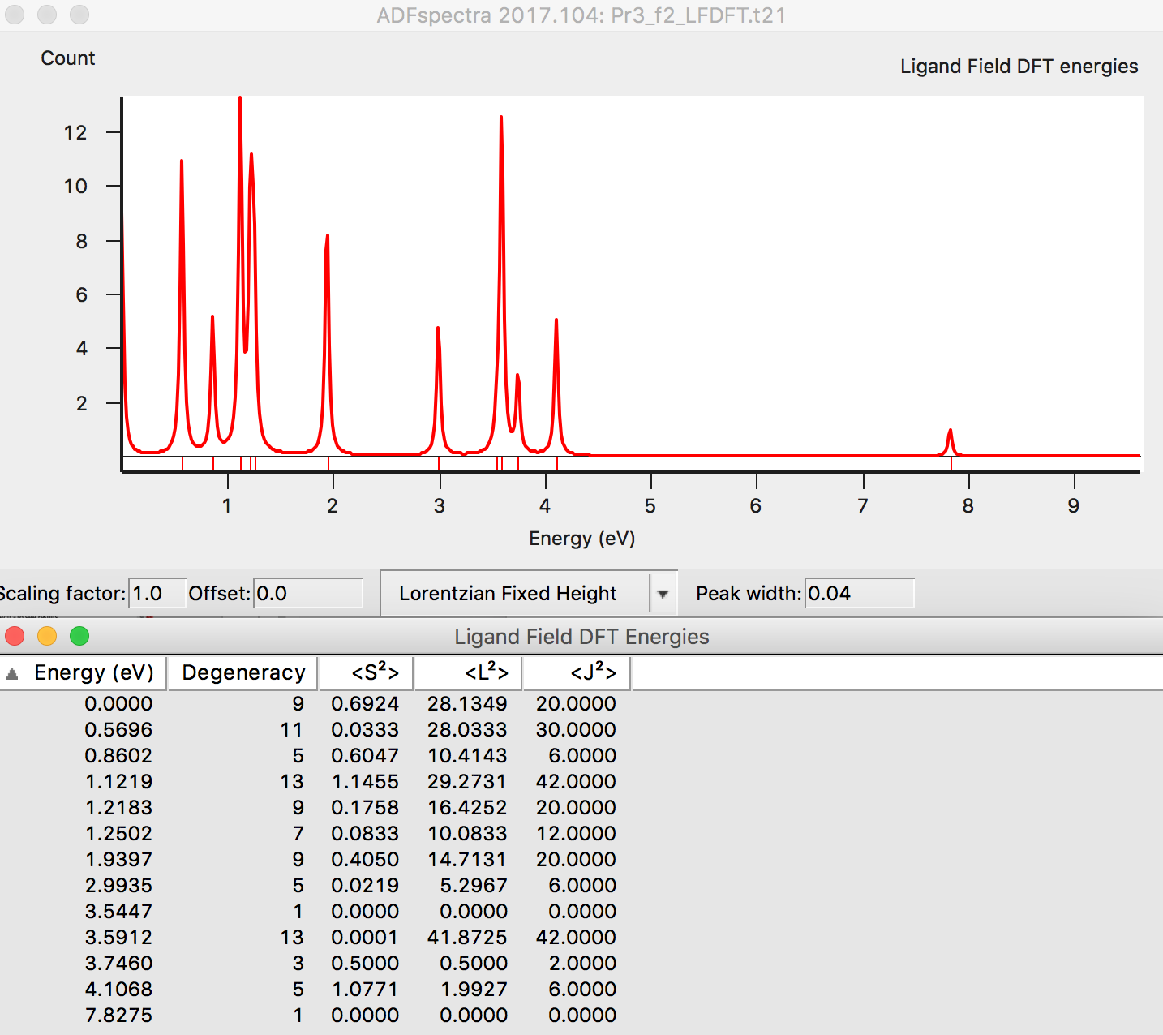
Example: Pr³⁺ ion
B. LFDFT for f²
Properties => Ligand Field DFT (Could be prompted to install LFDFT database)
Enter the MO indices 28-34
Set spin-orbit to 1
Set n to 4 and l to 3 (= 4f)
Run
Open ADFspectra to see the multiplet energies
11.
12.
13.
15.
9.
9.
9.

Slide 3
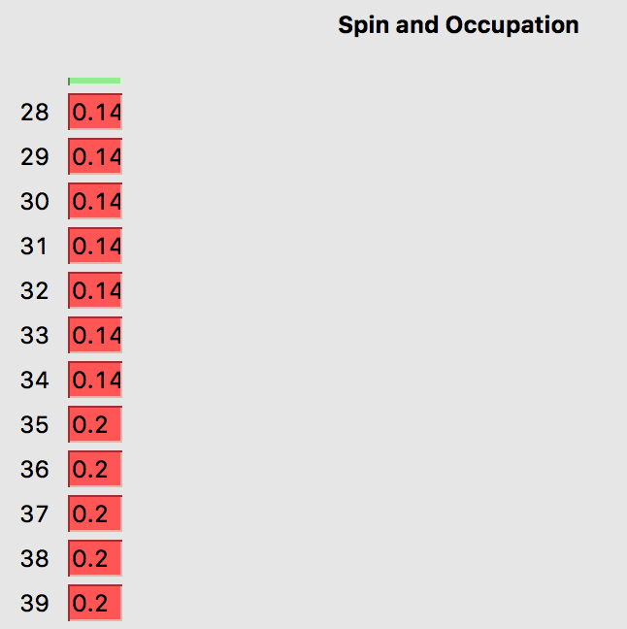
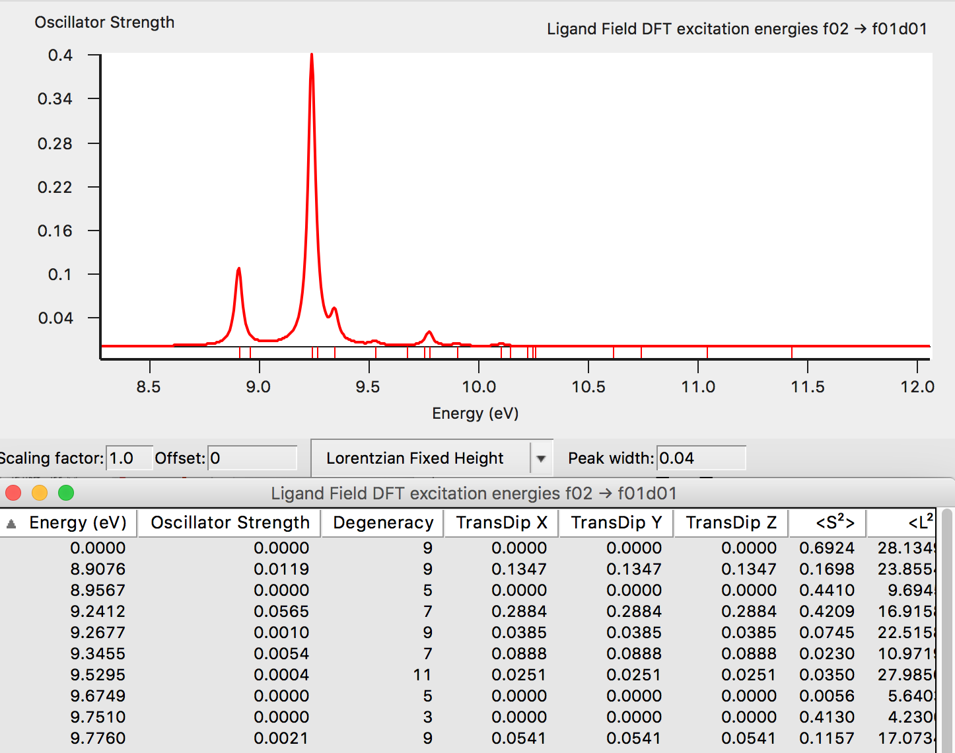
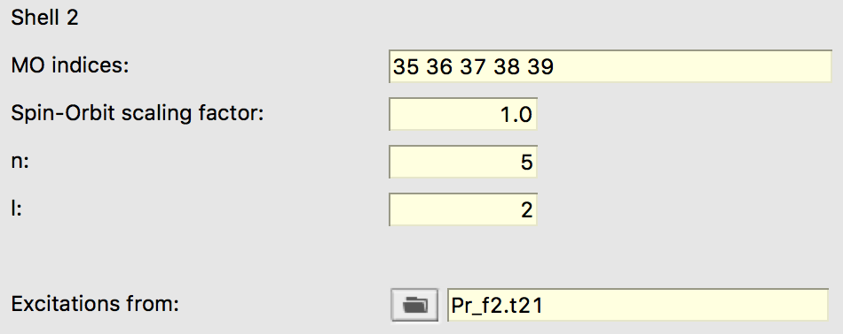
C. f² excitations to f¹d¹
We will now set up the AOC for the f¹d¹ excited state and calculate the excitations to that state from our previous f² calculation (the ground state).
Model => Spin & Occupations
set f-orbitals to 1/7th (0.1428571), & d-orbitals to 1/5th
Properties => Ligand Field DFT
Enter the MO indices for state 2
Set spin-orbit to 1
Set n to 5 and l to 2 (= 5d)
Select Excitations from: => the f² LFDFT .t21
Save as a Pr_f2_f1d1 & Run
ADFspectra Spectra =>Ligand Field DFT =>LF Excitations
17.
24.
19.
20.
21.
22.
9.
9.
9.

Slide 4
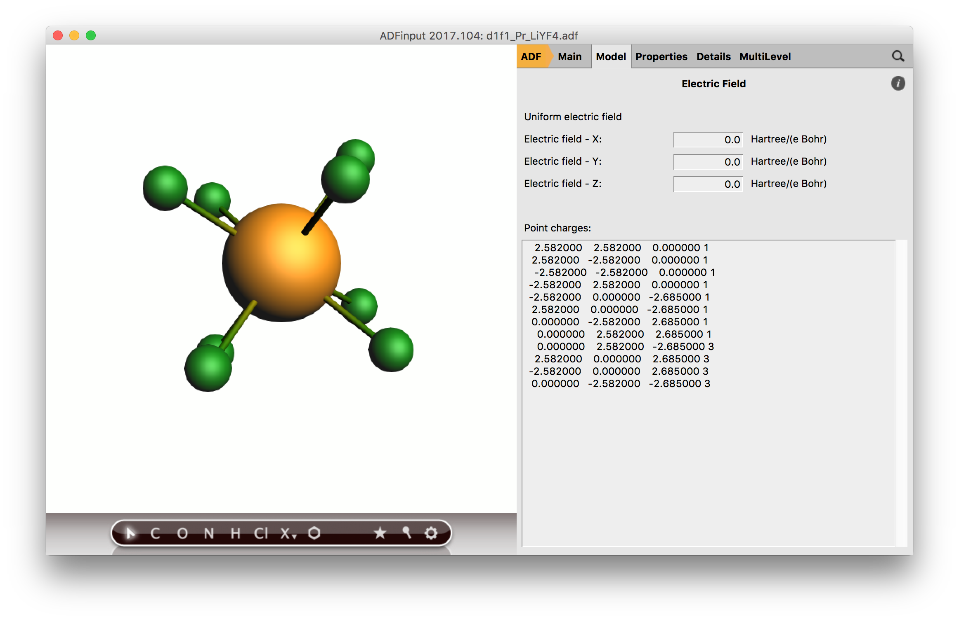
D. Expert options: Pr³⁺ in LiYF₄ matrix
You can study the f-d transitions in a matrix, based on the work in this paper (video):
Tailoring the optical properties of lanthanide phosphors: prediction and characterization of the luminescence of Pr3+-doped LiYF4, Phys. Chem. Chem. Phys., 2015,17, 9116-9125
This is quite an advanced exercise. Roughly you need these steps (you can also start with the input files):
1) Find the LiYF₄ cif file, make a 6x6x3 super cell and select a central Y.
Cut out a cluster of a few A so that you have a sufficiently large cluster (Li₈Y₅F₂₄) and replace the central Y with a Pr³⁺.
2) Optimize the central PrF₈ part, fixing the outer part. Use LDA (best geometries) with a TZP basis set, using an AOC for the two f-electrons.
3) Calculate the f² and d¹f¹ states for PrF₈⁻ in the field of Li and Y cations. You set up the occupations and LFDFT as done previously for the bare ion. For the d¹f¹ there will be some unoccupied orbitals in between the d and f orbitals.
9.
9.
9.

