Slide 1
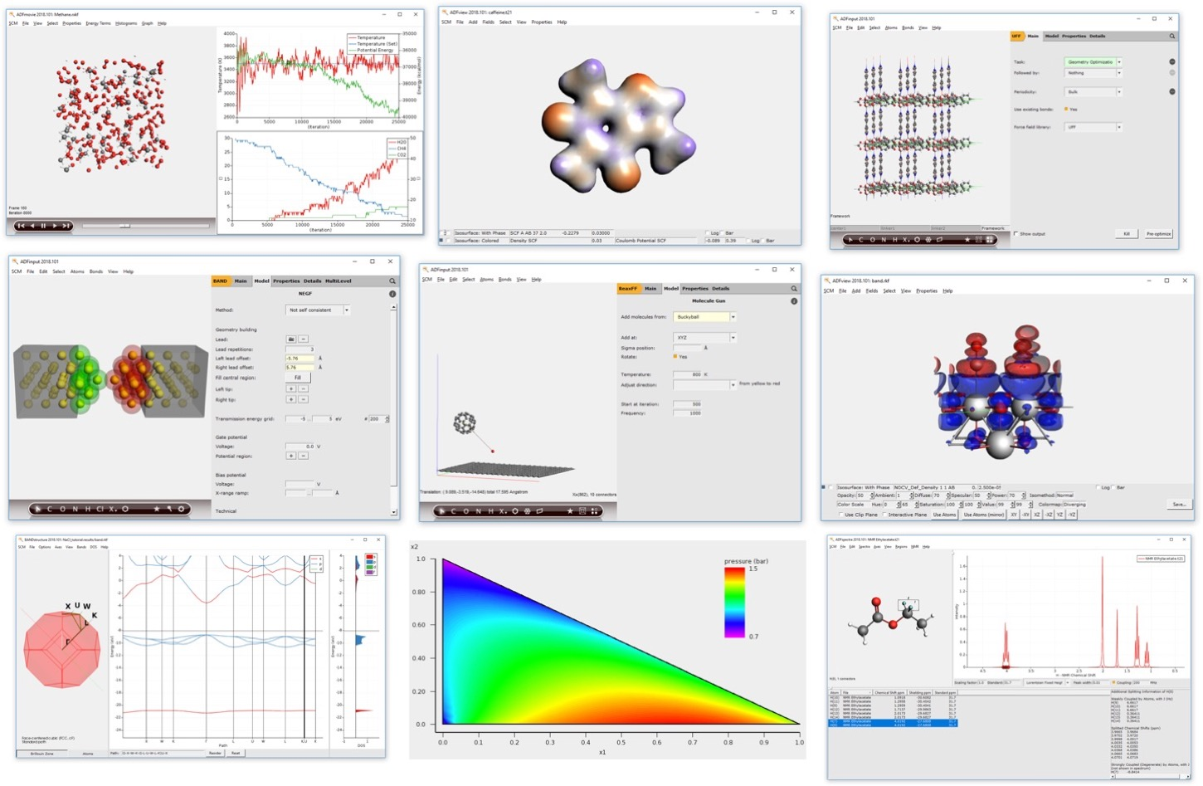
Chemistry & Materials with the Amsterdam Modeling Suite
28 March 2022
Fedor Goumans, goumans@scm.com

Slide 2
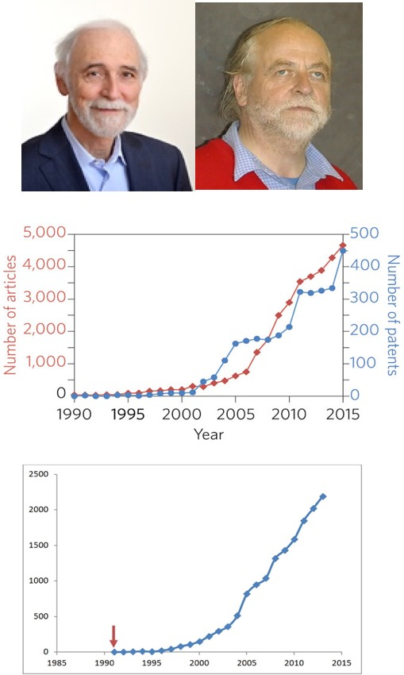
Background: SCM, ADF & AMS
ADF = first DFT code for chemistry (1970s)
Pragmatic: understand & predict chemistry
Baerends@VU (>’73), Ziegler@Calgary⁽⁺⁾ (>’75)
80s: support industrial users Mitsui, Shell, Akzo, Unilever
SCM: Spin-off company 1995
22 people (15 senior PhD’s) + 3 EU fellows
Many academic collaborators / EU networks
~160 authors
New functionality
Academia, government & industry users worldwide
SCM: development, debug,
port, optimize, docs & support
articles &patents in materials science with
“density functional theory”, Nat. Mat. 4619
Papers with
“DFT and Chemistry”

Slide 3
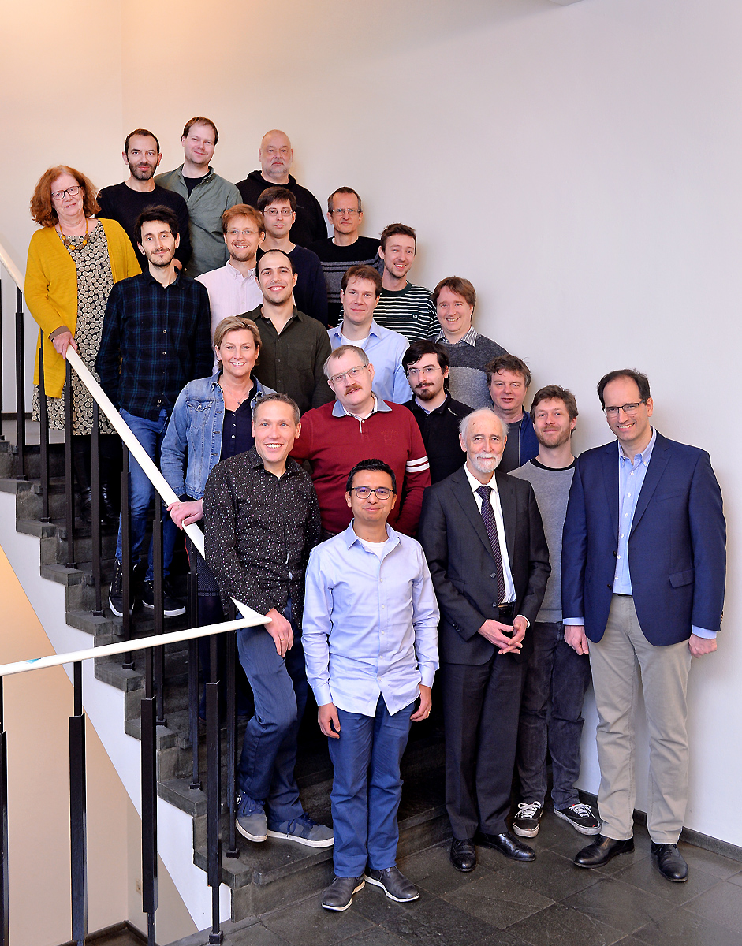
15 developers
3 support scientists
3 office / business
3 PhD students (EU)
The SCM team in Amsterdam

Slide 4
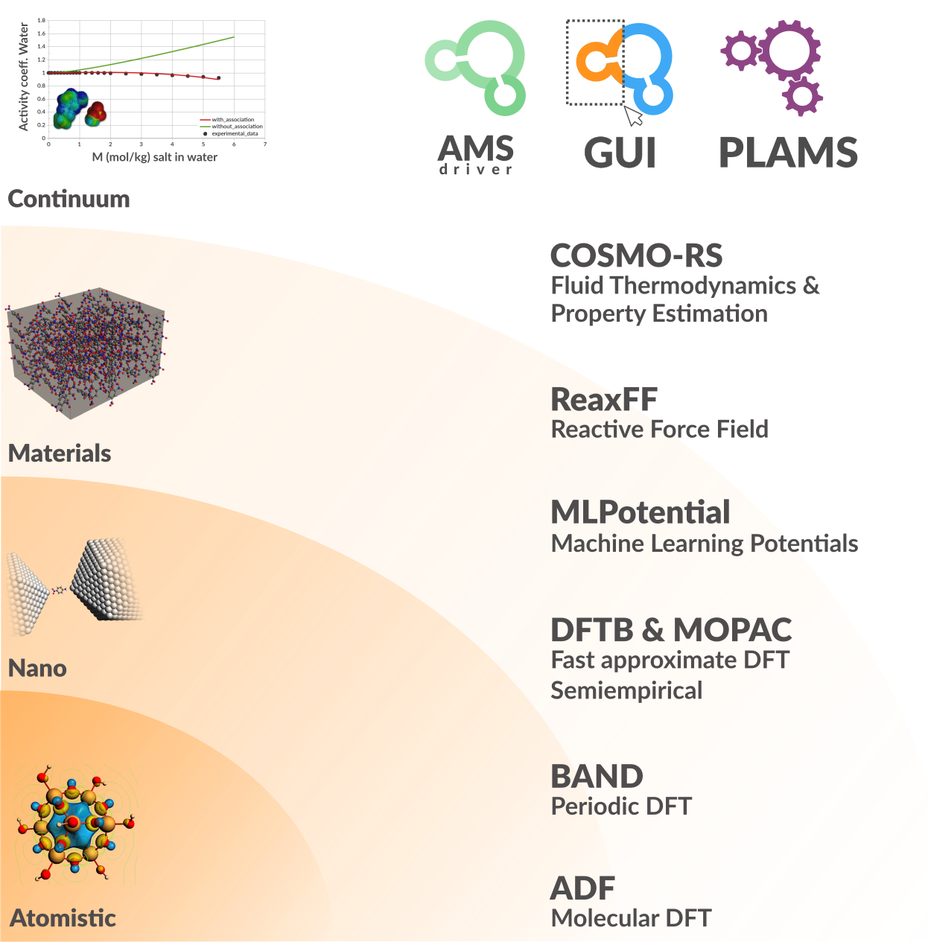
Amsterdam Modeling Suite
ADF: powerful molecular DFT
Reactivity, spectroscopy
Spectroscopy: NMR, EPR, VCD, UV, XAS
BAND: periodic DFT
(2D) Materials, spectroscopy, analysis
Interface with QE, VASP
DFTB & MOPAC: fast electronic structure
ReaxFF: Reactive MD
Dynamics of large complicated systems
MLPotential
Backends SchNetPack, sGDML, PiNN, TorchANI
COSMO-RS: fluid thermodynamics
VLE, LLE, logP, solubility
AMSdriver: PES exploration, MD, MC
Hybrid: multi-layer, QM/MM, QM/QM’
Integrated GUI, python scripting (workflows)
Notes:
Strong points AMS: DFT, semi-empirical and reactive FF in 1 Suite, with 1 integrated GUI, (python) scripting tools

Slide 5
1 GUI: build, run & analyze

Slide 6
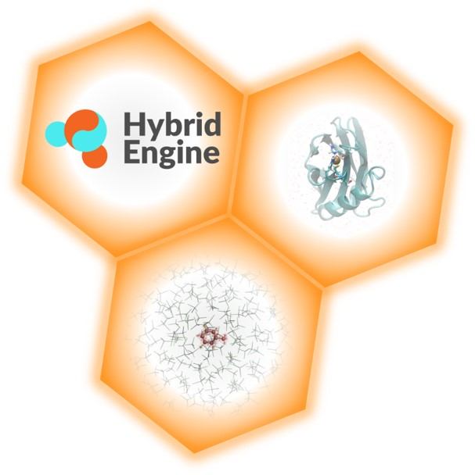
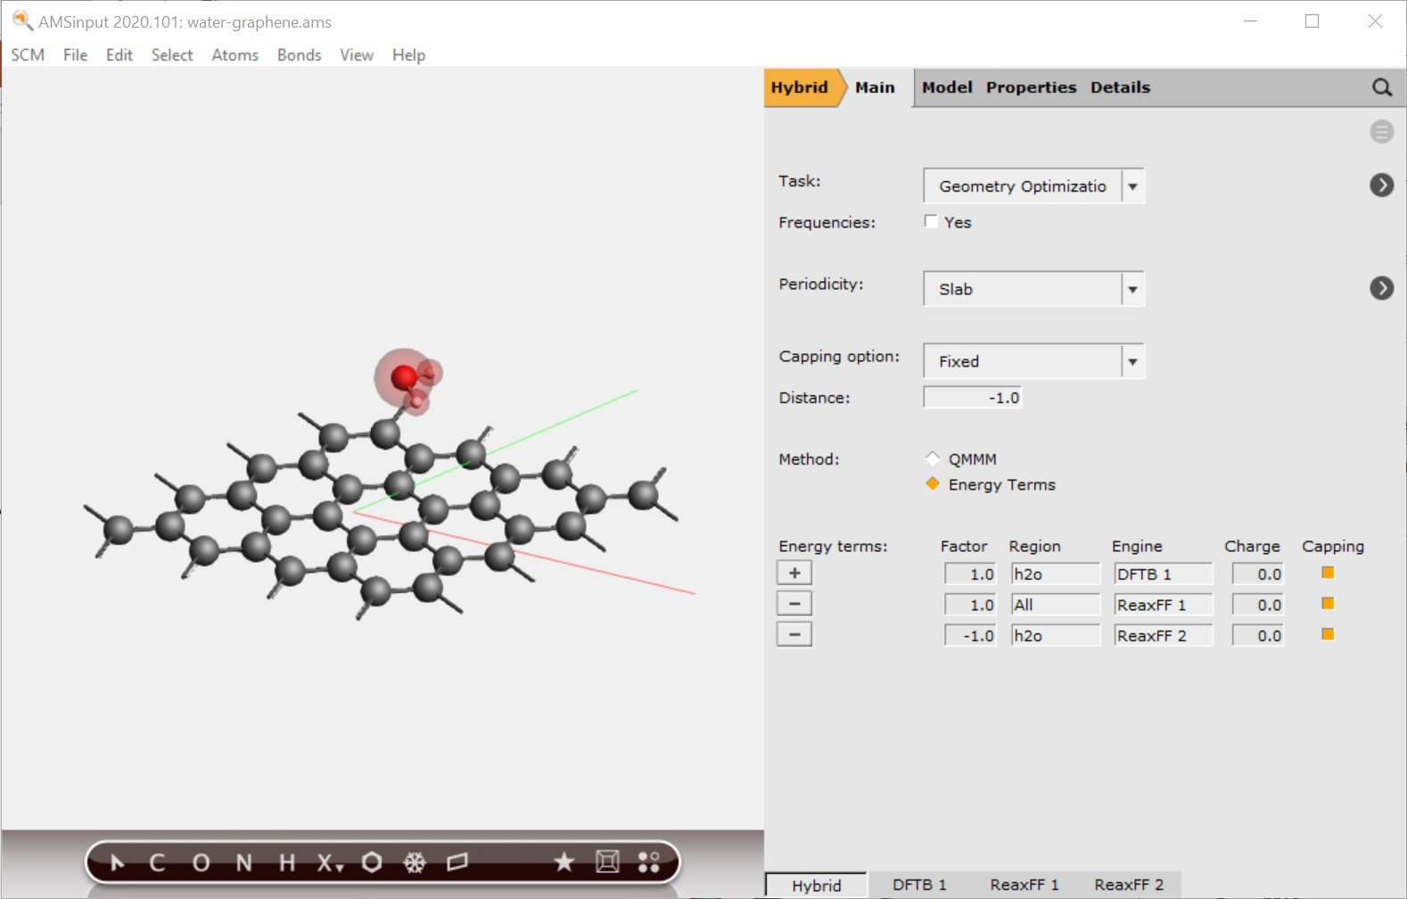
Hybrid Engine
Multi-layer (subtractive, QUILD, ONIOM)
combine any periodicity, number of layers, and QM or MM methods
2-layer: (additive) QM/MM
any periodicity
QM: ADF, DFTB, BAND, MM: Force Field engine
Demo video

Slide 7
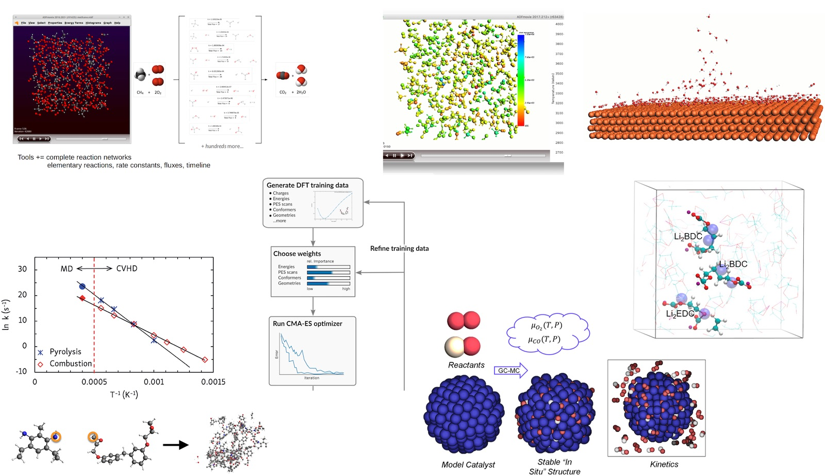
ReaxFF tools in Amsterdam Modeling Suite
ChemTraYzer: Automated rates & pathways
Analyze surface reactions
T-NEMD, local T:
heat transport
Molecule gun: depositing molecules on surfaces
eReaxFF: include e-
fbMC, CVHD, PRD: speed up kinetics
CMA-ES ReaxFF force field (re)parameterization
bond boost
build polymers
GCMC: speed up thermo

Slide 8
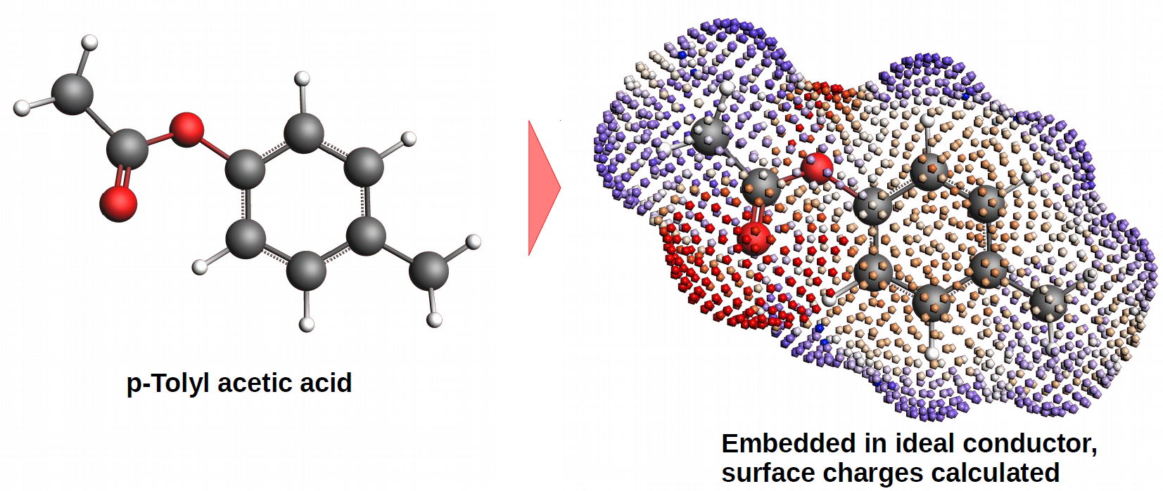
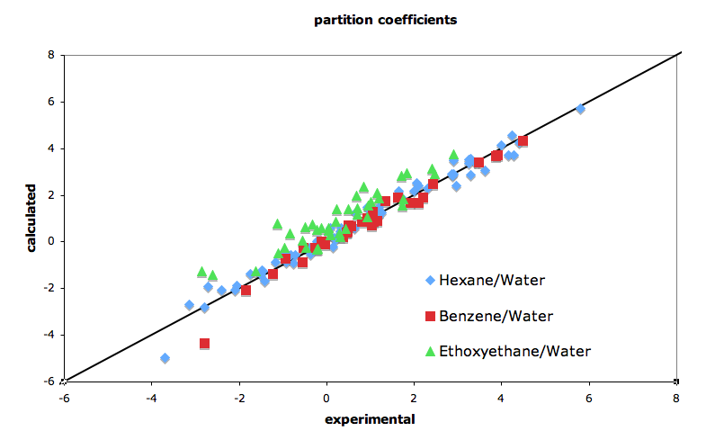
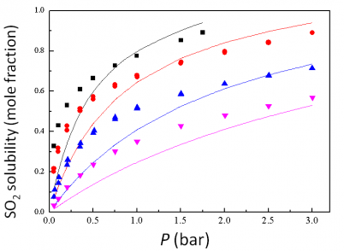
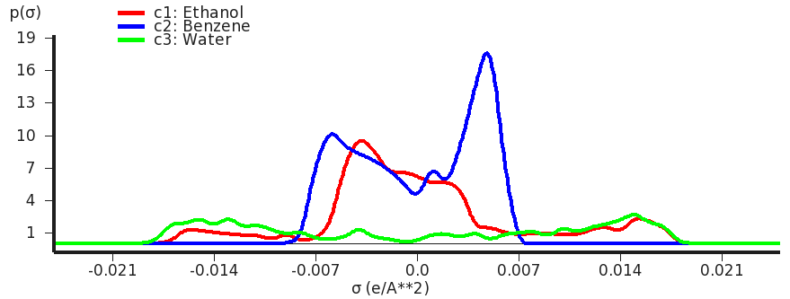
COSMO-RS/SAC: thermodynamic properties of fluids
Quantum Chemistry & QSPR for quick property predictions
COntinuum Solvation MOdel + RS (Klamt), SAC (Sandler)
chemical potential => activity coefficients => instantaneous properties
Solvation & excess energies, pKa
Solubilities, LLE, VLE, boiling points
Optimize mixtures: solubility, LLE
Polymers: Flory-Huggins X
QSPR & fast sigma: using SMILES
Sigma profile: 1D surface charge histogram

Slide 9
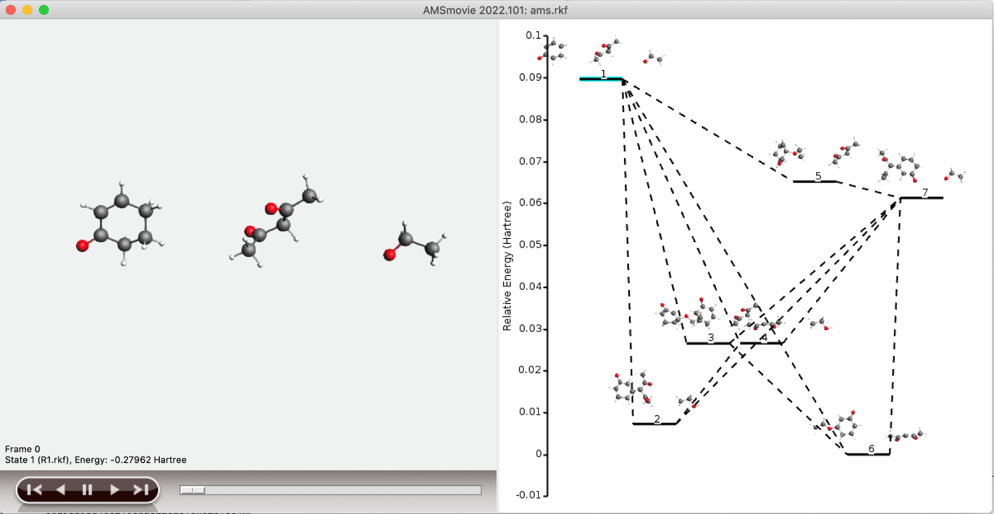
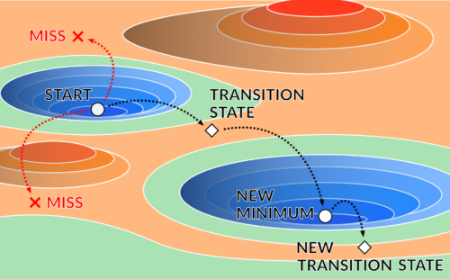
New in AMS2021+2: Parametrization, auto reaction pathways
Build training sets with AMS
Define cost function
Optimize parameters
Lennard-Jones
ReaxFF
DFTB
Future: …. ?
EON + ACE Reaction (Auto TS search)
Find reaction networks, minima, TSs
Refinement of TSs with higher-level
Determine and visualize binding sites
ChemTraYzer2: reaction rates + fluxes
kMC (interface to Zacros)

Slide 10
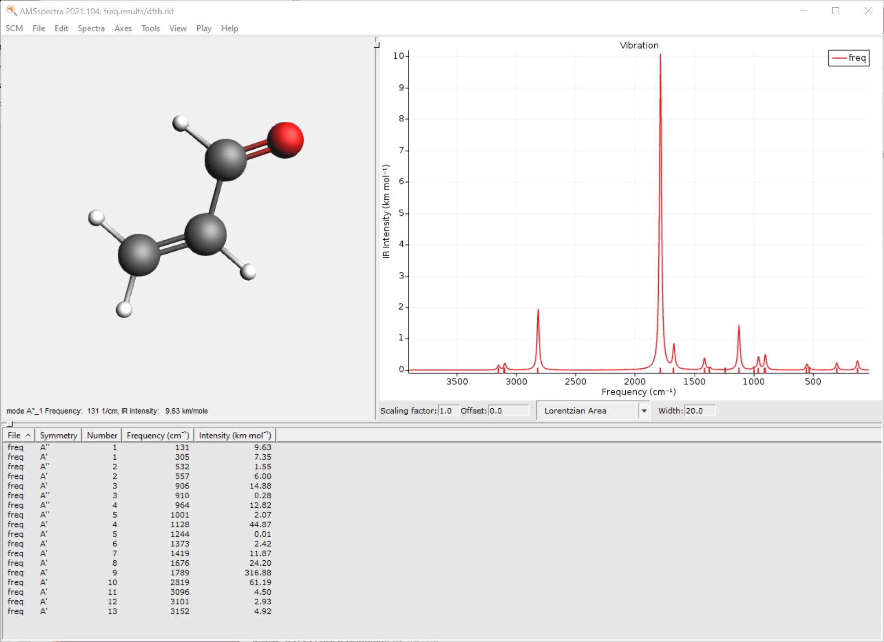
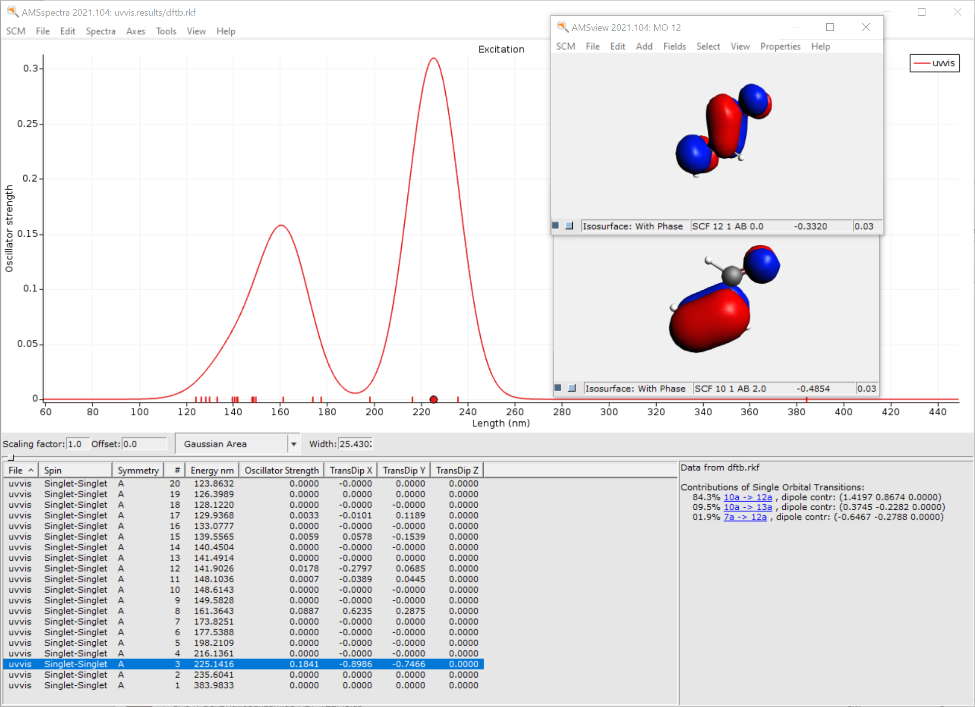
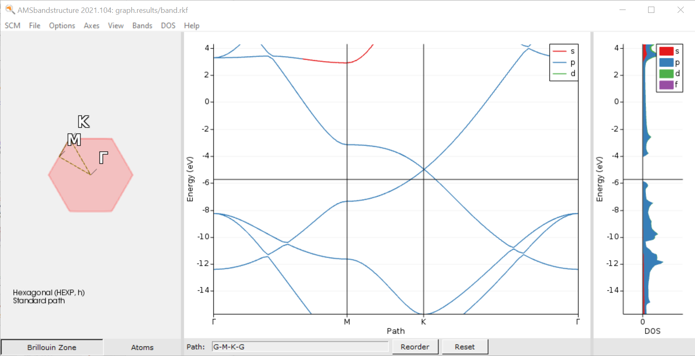
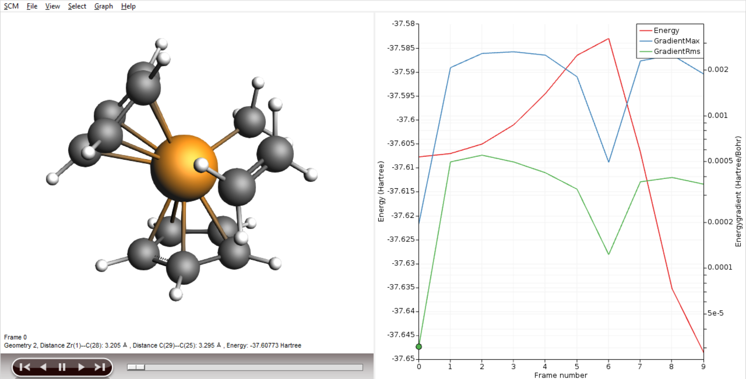
Demonstration, self-learning
Ziegler-Natta TS tutorial
Virtual winter school 2020 workshop

Slide 11
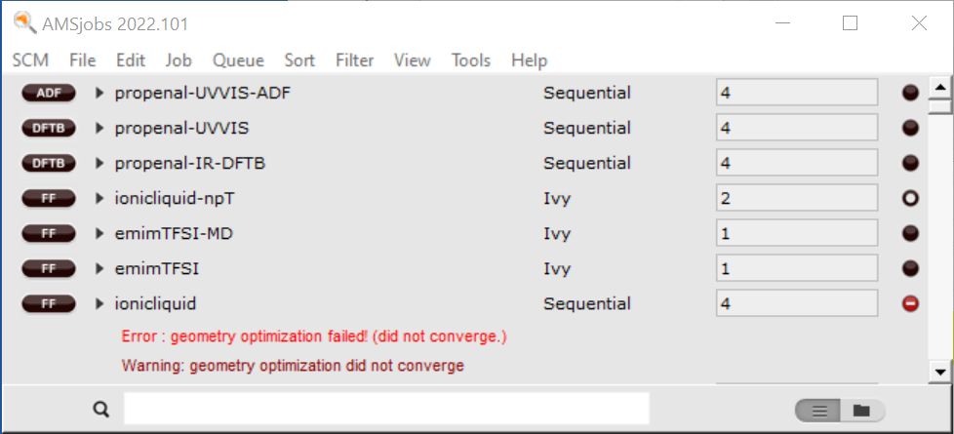
AMSjobs: job bookkeeping
switch GUI functionality
define & switch queues
change default
e.g. cores / nodes
see files for this job
reports & templates
queue
job status
search
all jobs / folder view

Slide 12
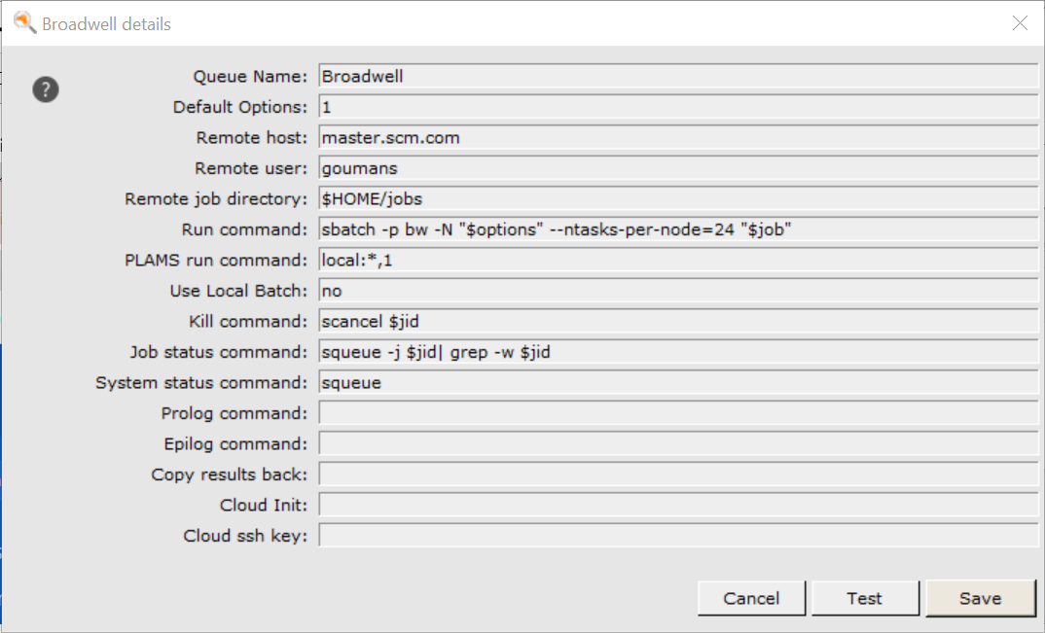
AMSjobs: remote queues
See AMSjobs,
Usually cores/nodes/hours
Scheduler command
Very old video: generate SSH keys and set up remote queues https://www.youtube.com/watch?v=Bh6Fo1Rg3nQ

Slide 13
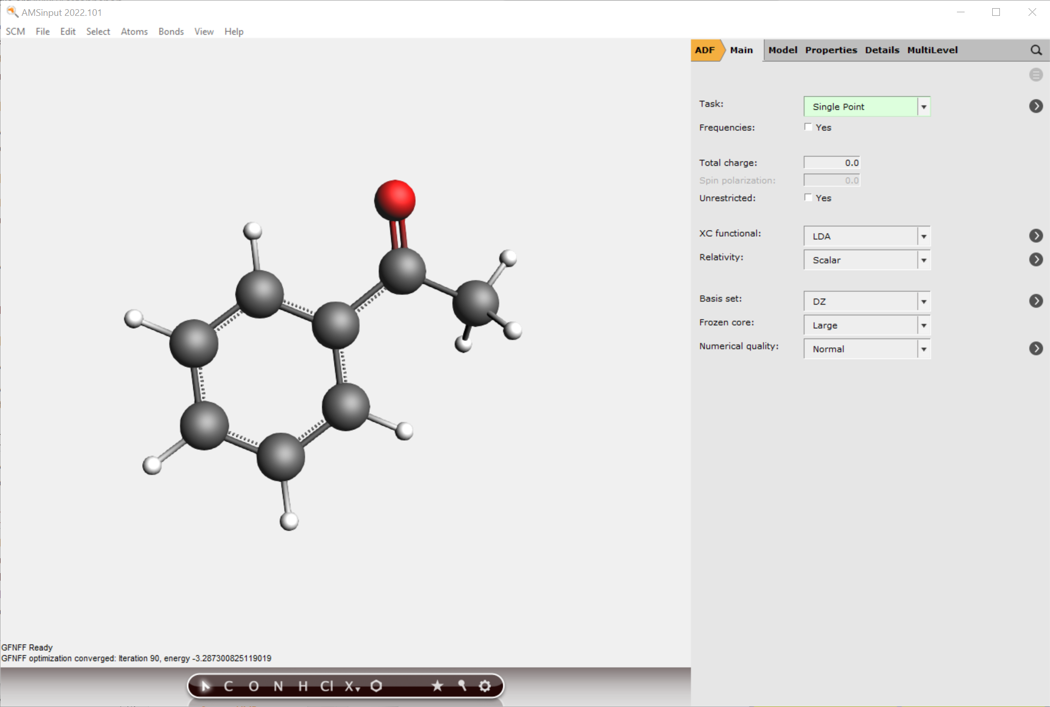
Basic calculations & settings
switch modules
job types & set up
search
job type
charge/spin
> = more details
functional &
relativistic appr
basis & numerical
accuracy
builder tools
preoptimize
UFF, GFN-FF, MOPAC, xTB, ANI-1ccx
Works also on selection only!
symmetryze

Slide 14
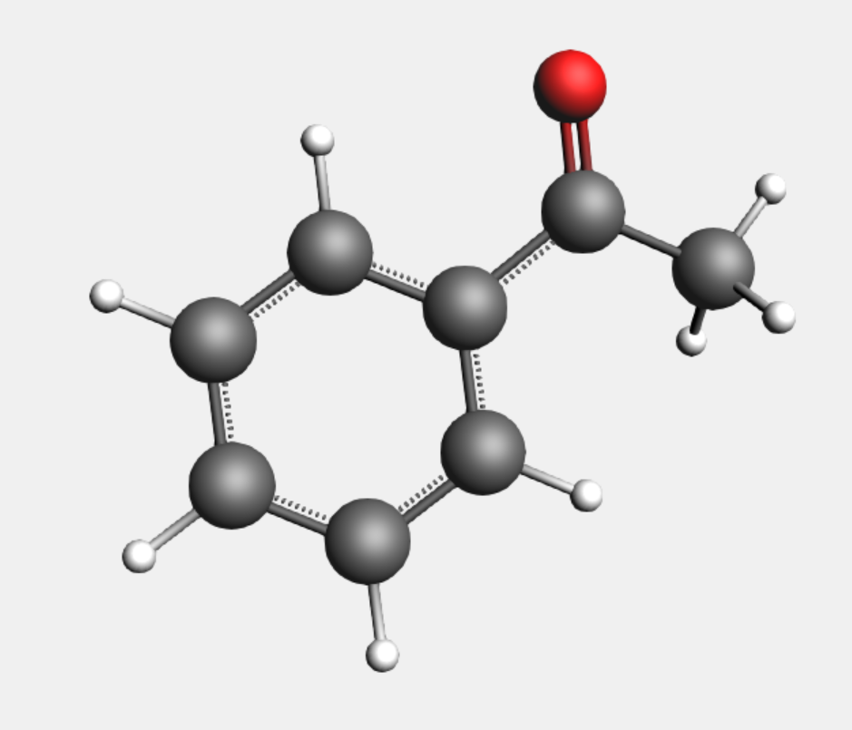
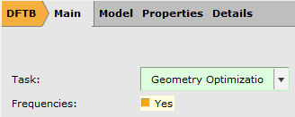
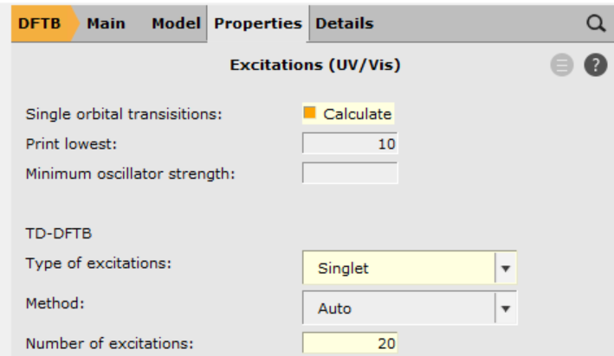
Building molecules, spectra
www.scm.com/doc/Tutorials/GUI_overview/Building_Molecules.html
Search molecules
Import: InChI, SMILES, xyz, cif, pdb, …
Included library + building
Find 3 ways to build acetophenone
IR frequencies (tutorial)
Geometry needs to be optimized at same level as frequency calc.
Try ADF, DFTB, MOPAC, MLPot, ...
SCM -> Spectra
UV/VIS FAQ for tips + links to tutorials
ADF: (s)TDDFT, (s)TDA, TD-DFT+TB
Visualize MOs Single Orbital Transition (ADF: also NTOs)
Compare to NIST (IR), NIST (UV/VIS)

Slide 15
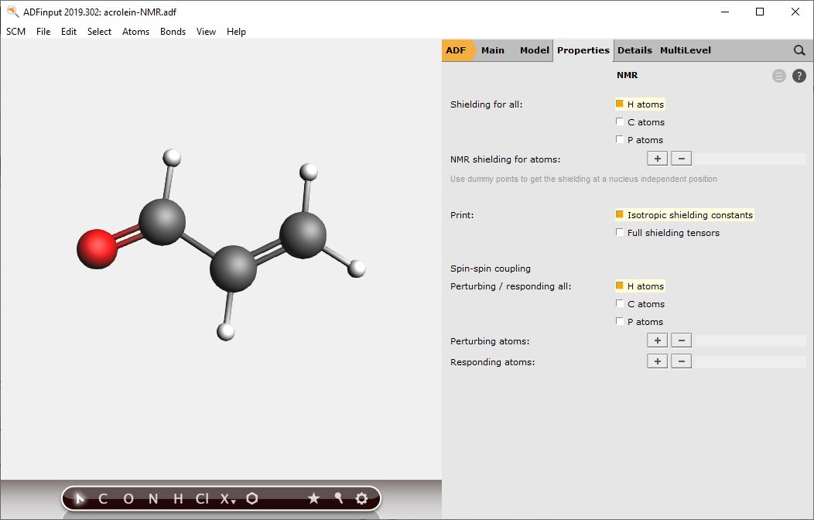
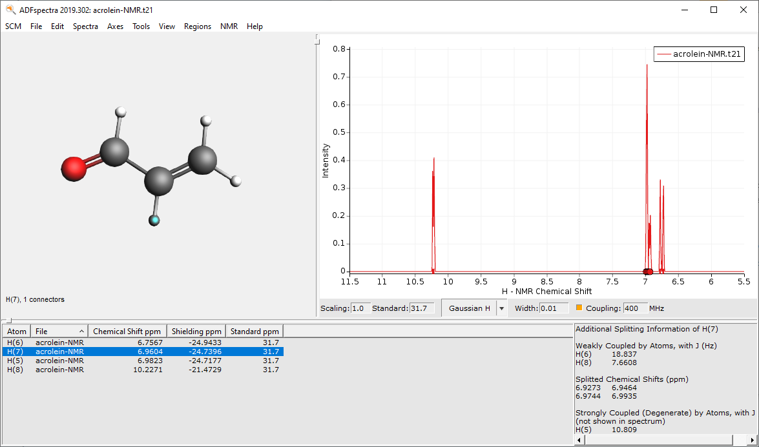
Spectra: NMR
Exercise: NMR spectrum acrolein
See also NMR FAQ for tips + advanced tutorials
Use PBE0 + TZP, Scalar, no core (.adf)
Select Properties -> NMR
select shielding & coupling for all H
Set 400 MHz and tick coupling, compare
Note the internal ref. uses different settings!
Recalculate TMS with same set up

Slide 16
Quick thermodynamic properties
Open SCM -> COSMO-RS (no need to install database)
In the SMILES input, put O=C(c1ccccc1)C (acetophenone) and Add
Properties -> Pure compound
Compare some properties (density, boiling point, flash point) (e.g. Wikipedia)
Property | c1 | Unit
Boiling point | 495.699 | K
Critical pressure | 40.244 | bar
Critical temperature | 619.99 | K
Critical volume | 0.377 | L/mol
Liquid density | 1.019 | kg/L
Dielectric constant | 5.768
Absolute entropy (ideal gas) | 366.735 | J/(mol K)
Flash point | 379.54 | K
Gibbs energy of formation (ideal gas) | 20.757 | kJ/mol
Net enthalpy of combustion | -3963.83 | kJ/mol
Std. state enthalpy of formation | -146.849 | kJ/mol
Enthalpy of fusion | 18.383 | kJ/mol
Enthalpy of formation (ideal gas) | -69.997 | kJ/mol
Enthalpy of sublimation | 68.697 | kJ/mol
Melting point | 301.8 | K
Liquid molar volume | 0.118 | L/mol
Parachor | 291.006
Solubility parameter | 10.41 | √(cal/cm^3)
Triple point temperature | 301.257 | K
Van der Waals area | 145.657 | Å²
Van der Waals volume | 115.395 | Å³

Slide 17
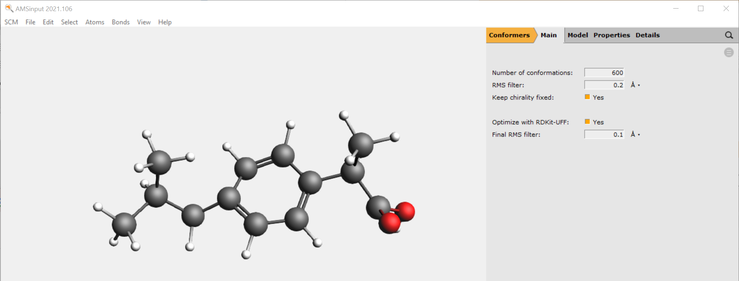
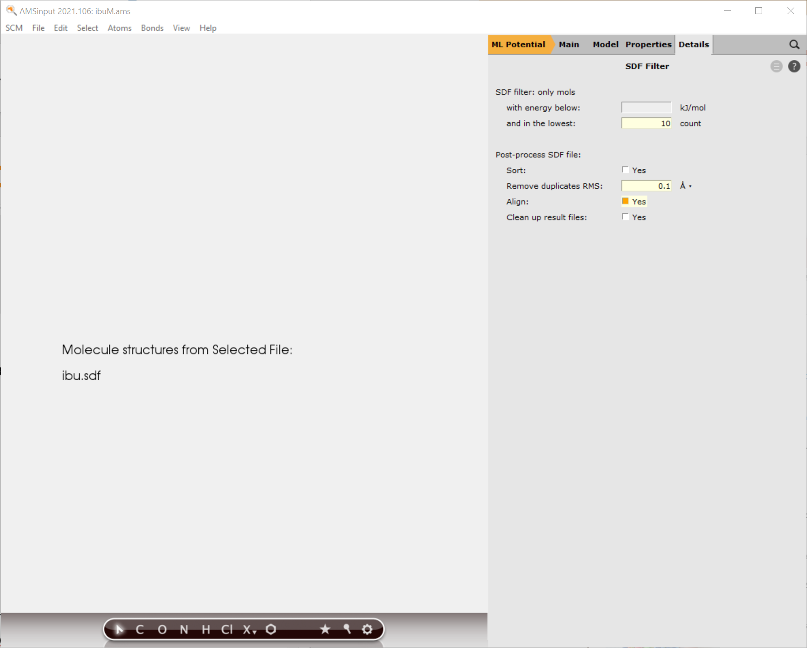
ML Potentials: conformers
Import ibuprofen SMILES
Switch to Conformers, Run, Movie
Switch to ML Potential, choose ANI-1ccx
Model -> Coordinates | Use: -> Selected File
Select the .sdf from the previous job
Click on > to go to Details->SDF Filter
Lowest 10 count, align & remove dups (0.1A)
(Do you want to re-sort on Energy?)

Slide 18
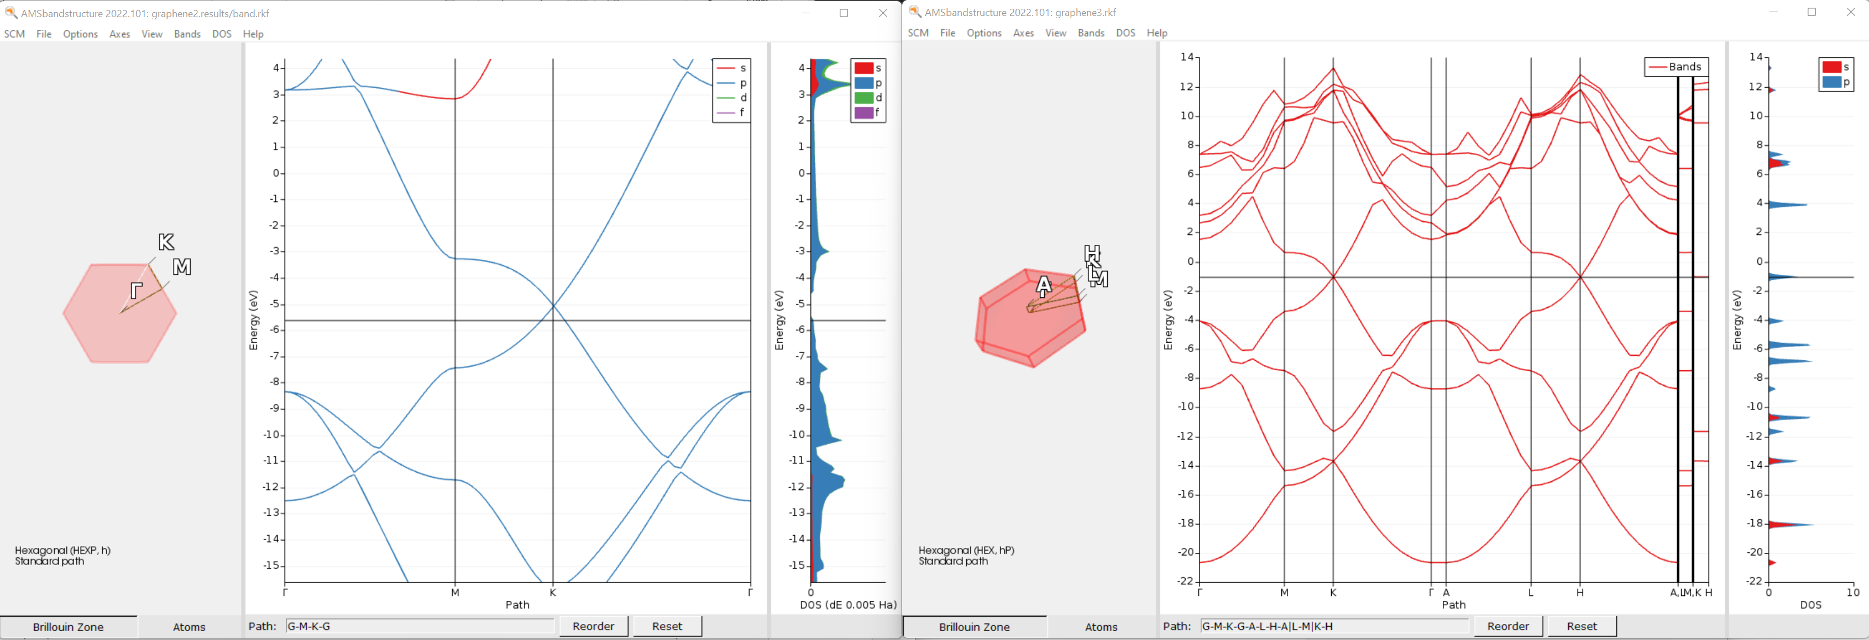
Periodic DFT(B) calculations
Import cif, periodic pdb/xyz, use structure builder
Run graphene 2D with BAND and DFTB
3D with QE (think about z lattice vector, and reorder the visualization path!)
You can reorder the path to sample only 2D (G-M-K-G)
2D with BAND
3D with Quantum ESPRESSO

Slide 19
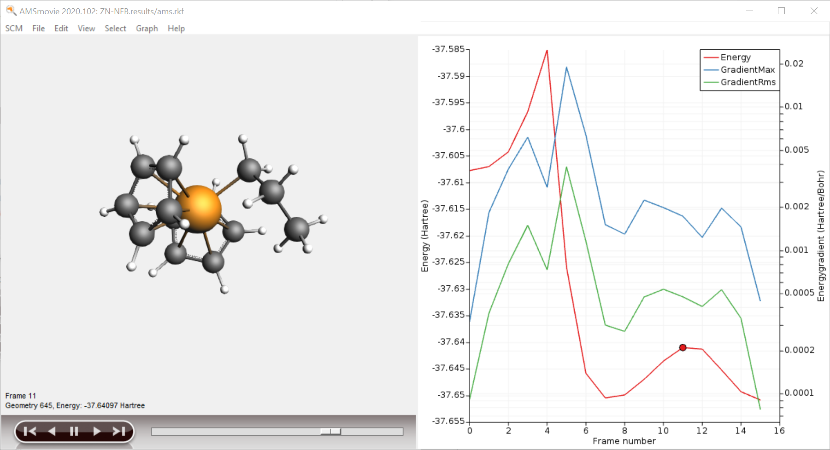
Transition States: Tips & Tricks

Slide 20
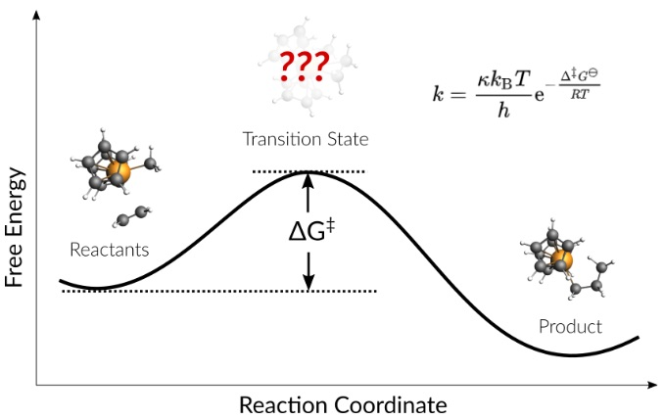
Pointers & ideas for TS search
Good starting point (geometry close to TS)
First explore reactant and product
(Initially) use low convergence criteria
Scan the PES with MOPAC or GFNx-TB
Sometimes scanning from product side is easier
Can use complex composite scan coordinates
Use CI-NEB (tutorial)
Always a good idea to explore Reactants
Pass on coordinates (+Hessian) to ADF
Previous TS ‘similar’ system
Consider first doing constrained/partial optimization
Good description of the curvature: lowest Hessian eigenmode(s)
Partial Hessian
Low-level Hessian from previous, ADF choose ‘Calculate With Fast Engine’
TSRC: define (complex) reaction coordinate
Consider ‘TS point characterization’ to check only 1 negative eigenmode
Automated reaction path search (Thomas, tutorial)
Accuracy?
Solvent effects: COSMO and/or SM12 (single point only), COSMO-RS
metaGGA? TZP/DZP? Good numerical quality?
Double hybrids (single point)
Low-eigenmode corrections to frequencies
Sometime spurious 2nd imaginary modes are hard to get rid of -> ScanFreq
Video

Slide 21
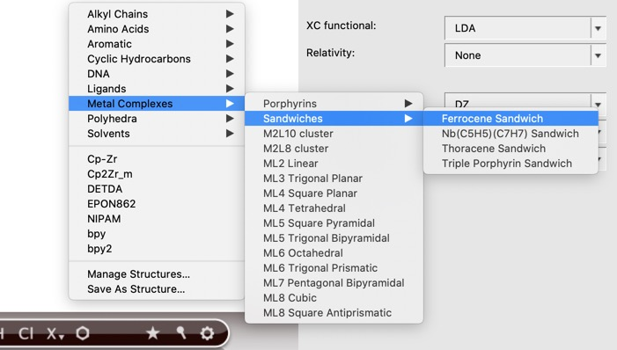
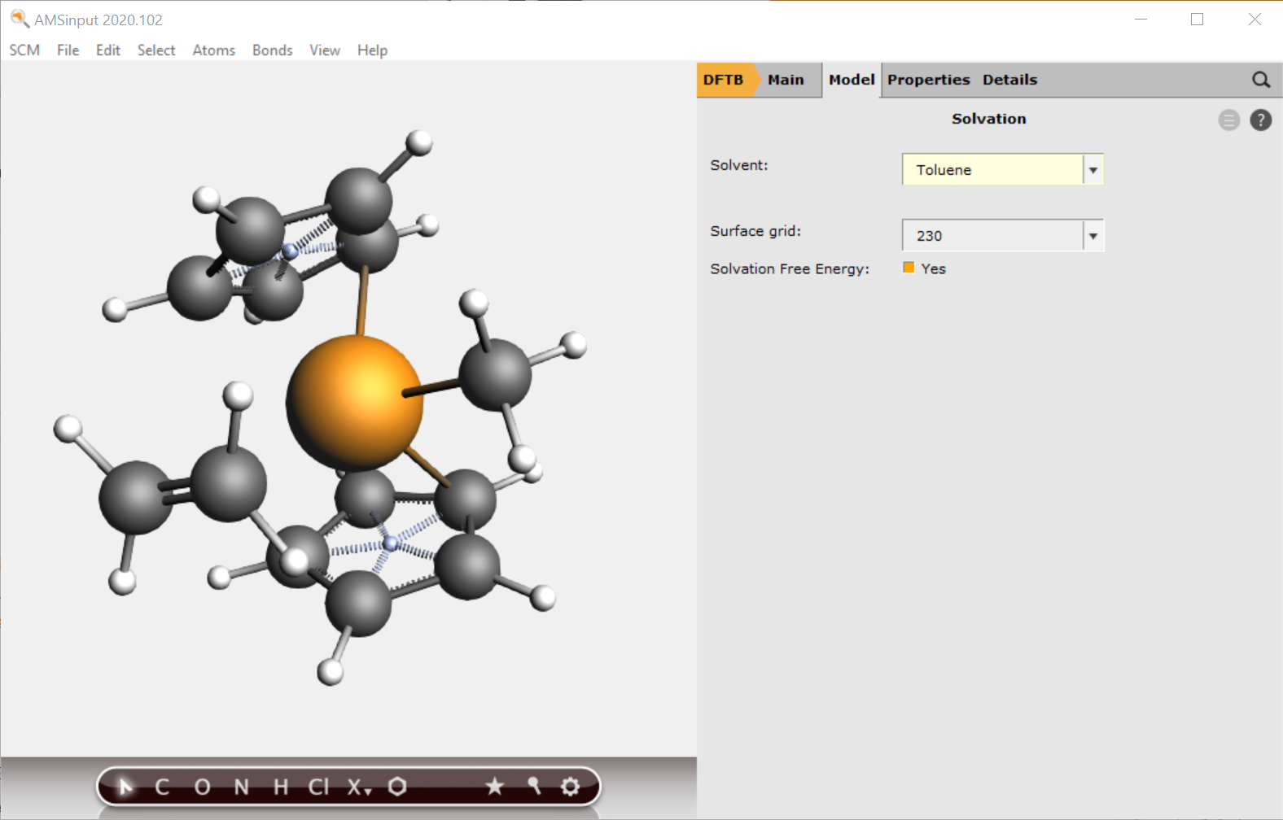
Transition State through PES scan
Exercise (Ziegler-Natta tutorial):
New DFTB input
Build Cp₂ZrMe⁺
structure tool => ferrocene
Right-click Fe -> Element -> Zr
Add C and replace by methyl
(Use dummies to change CpMCp angle)
Model -> Solvent -> Toluene
Add charge and optimize
Add ethene (use the )
Manipulate it in position
Right-click + drag = translate
Left-click + drag = rotate
Ctrl+M = select molecule
Remove dummies
Optimize

Slide 22
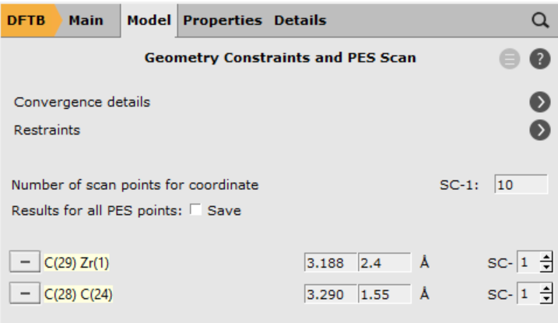
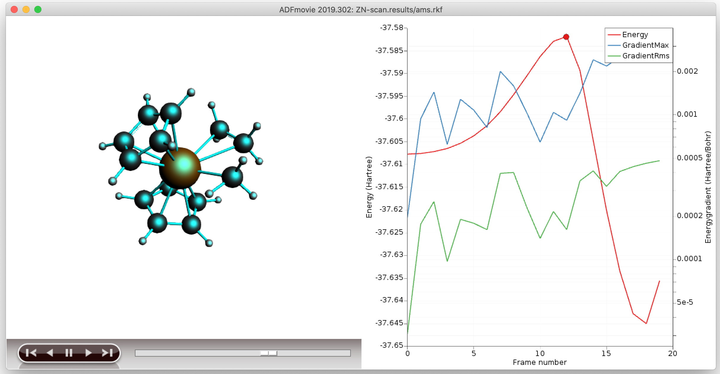
Transition State through PES scan
Set up a PES scan, using 1 combined scan coordinate
Zr-C to 2.4 & C-C to 1.55
Details -> Geometry Optimization:
Loosen the Convergence criteria by a factor of 5
Run, and when finished, open AMSMovie
Copy the highest energy structure (e.g. Ctrl+U), or save as structure
Set up a TS run (ideally make a new input)
make sure there are no constraints, and regular convergence
use a calculate Hessian as initial guess and calculate frequencies

Slide 23
Transition State, start with NEB - Ziegler-Natta
Exercise:
Optimize reactant & product from the last PES scan points
Rotate the Zr-C-C-H dihedral to ~0 (metallacycle Zr-C-C-H) & optimize => alpha-agostic
Set up a climbing nudged elastic band calculation Task: NEB
Choose this structure as final, the other product as intermediate, and R as initial (import structures from results/ams.rkf) and choose 14 points
Don’t optimize R&P, relax convergence by factor 5
Open AMSMovie when finished
Which is the rate-determining step?
Tip: use CI-NEB to get close enough to TS, use Hessian-based optimization to find it

Slide 24
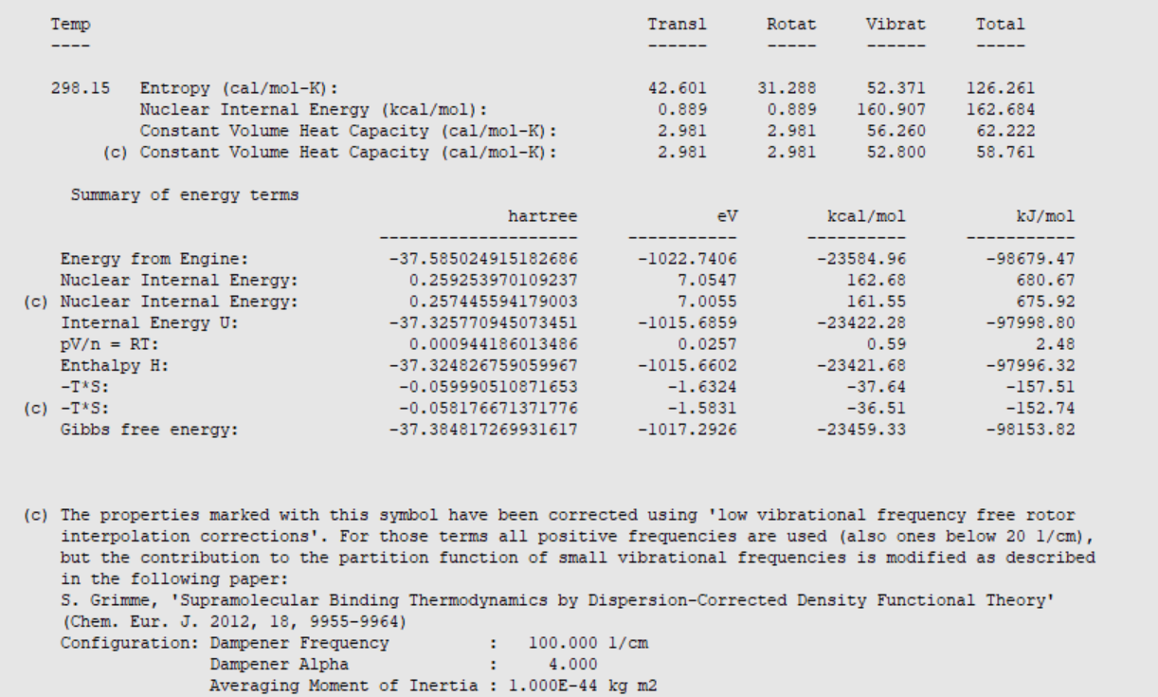
Transition States: Further considerations
Reaction rates:
Calculate ΔG#: include H_{vib}, S (AMSoutput -> Other Properties -> Statistical Thermal Analysis)
hTST as first approximation: k ~ exp (-G#/RT), Low-level frequencies: Grimme corrections
Could also try mircokinetics. More underway (ReaxPro)
Suggestions & troubleshooting
get close to TS: NEB, PES Scan, constrained opt, previous TS + change ligands (PLAMS script!), ….
get a good curvature (Hessian): pre-calc with GFN-xTB, MOPAC; partial Hessian
check final curvature / path: Frequency calculation, PES point characterization, IRC
Spurious imag. Freq.: displace along that mode (AMSSpectra, Ctrl+8 *5) & retry

Slide 25
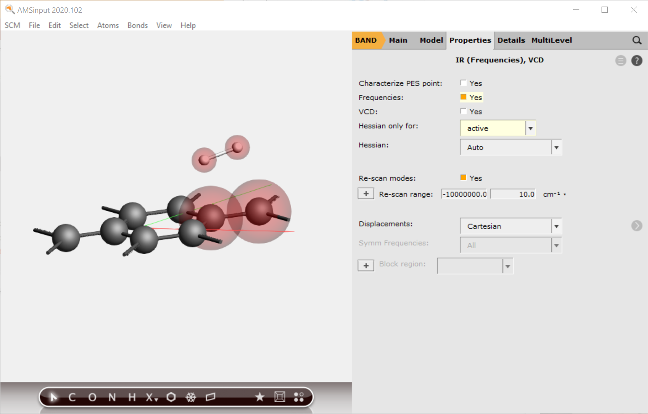
Periodic systems: surfaces & bulk
How to get good TS geometry guess?
Literature or previous results:
similar TS + constrained optimization
Quick (?) NEB (you want to find R & P anyway)
PES scan (can you use ReaxFF, MOPAC, GFN-xTB? Otherwise: cheaper DFT?) (video)
Maybe you can get away with periodic DFT/DFTB (video) or DFT/MM ?
How to get good guess for lowest few Hessian eigenmodes?
Could try MOPAC or DFTB Hessian
Inspect modes first?
Define reaction coordinate (TSRC)
Use a partial Hessian (‘active’ region)
Video

Slide 26
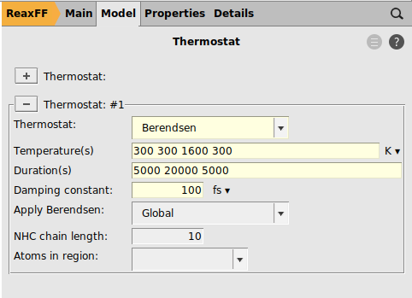
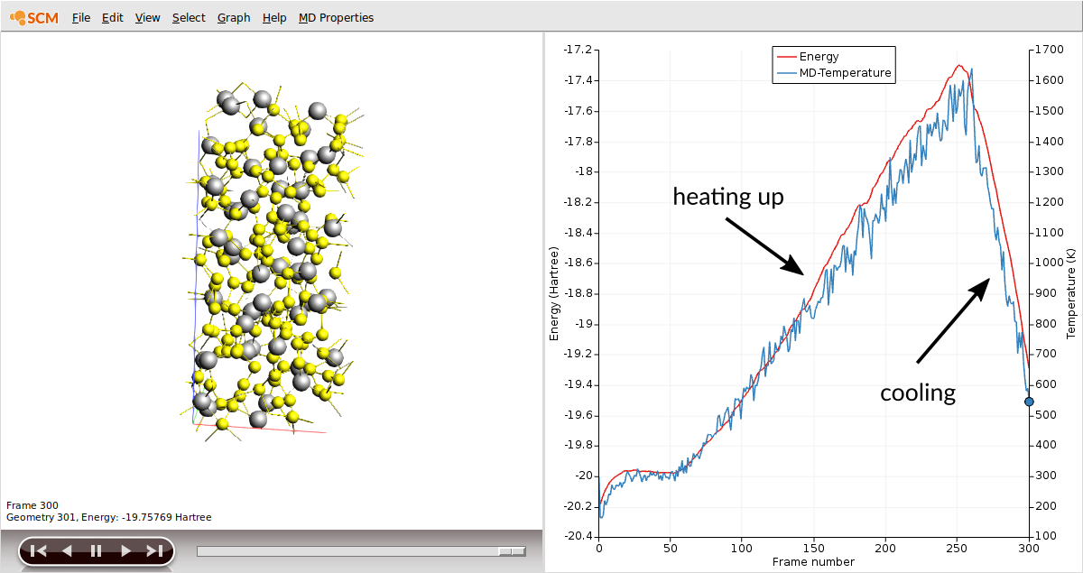
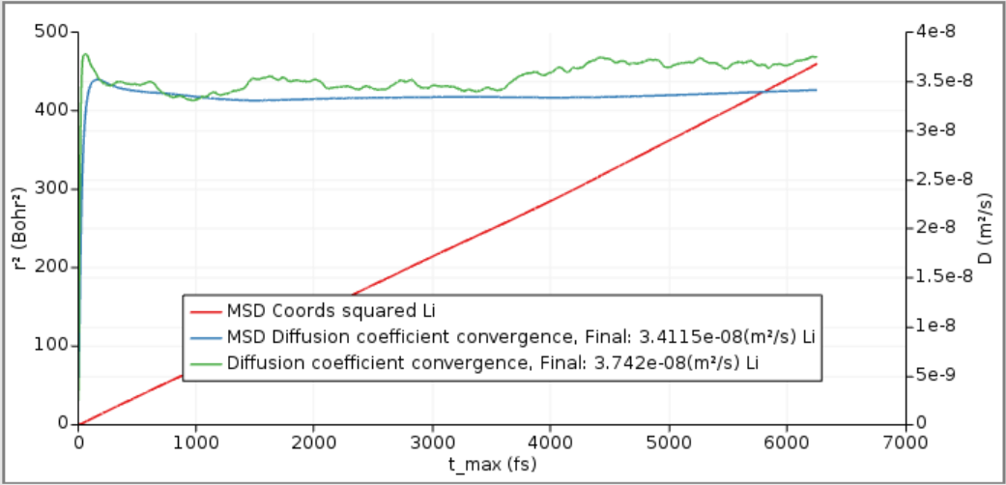
ReaxFF: Li diffusion (tutorial)
Switch to Reaxff, import S8 cif, make Li atom, save as Li.xyz
Edit->Builder, Fill with 51 Li.xyz, distance 1.0A (notice GCMC is better!)
Optimize + lattice with LiS.ff, followed by simulated annealing after annealing, reoptimize (+lattice)
MD with sample frequency 5 at 1600K
Plot MSD and D via VACF
See tutorial for more tips
Extrapolate T from Arrhenius

