Slide 1
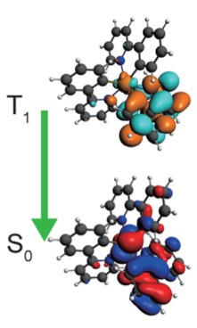
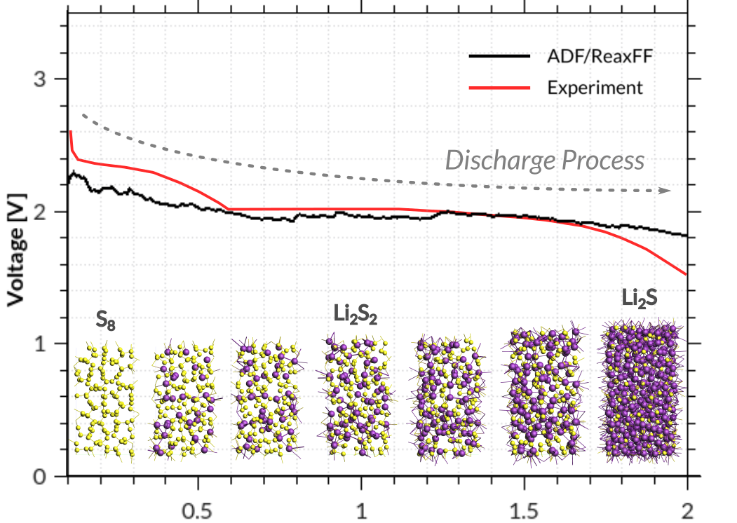
Amsterdam Modeling Suite Accelerating Chemistry & Materials Research
Fedor Goumans, Chief Customer Officer, goumans@scm.com
Seminar / workshop with T&J, Seoul, 19 October 2023 www.scm.com/Korea23
Notes:
None of you needs further convincing that we need new, better-performing materials to help tackle our societal challenges, in particular related to food, water, and energy. We need new materials and processes to capture and store energy, to desalinate and clean water, to more efficiently and sustainably produce food, and to recycle plastics and precious metals. And we need those new materials & processes quickly.
I’m Fedor Goumans, Chief Customer Officer with Software for Chemistry and Materials. I will talk to you about our ongoing efforts in developing atomistic methods to understand and predict molecules, materials, and processes; where we envision accelerating them through artificial intellegence; why linking to the macro-scale is important, and in general an wholistic view of where amalgation of existing and emerging digitial technologies can help accelerate new materials discovery.

Slide 2
Program
Motivation, history, background SCM & intro Amsterdam Modeling Suite
Parametrization of ReaxFF and DFTB with ParAMS
Modeling OLED materials
accurate ionization potentials, electron affinities, and UV/VIS with GW+BSE
multiscale device-level modeling
Modeling battery materials
Redox potentials with DFTB, ADF & COSMO-RS
Diffusion barriers with the new M3GNet universal ML potential
Reaction discovery tools
Other new and upcoming developments in AMS
Active learning (on-the-fly ML potentials)
Files, slides, available to download from: www.scm.com/Korea23

Slide 3
New materials discovery too slow
8-19 years to develop materials solutions in new markets
80-85% R&D programs fail
>50% R&D spending only incremental improvement
Catch 22: slow discovery ⬄ few new materials
https://www.mckinsey.com/industries/chemicals/our-insights/chemical-innovation-an-investment-for-the-ages
Simulations -> predict new materials
Robots -> make new materials
AI -> improve simulations and DOE
the Matter Lab - Aspuru-Guzik
Notes:
As you’ve heard, traditional R&D for new materials is too slow. It takes some dozen years to develop materials solutions in new markets, because most programs fail, and if they succeed, more often than not, only lead to incremental improvement. The Catch-22 is that since so little new materials are being discovered, only very few new materials are being made. To break this status quo, simulations can help navigate through material space and predict the most promising new materials which can then be made and tested.
This really comes to fruition if we can make a continuous upward cycle by incorporating robots to make and test the predict materials, and ideally improve the speed and quality of predictions by including AI full circle.

Slide 4
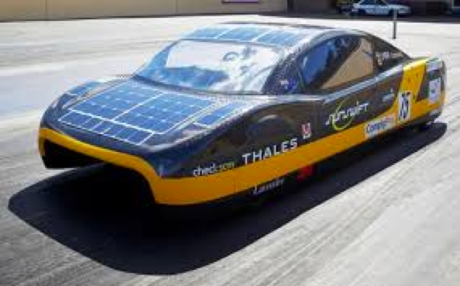
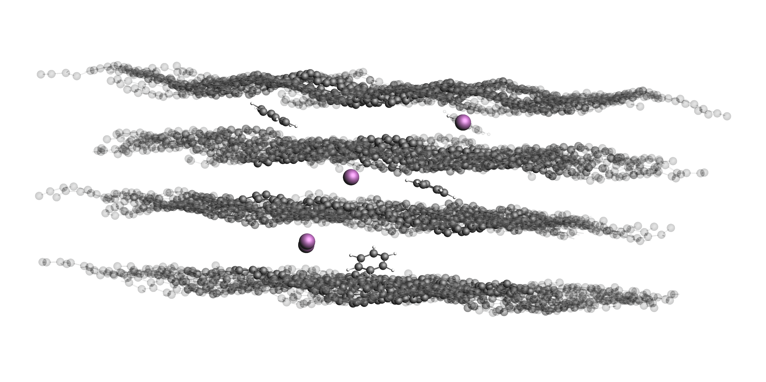
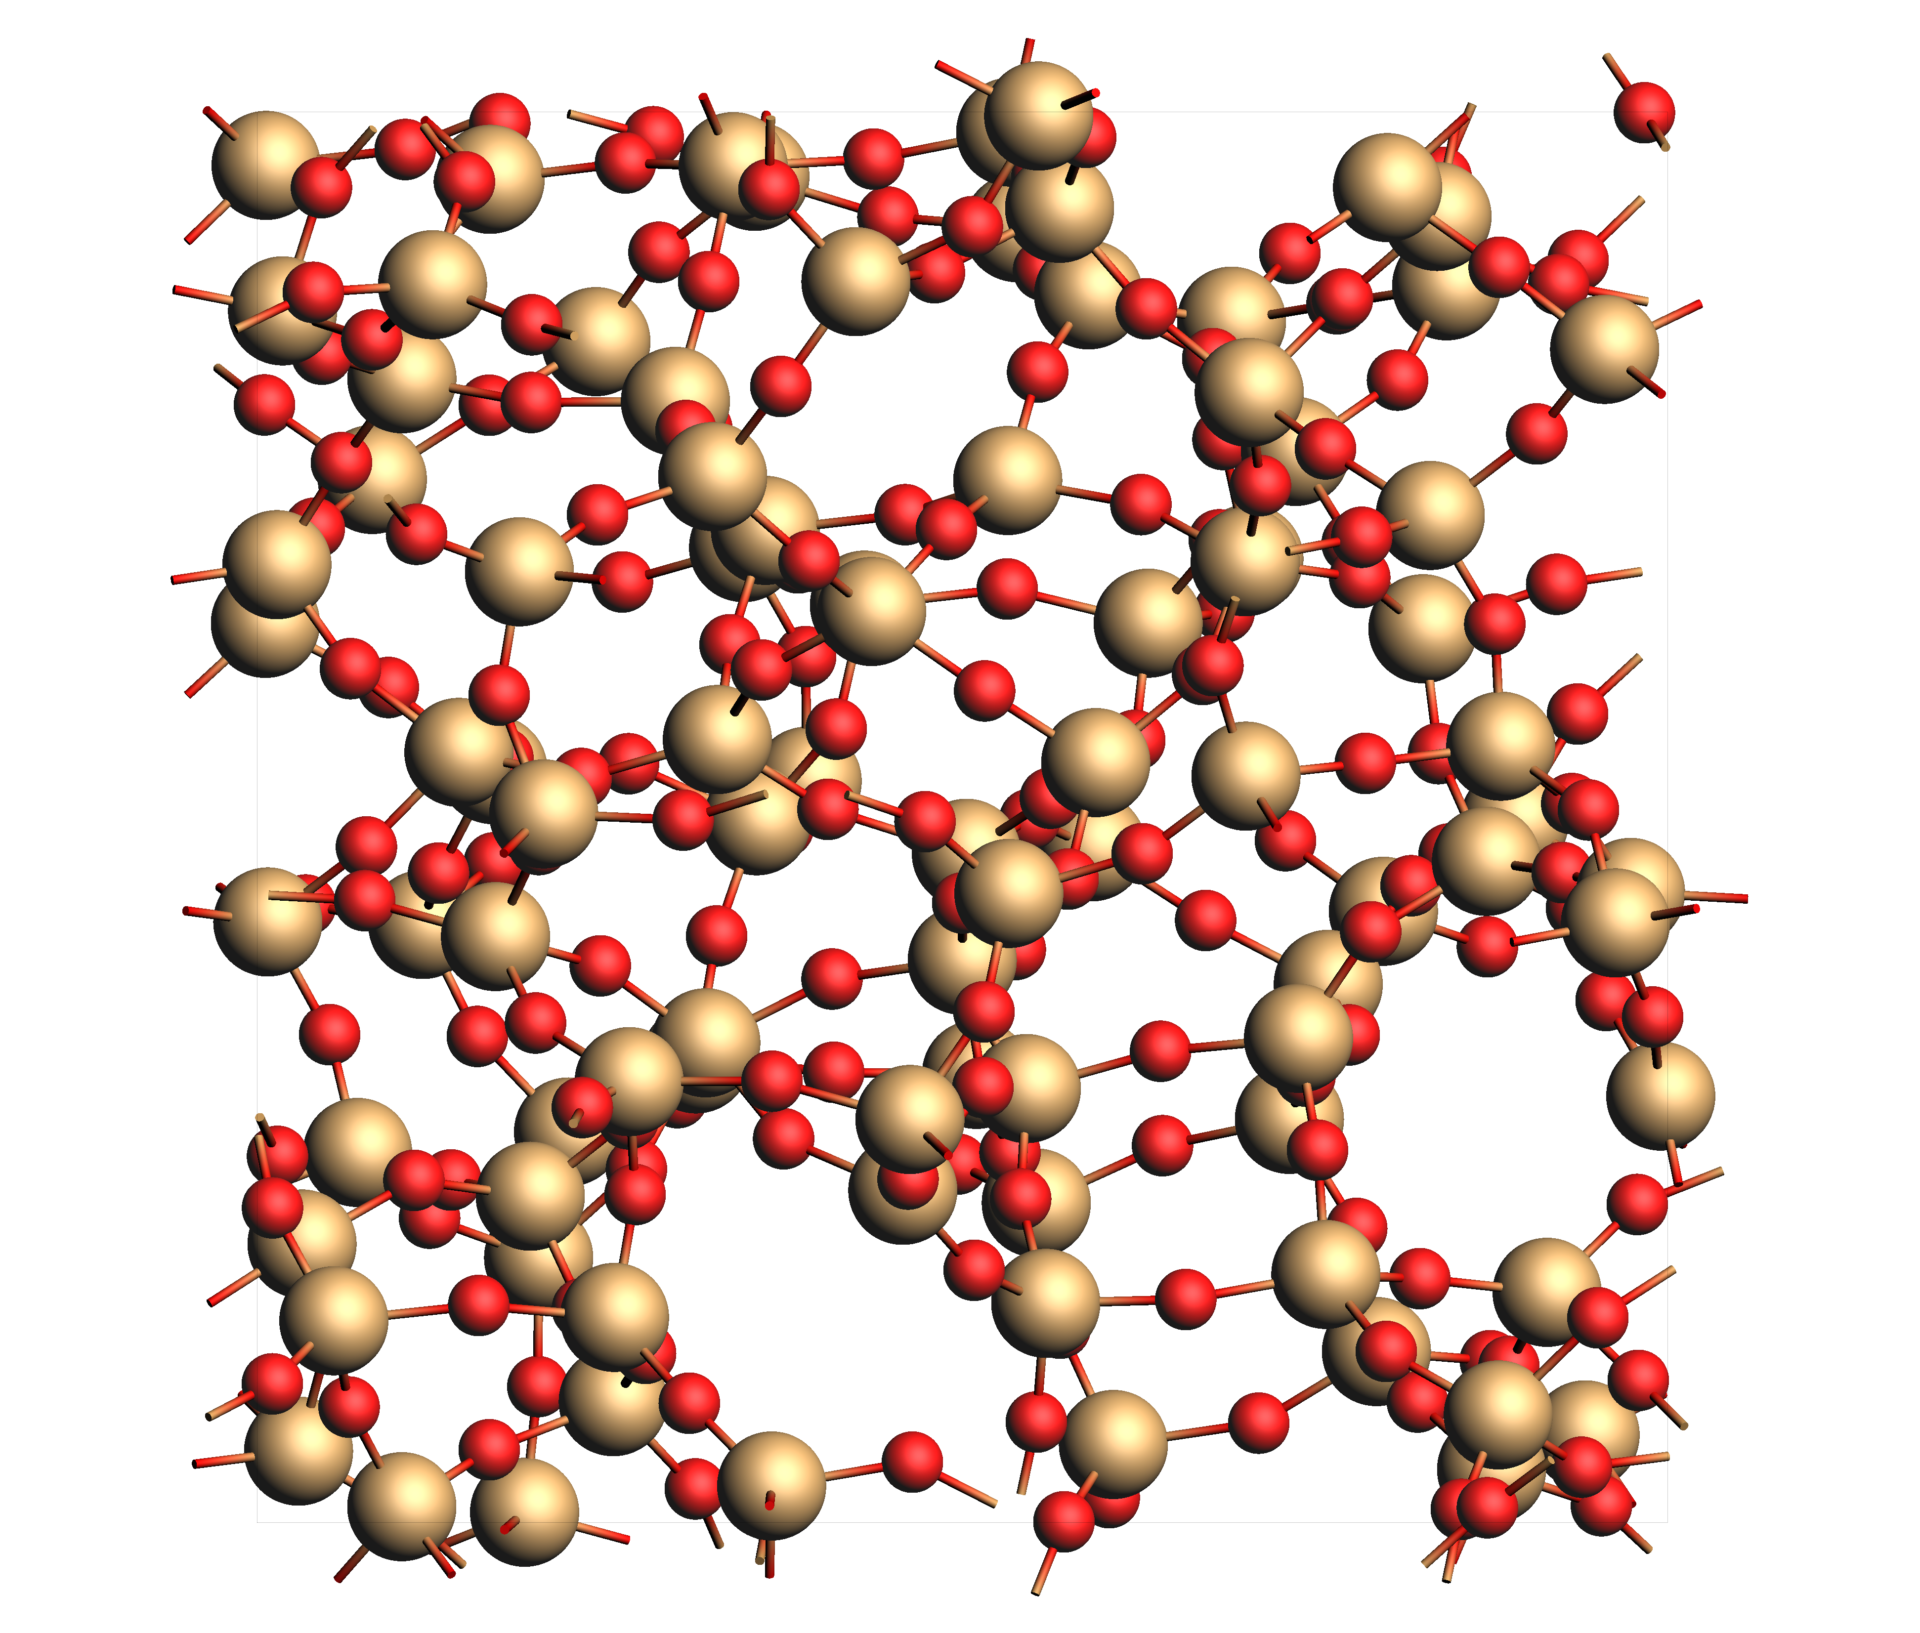
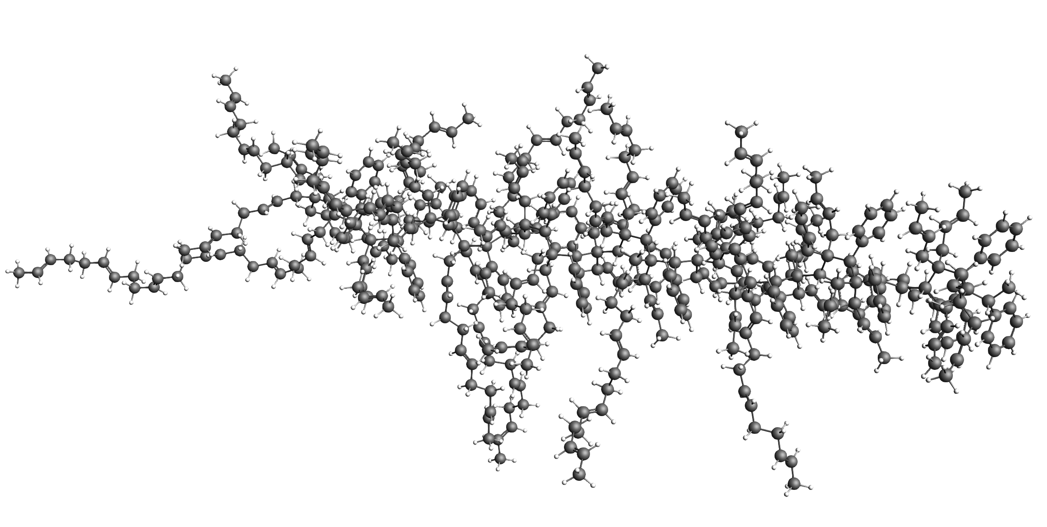
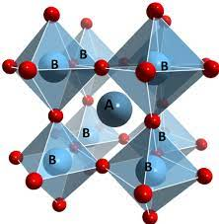
Bottom up Property Prediction
Properties are determined at the atomistic level => predict, understand & improve through modeling
Batteries: fast recharge, high capacity
Chassis: light & durable, coating
Glass: optical properties, electronics
Tires: Reduce wear &friction
Solar cells: long lifetime & high efficiency
Notes:
Ultimately, the property of any material is dictated by what’s happening at the atomistic level, including the materials’ behavior in, say, a battery or a chemical reactor. So while through atomistic simulations you can more quickly select individual molecules or materials with the desired properties, however, one should take into account how it interacts in the grand scheme of things, in which what I’ll call the device level for now.
While we can model all we want, eventually the only real test if the device made out of the materials works as intended. We can and should use that as feedback for improved atomistic and multi-scale modeling.

Slide 5
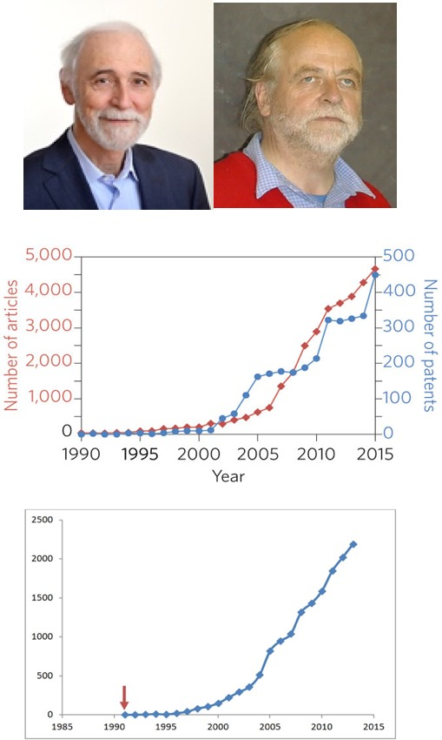
Background: SCM, ADF & AMS
ADF: first DFT code to understand chemistry (1970s)
Baerends@VU (>’73), Ziegler@Calgary(+) (>’75)
1980s: support from Mitsui, Shell, Akzo, Unilever
SCM: Spin-off company 1995
2010s: DFTB, ReaxFF, COSMO-RS (Albemarle, DSM)
2019: Multi-scale: ReaxPro (BASF, Dow, Shell, JM)
29 people (21 senior PhD’s) + 2 EU fellows
Many academic collaborators & EU networks
SCM: development, debug, port, optimize, & support
articles &patents in materials science with
“density functional theory”, Nat. Mat. 4619
Papers with
“DFT and Chemistry”

Slide 6
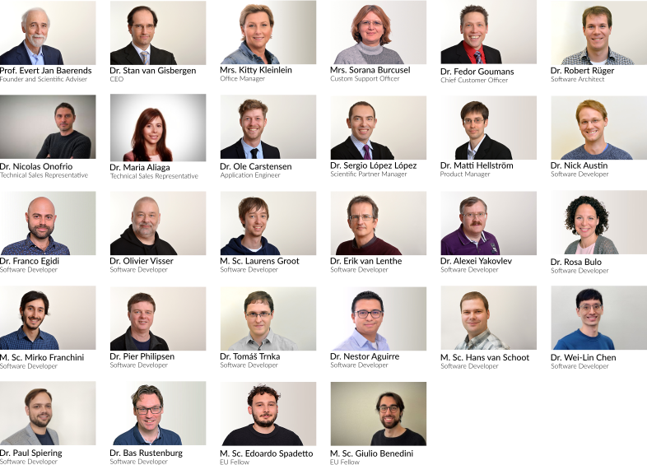
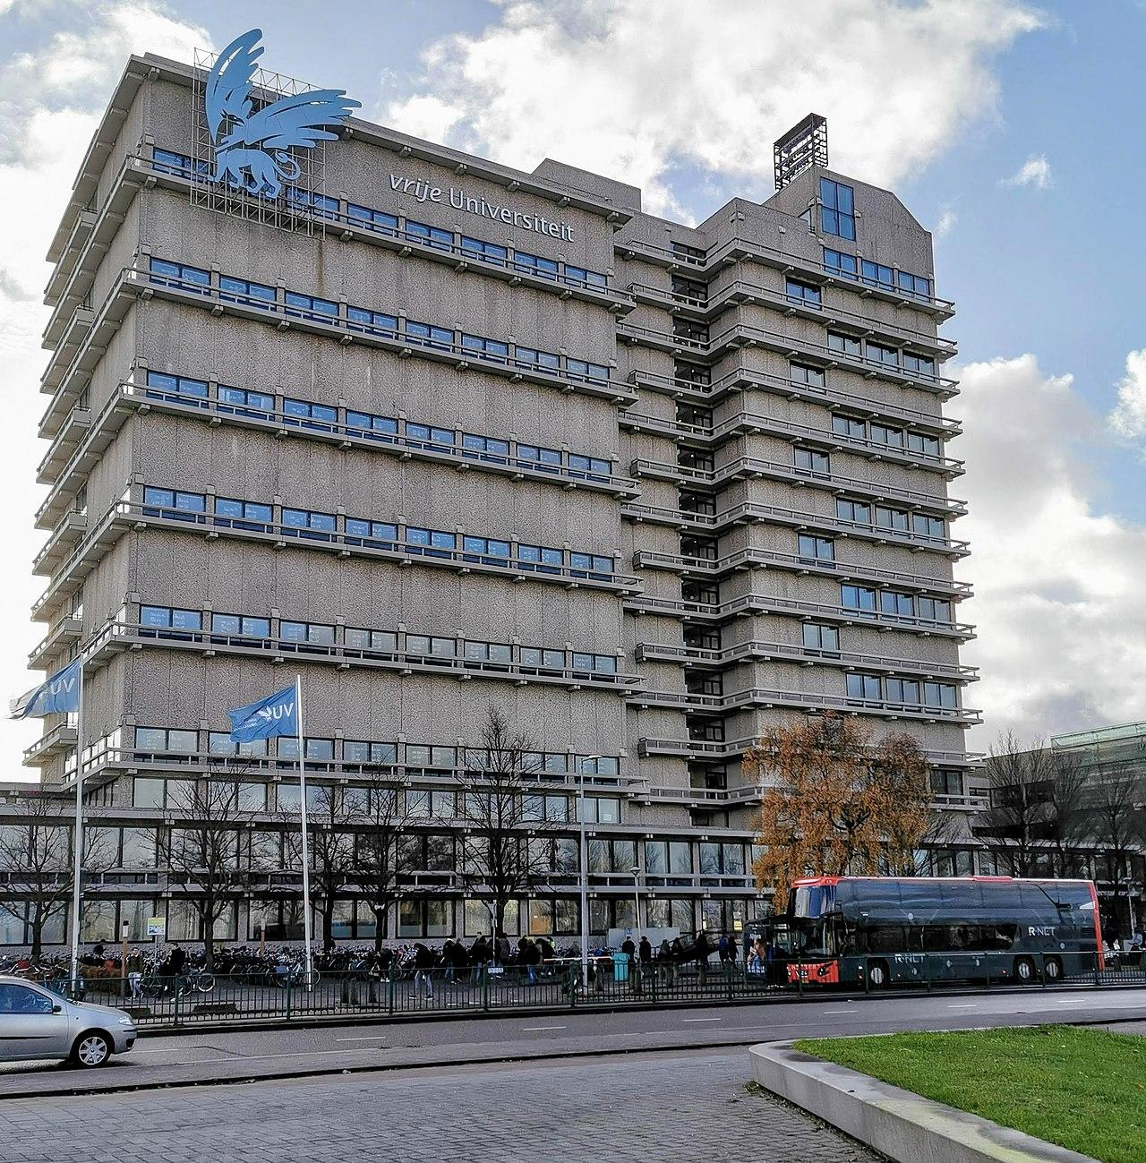
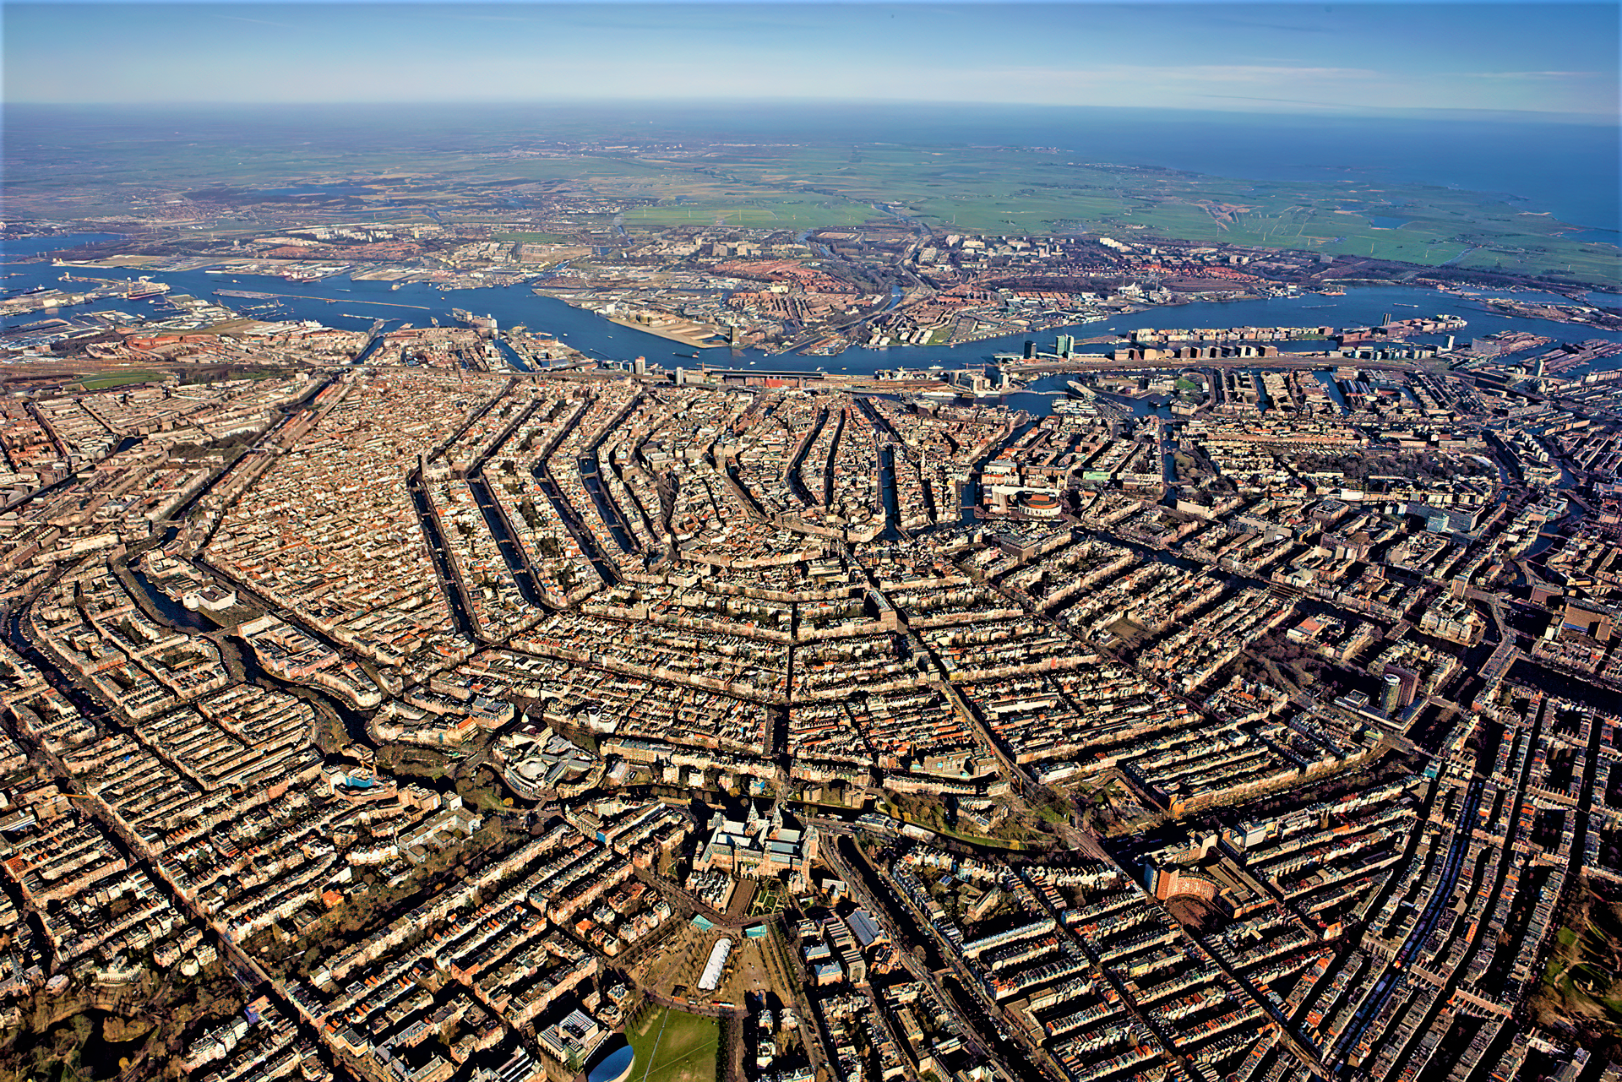
The SCM team in Amsterdam
Notes:
Strong points AMS: DFT, semi-empirical and reactive FF in 1 Suite, with 1 integrated GUI, (python) scripting tools

Slide 7
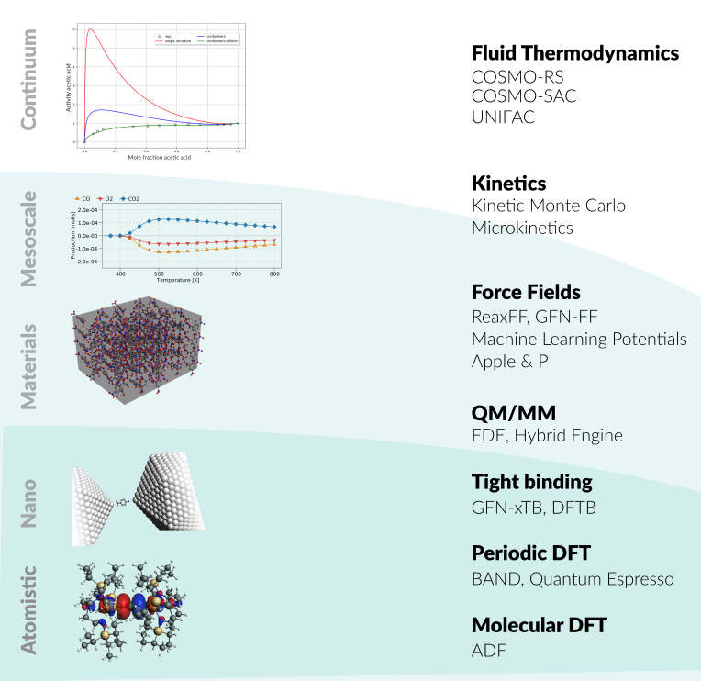
Amsterdam Modeling Suite
ADF: powerful molecular DFT
Reactivity, spectroscopy
Spectroscopy: NMR, EPR, VCD, UV, XAS
BAND: periodic DFT
(2D) Materials, spectroscopy, analysis
Interface with QE, VASP
DFTB, MOPAC: fast electronic structure
ReaxFF: Reactive MD
Dynamics of large complicated systems
MLPotential, force fields
Several backends, ANI-2x, M3GNet
COSMO-RS: fluid thermodynamics
VLE, LLE, logP, solubility
AMSdriver: PES exploration, MD, MC
Hybrid: multi-layer, QM/MM, QM/QM’
Integrated GUI, python scripting
ParAMS: parametrize ReaxFF & xTB
Notes:
Strong points AMS: DFT, semi-empirical and reactive FF in 1 Suite, with 1 integrated GUI, (python) scripting tools

Slide 8
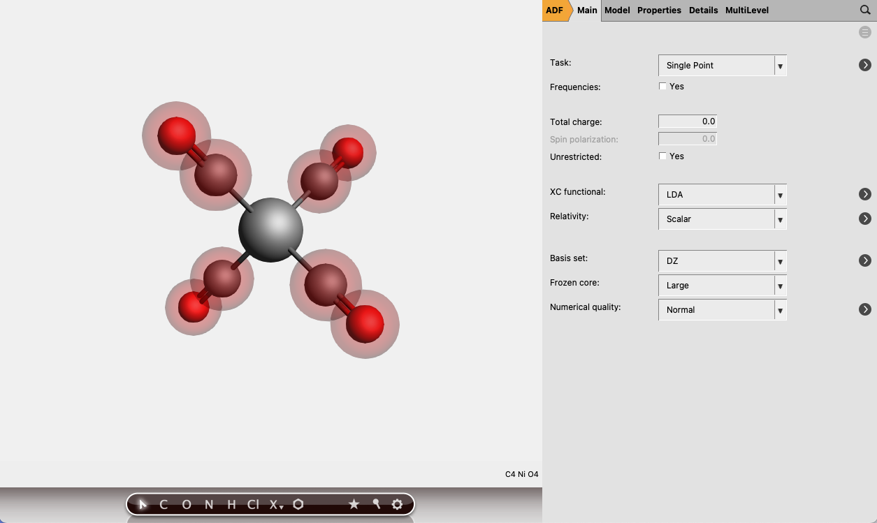
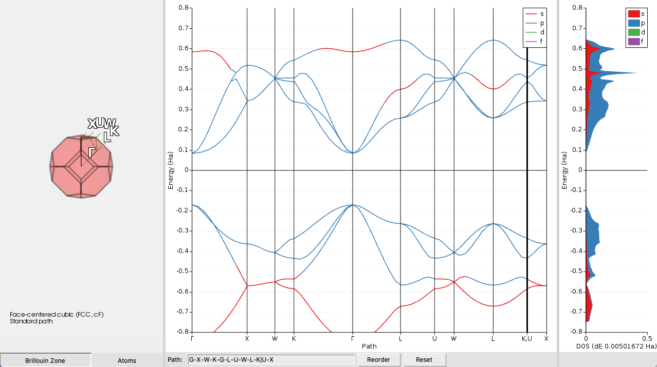
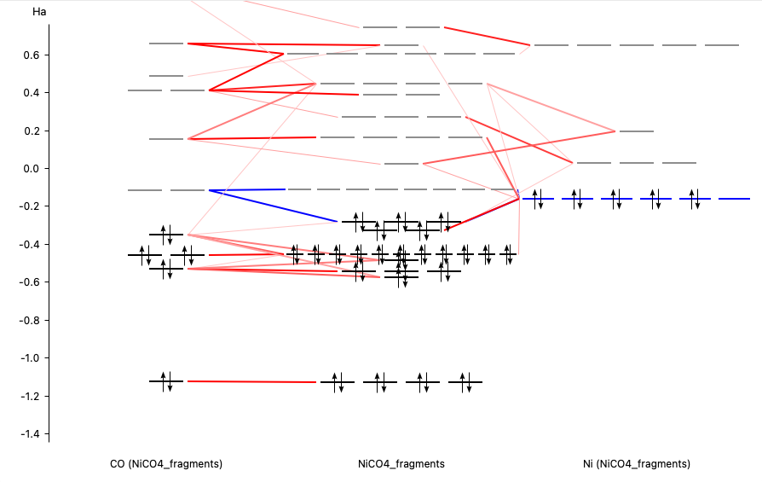
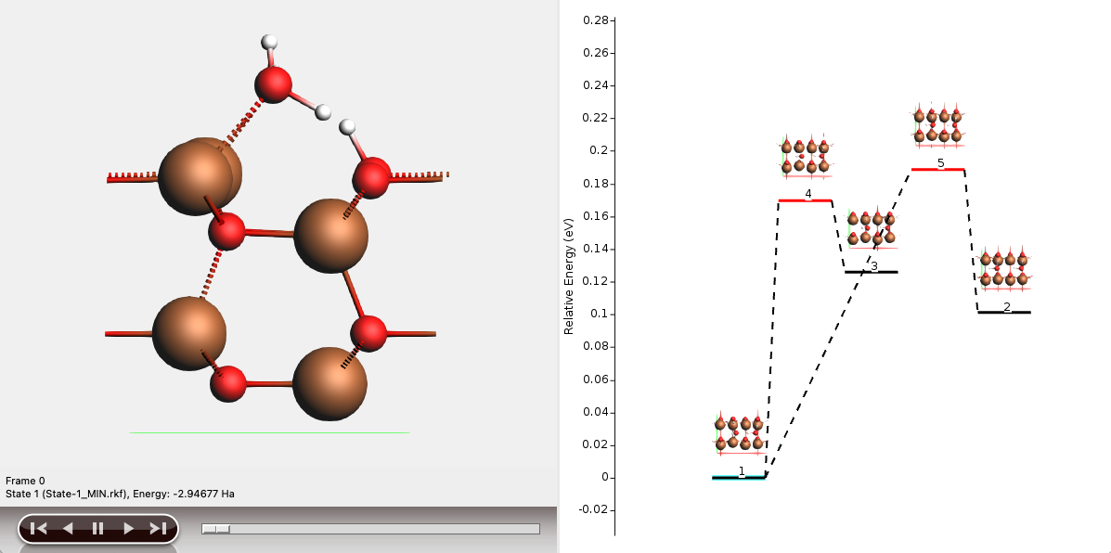
The graphical user interface (GUI)
Setup & analyze calculations
AMSjobs
manage jobs, locally or remotely
extract summaries
AMSinput
build molecules, periodic systems, surfaces, polymers, etc.
import structures from many formats
AMSview, AMSlevels, AMSspectra, etc.
analyze results
visualize trajectories, structures, transition states, orbital densities, DOS, band structure, spectra, etc.

Slide 9
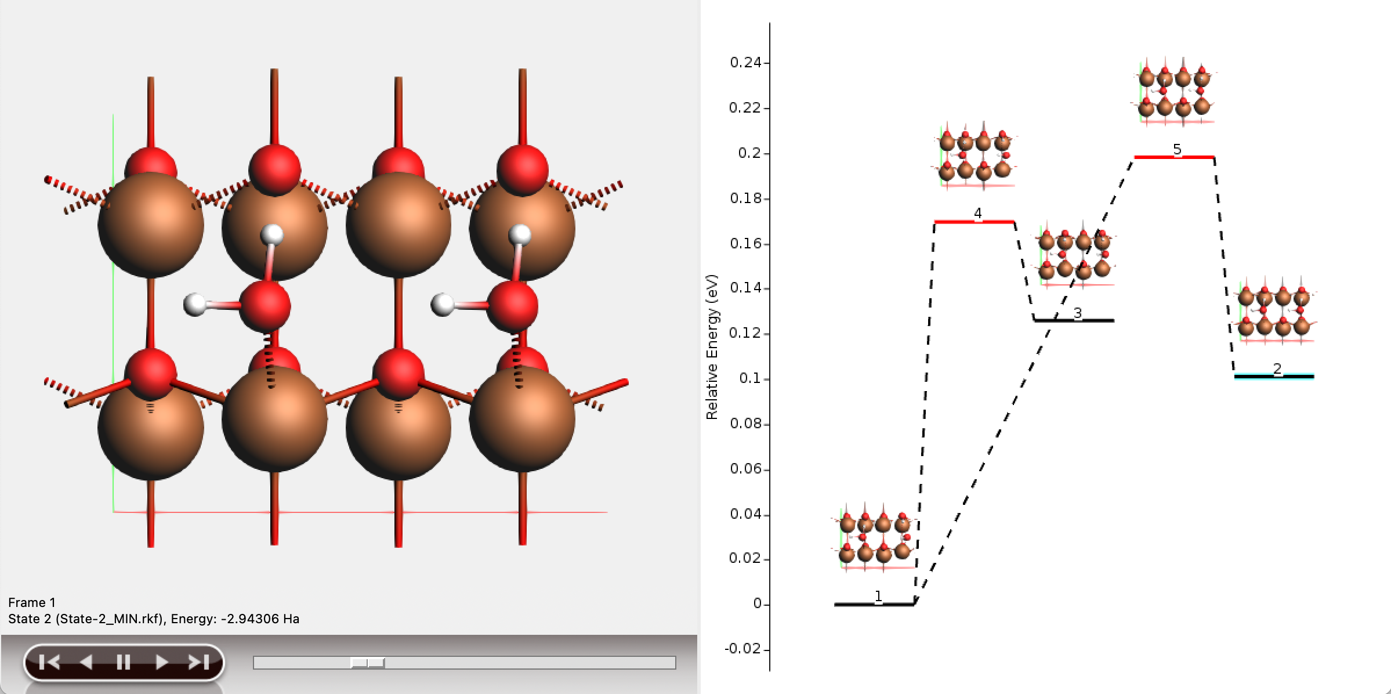
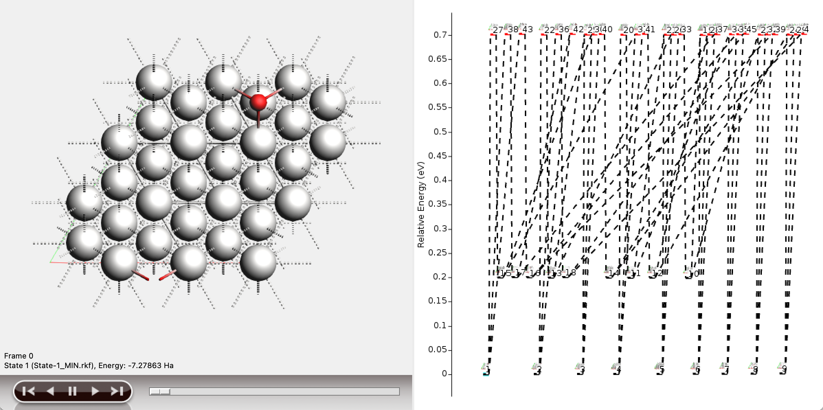
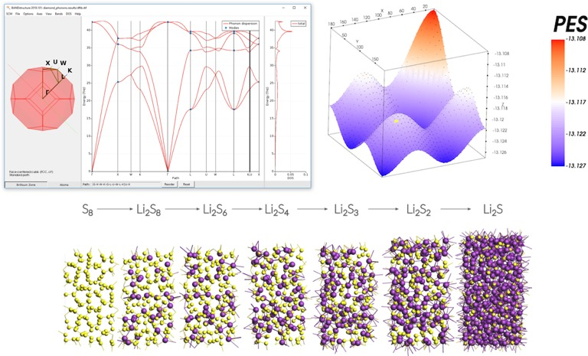
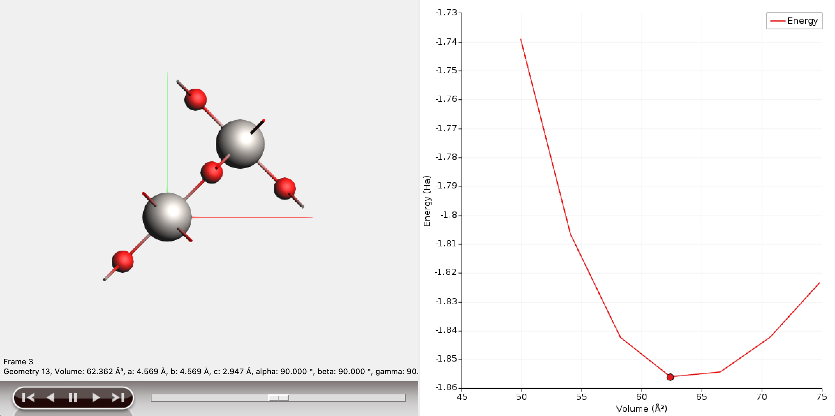
AMS driver: MD with ‘anything’
A unified driver to explore the Potential Energy Surface (PES)
Molecular dynamics
Frequencies & phonons
Stress & elastic tensors
Scan coordinates & constraints
Monte Carlo, etc.
Reaction discovery
Tasks
Engines
ADF
BAND
DFTB
ReaxFF
MLP, FF
External

Slide 10
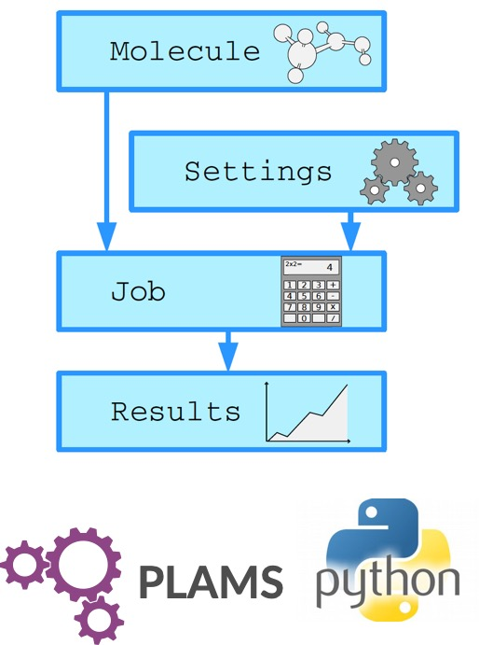
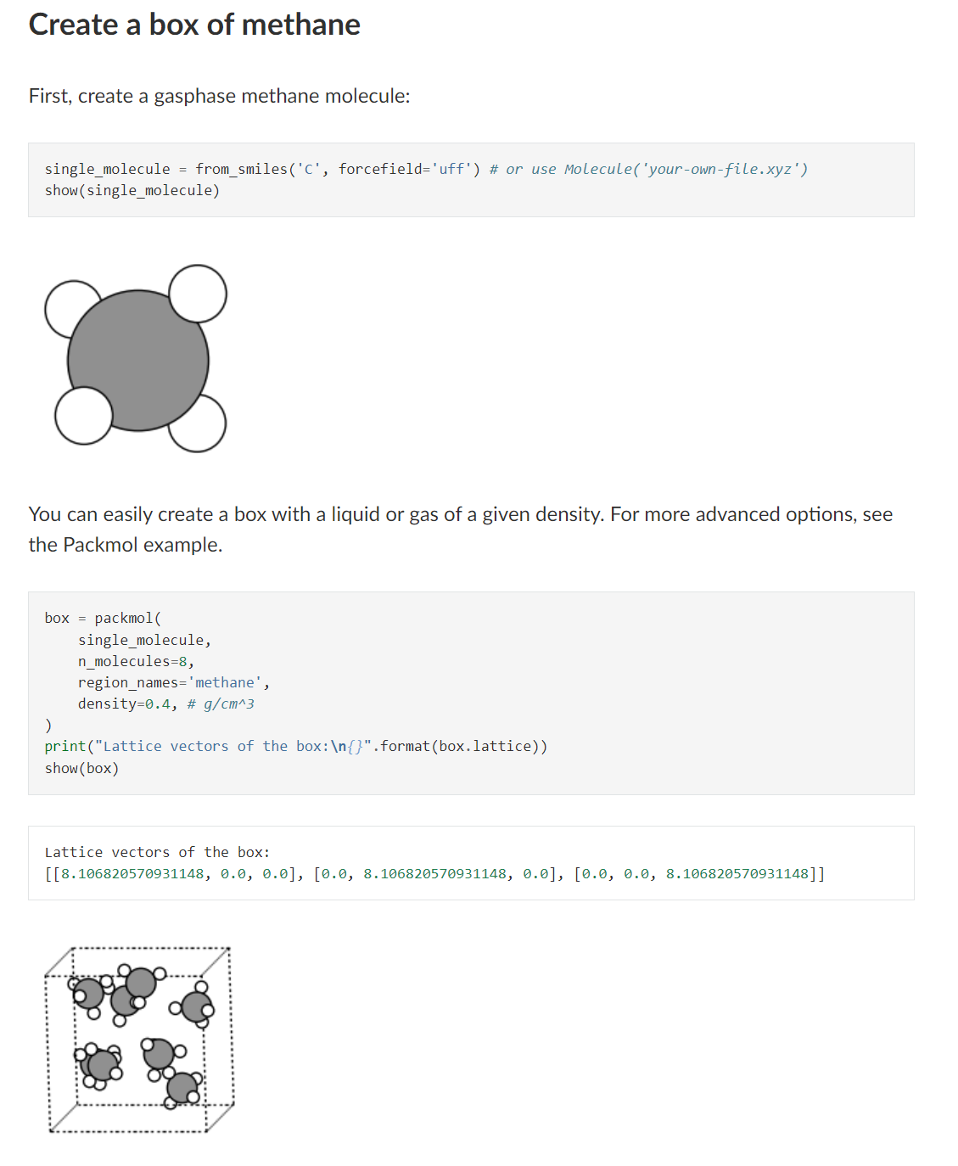
PLAMS: python scripting
Links all modules + various tools
→ workflows & screening
→ (custom) post-processing
→ rapid prototyping

Slide 11
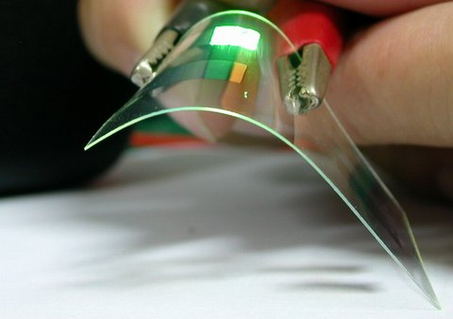
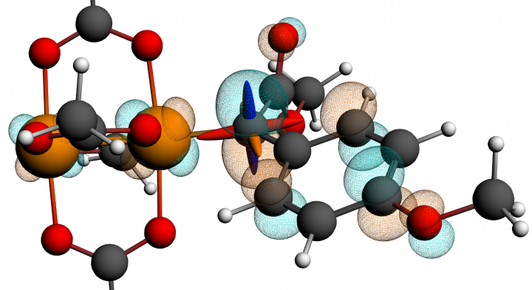
ADF: Molecular DFT
Strong & unique points
All-electron Slaters, H-Og
Relativity: ZORA (SR, SOC)
Spectroscopy
EPR, NMR, IR (VCD), UVVIS, XAS
qsGW+BSE
Phosphorescence
Bonding analysis:
Fragment-based approach
ETS-NOCV, QTAIM, MO diagrams, NCI, ....
Transfer integrals (charge mobility)
Environments
Subsystem DFT (FDE), DIM/QM, QM/MM, QM/FQ, 3D-RISM, COSMO, SM12
NMR calculations locate ¹³C di-Rh carbene
catalyst intermediate, Science, 342, 351 (2013)

Slide 12
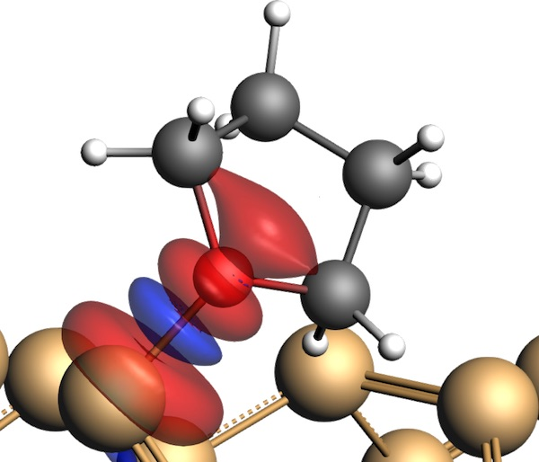
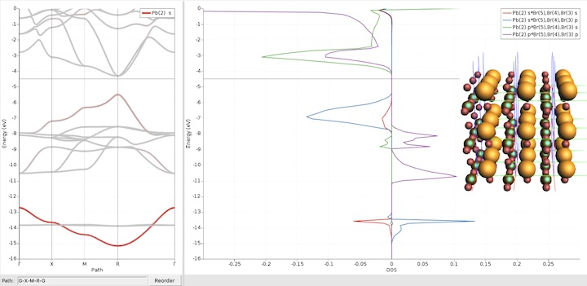
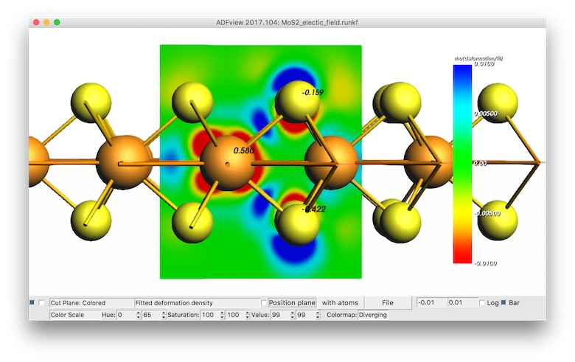
Periodic DFT: BAND vs Plane Waves
Atom centered basis functions, STO or NAO
Compare cluster with periodic
No pseudopotentials, all elements
Core spectroscopy (core holes)
Dielectric function, refractive index, susceptibility
Easy orbital analysis: pDOS, COOP, EDA
xc: r2SCAN, MN15-L, HSE06, GLLB-sc, D3(BJ), D4, DFT-1/2
Self-consistent NEGF: Gate & bias potential, spin transport
True 2D surfaces, 1D polymers
Catalysts: polarization, solvation
2D electronics (homogeneous E field)
Easy access to Work function
QM/MM and QM/QM’ for 2D
Integrated Graphical Interface:
Easy set up & analysis
Switch: ADF, BAND & Quantum Espresso, VASP
periodic energy decomposition analysis (tutorial)
L. Pecher and R. Tonner
WIREs CMS, (2018)
COOP in perovskites
(tutorial)
Goesten & Hoffmann
JACS (2018)
Polarizing 2D semiconductor (tutorial)
N. Zibouche et al.
PCCP (2014)

Slide 13
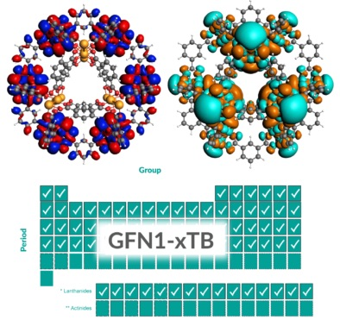
DFTB: ‘fast DFT’ for molecules & periodic
Approximated DFT
Nearest neighbor & minimal basis
Tabulated elec & rep. parameters:
Grimme GFN-xTB (Z = 1-86)
QuasiNaNo & DFTB.org
Capabilities & Features
UV/VIS (fast!)
MOs, band structures, DOS
Through AMS
Geometries, frequencies, phonons
Stress tensors (optimize under p)
Advanced MD, PES scans
GCMC, molecule gun
Multi-layer, QM/MM, QM/QM’
Reparametrize xTB

Slide 14
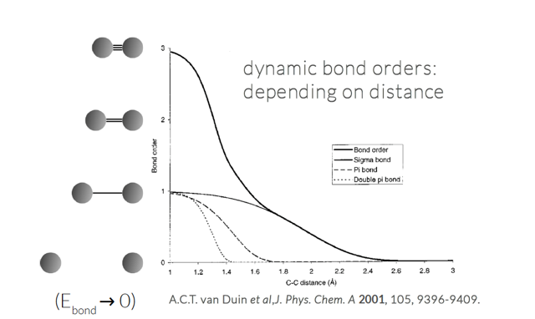
ReaxFF – reactive molecular dynamics
No discontinuities in energy or forces
No pre-defined reaction sites or types
Dynamic bond orders, charge equilibration
Only 1 atom type per element
300K 400K 500K
Li battery discharge: J. Electrochem. Soc. 161, E3009 (2014); PCCP, 17, 3383 (2015), tutorial
eReaxFF to study electron mobility & Li ion reduction, explicit electrons & electric field, J. Electrochem. Soc. 169 ,110540 (2022)
)

Slide 15
General ReaxFF rules
No discontinuities in energy or forces
No pre-defined reaction sites or types
Only 1 atom type per element
Review NPJ Comp. Materials (2016):
The ReaxFF reactive force field: development, applications and future directions
Notes:
User should not have to pre-define reactive sites or reaction pathways; potential functions should be able to automatically handle coordination changes associated with reactions.
force field should be able to determine equilibrium bond lengths, valence angles etc. from chemical environment.

Slide 16
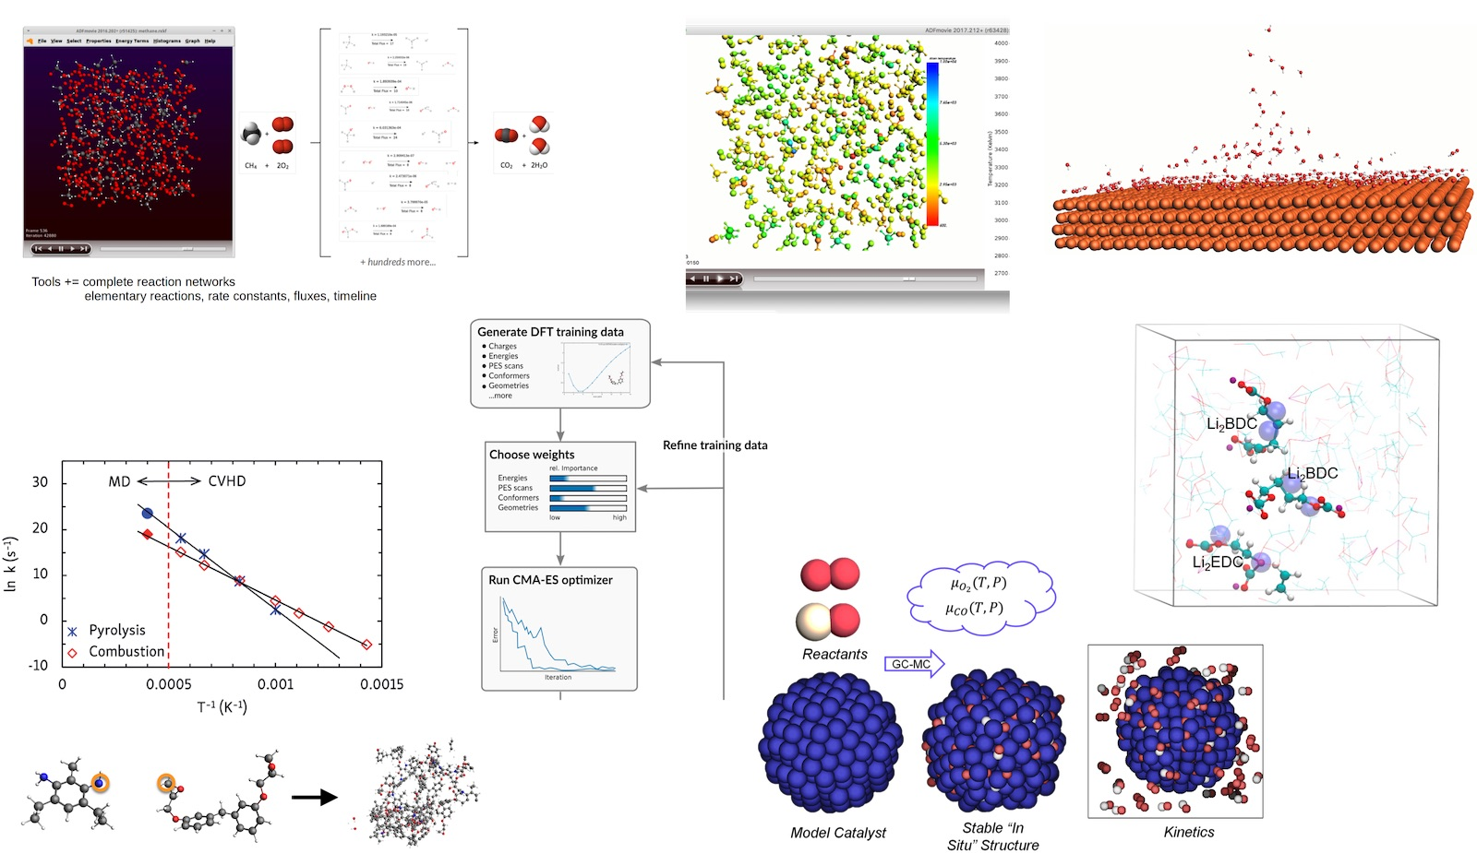
Reactive MD tools Amsterdam Modeling Suite
ChemTraYzer: Automated rates & pathways
New: Analyze surface reactions
T-NEMD, local T:
heat transport
Molecule gun: depositing molecules on surfaces
eReaxFF: include e-
fbMC, CVHD, PRD: speed up kinetics
ParAMS - easy ReaxFF & DFTB (re)parameterization
bond boost
build polymers
GCMC: speed up thermo

Slide 17
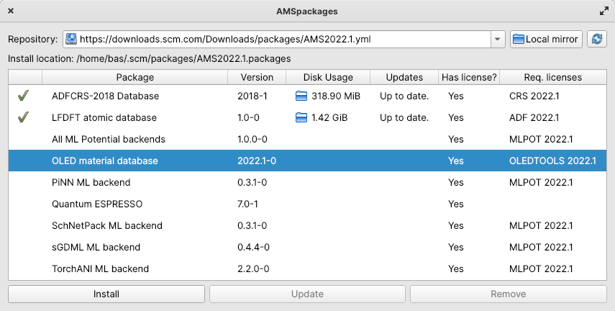
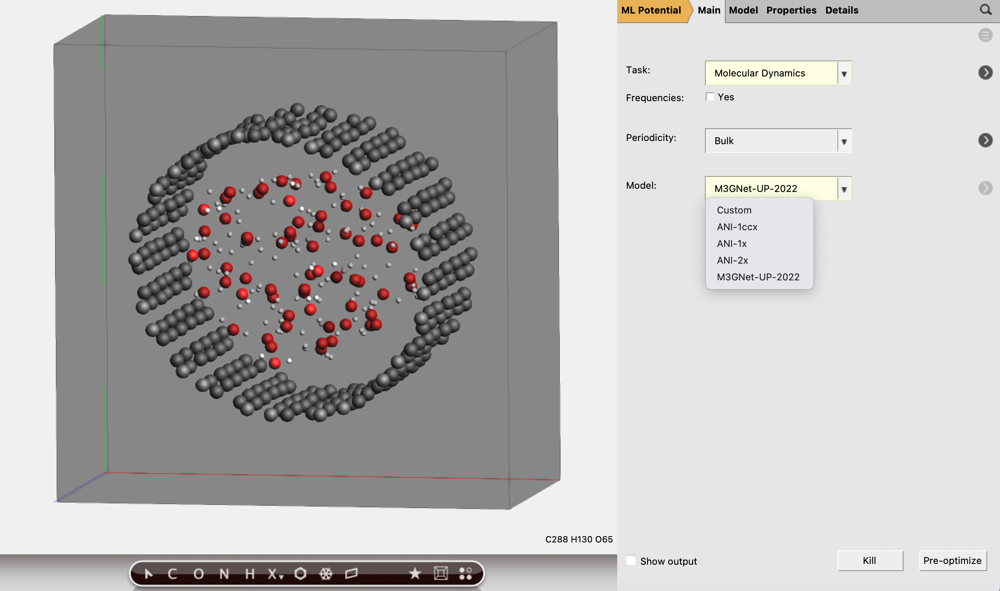
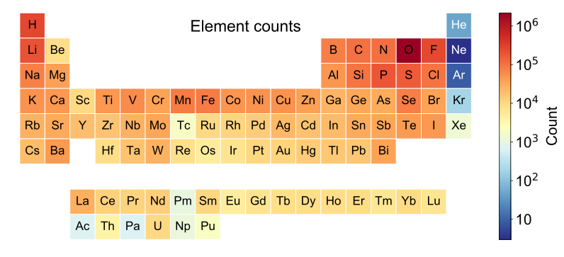
Machine Learning Potentials
Automatically install popular ML Backends
Pre-parametrized
ANI-1x and 2x (H, C, N, O, F, S, Cl)
M3GNet (“Universal”)
Backends, via ASE
NEquIP, FLARE (on-the-fly)
sGDML
SchNet
CHGNet
Use MLP with all the tasks in the AMS driver
PES scans, reaction discovery, conformers, IR, phonons, MD, MC etc.
Hybrid (multi-layer): combine with other methods
CUDA-enabled PyTorch and Tensorflow
i) O. Isayev et al. Chem. Sci., 2017, 8, 3192–3203
ii) C. Chen, S.P. Ong., Nature Comp. Sci. 2, 718–728 (2022)
iii) S. Batzner et al. Nature Comm. 13: 2453 (2022) iv) S. Chmiela et al. Comp. Phys. Commun. 240 (2019) 38-45
v) K. T. Schütt et al., J. Chem. Theory Comput. 15 (2019) 448-455

Slide 18
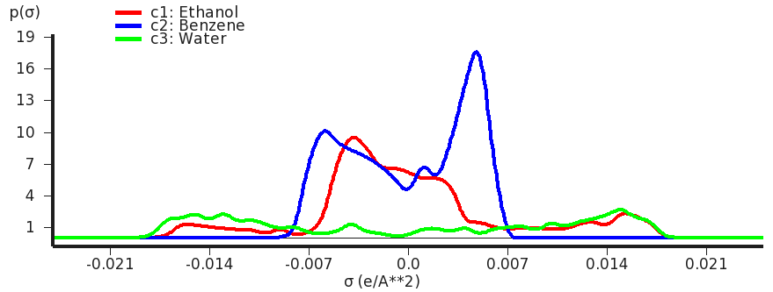
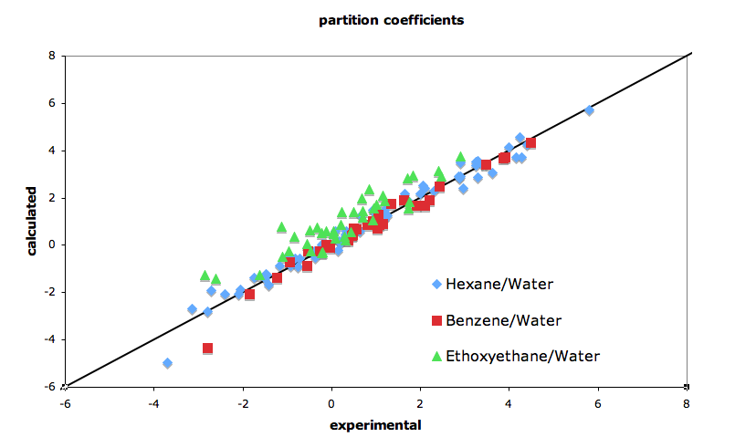
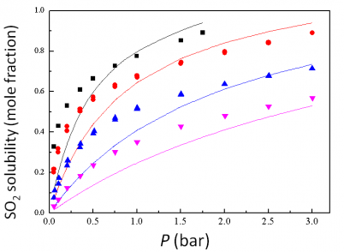
COSMO-RS/SAC: thermodynamic properties of fluids
Quantum Chemistry & QSPR for quick property predictions
COntinuum Solvation MOdel + RS (Klamt), SAC (Sandler)
chemical potential => activity coefficients => instantaneous properties
Solvation & excess energies, pKa
Solubilities, LLE, VLE, boiling points
Optimize mixtures: solubility, LLE
Polymers: Flory-Huggins X

Slide 19
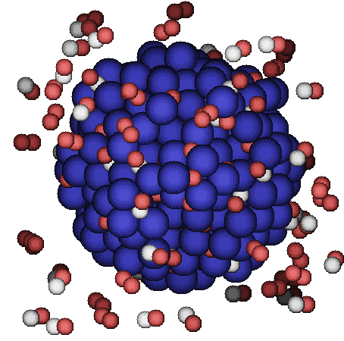
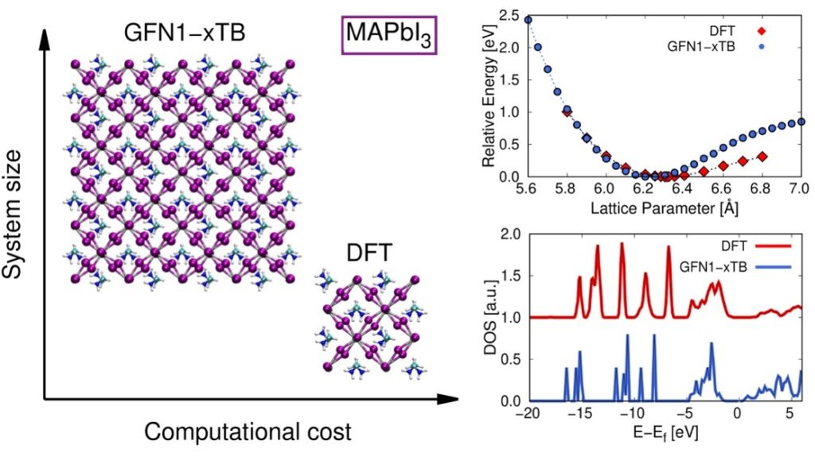
Parametrizing fast methods with ParAMS DFTB, ReaxFF (ML)

Slide 20
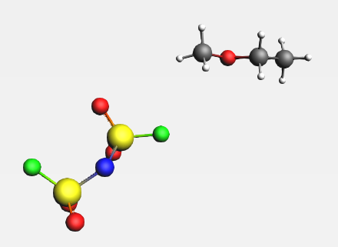
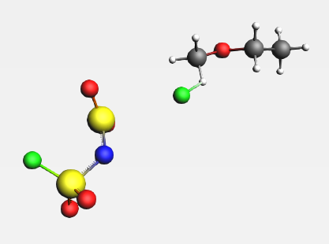
ReaxFF and DFTB problems
ReaxFF force field may not exist for your application
Not always accurate enough for “unseen” structures or molecules
Example AMS industry customer: lithium bis(fluorosulfonyl)imide in organic solvent
Published ReaxFF force field predicts that a fluorine atom dissociates from the anion
Fix: 3.5h

Slide 21
General ReaxFF rules
No discontinuities in energy or forces
No pre-defined reaction sites or types
Only 1 atom type per element
Review NPJ Comp. Materials (2016):
The ReaxFF reactive force field: development, applications and future directions
Notes:
User should not have to pre-define reactive sites or reaction pathways; potential functions should be able to automatically handle coordination changes associated with reactions.
force field should be able to determine equilibrium bond lengths, valence angles etc. from chemical environment.

Slide 22
The Optimization Challenge
Which parameters do I optimize?
Are my parameter ranges appropriate?
Is my training set balanced?
Are any training set items problematic?

Slide 23
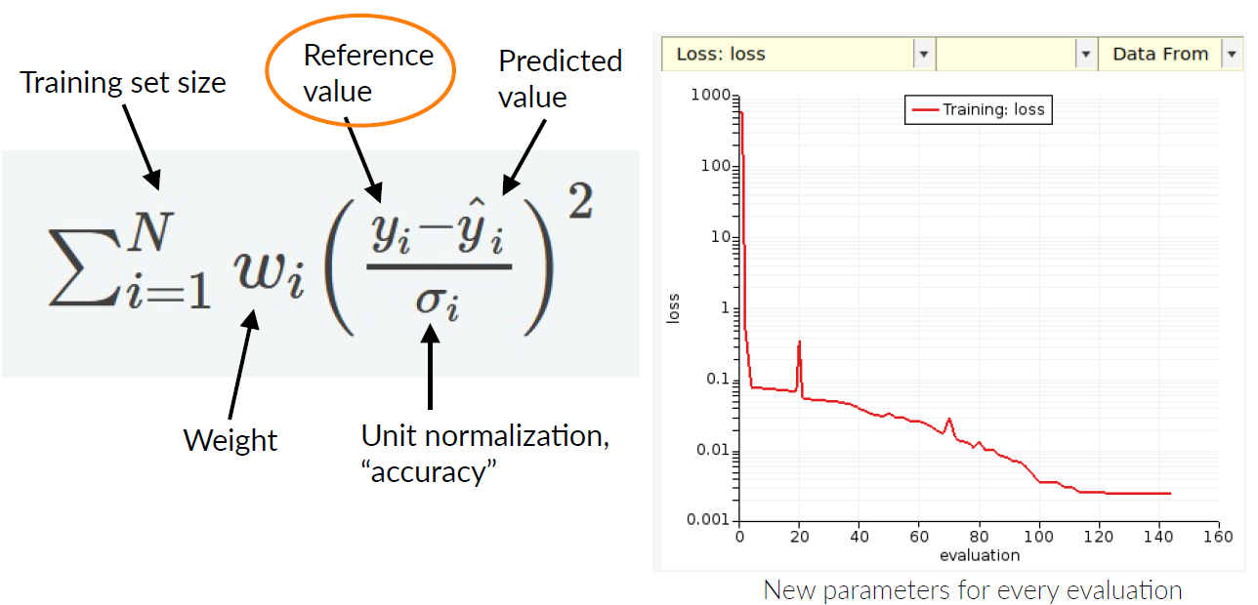
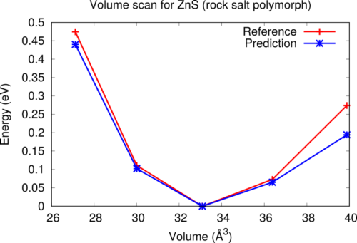
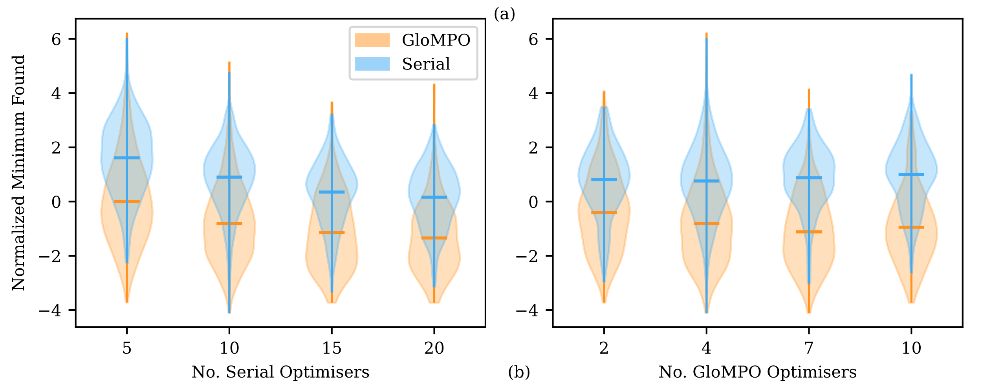
ParAMS: GUI + scripts for Parametrization GloMPO: Global parallel optimizations
Build training sets with AMS
ADF, BAND, (+VASP, QE, Gaussian)
Define references & loss function
Choose & optimize parameters
Lennard-Jones
ReaxFF
DFTB
AMS2024: ML Potentials (active learning)
Validate (& iterate)
Komissarov, L.; Rüger, R.; Hellström, M.; Verstraelen, T. ParAMS: Parameter Optimization for Atomistic and Molecular Simulations J. Chem. Inf. Model. 2021, 61, 8, 3737-3743
Freitas Gustavo, M., Verstraelen, T. GloMPO (Globally Managed Parallel Optimization): a tool for expensive, black-box optimizations, application to ReaxFF reparameterizations. J. Cheminform. 2022, 14, 7.

Slide 24
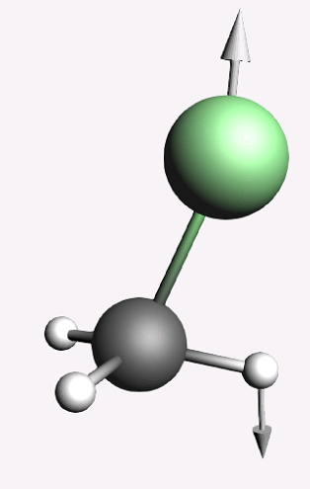
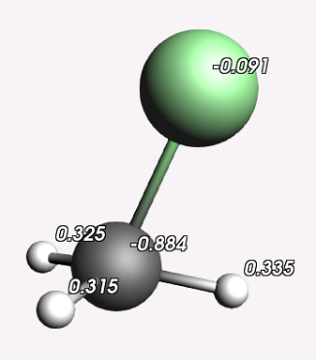
ParAMS: Types of reference values
“Anything” that can be extracted from a job can be used as a reference value
Forces, atomic charges
forces
charges

Slide 25
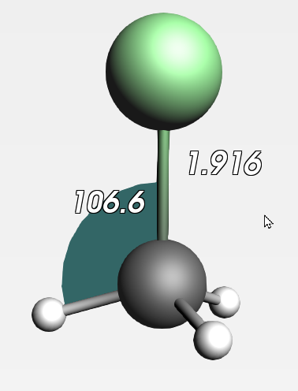
ParAMS: Types of reference values
“Anything” that can be extracted from a job can be used as a reference value
(optimized) Bond distances, angles

Slide 26
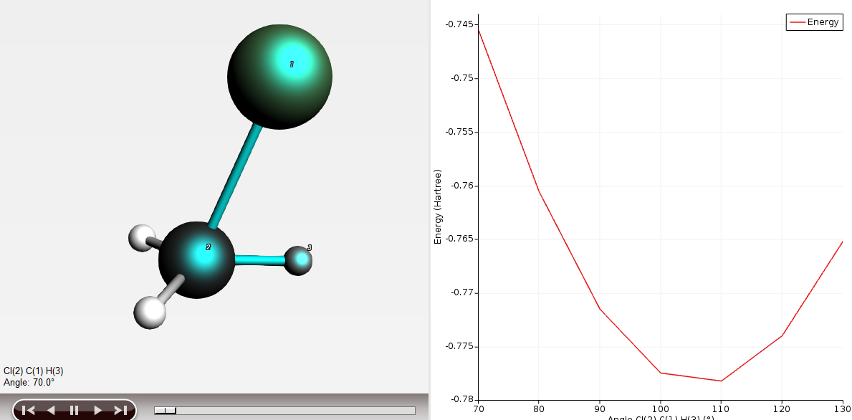
ParAMS: Types of reference values
“Anything” that can be extracted from a job can be used as a reference value
PES Scans: Energy vs. bond length, angle, or cell volume

Slide 27
ParAMS: Types of reference values
Values from multiple jobs: Reaction energies (adsorption energy, surface energy, formation energy, ...)
C₃H₆(g) + (9/2) O₂(g) → 3 CO₂(g) + 3 H₂O(g)
ΔH_{r}⁰ = -491.8 kcal/mol

Slide 28
ParAMS: Types of reference values
“Anything” that can be extracted from jobs can be used as a reference value
Forces, atomic charges
Optimized bond lengths or angles
PES Scans: Energy vs. bond length, angle, or cell volume
Reaction energies (adsorption energy, surface energy, formation energy, ...)
Job
Extractor
Ref. value
charges
charges
Job1
forces
forces
energy
Reaction energy
Job2
energy

Slide 29
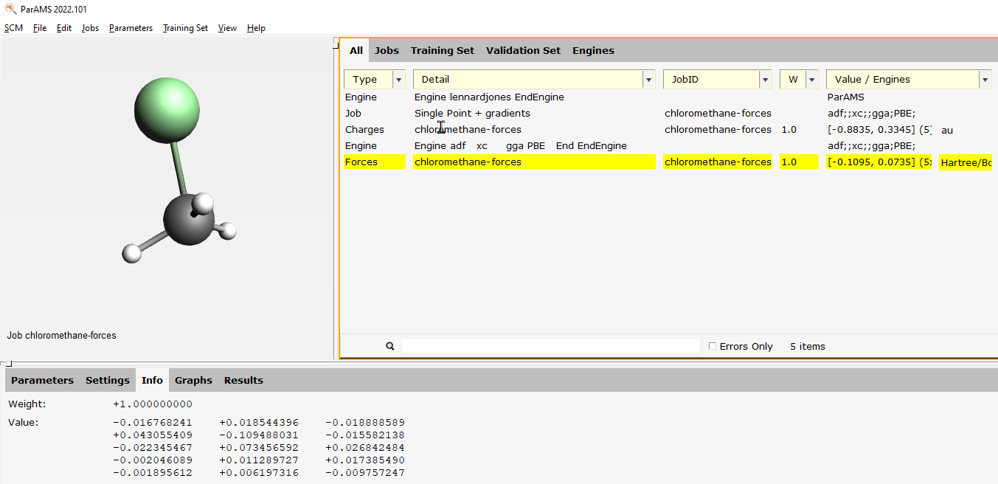
Example reference values: Charges and forces of chloromethane

Slide 30
Example reference values: Optimized bond lengths and angles
For bond lengths and angles, add geometry optimization jobs!

Slide 31
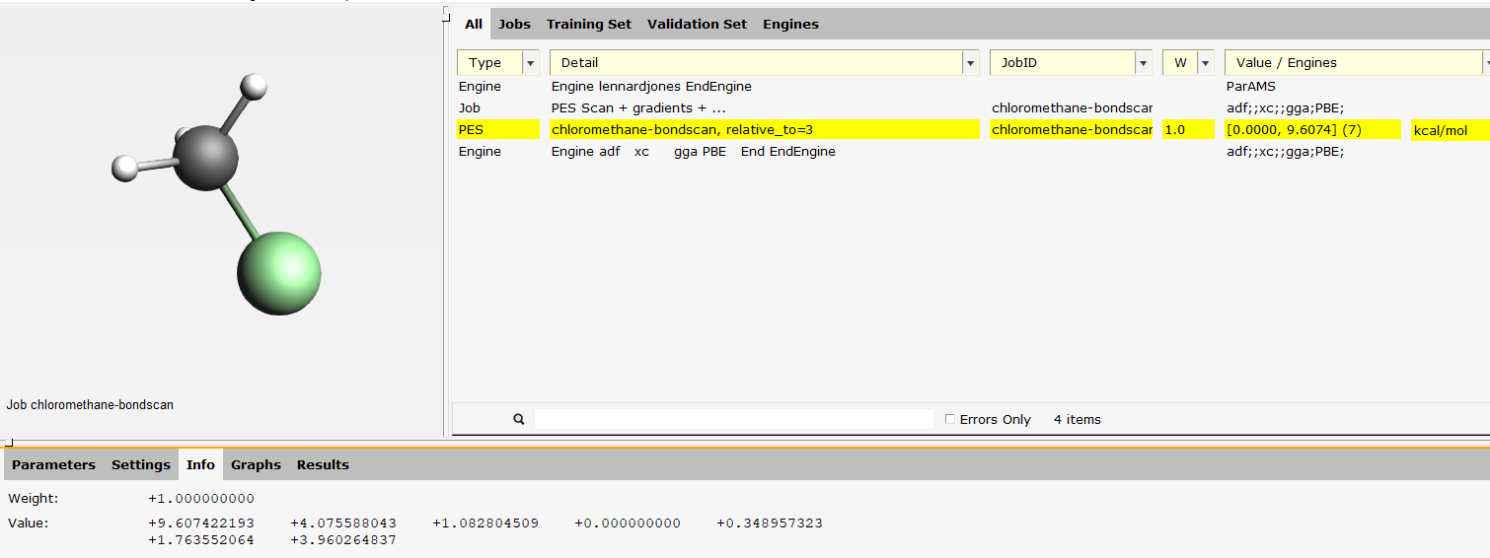
Example reference values: Bond scan, angle scan, lattice scan
For PES scans, add PES Scan jobs!

Slide 32
Example reference values: Reaction energy
Propene combustion: C₃H₆(g) + (9/2) O₂(g) → 3 CO₂(g) + 3 H₂O(g)
Automatically balanced stoichiometric coefficients!

Slide 33
ParAMS settings
Which parameters to optimize?
Choose as few as possible
First try parameters in the “standard” category
If a parameter value is close to min/max, change the range and continue
Which optimization algorithm?
We recommend CMA-ES for most optimization problems
Webinar about this algorithm: https://youtu.be/Icv7kWUaoTI

Slide 34
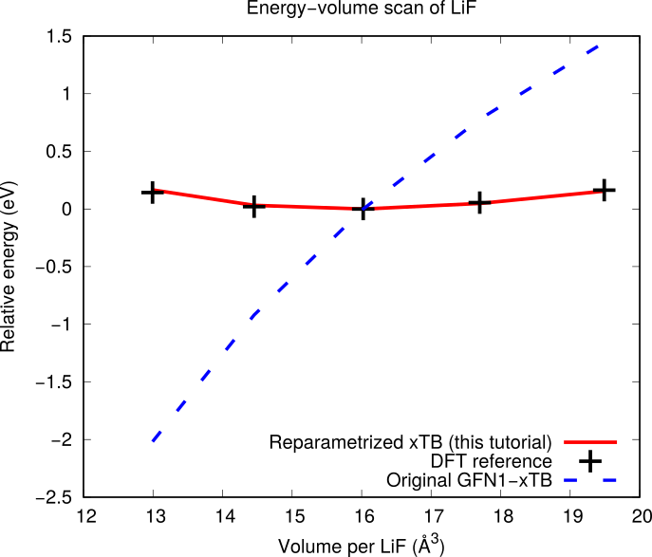
Tutorial: reparametrize xTB for LiF
Reparametrize repulsive xTB parameters against DFT EOS + exp H_{f} https://www.scm.com/doc/params/examples/xtb_lif/xtb_lif.html

Slide 35
Example: reparametrize xTB for TiO₂
Equation of states (Anatase)
Equation of states (Rutile)
Diagonal stress tensor

Slide 36
Example: reparametrize xTB for perovskites
S. Raaijmakers, M. Pols, J. M. Vicent-Luna, S. Tao, Refined GFN1-xTB Parameters for Engineering Phase-Stable CsPbX3 Perovskites, J. Phys. Chem. C, 126, 9587-9596 (2022)

Slide 37
Demo: fix CO₂ bond scan
JuPyter Notebook: CO2-reparam.ipynb GUI files in CO2-reparam directory

Slide 38
(Multi-scale) modeling OLED materials

Slide 39
Integrated OLED multi-level modeling
Atom & electrons determine single material properties
Predict, understand & improve with
atomistic modeling
Interactions between materials determine device-level behavior
Predict, understand & improve with meso- & macroscale modeling
(with Simbeyond)
Maximize luminescence
Optimize color
Minimize destructive processes
Optimize charge & exciton transport
OPV: same properties
Notes:
And now for something completely different. Organic light emitting diodes. Here, too, we should aim to optimize the properties of individual materials, such as color profile, and luminescence efficiency. However, different materials need to come together in a stack to create a workable device generating such nice crisp pixels, at a low electricity costs and with a long lifetime.

Slide 40
Optimize OLED emitter lifetimes
ADF 2005: Spin-orbit TDDFT => phosphorescence lifetimes
BASF: efficient blue emitter (Adv. Mater. 2010), patent 2016 (=> UDC)
DuPont: protocol for screening lifetimes (JPCC 2013)
PCCP 16,
14523 (2014)
Notes:
Our molecular DFT code ADF can uniquely predict phosphorescent lifetimes of inorganic complexes. While this was quite an academic undertaking at the beginning of this millennium, it’s predictive power was realized by our Japanese partner and many Japanese companies still use this technology. It has been further refined and used by companies worldwide as witnessed by a few patents. Applying spin-orbit coupling calculations to Thermally Activated Delayed Fluorescence came much later, but also there we saw academic work preceding the industrial use cases.

Slide 41
Optimize OLED emitter color / emission width
Excellent agreement vibrational progression FCF T₁-S₀
0-0 well reproduced by Delta SCF calculation (22,000 cm⁻¹)
Notes:
Calculate vibrational couplings => vibronic fine structure. Important for color of emitted light. Here very good agreement. Faster methods to do this will be available in ADF2019.3

Slide 42
Optimize TADF emission rate
Spin-orbit TDDFT => Intersystem crossing
Z.-M. Su et al Dyes & Pigments 2017, Bredas et al. J. Am. Chem. Soc. 2017
OSRAM: patent 2018, Cynora: patent 2019
blue TADF emitter: Nanomat. 2019; Organic Electronics 2020
Min. S₁-T₁ gap & Max. SOC
Min. emission width
Max. k_{phos} & k_{TADF}

Slide 43
Emission width TADF emitters: faster calculations
adiabatic Hessian
28h @ 32cores
quicker screening
vibronic spectrum DABNA & related
TADF emitters
Protocol + modify -> python workflow-> cluster/cloud
vertical gradient
0.5h @ 32cores

Slide 44
Optimize charge mobility (OLED, OFET)
2003: easy to get transfer integrals from ADF (fragment-based)
2007: organic semiconductors (BASF): hole and electron mobility
Solubility / miscibility: COSMO-RS
From adiabatic states (FDE)
Environment polarization
Charge generation
Charge recombination
Exciton transfer

Slide 45
Ionization Potentials & Electron Affinities: qsGW
Webinar
Recommended:
qsGW
TZ2P or larger
IP = -HOMO
EA = -LUMO
Quasiparticle self-consistent GW: can use a GGA
Spin-orbit coupling and excitations with BSE possible (qsGW-BSE)
In progress: qsGW embedding, alternative: COSMO corr. with DFT
A. Förster, L. Visscher, Low-Order Scaling Quasiparticle Self-Consistent GW for Molecules, Frontiers in Chemistry, 2021, 9: 736591; A. Förster, L. Visscher, Quasiparticle Self-Consistent GW-Bethe-Salpeter equation calculations for large chromophoric systems, J. Chem. Theory Comput. 2022, 18, 11, 6779–6793

Slide 46
Accurate predictions, IP, EA, S1, T1
Gas phase HOMO/LUMO can be well trained with NN
Environment effects important!
Fast GW + BSE (webinar)
Bottleneck: deposition
Notes:
To predict the electronic and excitonic properties of the devices, molecular level input from ADF can be used. I inivite you to check out our latest colleagues’ work: Arno Foerster who implemented really fast self-consistent GW and BSE.
Properties such as ionization potentials, electron affinity, singlet and triplet states can be well predicted with a machine learned model,
https://deepchem.readthedocs.io/en/latest/api_reference/featurizers.html#circularfingerprint op basis van deze met size=1024
so that’s a logical addition to the multi-scale OLED toolchain.
However, we’re currently trying to figure out if there’s any way in which we can leverage ML to accelerate the rate-determining step, namely the sequential deposition to give realistic amorphous morphologies. The environment effects on the electronic and excitonic properties are very important to get right spread of values.

Slide 47
Deposition: sequential = slow
Notes:
To predict the electronic and excitonic properties of the devices, molecular level input from ADF can be used. I inivite you to check out our latest colleagues’ work: Arno Foerster who implemented really fast self-consistent GW and BSE.
Properties such as ionization potentials, electron affinity, singlet and triplet states can be well predicted with a machine learned model,
https://deepchem.readthedocs.io/en/latest/api_reference/featurizers.html#circularfingerprint op basis van deze met size=1024
so that’s a logical addition to the multi-scale OLED toolchain.
However, we’re currently trying to figure out if there’s any way in which we can leverage ML to accelerate the rate-determining step, namely the sequential deposition to give realistic amorphous morphologies. The environment effects on the electronic and excitonic properties are very important to get right spread of values.

Slide 48
Ionization Potentials & Electron Affinities: workflow
1) deposit (UFF4MOF-II) Video
fbMC, with graphite support that is later removed
2) Opt neutral, cation, anion + environment (xTB/UFF4MOF-II)
3) Calculate properties
IP, EA: DFT+embedding
Transfer integrals
Exciton properties

Slide 49
OLEDs: Optimize many materials & properties
Predict promising materials + stacks
Expensive
Molecular level:
Electron affinity(EA)/LUMO
Ionization potential(IP)/HOMO
Decay rates
Exciton energies
Transfer integrals
Device level: kMC, OL-ME
+ scaling (x10)
Material combinations
Layer thickness
Material concentrations
Notes:
We integrated our atomistic methods, which have been used successfully in industry to develop better charge transport and emitting materials, with those of Simbeyond, experts in mesoscale simulations of electronic and excitonic processes.

Slide 50
Multi-scale OLED workflow
Webinar

Slide 51
Pilot project: hyperfluorescent devices
Experimental** and computed* IP in OK agreement
Experimental J(V) trends well captured by simulations
Speed vs accuracy
* Calculated values from multiscale toolchain
**Experimental values Cynora
Notes:
We finished the initial stages and in a pilot project with a European OLED materials company demonstrated that the trends for J-V curves can be well reproduced. We still have work to do to improve speed vs. accuracy across the whole integrated modeling toolchain and I believe machine learning can play a key role here.

Slide 52
Demo: qsGW+BSE (tutorial)

Slide 53
Modeling battery materials

Slide 54
Properties for battery materials
Charge mobility, diffusion, viscosity
ReaxFF, APPLE&P, DFTB-MD
NEGF: I-V curves, mobility across interface
Electrolyte solubility & electrochemistry
Accurate redox potentials (ADF+COSMO-RS), ionization potentials
Solubility: COSMO-RS
(e)ReaxFF: electrolyte degradation
ReaxFF, DFTB, BAND, polymer properties (band gaps)
BAND: include solvation, E field
(Dis)charge processes
GCMC with ReaxFF, or DFT(B)
Understand battery ‘operando’
ADF - Spectroscopy: NMR, NEXAFS
Notes:
Strong points ADF: basis sets with the right asymptotic behavior for all elements. No pseudopotentials. Good & efficient ways of dealing with relativistic effects.
Many spectroscopic properties (basis set + relativistic treatment = important). Many people use ADF for bonding analysis.

Slide 55
Solvation energies, redox potentials, NMR spectra
Developing non-flammable electrolytes: DFT + Continuum Solvation (COSMO) aids experiments
A biomimetic high-capacity phenazine-based anolyte for aqueous organic redox flow batteries, Nature Energy 3, 508-514 (2018) Non-flammable electrolytes with high salt-to-solvent ratios for Li-ion and Li-metal batteries, Nature Energy 3, 674–681 (2018)

Slide 56
Solvation energies, redox potentials, NMR spectra
(python) workflow screening redox potentials: E⁰ = - ΔG (A + e– → A– )/F (reduction)
DFTB + solvation (first pass) -> ADF + solvation (more accurate) Use directly with COSMO, or through thermodynamic cycle with COSMO-RS
J. Belić, A. Förster, J. P. Menzel, F. Buda, and L. Visscher, Automated assessment of redox potentials for dyes in dye-sensitized photoelectrochemical cells, Phys. Chem. Chem. Phys. 24, 197-210 (2022)

Slide 57
Screening polymers for Lithium Ion Batteries
Screening band gaps and lithiation energies with 1D periodic DFT + COSMO
H. Lu, J. Yu, G. Chen, and S. Sun, Theoretical screening of novel electrode materials for lithium–ion batteries from industrial polymers, Ionics (2019)
Notes:
Lithiation energy corresponds to experimental potential

Slide 58
Discharge process Li-S batteries
Cathode expansion
Voltage reduction
Diffusion induced stress
Tutorials: Battery discharge (GCMC)
& Li ion diffusion
Battery discharge video
M. M. Islam, A. Ostadhossein, O. Borodin, A. T. Yeates, W. W. Tipton, R. G. Hennig, N. Kumar, and A. C. T. van Duin, ReaxFF molecular dynamics simulations on lithiated sulfur cathode materials, Phys. Chem. Chem. Phys. 17, 3383-3393 (2015)

Slide 59
Teflon protects electrolyte in Li battery
Teflon layer on anode-electrolyte interface significantly reduces lithium reactivity and diffusion through the electrolyte phase
J. Electrochem. Soc. 161, E3009-E3014 (2014).

Slide 60
Solid electrolyte interface formation Lithium Ion Batteries
ReaxFF protocol to study the initial formation stages of SEI formation
Wang J, Liun Y, Tu Y, Wang Q, Reductive Decomposition of Solvents and Additives toward Solid-Electrolyte Interphase Formation in Lithium-Ion Battery, J. Phys. Chem. (2020).

Slide 61
eReaxFF – explicit electrons
Reductive decomposition of ethylene carbonate in Li ion batteries
eReaxFF video
M. M. Islam and A. C. T. van Duin, J. Phys. Chem. C 2016, 120 (48), 27128-27134.

Slide 62
eReaxFF – Li on graphitic anodes
eReaxFF to study electron mobility & Li ion reduction, including (video)
- explicit electrons - electric fields
red: e-
300K 400K 500K
Md Jamil Hossain et al. J. Electrochem. Soc. 169 ,110540 (2022)

Slide 63
MLPotentials for (battery) materials
M3GNet, trained to Materials Project 1000x faster than DFT
C. Chen, S.P. Ong., Nature Comp. Sci. 2, 718–728 (2022)
Li intercalation potentials accurately predicted with DFT (~100 atoms)
M3GNet reproduces DFT really well
ΔE
Li potential
Mechanical properties of electrode (volume change upon lithiation)
Li diffusion through NEB or PES scan
M3GNet can accelerate by 1000x
(Dis)charge curves: GCMC
Activation energy
Diffusion (kinetics)

Slide 64
Diffusion, Conductivity with APPLE&P
Polarizable force field for batteries, ionic liquids, fuel cells
APPLE&P MD simulations: ion dynamics within 15-20% from experiment
More transferable than non-polarizable force fields with rescaled ion charges
Chem. Rev. 2019, 119, 7940

Slide 65
Kinetic Monte Carlo: SEI dendrite formation
Modified (py)Zacros kMC to study dendrite formation
3 Processes (rates can be computed with AMS):
1) Metal ion (M^{z+}) transport across electrolyte
2) Reduction at the solid-electrolyte interface (M^{z+}->M)
3) Diffusion of the metal (M) over the electrode surface
no step diffusion no terrace diffusion
Inspired by Surface diffusion manifestation in electrodeposition of metal anodes, PCCP 2020 (22), 11286
Notes:
Fig. 1 Schematic of the surface self-diffusion pathways. Surface atoms A, B and C exhibit (a) terrace diffusion (b) diffusion away from a step and (c) interlayer diffusion/diffusion across a step, with energy barriers E_{a1}, E_{a2}, and E_{a3}, respectively. A representative energy profile along the reaction path, showing the initial state (IS), final state (FS), height of the diffusion barrier (E_{a}) and the transition state (TS) is illustrated in (d). Fig. 2 Electrodeposition morphologies obtained at an overpotential of 0.3 V, 0.4 V and 0.5 V. Two specific conditions are set for the self-diffusion barriers: (a) E_{a1} = 0.15 eV and E_{a2} = 0.3 eV with E_{a3} → ∞; (b) E_{a1} = 0.15 eV and E_{a3} = 0.3 eV with E_{a2} → ∞

Slide 66
Demo: Li diffusion (tutorial)
M3GNet, trained to Materials Project 1000x faster than DFT
M3GNet: C. Chen, S.P. Ong., Nature Comp. Sci. 2, 718–728 (2022)

Slide 67
Reaction discovery

Slide 68
AutoCheMo: Automatic generation of Chemical Models
4 PhD projects, in collaboration with Universities of Gent and Aachen:
Complex reaction networks, automatic rates ChemTraYzer2
Semi-automatic ReaxFF force field parameterization ParAMS
Efficient methods to estimate and optimize ReaxFF parameters GloMPO
Large amplitude motions CIMCI
Grant #814143, Finished Sept. 2022
with Verstraelen, Leonhard

Slide 69
ReaxPro: Multi-Scale Reactive Process Design
LEIT - Grant Agreement No 814416
PES exploration
Notes:
SCM coordinates ReaxPro, a Leadership in enabling and industrial technologies, consortium of Universities, government labs, and a few companies. We have linked atomistic methods with advanced methods for long-time scale dynamics and reaction exploration, EON. The reaction rates are passed on to mesoscale kinetic Monte Carlo code Zacros. We are currently wrapping up the final step, where the kMC results generate a surrogate model which is fed into reactive computational fluid dynamics (catalytic foam) to solve the fluid thermodynamics including kinetics and transport at a reactor scale level.
Woo Youn Kim: Monte Carlo Tree Search ACE-reaction -> change to reinforcement learning? Use ML for better energetics (e.g. Persson )
Rates at different coverage: ML
kMC -> CFD: surrogate model.

Slide 70
PES exploration
Notes:
SCM coordinates ReaxPro, a Leadership in enabling and industrial technologies, consortium of Universities, government labs, and a few companies. We have linked atomistic methods with advanced methods for long-time scale dynamics and reaction exploration, EON. The reaction rates are passed on to mesoscale kinetic Monte Carlo code Zacros. We are currently wrapping up the final step, where the kMC results generate a surrogate model which is fed into reactive computational fluid dynamics (catalytic foam) to solve the fluid thermodynamics including kinetics and transport at a reactor scale level.
Woo Youn Kim: Monte Carlo Tree Search ACE-reaction -> change to reinforcement learning? Use ML for better energetics (e.g. Persson )
Rates at different coverage: ML
kMC -> CFD: surrogate model.

Slide 71
AutoReactPro: Automated Prediction Side Reactions for Process Design
Thermodynamics (calc + exp)
Automatically predict (side) reactions,
improve rates
Kinetics
with Hafnium Labs
Notes:
This study is a proof of principle that computational methods have much to offer in terms of identifying potentially active catalysts for a chemistry of interest. Yet, the multiscale nature of the heterogeneous catalysis phenomena, pose several challenges, as we are required to bridge a vast range of temporal and spatial scales, all the way from the molecular scale, up to the phenomenological reactor scale. In my talk I will be focusing on the first three scales, and some of the key challenges associated with them are shown here…
http://en.wikipedia.org/wiki/File:Final_half_coil_vessel.JPG (GNU Free Documentation License)

Slide 72
Nanoreactor
External Force
Coordinate Rescaling
Notes:
This study is a proof of principle that computational methods have much to offer in terms of identifying potentially active catalysts for a chemistry of interest. Yet, the multiscale nature of the heterogeneous catalysis phenomena, pose several challenges, as we are required to bridge a vast range of temporal and spatial scales, all the way from the molecular scale, up to the phenomenological reactor scale. In my talk I will be focusing on the first three scales, and some of the key challenges associated with them are shown here…
http://en.wikipedia.org/wiki/File:Final_half_coil_vessel.JPG (GNU Free Documentation License)

Slide 73
ACE-Reaction: Automatic Reaction Discovery
Y. Kim, J. W. Kim, Z. Kim and W. Y. Kim, Chem. Sci. 2018, 9, 825; JPCA 2019, 123, 4796.
Notes:
SCM coordinates ReaxPro, a Leadership in enabling and industrial technologies, consortium of Universities, government labs, and a few companies. We have linked atomistic methods with advanced methods for long-time scale dynamics and reaction exploration, EON. The reaction rates are passed on to mesoscale kinetic Monte Carlo code Zacros. We are currently wrapping up the final step, where the kMC results generate a surrogate model which is fed into reactive computational fluid dynamics (catalytic foam) to solve the fluid thermodynamics including kinetics and transport at a reactor scale level.
Woo Youn Kim: Monte Carlo Tree Search ACE-reaction -> change to reinforcement learning? Use ML for better energetics (e.g. Persson )
Rates at different coverage: ML
kMC -> CFD: surrogate model.

Slide 74
Demo reactivity exploration: oxirane
NEB
ACE-Reaction
PES exploration
Nanoreactor
Files in Reactions-oxirane directory
Notes:
SCM coordinates ReaxPro, a Leadership in enabling and industrial technologies, consortium of Universities, government labs, and a few companies. We have linked atomistic methods with advanced methods for long-time scale dynamics and reaction exploration, EON. The reaction rates are passed on to mesoscale kinetic Monte Carlo code Zacros. We are currently wrapping up the final step, where the kMC results generate a surrogate model which is fed into reactive computational fluid dynamics (catalytic foam) to solve the fluid thermodynamics including kinetics and transport at a reactor scale level.
Woo Youn Kim: Monte Carlo Tree Search ACE-reaction -> change to reinforcement learning? Use ML for better energetics (e.g. Persson )
Rates at different coverage: ML
kMC -> CFD: surrogate model.

Slide 75
Ongoing developments in AMS
OLEDs: faster deposition, exciton couplings, GW + polarizable embedding
Machine learning potentials
Reactive potentials: CHGNet, ANI-xnr, Open Catalyst Project
On-the-fly learning: NEquIP, FLARE
Further integration Quantum ESPRESSO (phonons, Raman(?), ParAMS, …)
Charged periodic systems (defects, electrochemistry??)

Slide 76
Training MLP with ParAMS
Active learning workflow
No
Accurate?
Initial dataset
Train ML
Use ML to generate new data
Replay with DFT
Geometry optimization
~10 steps

Slide 77
Training MLP with ParAMS
Active learning workflow
No
Accurate?
Initial dataset
Train ML
Use ML to generate new data
Replay with DFT
Geometry optimization
~10 steps
Training 1.1
9 training
5 validation

Slide 78
Training MLP with ParAMS
Active learning workflow
No
Accurate?
Initial dataset
Train ML
Use ML to generate new data
Replay with DFT
Geometry optimization
~10 steps
Training 1.1
9 training
5 validation
12.5 fs NVT 100 K
25 fs NVT 100 K
50 fs NVT 100 K
etc.

Slide 79
Training MLP with ParAMS
Active learning workflow
No
Accurate?
Initial dataset
Train ML
Use ML to generate new data
Replay with DFT
Geometry optimization
~10 steps
Training 1.1
9 training
5 validation
12.5 fs NVT 100 K
25 fs NVT 100 K
50 fs NVT 100 K
etc.
y = x
MAE = 1.83 eV/Å

Slide 80
Training MLP with ParAMS
Active learning workflow
No
Accurate?
Initial dataset
Train ML
Use ML to generate new data
Replay with DFT
Geometry optimization
~10 steps
Training 1.2
13 training
6 validation
12.5 fs NVT 100 K
25 fs NVT 100 K
50 fs NVT 100 K
etc.
y = x
MAE = 1.83 eV/Å

Slide 81
Training MLP with ParAMS
Active learning workflow
No
Accurate?
Initial dataset
Train ML
Use ML to generate new data
Replay with DFT
Geometry optimization
~10 steps
Training 1.3
17 training
7 validation
12.5 fs NVT 100 K
25 fs NVT 100 K
50 fs NVT 100 K
etc.
MAE = 1.32 eV/Å

Slide 82
Training MLP with ParAMS
Active learning workflow
No
Accurate?
Initial dataset
Train ML
Use ML to generate new data
Replay with DFT
Geometry optimization
~10 steps
Training 1.4
21 training
8 validation
12.5 fs NVT 100 K
25 fs NVT 100 K
50 fs NVT 100 K
etc.
MAE = 0.26 eV/Å

Slide 83
Training MLP with ParAMS
Active learning workflow
No
Accurate?
Initial dataset
Train ML
Use ML to generate new data
Replay with DFT
Geometry optimization
~10 steps
Training 1.5
25 training
9 validation
12.5 fs NVT 100 K
25 fs NVT 100 K
50 fs NVT 100 K
etc.
MAE = 0.25 eV/Å

Slide 84
Training MLP with ParAMS
Active learning workflow
No
Accurate?
Initial dataset
Train ML
Use ML to generate new data
Replay with DFT
Geometry optimization
~10 steps
Training 1.16
69 training
20 validation
12.5 fs NVT 100 K
25 fs NVT 100 K
50 fs NVT 100 K
etc.
MAE = 0.10 eV/Å

Slide 85
Training MLP with ParAMS
Active learning workflow
Yes
Accurate?
Initial dataset
Train ML
Use ML to generate new data
Replay with DFT
Geometry optimization
~10 steps
Training 1.16
73 training
21 validation
12.5 fs NVT 100 K
25 fs NVT 100 K
50 fs NVT 100 K
etc.
MAE = 0.18 eV/Å

Slide 86
Training MLP with ParAMS
Active learning workflow
Yes
Accurate?
Initial dataset
Train ML
Use ML to generate new data
Replay with DFT
Geometry optimization
~10 steps
Training 14.9
220 training
55 validation
12.5 fs NVT 100 K
25 fs NVT 100 K
…
2.5 ps NVT 300 K
MAE = 0.05 eV/Å
Final model
NVT@300K
amshome/scripting/scm/params/examples/ActiveLearning

Slide 87
Training MLP with ParAMS
Summary
Compute the initial training set of reference calculations
Select the ML model to optimize (nequip, flare)
Define the series of test tasks (default/custom)
Run an interactively follow the training procedure
MAE plot
Parity plot
Dynamics
Add last DFT frame
Accurate?
Initial dataset
Train ML
(1) Use ML to generate new data
Replay with DFT
Small and conservative
Add last DFT frame
Yes
No
Add last DFT frame
Accurate?
Train ML
(2) Use ML to generate new data
Replay with DFT
Bigger, bolder (longer MD, higher T, more molecules, etc.)
amshome/scripting/scm/params/examples/ActiveLearning
https://www.scm.com/product/params
Final model
(#) Even bigger..
Yes

Slide 88
매우 감사합니다! Let us help you accelerate your R&D!
Important properties?
Most exp. costs/time?
Need help setting up?
Errors?
support@scm.com
goumans@scm.com
(주)티앤제이테크
comj@tnjtech.co.kr
Notes:
Let me stop here and thank you for your attention. At SCM we love to discuss your research challenges as well as collaboration options. Happy to have a chat if you are interested!

