Slide 1
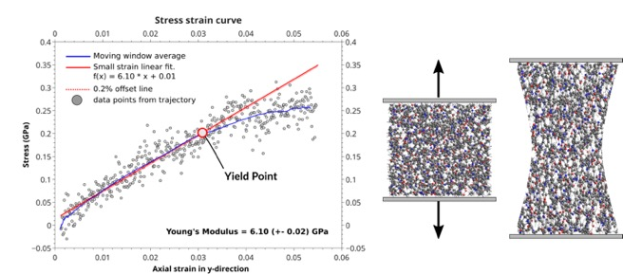
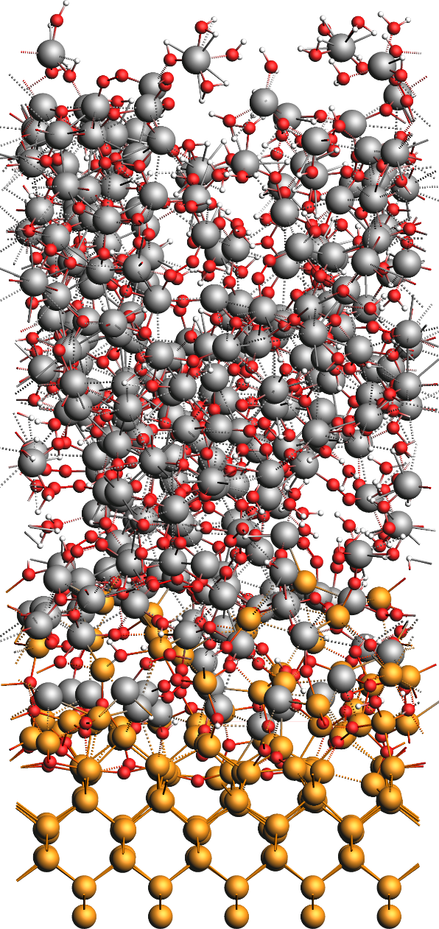





Amsterdam Modeling Suite
Atomistic & Multiscale Simulations for Chemistry & Materials
Fedor Goumans, Chief Customer Officer, goumans@scm.com
AMS Workshop, NTU, Taiwan, 28 August 2023
Notes:
None of you needs further convincing that we need new, better-performing materials to help tackle our societal challenges, in particular related to food, water, and energy. We need new materials and processes to capture and store energy, to desalinate and clean water, to more efficiently and sustainably produce food, and to recycle plastics and precious metals. And we need those new materials & processes quickly.
I’m Fedor Goumans, Chief Customer Officer with Software for Chemistry and Materials. I will talk to you about our ongoing efforts in developing atomistic methods to understand and predict molecules, materials, and processes; where we envision accelerating them through artificial intellegence; why linking to the macro-scale is important, and in general an wholistic view of where amalgation of existing and emerging digitial technologies can help accelerate new materials discovery.

Slide 2
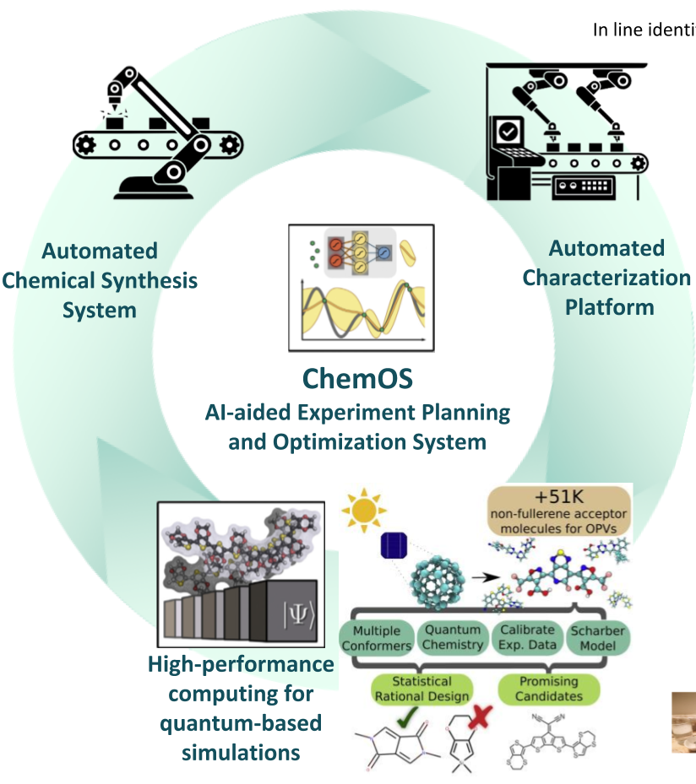
New materials discovery too slow
8-19 years to develop materials solutions in new markets
80-85% R&D programs fail
>50% R&D spending only incremental improvement
Catch 22: slow discovery ⬄ few new materials
https://www.mckinsey.com/industries/chemicals/our-insights/chemical-innovation-an-investment-for-the-ages
  Simulations -> predict new materials
  Robots -> make new materials
  AI -> improve simulations and DOE
the Matter Lab - Aspuru-Guzik
Notes:
As you’ve heard, traditional R&D for new materials is too slow. It takes some dozen years to develop materials solutions in new markets, because most programs fail, and if they succeed, more often than not, only lead to incremental improvement. The Catch-22 is that since so little new materials are being discovered, only very few new materials are being made. To break this status quo, simulations can help navigate through material space and predict the most promising new materials which can then be made and tested.
This really comes to fruition if we can make a continuous upward cycle by incorporating robots to make and test the predict materials, and ideally improve the speed and quality of predictions by including AI full circle.

Slide 3

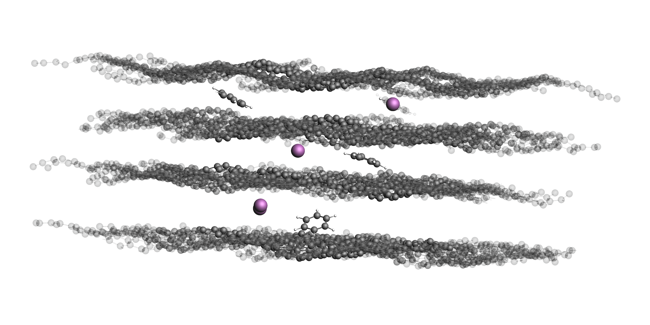
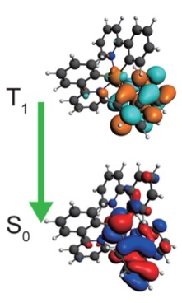
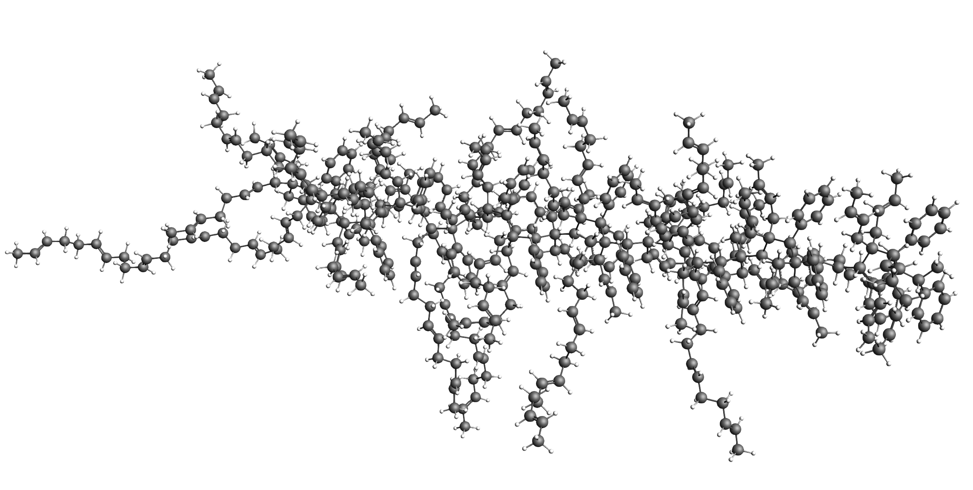
Bottom up Property Prediction
  Atomistic modeling
  Decreases search space
  Develops understanding
  Input for meso & macro
Batteries:
fast recharge,
high capacity
(m)CPU: high capacity, I-V profiles
Glass, coating: optical properties, conductivity
OLEDs, QLEDs: color, lifetime & efficiency

Slide 4
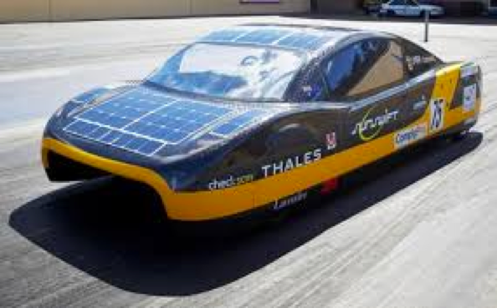
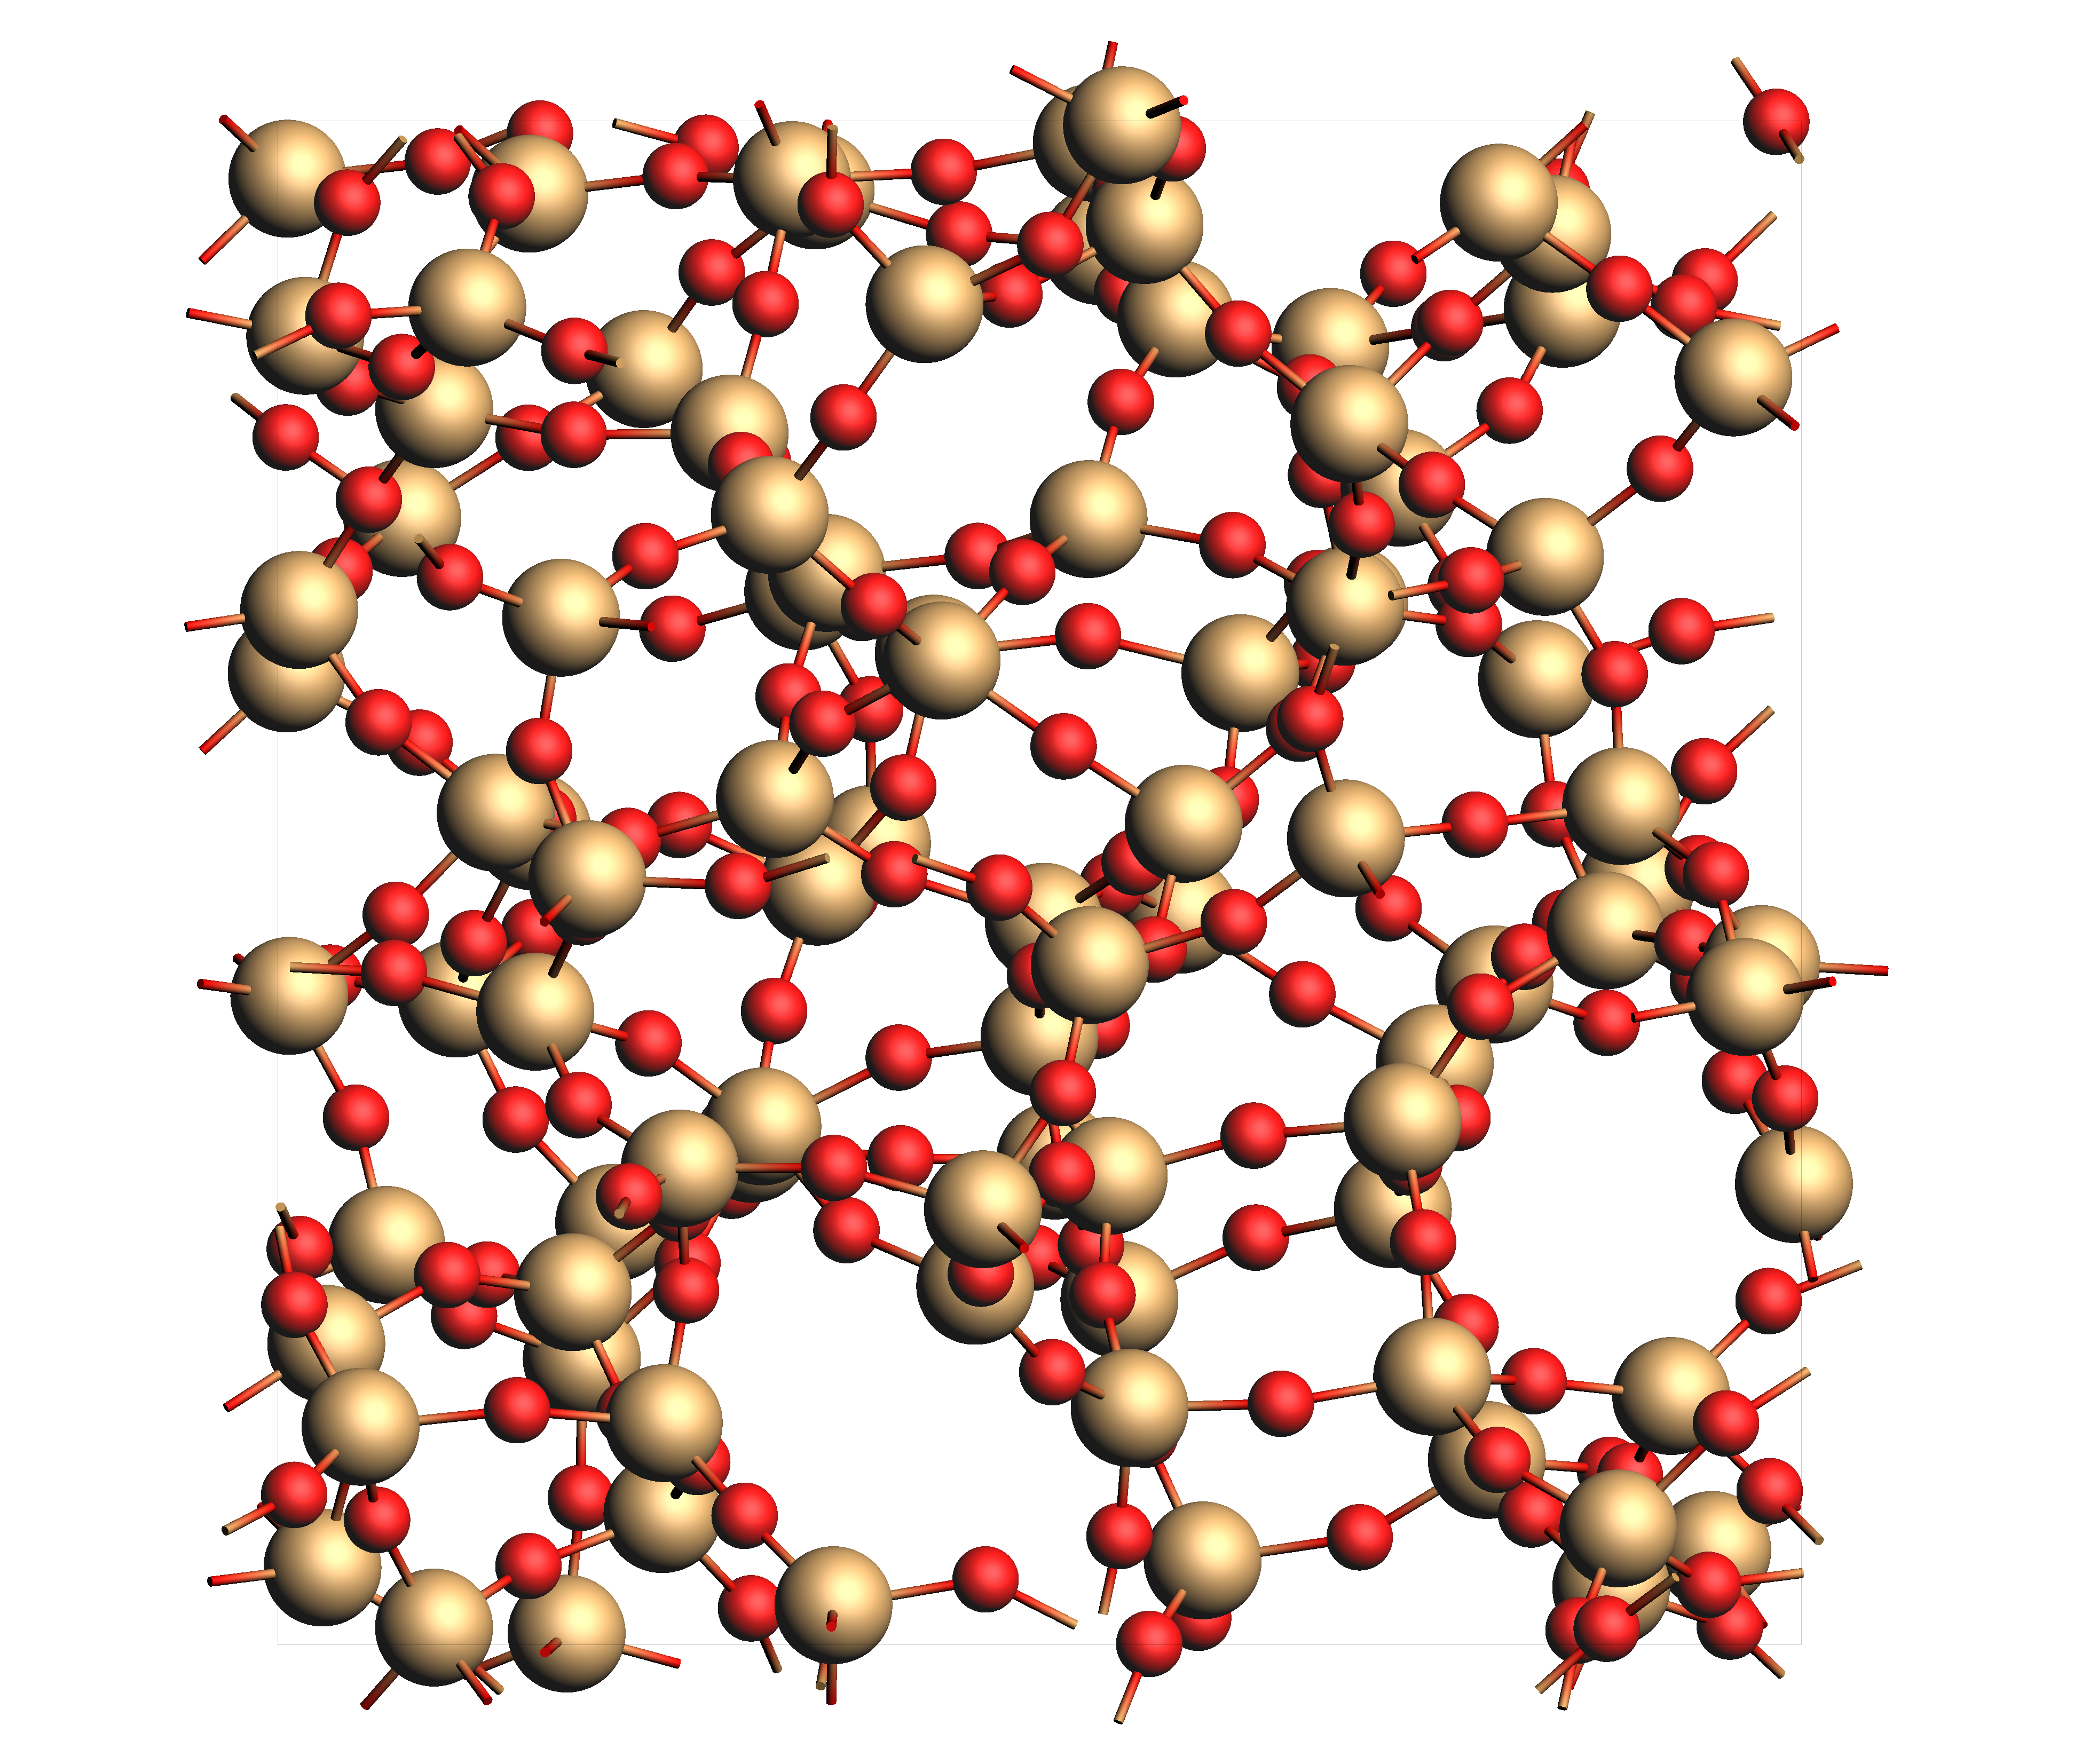
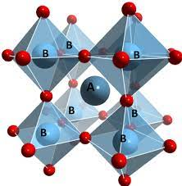
Bottom up Property Prediction
  Properties are determined at the atomistic level => predict, understand & improve through modeling
Batteries: fast recharge, high capacity
Chassis: light & durable, coating
Glass: optical properties, electronics
Tires: Reduce wear &friction
Solar cells: long lifetime & high efficiency
Notes:
Ultimately, the property of any material is dictated by what’s happening at the atomistic level, including the materials’ behavior in, say, a battery or a chemical reactor. So while through atomistic simulations you can more quickly select individual molecules or materials with the desired properties, however, one should take into account how it interacts in the grand scheme of things, in which what I’ll call the device level for now.
While we can model all we want, eventually the only real test if the device made out of the materials works as intended. We can and should use that as feedback for improved atomistic and multi-scale modeling.

Slide 5
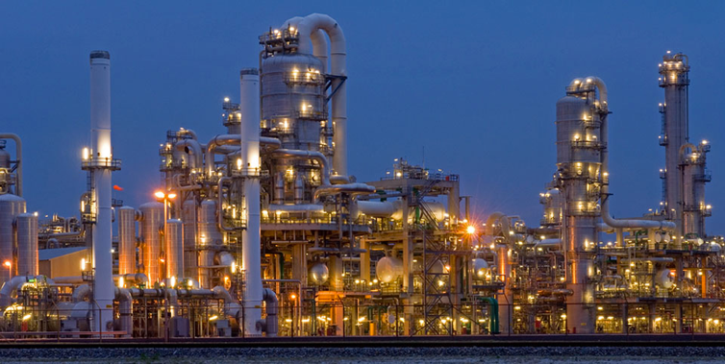
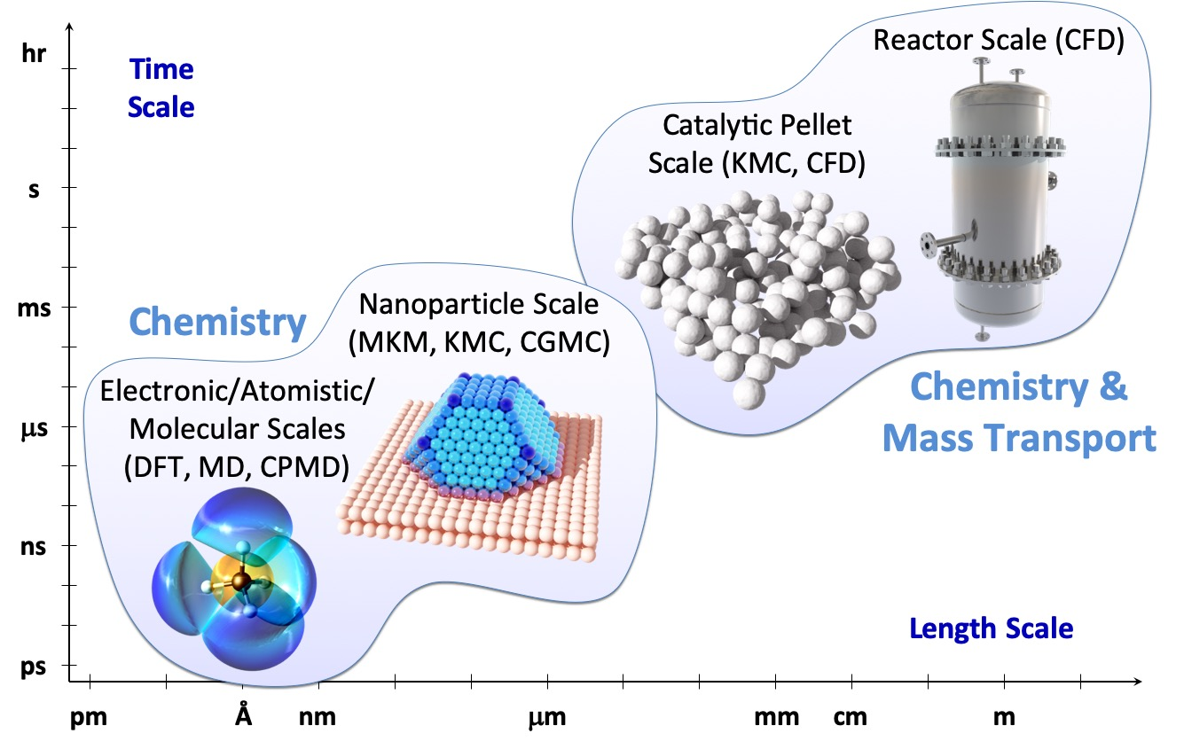
Bottom up Reactor Design
Optimize separation
processes
Reduce corrosion & embrittlement
Optimize catalyst
selectivity & reactivity
  Crossing the scales, discovering reactions parametrizing fast methods
  ReaxPro
  AutoReactPro
  AutoCheMo

Slide 6
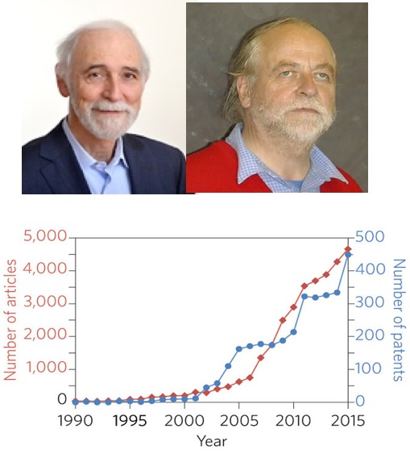
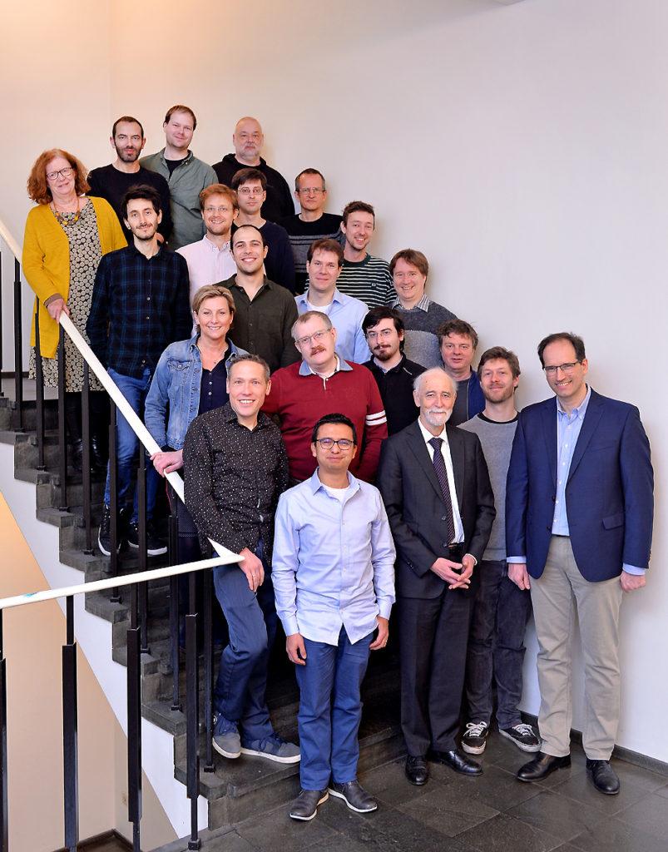
History: Sofware for Chemistry & Materials
1970s ADF: first DFT code to
understand chemistry
  Baerends@VU & Ziegler@Calgary⁽⁺⁾
1980s: Mitsui, Shell, Akzo, Unilever:
  Training in Amsterdam -> optimize catalysts
1995 SCM: Spin-off company
  Continuous support & Development
2010s: DFTB, ReaxFF, COSMO-RS (Albemarle, DSM)
2019: Multi-scale: ReaxPro (BASF, Dow, Shell, JM)
2023: ~30 people (19 senior PhD’s)
  Many collaborations nonprofit & industry
  SCM: development, debug, port, optimize, & support
articles &patents in materials science with
“density functional theory”, Nat. Mat. 4619
Notes:
To help inorganic chemists predict & understand reactivity, almost half a century ago, Prof. Evert Jan Baerends took density functional theory methods from the physics community and discretized them. In the first 2 decades the code was developed by academic researchers, sponsored by the chemical industry who were eager to come to Amsterdam and learn how to use Amsterdam Density Functional to help them develop better catalysts.
Founded in 1995 in Amsterdam, Software for Chemistry & Materials has grown organically to over 20 people. The Amsterdam Modeling Suite, is used by academics, government labs, and industrial researchers around the globe in a variety of application areas.
We are still developer-heavy and collaborate with many universities and companies to continuously improve our software to tackle tougher problems.

Slide 7
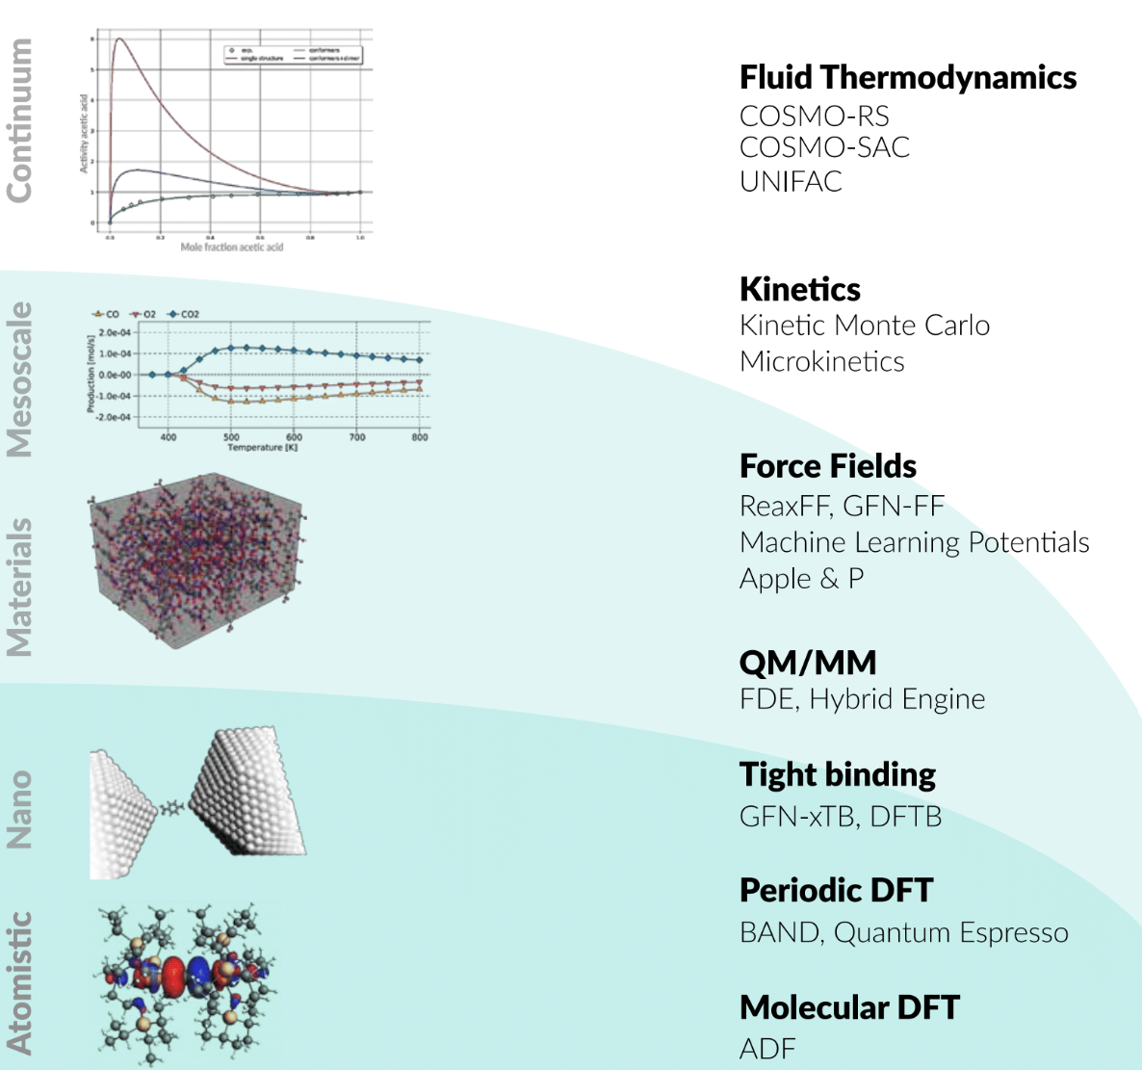
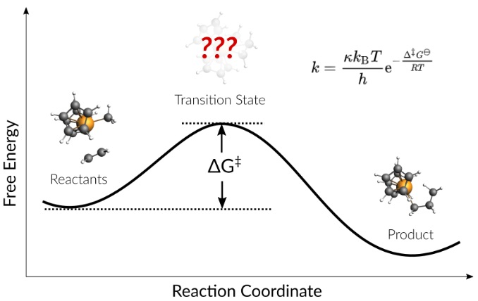
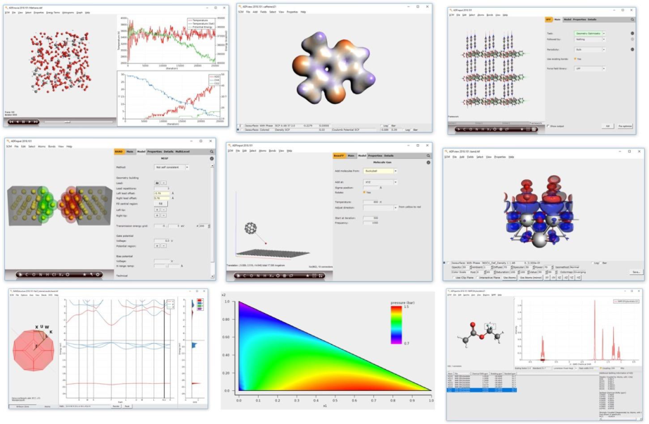

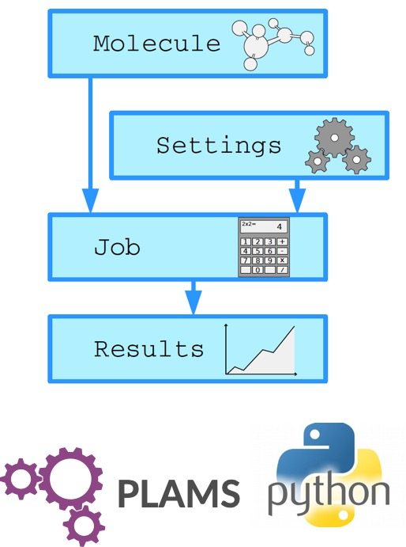
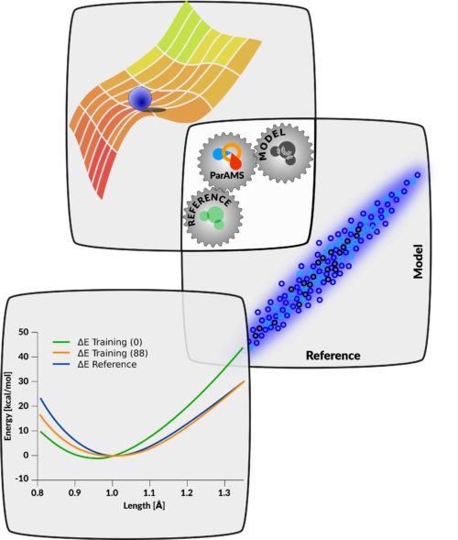
Amsterdam Modeling Suite
AMS Driver: PES exploration, MD, MC, TS, IR, phonons, ...
Integrated GUI, remote jobs
Python: workflows, parametrize
  Progressive screening
  Train / parametrize
Notes:
Besides DFT for molecules and periodic systems, we have developed faster electronic structure methods (DFTB), force-field based methods, as well as continuum fluid thermodynamics methods, and integrated meso-scale kinetics. The comprehensive Amsterdam Modeling Suite has an integrated user interface, both graphically and through python, and comes with a central driver that can perform complex tasks on the PES with any of the atomistic methods or a multi-layer combination thereof.

Slide 8
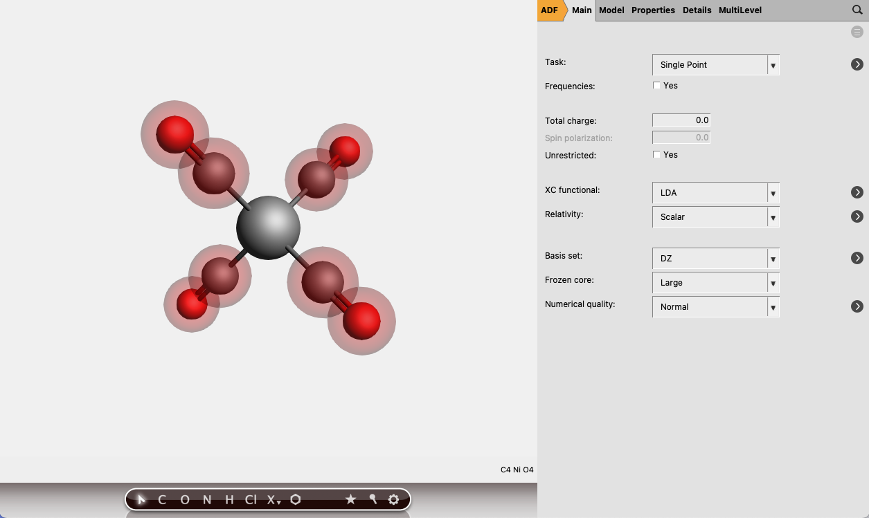
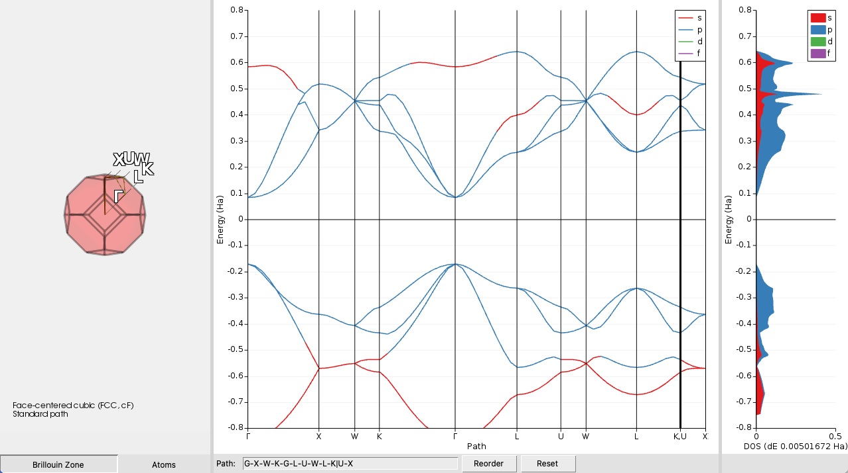
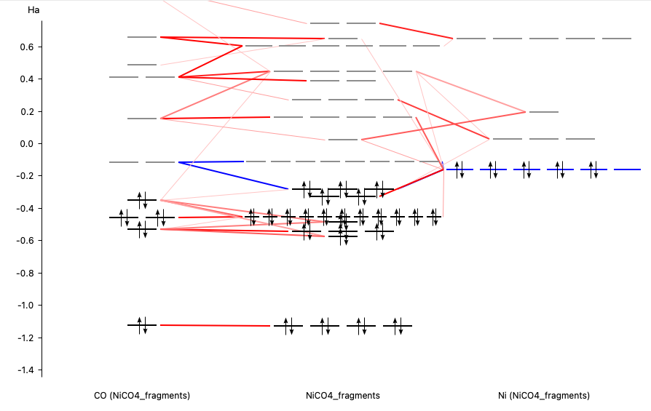
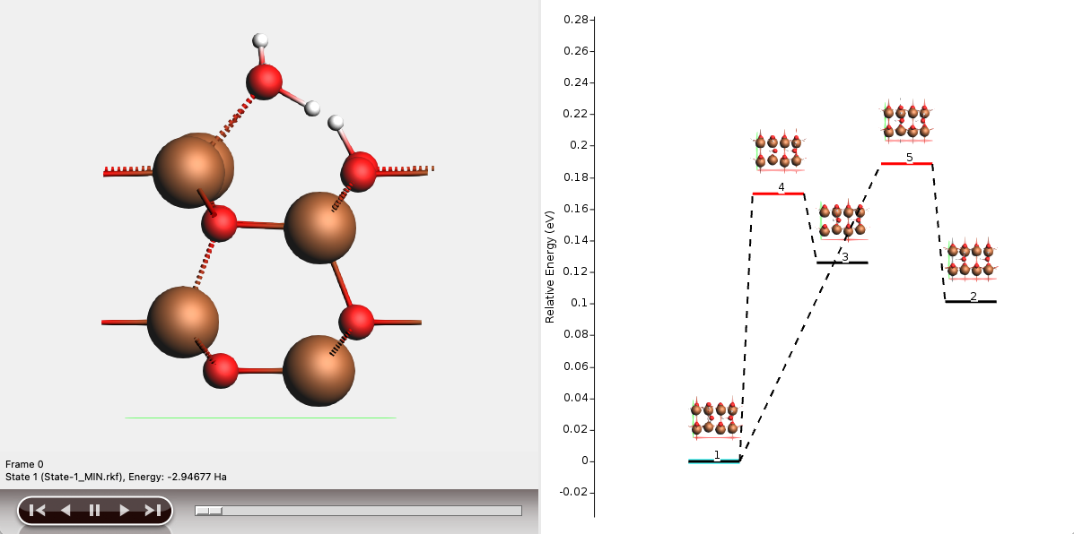
The graphical user interface (GUI)
Setup & analyze calculations
AMSjobs
  manage jobs, locally or remotely
  extract summaries
AMSinput
  build molecules, periodic systems, polymers, etc.
  import structures from many formats
AMSview, AMSlevels, AMSspectra, etc.
  analyze results
  visualize structures, transition states, orbital densities, DOS, band structure, spectra, etc.

Slide 9
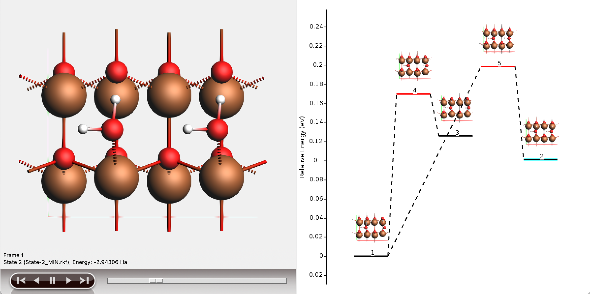

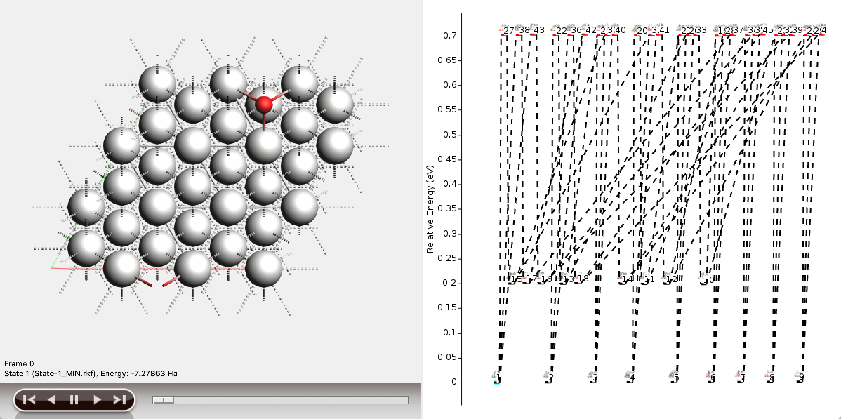

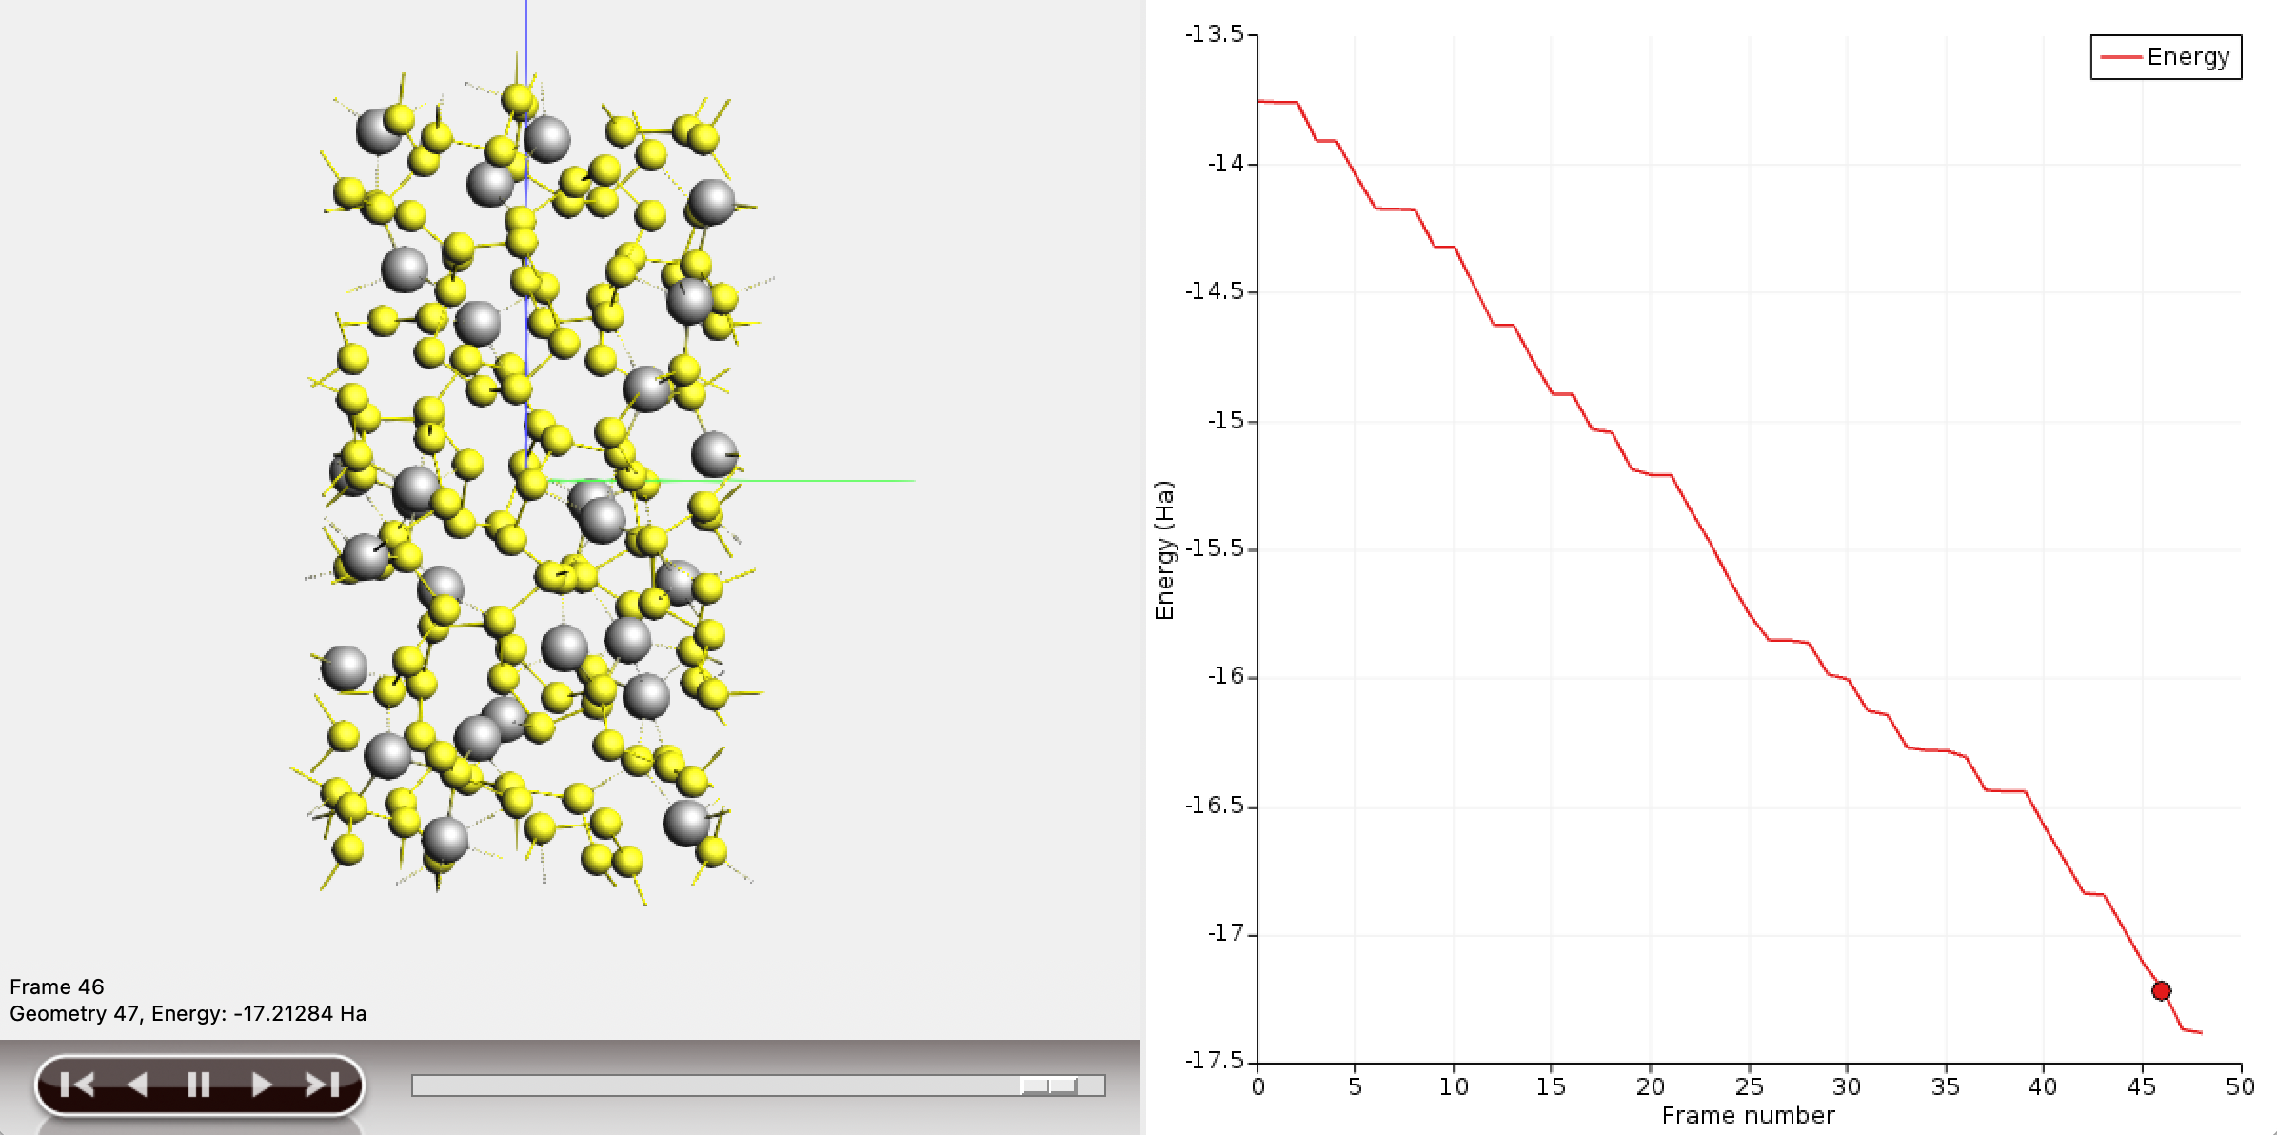
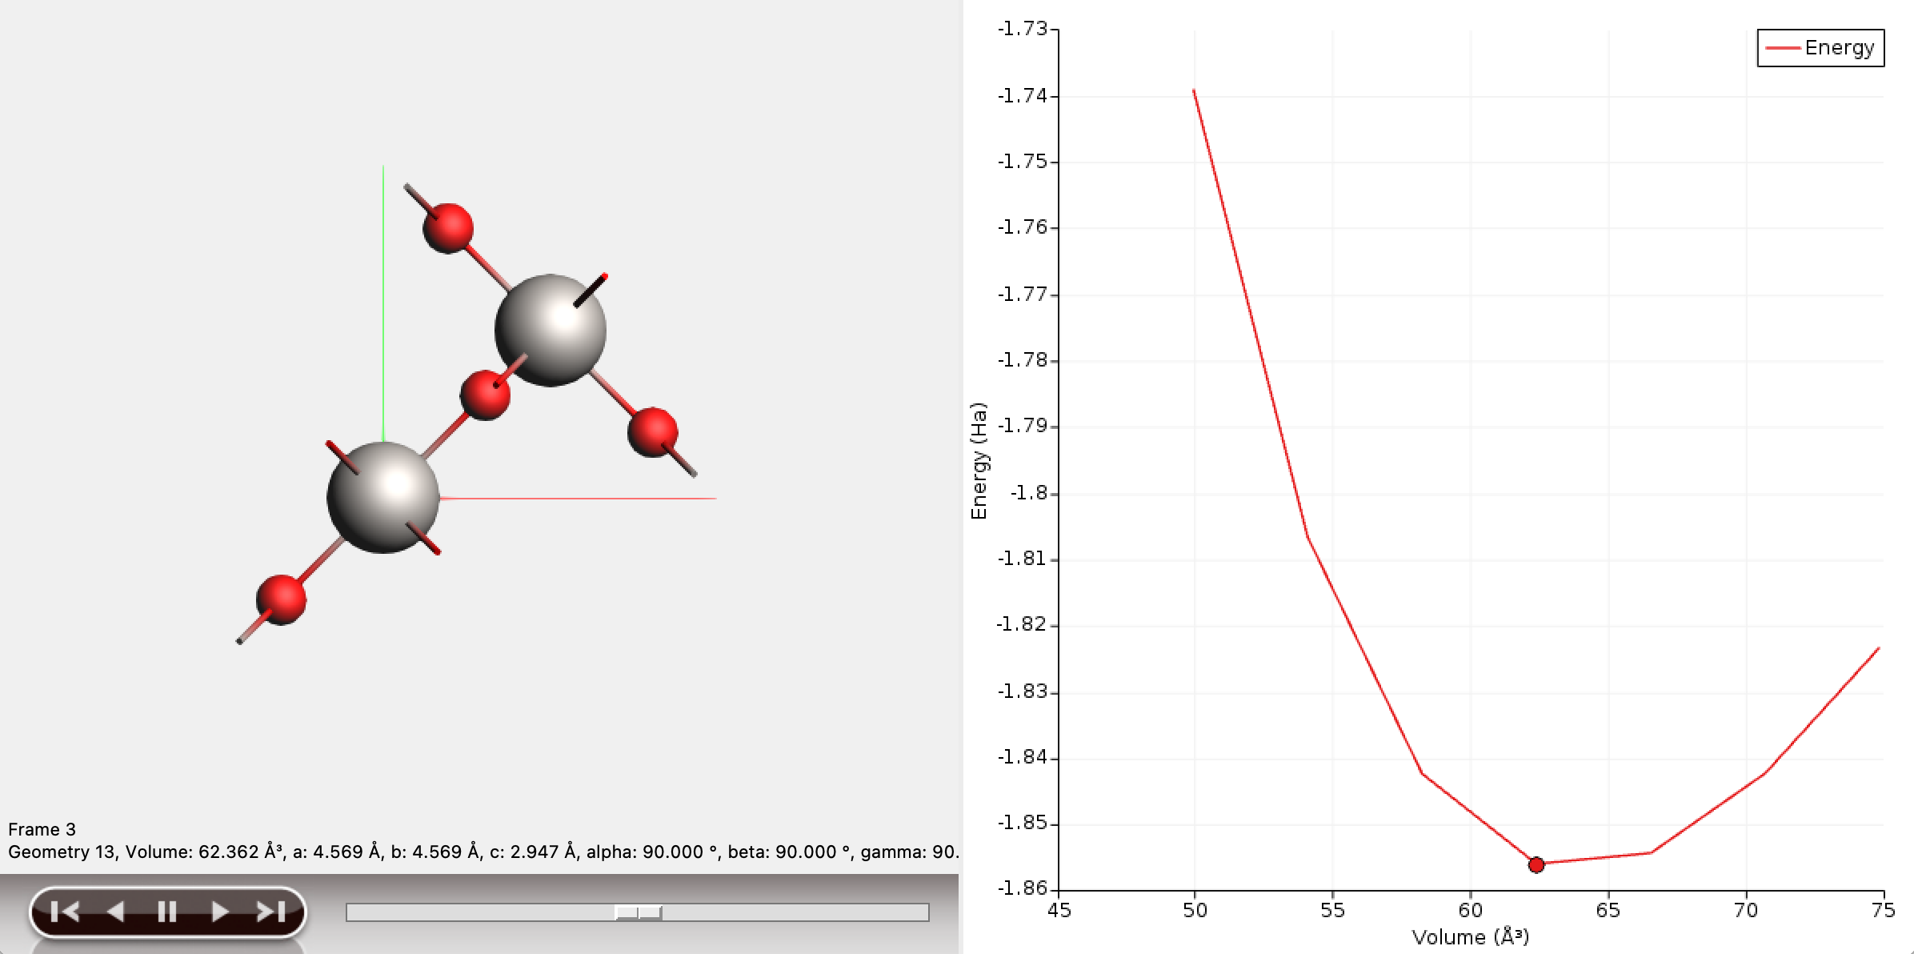
AMS driver: MD with ‘anything’
A unified driver to explore the Potential Energy Surface (PES)
Molecular dynamics
Frequencies & phonons
Stress & elastic tensors
Scan coordinates & constraints
Monte Carlo, etc.
Tasks
Engines
  ADF
  BAND
  DFTB
  ReaxFF
  MLP

Slide 10
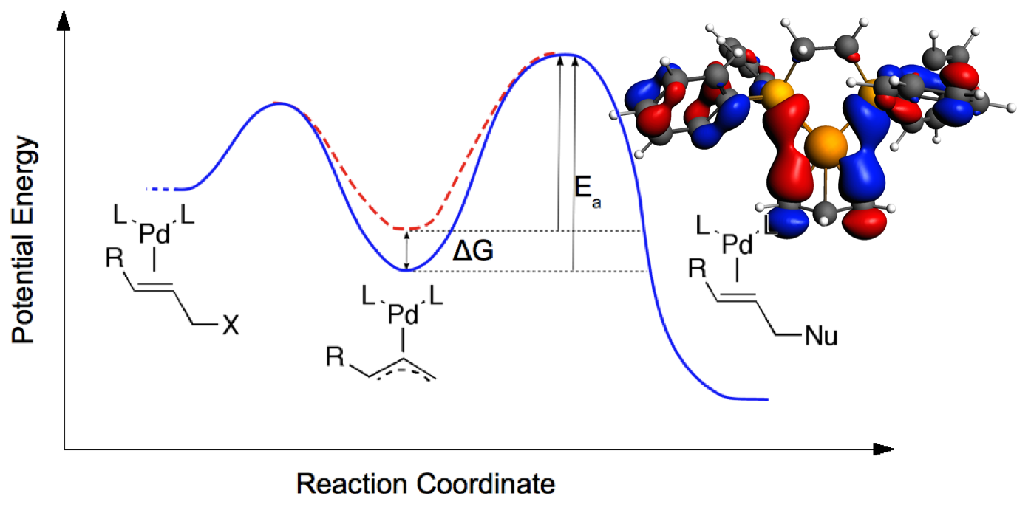
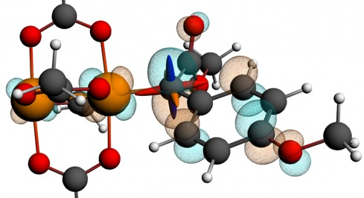
ADF: Molecular DFT
Strong & unique points
All-electron Slaters, all elements
ZORA & X2C scalar relativistic
Spin-orbit coupling
Fast GW, BSE, double hybrids
Spectroscopy
    EPR, NMR, IR, Raman, UV/VIS, XANES,
Bonding analysis
    ETS-NOCV, QTAIM, MO diagrams, NCI
    NTOs, CT descriptors
    TDM between excited states
    Transfer integrals
Environments
    COSMO, SM12, 3D-RISM
    Subsystem DFT (FDE)
    DRF, SCRF, DIM/QM, QM/FQ, multi-layer
Bonding analysis: Understanding Catalyst-Substrate Interactions Nature Chem. 2, 417 (2010)
NMR calculations locate ¹³C di-Rh carbene
catalyst intermediate, Science, 342, 351 (2013)

Slide 11
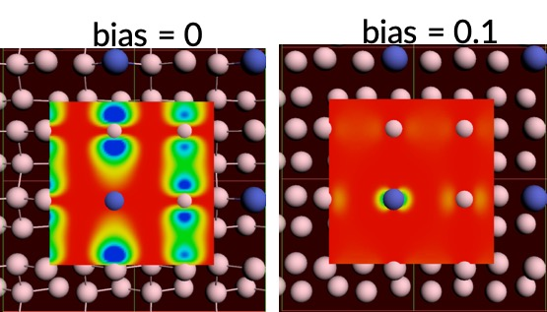
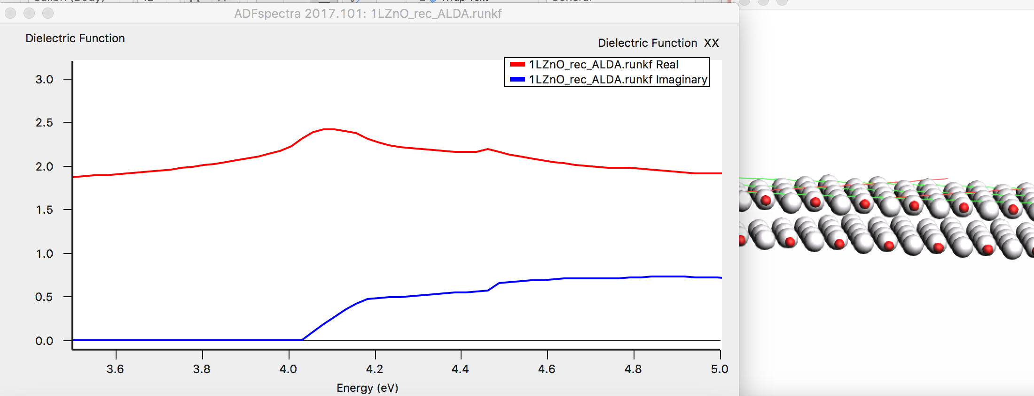
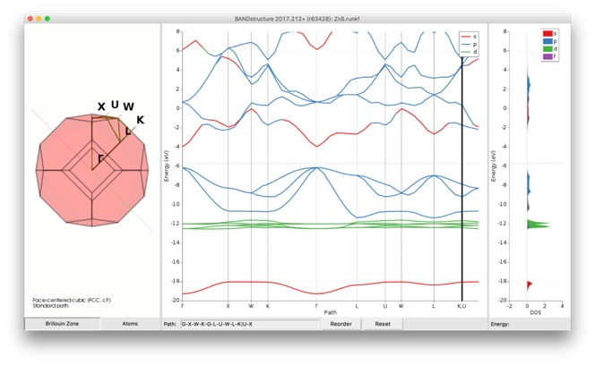
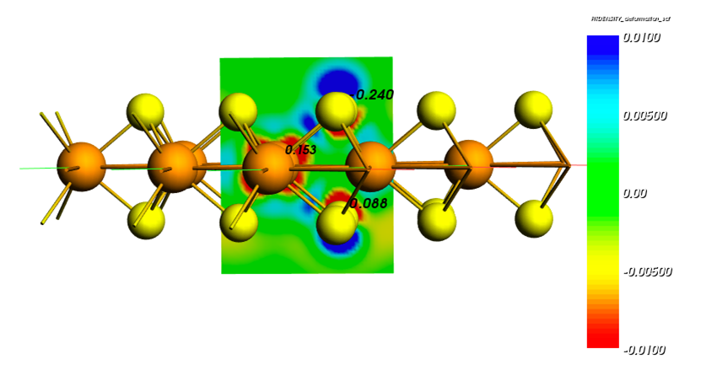
BAND Periodic DFT with AOs
Dielectric function ML ZnO (2D TDCDFT)
LDOS: STM PtGe(100)
Band structure, pDOS, fat bands ZnS
Polarizing MoS₂ with an electric field

Slide 12
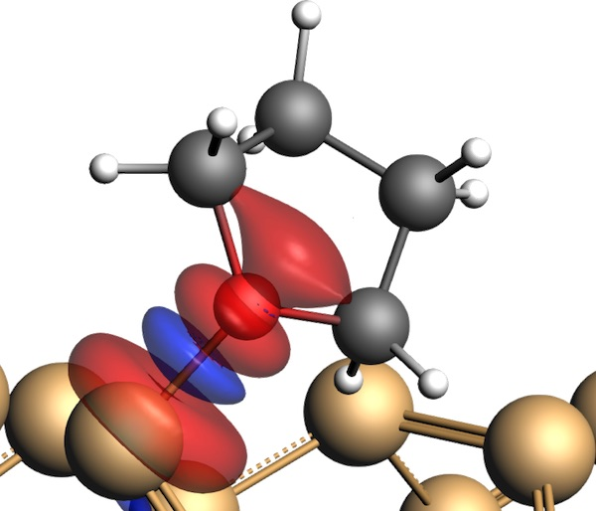
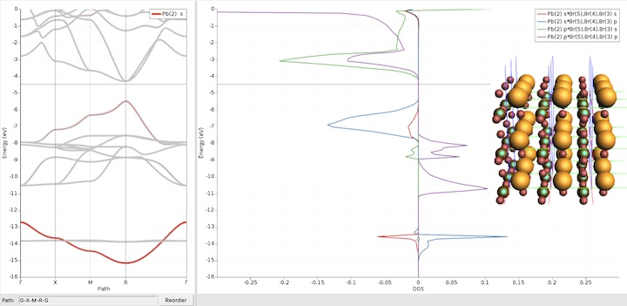
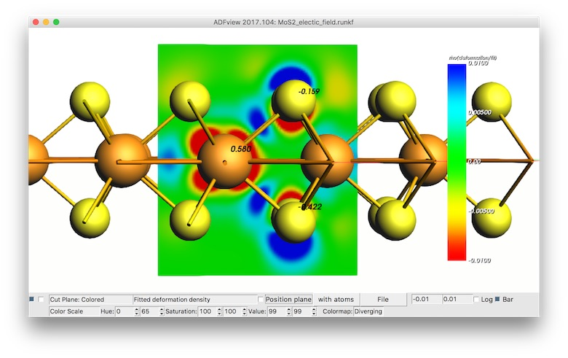
BAND + Plane Wave codes (QE)
Atom centered basis functions, STO + NAO
  Compare cluster with periodic
  No pseudopotentials, basis sets for all elements
  Core spectroscopy (core holes)
  Easy orbital analysis: pDOS, COOP, EDA
  Dielectric function: polarization functional, TDCDFT
  xc: TASK, SCAN, MN15-L, HSE06, GLLB-sc, D3(BJ), DFT-1/2, r2SCAN-D4
  Self-consistent spin-orbit coupling
  Self-consistent NEGF (biases, spin)
True 2D surfaces, 1D polymers
  Solvation: COSMO, SM12
  Polarization in z-direction
  1D, 2D electronics (homogeneous E field)
  Nanotubes
Integrated GUI + Python I/F
  Easy set up & analysis
  Switch: ADF, DFTB, BAND, QE (VASP)
  Parametrize DFTB, ReaxFF, MLP
periodic energy decomposition analysis (tutorial)
L. Pecher and R. Tonner
WIREs CMS, (2018)
COOP in perovskites
(tutorial)
Goesten & Hoffmann
JACS (2018)
Polarizing 2D semiconductor (tutorial)
N. Zibouche et al.
PCCP (2014)

Slide 13
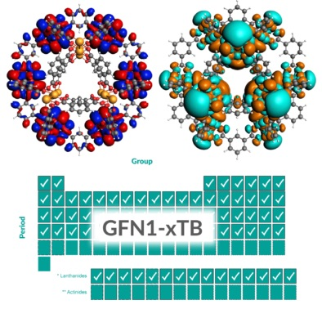
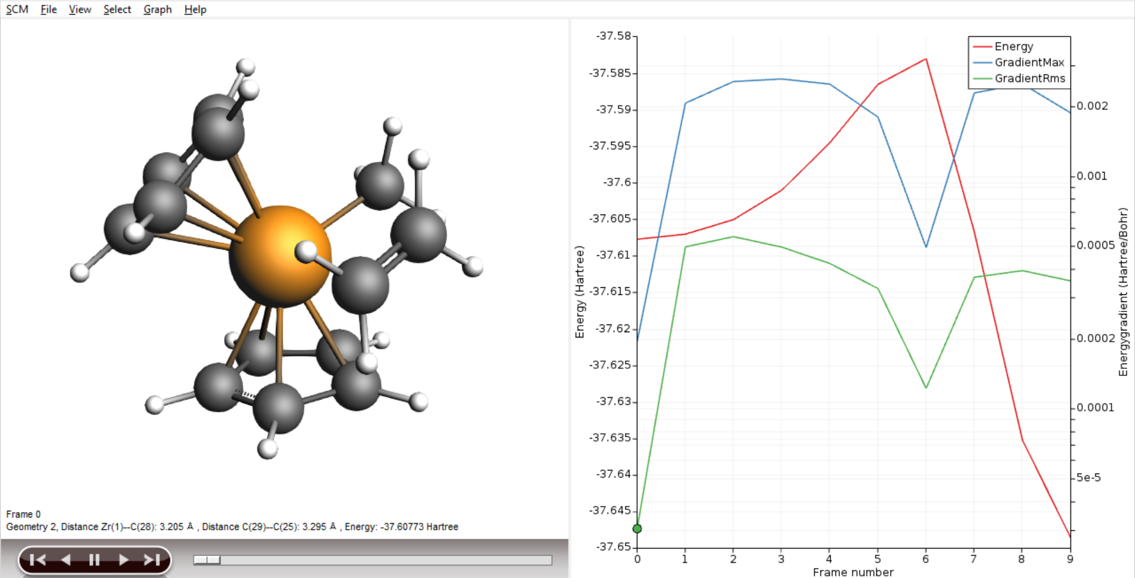
DFTB: ‘fast DFT’ for molecules & periodic
Approximated DFT
Nearest neighbor & minimal basis
Tabulated elec & rep. parameters:
  Grimme GFN-xTB (Z = 1-86)
    GBSA solvation
  QuasiNaNo & DFTB.org
Capabilities & Features
UV/VIS for molecules (fast!)
MOs, Band structures, DOS
Molecules, 1D polymers, bulk
NEGF: transmission
DFTB & MOPAC + AMS driver
Geometries, frequencies, phonons
Stress tensors (optimize under p)
Advanced MD, PES scans
GCMC, molecule gun (deposition)
Ziegler-Natta TS tutorial

Slide 14
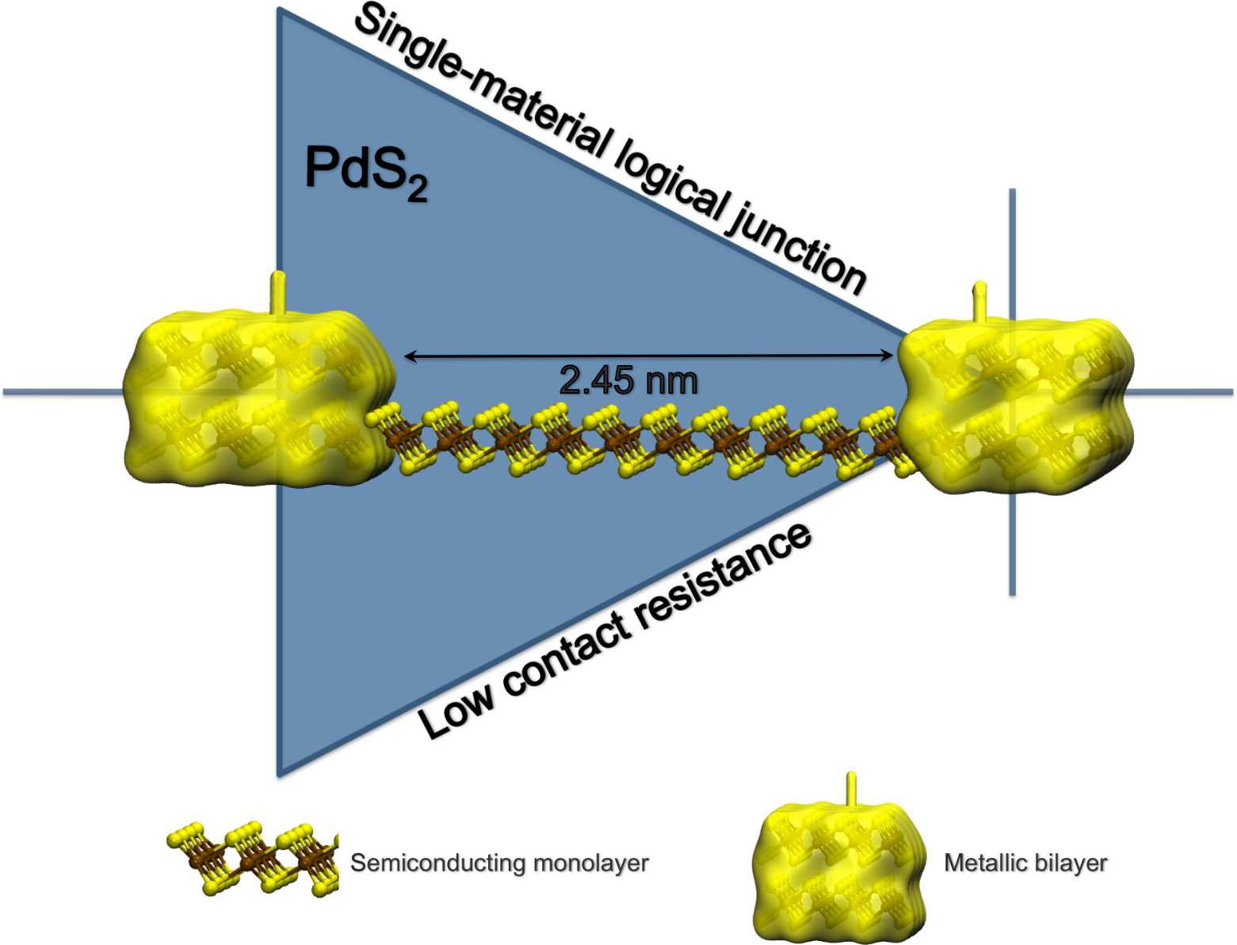
Single 2D semiconductor material diode
2D PdS₂ is
semiconducting as ML
semimetallic as BL
DFTB-NEGF
channel lengths of about 2.5 nm
I–V characteristics tunable by gate voltage
M.Ghorbani-Asl, A. Kuc, P. Miró, and T. Heine, A Single-Material Logical Junction Based on 2D Crystal PdS2, Adv. Mater. (2016)

Slide 15
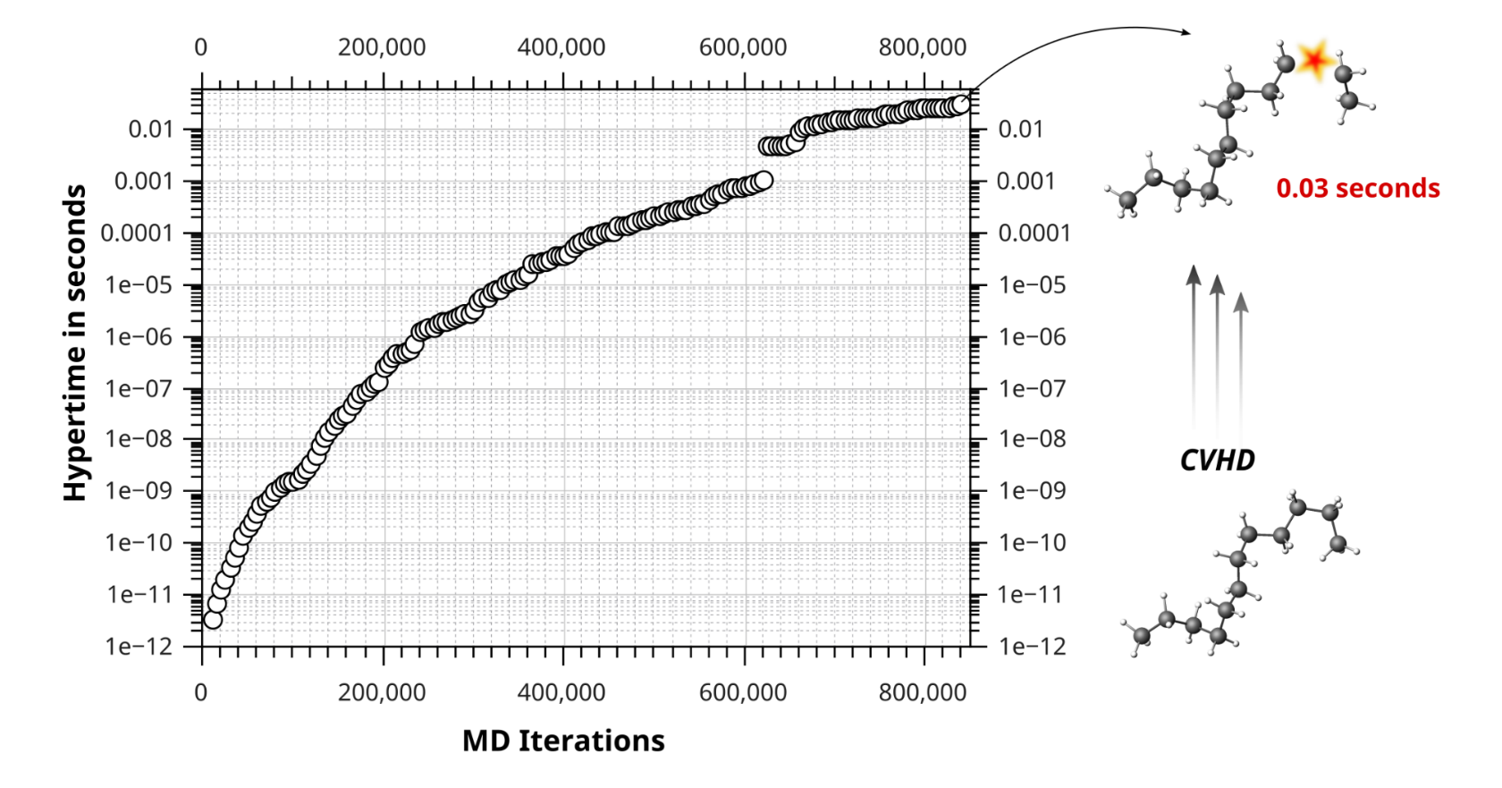
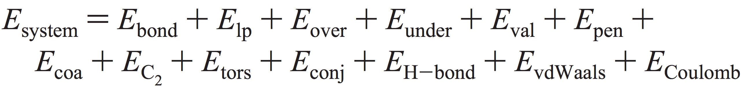
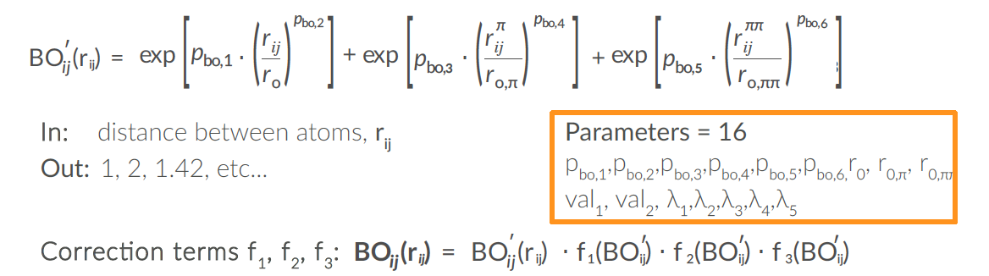
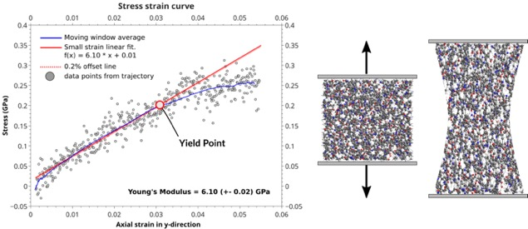
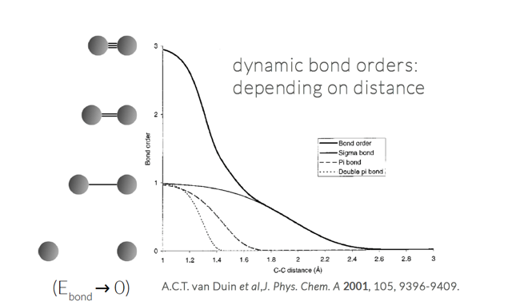
ReaxFF – reactive molecular dynamics
Single atom type, bond-order based
Charge equilibration
Continuous F & E
Combustion, pyrolysis
Chem. Sci., 2016, 7, 5280
Review NPJ Comp. Materials (2016):
The ReaxFF reactive force field: development, applications and future directions
Polymer formation & Tg, CTE, yield point
J. Polym. Sci. B 2018, 56, 255

Slide 16
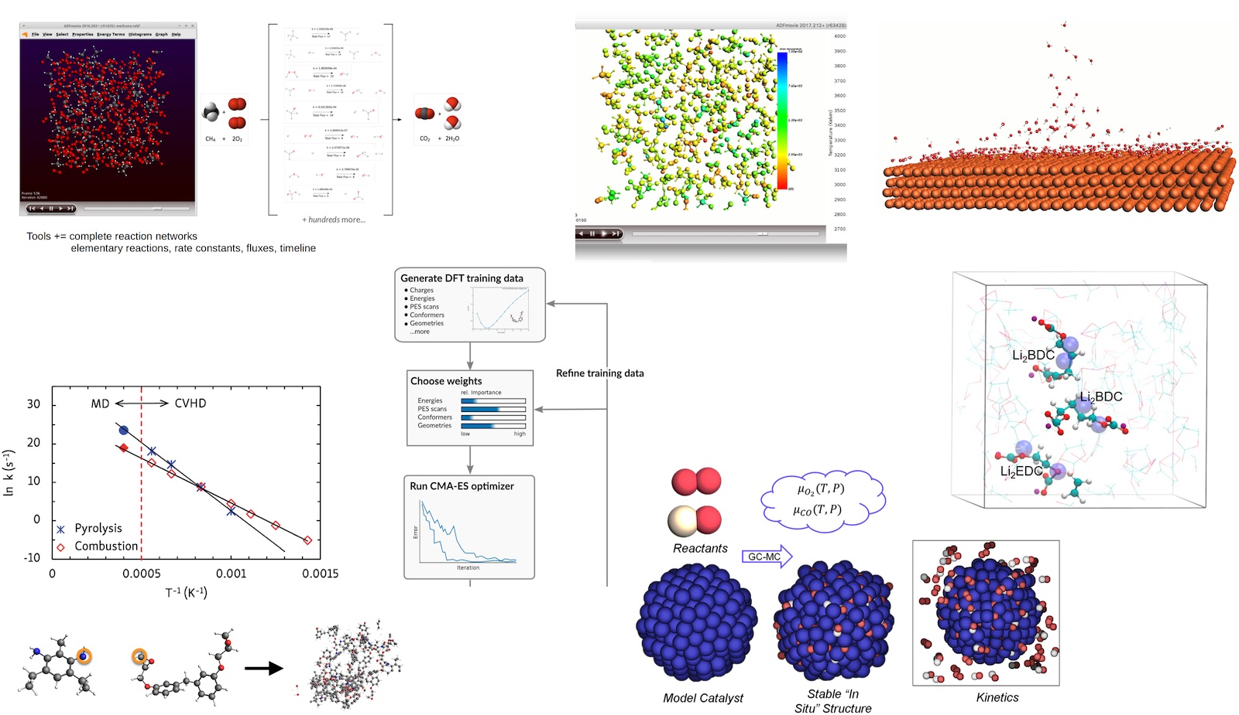
MD tools AMS driver
ChemTraYzer2: Automated rates & pathways
Analyze surface reactions
T-NEMD, local T:
heat transport
Molecule gun: CVD, ALD, etching
eReaxFF: include e-
Accelerated dynamics:
fbMC, CVHD, PRD
CMA-ES (ReaxFF) (re)parameterization
ParAMS tools & GUI
bond boost
build polymers
GCMC: speed up thermo

Slide 17
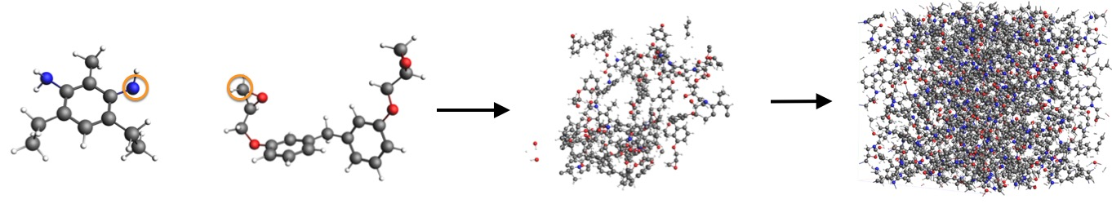
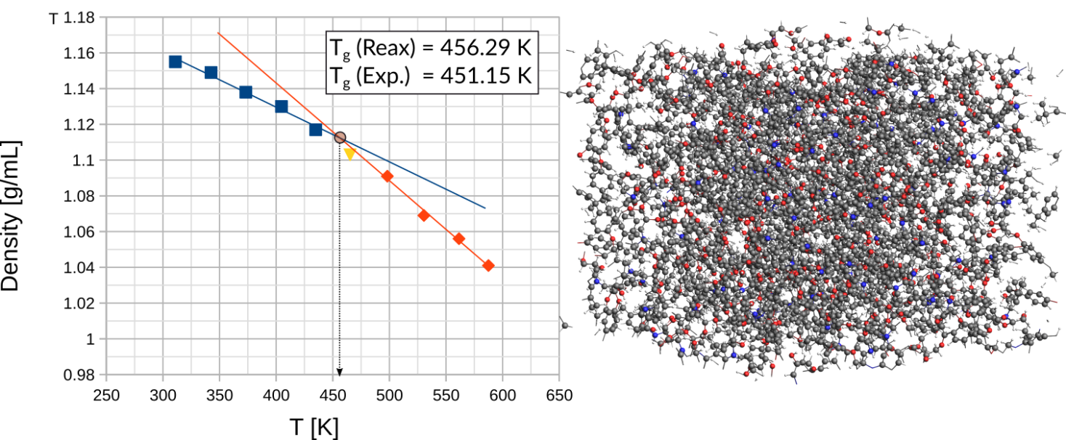
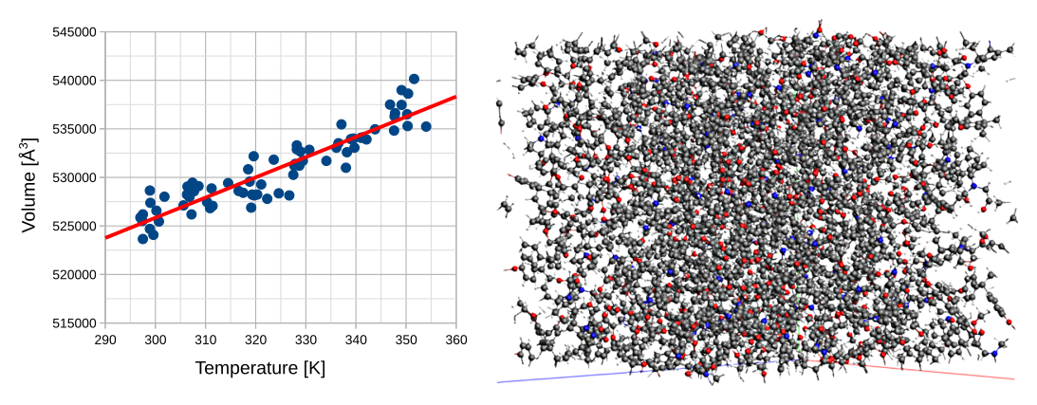
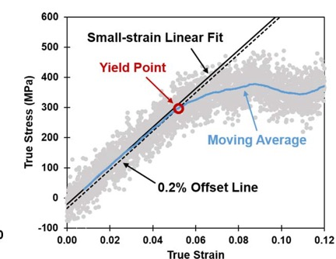
Epoxy polymers: structure & properties
Understand & predict how cross-linking effects mechanical properties
  Exp = slow: minutes to hours to reach ~80% cross-linking
  ReaxFF: simulate few ns => accelerate kinetics to get highly xlinked structures
epoxy + amine
boost reaction
polymer
density(T) using npT
glass transition T_{g}
volume(T) npT
CTE
Stress-strain:
yield point, Poisson ratio
Notes:
www.scm.com/doc/Tutorials/MolecularDynamicsAndMonteCarlo/PolymersBondBoost.html
www.scm.com/doc/Tutorials/MolecularDynamicsAndMonteCarlo/PolymersGlassTransitionTemp.html
www.scm.com/doc/Tutorials/MolecularDynamicsAndMonteCarlo/PolymersThermalExpansionCoeff.html
www.scm.com/doc/Tutorials/MolecularDynamicsAndMonteCarlo/PolymersMechanicalProperties.html

Slide 18
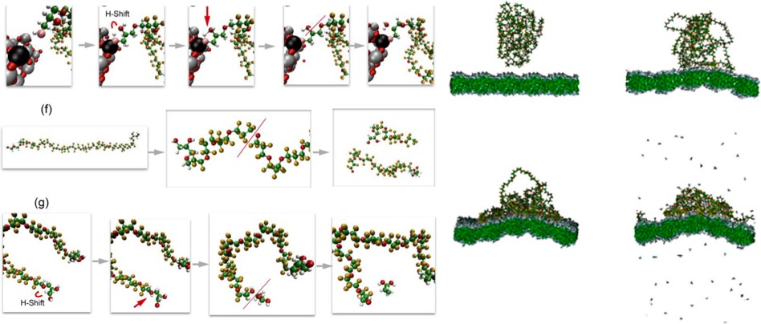
ReaxFF simulations: degradation
Degradation mechanisms perfluoropolyether lubricant on SiO₂, Fe₂O₃ nanoparticles & DLC, effect of oxygen and water. Work by van Duin (Penn State/RxFFconsulting) with Western Digital
J. Phys. Chem. C, 120, 27433 (2016)
J. Phys. Chem. C, 122, 2684 (2018)
Notes:
(c) dry-air-treated nanoparticles, (d) wet-air-treated nanoparticles, (e) mechanism for lubricant degradation by the H-shift on a
silica nanoparticle (target Si atom, black; target O atom, pink), (f) mechanism for lubricant degradation from the main chain, and (g) mechanism for
lubricant degradation from the functional group (C, green; F, yellow; O, red; H, white; Si, gray).

Slide 19
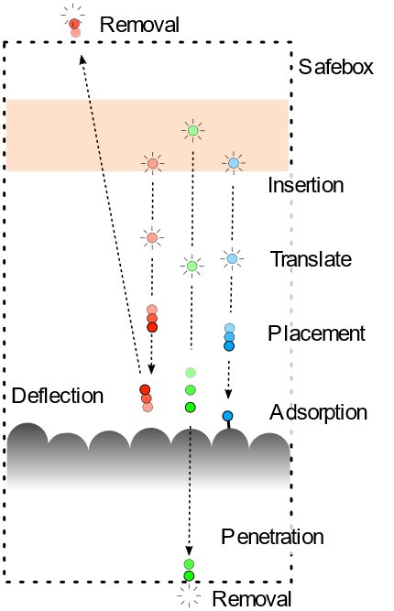



Sputtering, etching, CVD, ALD, PVD
Shoot molecule/atomic targets at surface
High E: sputtering, (plasma/photo?)etching
Low E: CVD, ALD, PVD
  Need good force fields:
  ReaxFF refit short distances
  Sputtering yields (E, angle) (movie: Ar / SiO₂)
Tutorial CVD: Alumina / Ge(001)

Slide 20



Machine Learning Potentials
Automatically install popular ML Backends
  Pre-parametrized
  ANI-1x and 2x (H, C, N, O, F, S, Cl)
  M3GNet (“Universal”)
  Backends, via ASE
  NEquIP, FLARE (on-the-fly)
  sGDML
  SchNet
  CHGNet
Use MLP with all the tasks in the AMS driver
  PES scans, reaction discovery, conformers, IR,
  phonons, MD, MC etc.
  Hybrid (multi-layer): combine with other methods
CUDA-enabled PyTorch and Tensorflow
i) O. Isayev et al. Chem. Sci., 2017, 8, 3192–3203
ii) C. Chen, S.P. Ong., Nature Comp. Sci. 2, 718–728 (2022)
iii) S. Batzner et al. Nature Comm. 13: 2453 (2022)
iv) S. Chmiela et al. Comp. Phys. Commun. 240 (2019) 38-45
v) K. T. Schütt et al., J. Chem. Theory Comput. 15 (2019) 448-455

Slide 21






MLPotentials for chemistry
From organic chemistry to catalysis
Explore conformers with ANI-1x/2x
  CREST & RDKit conformer generation
  Re-score with DFT
  Boltzman averaged properties
Screen adsorption sites with PESexploration
  Refined (or fully computed) with MLP
  OCP (Open Catalyst Project) via ASE engine
  https://opencatalystproject.org/
Discover chemical reactions with ANI-1xnr (2024)
  Use the nano reactor to accelerate reactions
  Analyze all chemical reactions with ChemTrayZer

Slide 22





MLPotentials for (battery) materials
M3GNet, trained to Materials Project 1000x faster than DFT
C. Chen, S.P. Ong., Nature Comp. Sci. 2, 718–728 (2022)
Li intercalation potentials accurately predicted with DFT (~100 atoms)
M3GNet reproduces DFT really well
ΔE
Li potential
Mechanical properties of electrode (volume change upon lithiation)
Li diffusion through NEB or PES scan
M3GNet can accelerate by 1000x
(Dis)charge curves: GCMC
Activation energy
Diffusion (kinetics)

Slide 23



Training FF with ParAMS
ParAMS making parameters optimization easier
Import, build and visualize training data
Use data from AMS, VASP, QE, and experiments
Tune parameters to describe energies, forces, geometries, stress tensor, charges, bandgaps, etc.
Use validation sets to prevent overfitting
Submit multiple optimization at the same time to explore parameters space
Explore the sensitivity of the parameters to select the most important subset to optimize
Train DFTB, ReaxFF, Force field, and … MLP
J. Chem. Inf. Model. 2021, 61, 8, 3737–3743
J. Chem. Theory Comput. 2023, 19, 9, 2557–2573
https://www.scm.com/product/params

Slide 24
Training MLP with ParAMS
Active learning workflow
No
Add last DFT frame
Accurate?
Initial dataset
Train ML
(1) Use ML to generate new data
Replay with DFT
Small and conservative
Add last DFT frame
Yes
No
Add last DFT frame
Accurate?
Train ML
(2) Use ML to generate new data
Replay with DFT
Bigger, bolder (longer MD, higher T, more molecules, etc.)
amshome/scripting/scm/params/examples/ActiveLearning
https://www.scm.com/product/params
Final model
(#) Even bigger..
Yes

Slide 25


Hybrid Engine
Multi-layer (subtractive, QUILD, ONIOM)
  combine any periodicity, number of layers, and QM or FF methods
2-layer: (additive) QM/MM
  any periodicity
  QM: ADF, DFTB, BAND, MM: Force Field engine
Demo video

Slide 26




COSMO-RS/SAC: thermodynamic properties of fluids
Quantum Chemistry & QSPR for quick property predictions
  COntinuum Solvation MOdel + RS (Klamt), SAC (Sandler)
  chemical potential => activity coefficients => instantaneous properties
Solvation & excess energies, pKa
Solubilities, LLE, VLE, boiling points
Optimize mixtures: solubility, LLE
Polymers: Flory-Huggins X
QSPR & fast sigma: using SMILES
Sigma profile: 1D surface charge histogram

Slide 27


COSMO-RS: solubility in (polymeric) ionic liquids
COSMO-RS predicts beyond parametrization (opposed to UNIFAC)
Works well for SO₂ solubilities
Improvements for CO₂ (2018)
Combined with polymer terms (2021)
Lei group: Chem. Rev., 114, 1289−1326 (2014),
Green Energy & Environment (2018),
Green Energy & Environment (2021)
Notes:
COSMO-RS prediction of SO₂ solubilities (solid lines) in [BMIM]⁺[MeSO4]⁻, compared with experiments (symbols) at different temperatures (283, 298.1, 323.1, 348.1 K)

Slide 28

Enjoy the workshop!
We love to hear about your R&D challenges!
goumans@scm.com | www.scm.com
生萊科技有限公司 | www.sunrise.tw
Notes:
Let me stop here and thank you for your attention. At SCM we love to discuss your research challenges as well as collaboration options. Happy to have a chat if you are interested!

Slide 29


Summary: Amsterdam Modeling Suite
Couple atomistic, meso & macro
Integrated User Interfaces
  Graphical
  Python layer
  Connections to third party
Applications
  Catalysis
  Organic electronics
  Batteries
  Polymers
Notes:
In summary, for real-life improvement of molecules & materials, simulations can help by coupling across the scales in both ways. Machine learning will help to improve the speed, accuracy and breadth in the search for the best materials & processes and reduce the experimental costs & time.

Slide 30

Polymers: QSPR with sigma-moments

Slide 31

Hydrodesulfurization MoS₂: exp + calc
STM with high p & T (different H₂/H₂S pressure)
BAND calc. 2D=> phase diagram of edge -> compare with exp
Reaction pathways (Albemarle: partial Hessian in BAND very useful!)
Nature Communications 10, 2546 (2019)
Notes:
31

Slide 32


CH₄ and H₂ dissociation on Ni/γ-Al₂O₃
Dissociation at TMO – NP interface preferred
Aluminum acts as electron donor
Need 2D to polarize surface
Li, Croiset, Ricardez-Sandoval, J. Phys. Chem. C 2013, 117, 16907
Notes:
32

Slide 33

Electrochemical activation MoTe₂ for H₂ evolution
1T′-MoTe₂ catalyst improved at bias
2D surfaces + COSMO solvation
H adsorbs on Te at cathodic bias
The rapid electrochemical activation of MoTe₂ for the hydrogen evolution reaction Nature Comm. 2019
Notes:
Bands are flat if Pb and CsBr3 sublattice are calculated => Pb 6s –Br 4p interaction,

Slide 34

Flory-Huggins from COSMO-RS

Slide 35
Training FF with ParAMS
Making parameters optimization simple
What can you do with ParAMS?
Import, build and visualize training data
Use data from AMS, VASP, QE, and experiments
Tune parameters to describe energies, forces geometries, stress tensor, charges, bandgaps, etc.
Use validation sets to prevent overfitting
Submit multiple optimization at the same time to explore parameters space
Explore the sensitivity of the parameters to select the most important subset to optimize
Train DFTB, ReaxFF, Force field, and … MLP
J. Chem. Inf. Model. 2021, 61, 8, 3737–3743
J. Chem. Theory Comput. 2023, 19, 9, 2557–2573
https://www.scm.com/product/params

Slide 36

Training MLP with ParAMS
Active learning workflow
No
Accurate?
Initial dataset
Train ML
Use ML to generate new data
Replay with DFT
Geometry optimization
~10 steps

Slide 37
Training MLP with ParAMS
Active learning workflow
No
Accurate?
Initial dataset
Train ML
Use ML to generate new data
Replay with DFT
Geometry optimization
~10 steps
Training 1.1
9 training
5 validation

Slide 38

Training MLP with ParAMS
Active learning workflow
No
Accurate?
Initial dataset
Train ML
Use ML to generate new data
Replay with DFT
Geometry optimization
~10 steps
Training 1.1
9 training
5 validation
12.5 fs NVT 100 K
25 fs NVT 100 K
50 fs NVT 100 K
etc.

Slide 39


Training MLP with ParAMS
Active learning workflow
No
Accurate?
Initial dataset
Train ML
Use ML to generate new data
Replay with DFT
Geometry optimization
~10 steps
Training 1.1
9 training
5 validation
12.5 fs NVT 100 K
25 fs NVT 100 K
50 fs NVT 100 K
etc.
y = x
MAE = 1.83 eV/Å

Slide 40
Training MLP with ParAMS
Active learning workflow
No
Accurate?
Initial dataset
Train ML
Use ML to generate new data
Replay with DFT
Geometry optimization
~10 steps
Training 1.2
13 training
6 validation
12.5 fs NVT 100 K
25 fs NVT 100 K
50 fs NVT 100 K
etc.
y = x
MAE = 1.83 eV/Å

Slide 41

Training MLP with ParAMS
Active learning workflow
No
Accurate?
Initial dataset
Train ML
Use ML to generate new data
Replay with DFT
Geometry optimization
~10 steps
Training 1.3
17 training
7 validation
12.5 fs NVT 100 K
25 fs NVT 100 K
50 fs NVT 100 K
etc.
MAE = 1.32 eV/Å

Slide 42

Training MLP with ParAMS
Active learning workflow
No
Accurate?
Initial dataset
Train ML
Use ML to generate new data
Replay with DFT
Geometry optimization
~10 steps
Training 1.4
21 training
8 validation
12.5 fs NVT 100 K
25 fs NVT 100 K
50 fs NVT 100 K
etc.
MAE = 0.26 eV/Å

Slide 43

Training MLP with ParAMS
Active learning workflow
No
Accurate?
Initial dataset
Train ML
Use ML to generate new data
Replay with DFT
Geometry optimization
~10 steps
Training 1.5
25 training
9 validation
12.5 fs NVT 100 K
25 fs NVT 100 K
50 fs NVT 100 K
etc.
MAE = 0.25 eV/Å

Slide 44

Training MLP with ParAMS
Active learning workflow
No
Accurate?
Initial dataset
Train ML
Use ML to generate new data
Replay with DFT
Geometry optimization
~10 steps
Training 1.16
69 training
20 validation
12.5 fs NVT 100 K
25 fs NVT 100 K
50 fs NVT 100 K
etc.
MAE = 0.10 eV/Å

Slide 45

Training MLP with ParAMS
Active learning workflow
Yes
Accurate?
Initial dataset
Train ML
Use ML to generate new data
Replay with DFT
Geometry optimization
~10 steps
Training 1.16
73 training
21 validation
12.5 fs NVT 100 K
25 fs NVT 100 K
50 fs NVT 100 K
etc.
MAE = 0.18 eV/Å

Slide 46



Training MLP with ParAMS
Active learning workflow
Yes
Accurate?
Initial dataset
Train ML
Use ML to generate new data
Replay with DFT
Geometry optimization
~10 steps
Training 14.9
220 training
55 validation
12.5 fs NVT 100 K
25 fs NVT 100 K
…
2.5 ps NVT 300 K
MAE = 0.05 eV/Å
Final model
NVT@300K
amshome/scripting/scm/params/examples/ActiveLearning

Slide 47
Training MLP with ParAMS
Summary
Compute the initial training set of reference calculations
Select the ML model to optimize (nequip, flare)
Define the series of test tasks (default/custom)
Run an interactively follow the training procedure
  MAE plot
  Parity plot
  Dynamics

