Slide 1
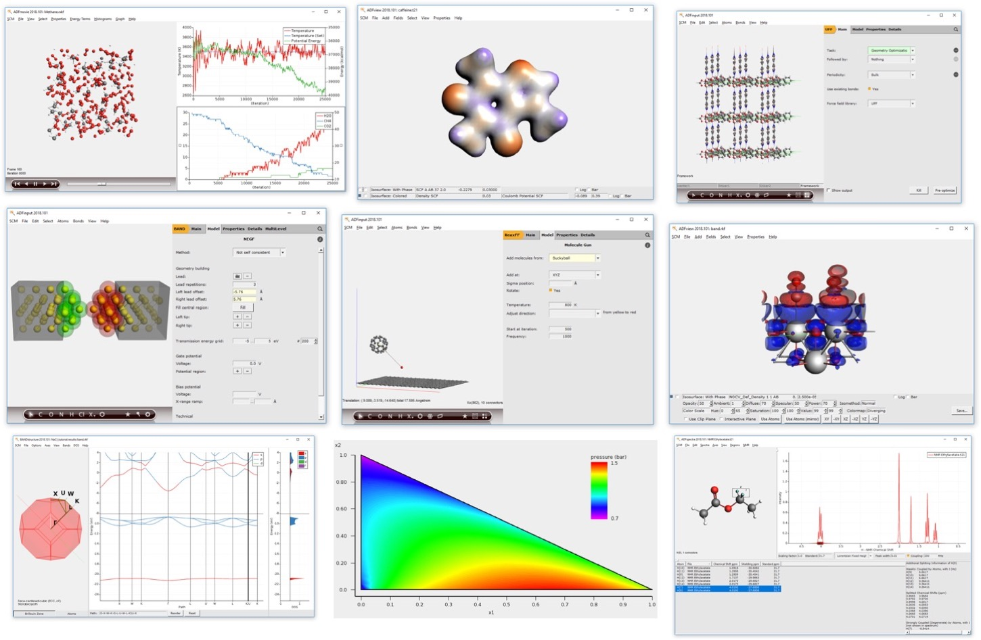
Online workshop: Chemistry & Materials with the Amsterdam Modeling Suite
Atomistic Simulation Center, hands-on workshop, 22 March 2023
Fedor Goumans, goumans@scm.com
Nicolas Onofrio, Robert Ruger
SCM support: support@scm.com

Slide 2
Program
Brief introduction Amsterdam Modeling Suite
Hands on:
building molecules, calculating spectra
periodic structures, DOS, band structures
finding transition states
Break
ReaxFF: combustion & reaction analysis
ReaxFF: chemical vapor deposition
Scaling and parallelization: elastic tensors
Many parallel jobs: calculating properties for a database of molecules (python scripting)
Q&A
NOTE: we’ll be using AMS2023 (in progress, to be release in April)
www.scm.com/doc2023
www.scm.com/bin2023
Files, slides, available to download from: www.scm.com/asc

Slide 3
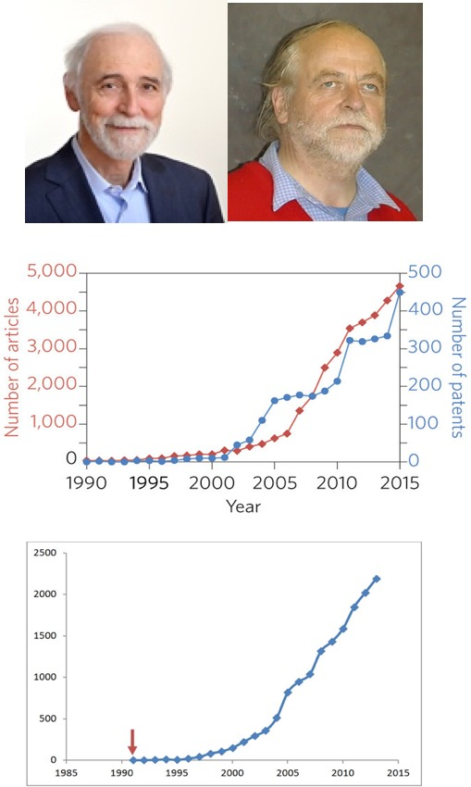
Background: SCM, ADF & AMS
ADF = first DFT code for chemistry (1970s)
Baerends@VU (>’73), Ziegler@Calgary⁽⁺⁾ (>’75)
80s: support industrial users Mitsui, Shell, Akzo, Unilever
SCM: Spin-off company 1995
24 people (17 senior PhD’s) + 3 EU fellows
Many academic collaborators / EU networks
~160 authors
New functionality
Academia, government & industry users worldwide
SCM: development, debug,
port, optimize, docs & support
articles &patents in materials science with
“density functional theory”, Nat. Mat. 4619
Papers with
“DFT and Chemistry”

Slide 4
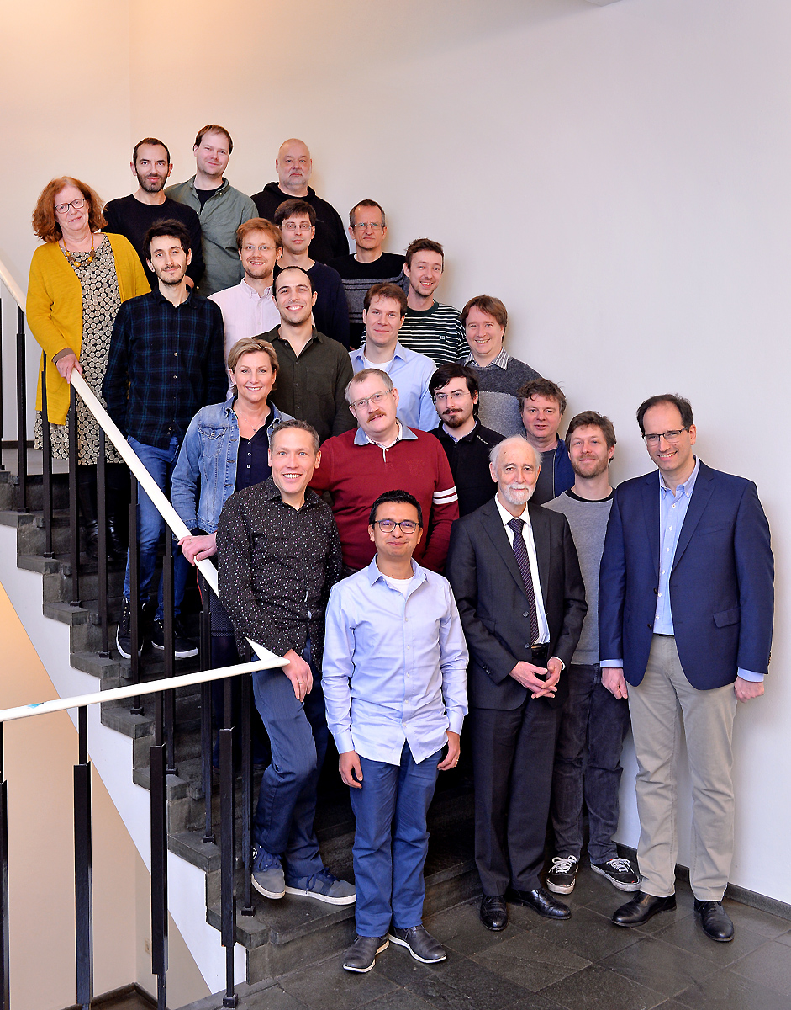
17 developers
4 support scientists
3 office / business
3 PhD students (EU)
The SCM team in Amsterdam

Slide 5
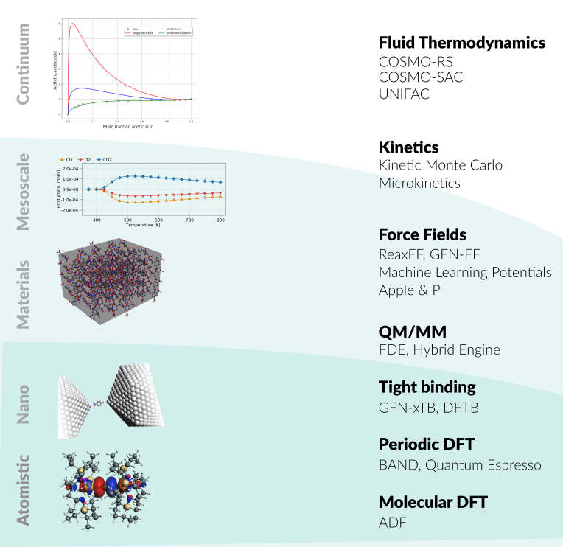
Amsterdam Modeling Suite
ADF: powerful molecular DFT
Reactivity, spectroscopy
Spectroscopy: NMR, EPR, VCD, UV, XAS
BAND: periodic DFT
(2D) Materials, spectroscopy, analysis
Interface with QE, VASP
DFTB & MOPAC: fast electronic structure
ReaxFF: Reactive MD
Dynamics of large complicated systems
MLPotential
Several backends, ANI-2x, M3GNet
COSMO-RS: fluid thermodynamics
VLE, LLE, logP, solubility
AMSdriver: PES exploration, MD, MC
Hybrid: multi-layer, QM/MM, QM/QM’
Integrated GUI, python scripting (workflows), ParAMS: parametrize ReaxFF & xTB
Notes:
Strong points AMS: DFT, semi-empirical and reactive FF in 1 Suite, with 1 integrated GUI, (python) scripting tools

Slide 6
1 GUI: build, run & analyze

Slide 7
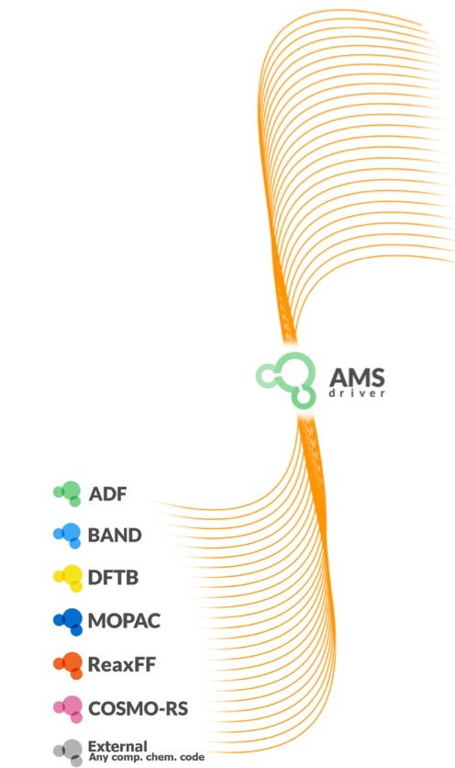
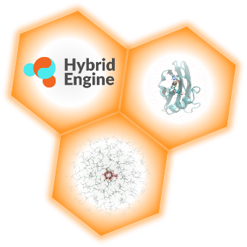
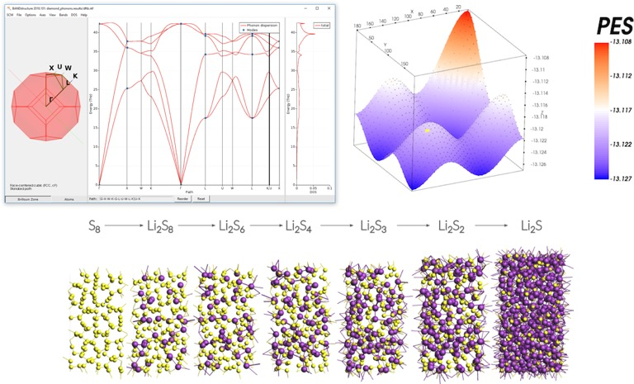
The AMS driver: decouple from Engine
Frequencies (+ analysis) & phonons
Stress & elastic tensors
Scan (multiple) coords, any periodicity
Geometries, TS, IRC
Advanced Molecular Dynamics
(Grand Canonical) Monte Carlo

Slide 8
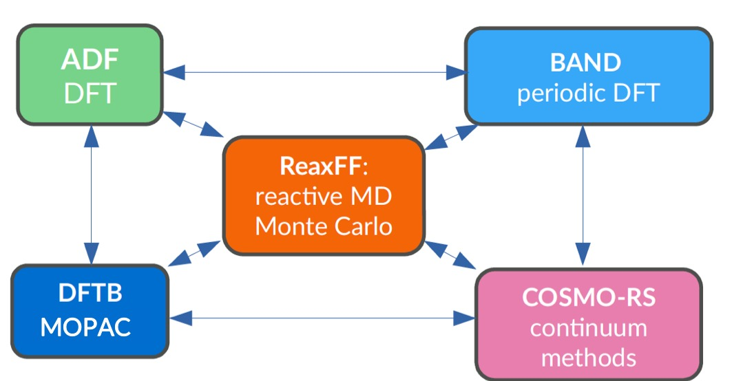
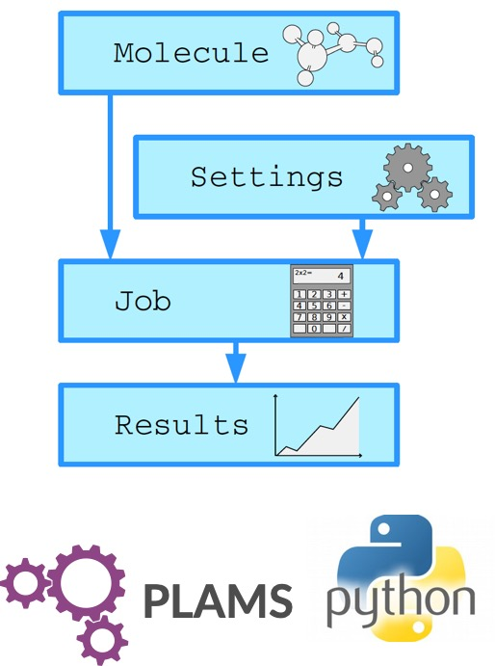
PLAMS: python scripting
Links all modules + various tools
→ workflows & screening
→ (custom) post-processing
→ rapid prototyping

Slide 9
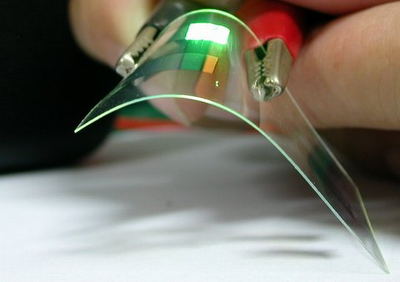
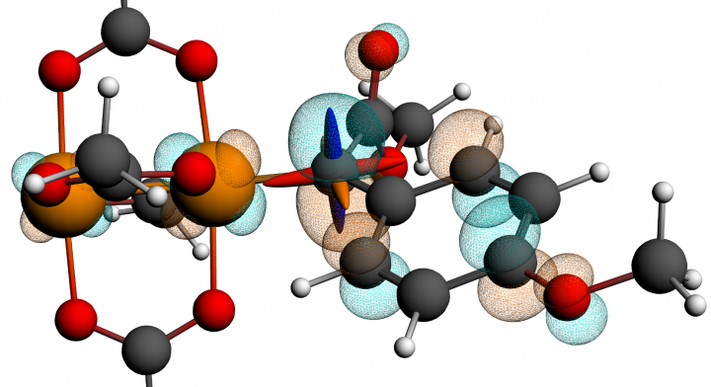
ADF: Molecular DFT
Strong & unique points
All-electron Slaters, H-Og
Relativity: ZORA (SR, SOC)
Spectroscopy
EPR, NMR, IR (VCD), UVVIS, XAS
qsGW+BSE
Phosphorescence
Bonding analysis:
Fragment-based approach
ETS-NOCV, QTAIM, MO diagrams, NCI, ....
Transfer integrals (charge mobility)
Environments
Subsystem DFT (FDE), DIM/QM, QM/MM, QM/FQ, 3D-RISM, COSMO, SM12
NMR calculations locate ¹³C di-Rh carbene
catalyst intermediate, Science, 342, 351 (2013)

Slide 10
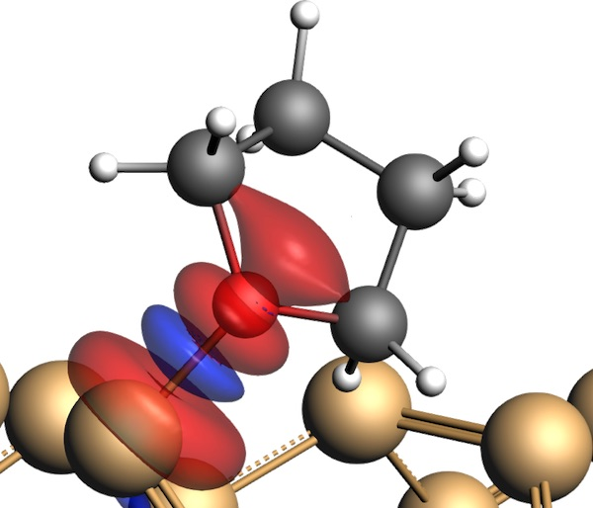
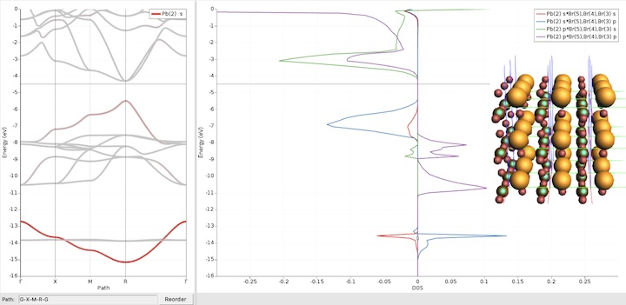
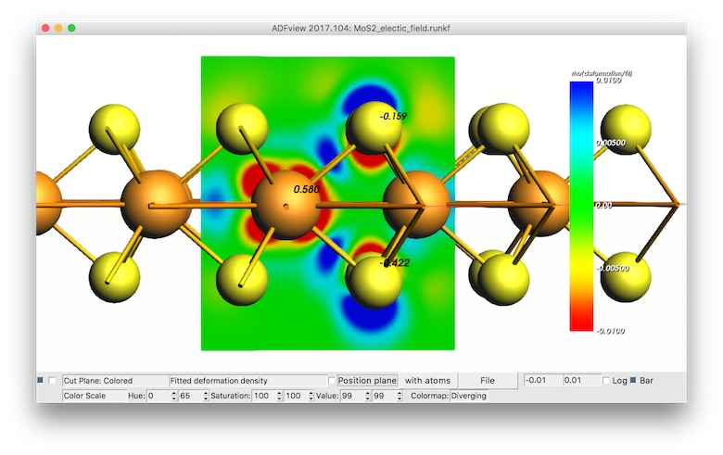
Periodic DFT: BAND vs Plane Waves
Atom centered basis functions, STO or NAO
Compare cluster with periodic
No pseudopotentials, all elements
Core spectroscopy (core holes)
Easy orbital analysis: pDOS, COOP, EDA
Fast for empty (1D, 2D, porous)
xc: r2SCAN, MN15-L, HSE06, GLLB-sc, D3(BJ), D4, DFT-1/2
Self-consistent NEGF
Gate & bias potential
Spin transport
True 2D surfaces, 1D polymers
Het. catalysis: polarization, COSMO, SM12
2D electronics (homogeneous E field)
Nanotubes
QM/MM and QM/QM’ for 2D
Integrated Graphical Interface:
Easy set up & analysis
Switch: ADF, BAND & Quantum Espresso, VASP
periodic energy decomposition analysis (tutorial)
L. Pecher and R. Tonner
WIREs CMS, (2018)
COOP in perovskites
(tutorial)
Goesten & Hoffmann
JACS (2018)
Polarizing 2D semiconductor (tutorial)
N. Zibouche et al.
PCCP (2014)

Slide 11
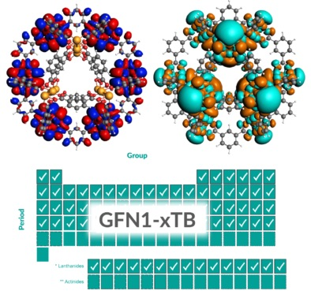
DFTB: ‘fast DFT’ for molecules & periodic
Approximated DFT
Nearest neighbor & minimal basis
Tabulated elec & rep. parameters:
Grimme GFN-xTB (Z = 1-86)
QuasiNaNo & DFTB.org
Capabilities & Features
UV/VIS (fast!)
MOs, band structures, DOS
Through AMS
Geometries, frequencies, phonons
Stress tensors (optimize under p)
Advanced MD, PES scans
GCMC, molecule gun
Multi-layer, QM/MM, QM/QM’
Reparametrize xTB

Slide 12
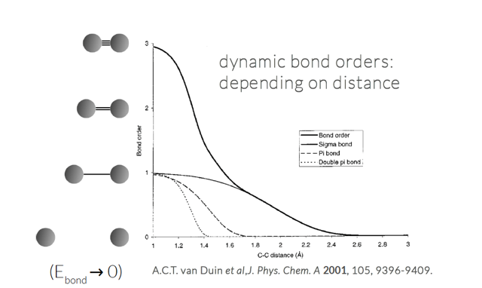
ReaxFF – reactive molecular dynamics
No discontinuities in energy or forces
No pre-defined reaction sites or types
Dynamic bond orders, charge equilibration
Only 1 atom type per element
300K 400K 500K
Li battery discharge: J. Electrochem. Soc. 161, E3009 (2014); PCCP, 17, 3383 (2015), tutorial
eReaxFF to study electron mobility & Li ion reduction, explicit electrons & electric field, J. Electrochem. Soc. 169 ,110540 (2022)
)

Slide 13
General ReaxFF rules
No discontinuities in energy or forces
No pre-defined reaction sites or types
Only 1 atom type per element
Review NPJ Comp. Materials (2016):
The ReaxFF reactive force field: development, applications and future directions
Notes:
User should not have to pre-define reactive sites or reaction pathways; potential functions should be able to automatically handle coordination changes associated with reactions.
force field should be able to determine equilibrium bond lengths, valence angles etc. from chemical environment.

Slide 14
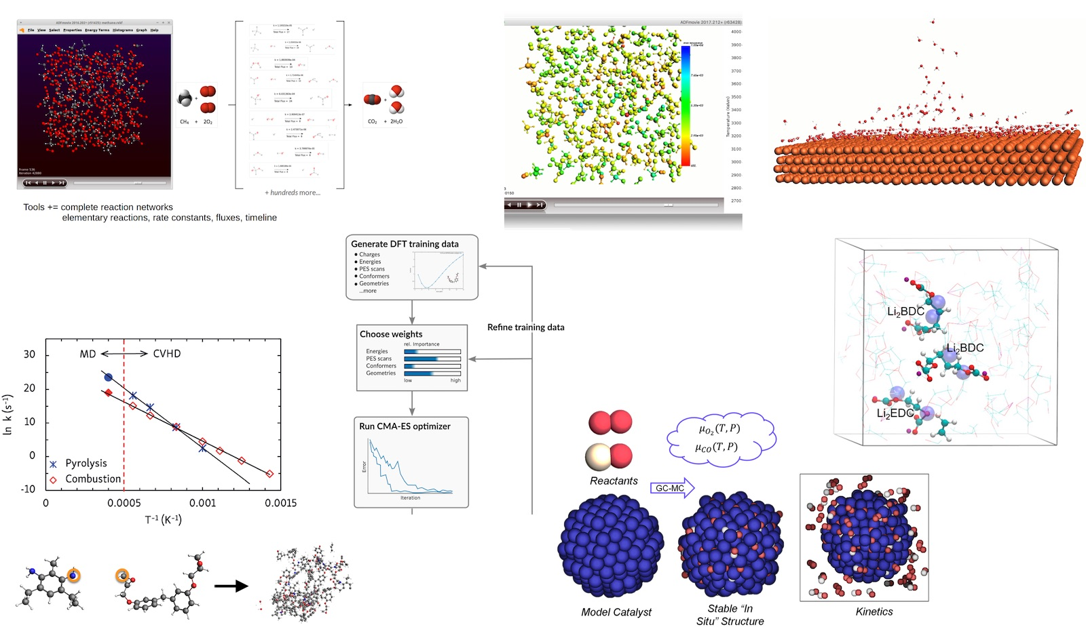
Reactive MD tools Amsterdam Modeling Suite
ChemTraYzer: Automated rates & pathways
New: Analyze surface reactions
T-NEMD, local T:
heat transport
Molecule gun: depositing molecules on surfaces
eReaxFF: include e-
fbMC, CVHD, PRD: speed up kinetics
ParAMS - easy ReaxFF & DFTB (re)parameterization
bond boost
build polymers
GCMC: speed up thermo

Slide 15
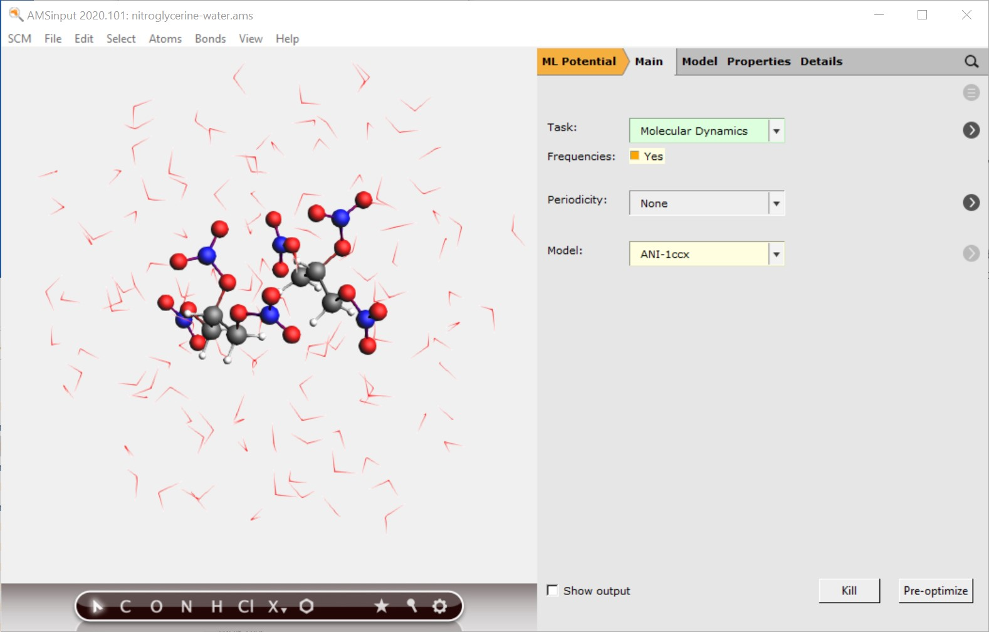
Machine Learned Potentials
Use machine learning potentials with AMS driver
PES scans, conformers, MD, reaction energies, …
Also with Hybrid engine (multi-layer)
Automatically install popular ML Backends
SchNetPack, sGDML, PiNN, TorchANI
Pre-parametrized neural network potentials ANI-1ccx, ANI-2x, M3GNet-UP(2022)
CUDA-enabled PyTorch and Tensorflow can be used
Demo video

Slide 16
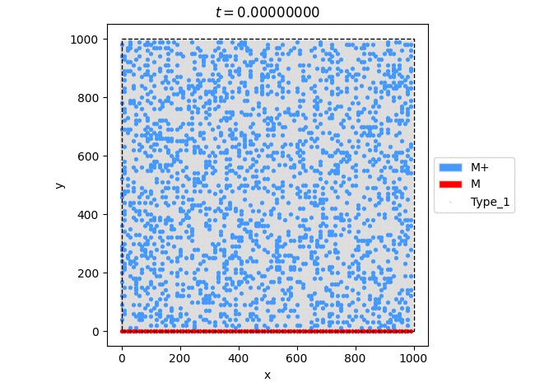
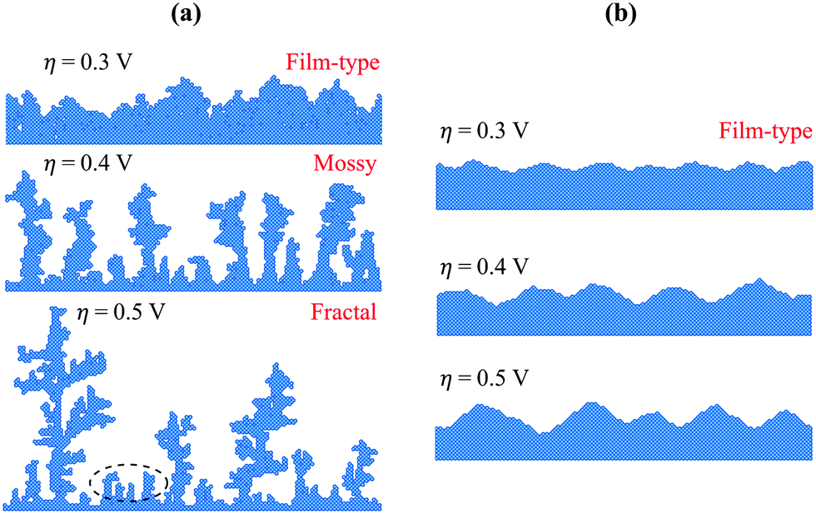
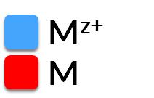
Kinetic Monte Carlo: SEI dendrite formation
Modified (py)Zacros kMC to study dendrite formation
3 Processes (rates can be computed with AMS):
1) Metal ion (M^{z+}) transport across electrolyte
2) Reduction at the solid-electrolyte interface (M^{z+}->M)
3) Diffusion of the metal (M) over the electrode surface
no step diffusion no terrace diffusion
Inspired by Surface diffusion manifestation in electrodeposition of metal anodes, PCCP 2020 (22), 11286
Notes:
Fig. 1 Schematic of the surface self-diffusion pathways. Surface atoms A, B and C exhibit (a) terrace diffusion (b) diffusion away from a step and (c) interlayer diffusion/diffusion across a step, with energy barriers E_{a1}, E_{a2}, and E_{a3}, respectively. A representative energy profile along the reaction path, showing the initial state (IS), final state (FS), height of the diffusion barrier (E_{a}) and the transition state (TS) is illustrated in (d). Fig. 2 Electrodeposition morphologies obtained at an overpotential of 0.3 V, 0.4 V and 0.5 V. Two specific conditions are set for the self-diffusion barriers: (a) E_{a1} = 0.15 eV and E_{a2} = 0.3 eV with E_{a3} → ∞; (b) E_{a1} = 0.15 eV and E_{a3} = 0.3 eV with E_{a2} → ∞

Slide 17
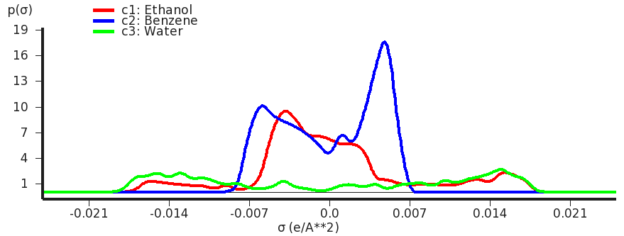
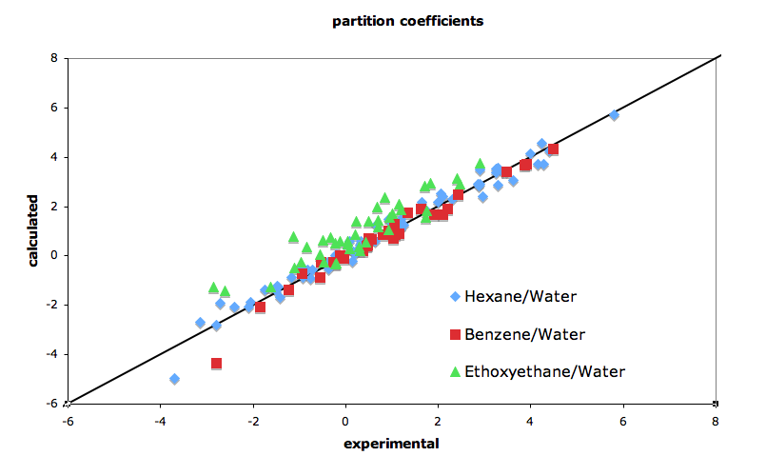
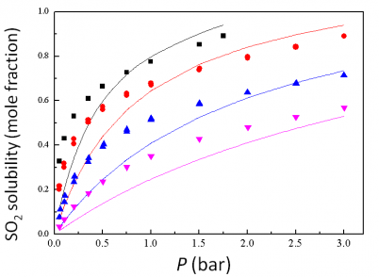
COSMO-RS/SAC: thermodynamic properties of fluids
Quantum Chemistry & QSPR for quick property predictions
COntinuum Solvation MOdel + RS (Klamt), SAC (Sandler)
chemical potential => activity coefficients => instantaneous properties
Solvation & excess energies, pKa
Solubilities, LLE, VLE, boiling points
Optimize mixtures: solubility, LLE
Polymers: Flory-Huggins X

Slide 18
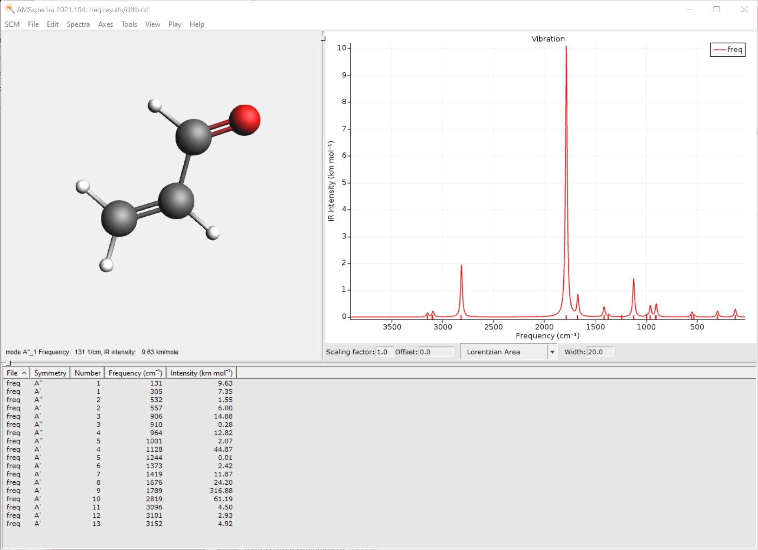
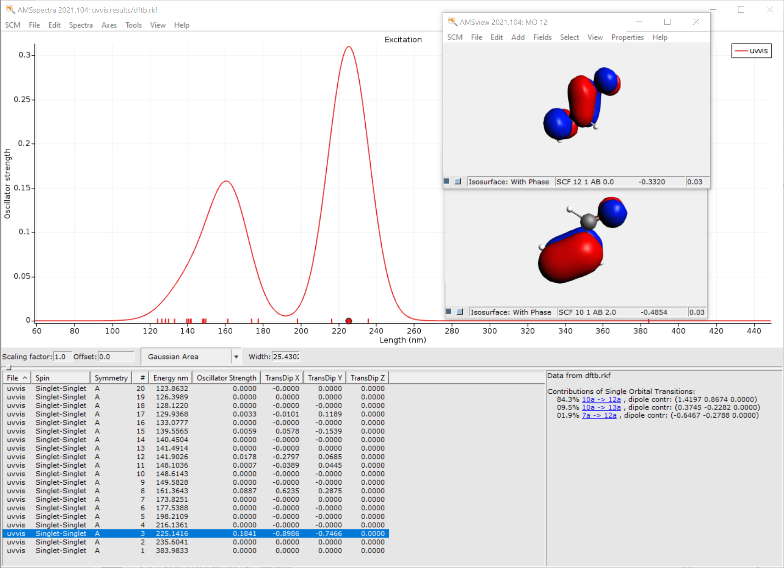
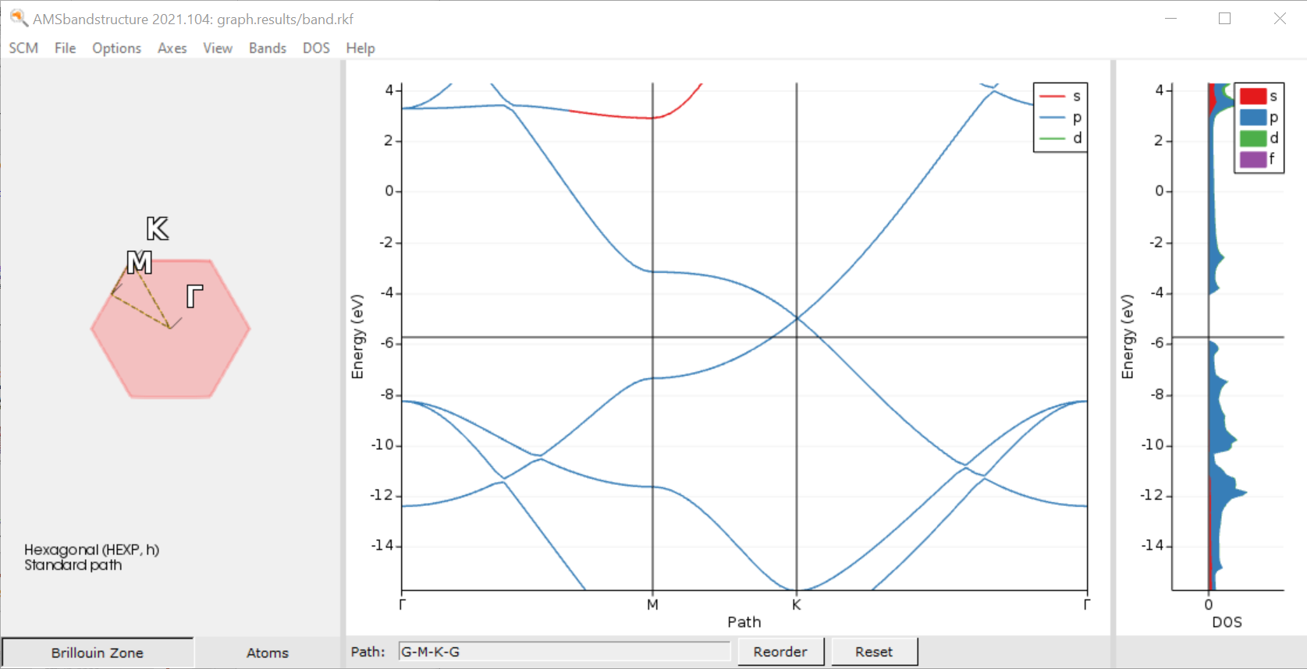
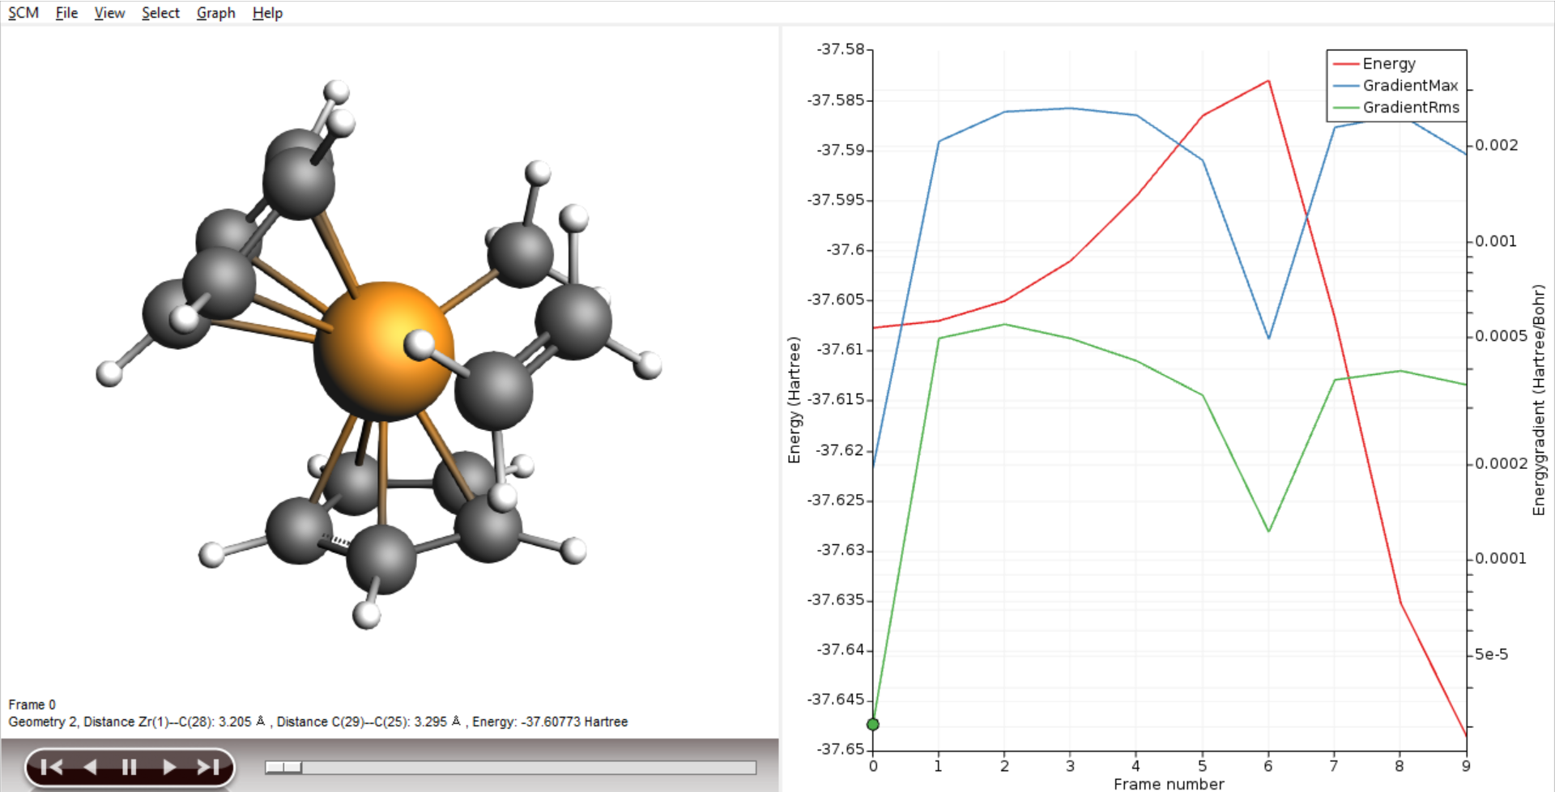
Hands on + self-learning

Slide 19
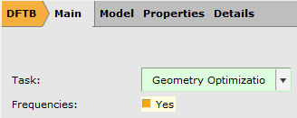
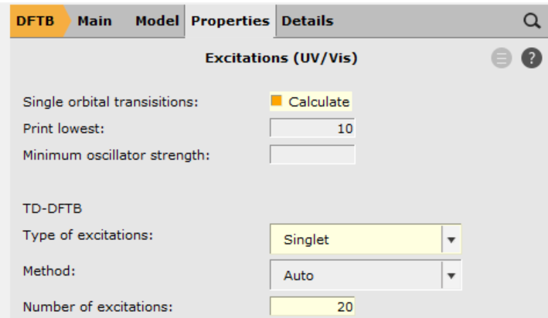
Building molecules, spectra
www.scm.com/doc/Tutorials/GUI_overview/Building_Molecules.html
Search molecules
Import: InChI, SMILES, xyz, cif, pdb, …
Included library + building
IR frequencies (tutorial)
Geometry needs to be optimized at same level as frequency calc.
Try ADF, DFTB, MOPAC, MLPot, ...
SCM -> Spectra
UV/VIS FAQ for tips + links to tutorials
ADF: (s)TDDFT, (s)TDA, TD-DFT+TB
Visualize MOs Single Orbital Transition (ADF: also NTOs)
Compare to NIST (IR), NIST (UV/VIS)

Slide 20
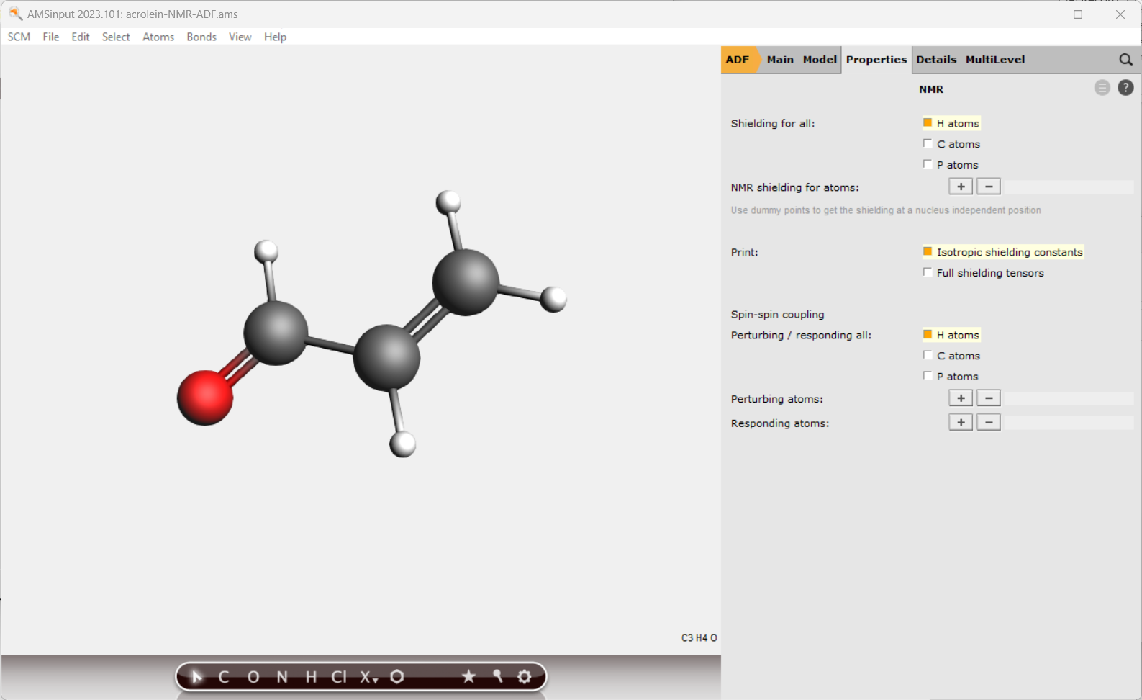
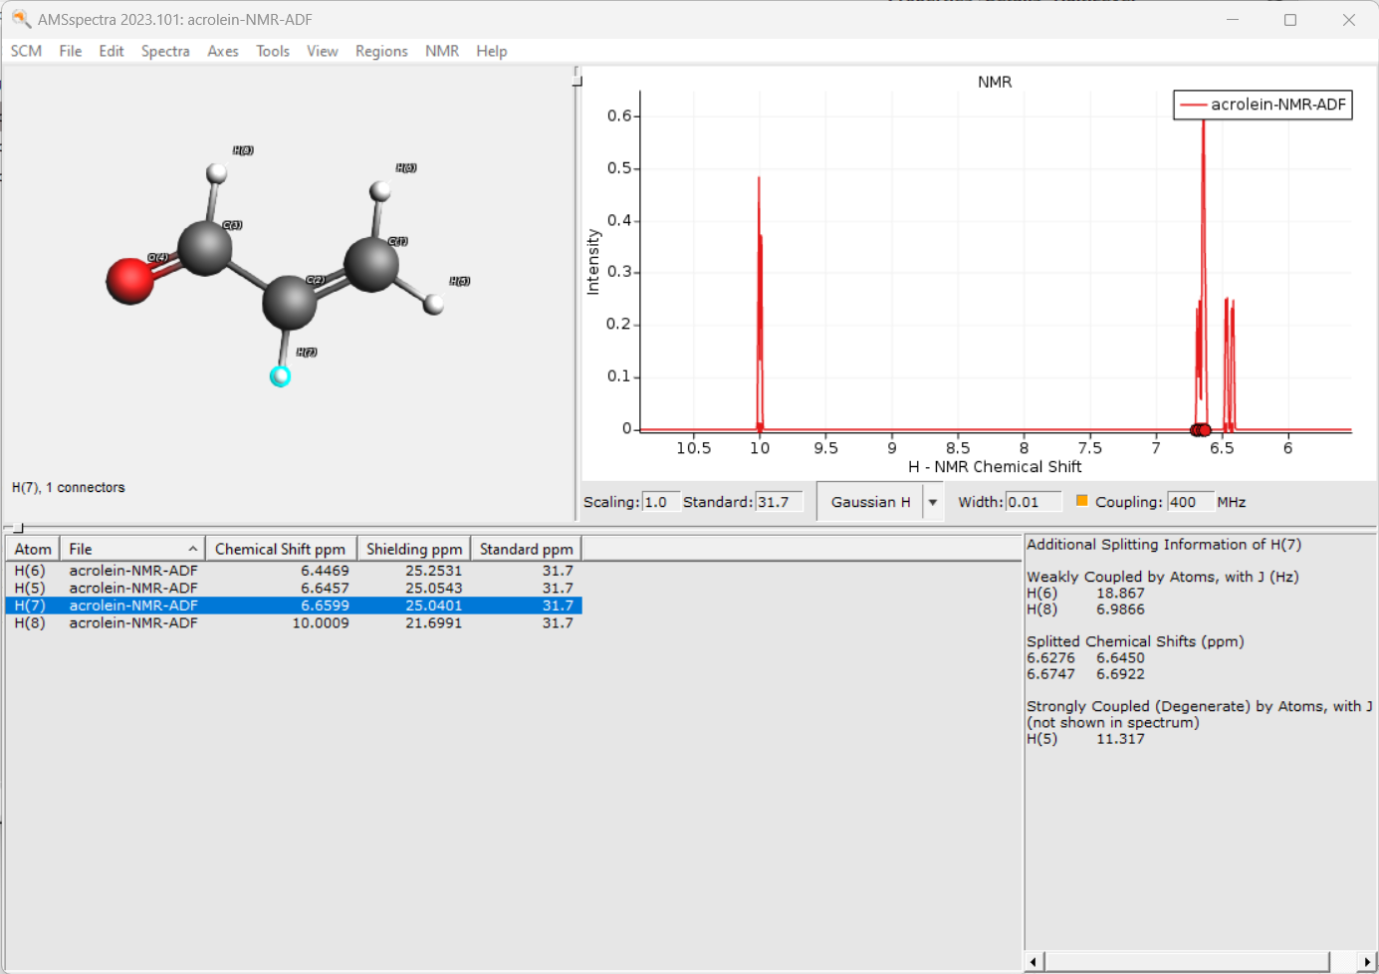
Spectra: NMR
Exercise:
See also NMR FAQ for tips + advanced tutorials
Use PBE0 + TZP, Scalar, no core
Select Properties -> NMR
select shielding & coupling for all H
Set 400 MHz and tick coupling, compare
Note the internal ref. uses different settings!
Recalculate TMS with same set up

Slide 21
Quick thermodynamic properties
Open SCM -> COSMO-RS (no need to install database)
In the SMILES input, put C=CC=O and Add
Properties -> Pure compound
Compare some properties (density, boiling point, flash point) (e.g. Wikipedia)
Try COSMO-RS Properties -> Boiling point pure compound
Property |  | Unit
Boiling point | 346.746 | K
Critical pressure | 51.21 | bar
Critical temperature | 524.603 | K
Critical volume | 0.195 | L/mol
Liquid density | 0.816 | kg/L
Dielectric constant | 10.985
Absolute entropy (ideal gas) | 309.848 | J/(mol K)
Flash point | 270.523 | K
Gibbs energy of formation (ideal gas) | -111.468 | kJ/mol
Net enthalpy of combustion | -1652.692 | kJ/mol
Std. state enthalpy of formation | -188.906 | kJ/mol
Enthalpy of fusion | 17.129 | kJ/mol
Enthalpy of formation (ideal gas) | -157.71 | kJ/mol
Enthalpy of sublimation | 49.534 | kJ/mol
Melting point | 213.82 | K
Liquid molar volume | 0.069 | L/mol
Parachor | 161.085
Solubility parameter | 10.098 | √(MPa)
Triple point temperature | 213.778 | K
Van der Waals area | 91.576 | Å²
Van der Waals volume | 63.229 | Å³

Slide 22
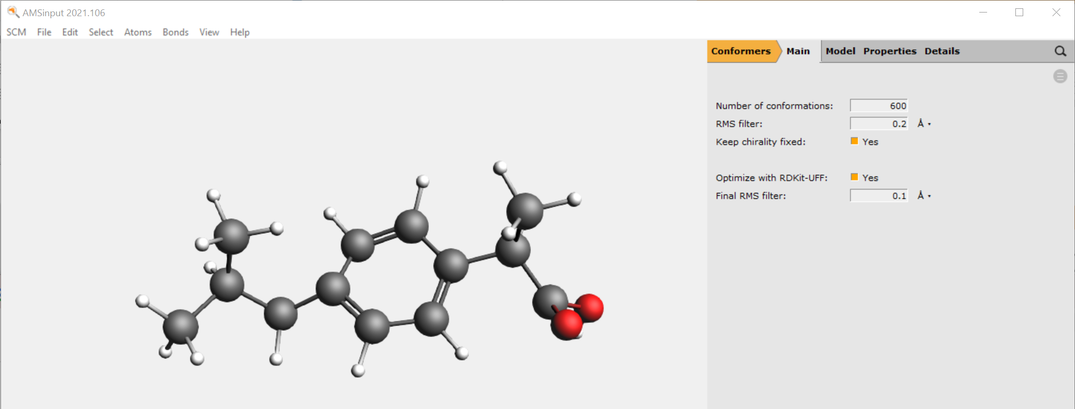
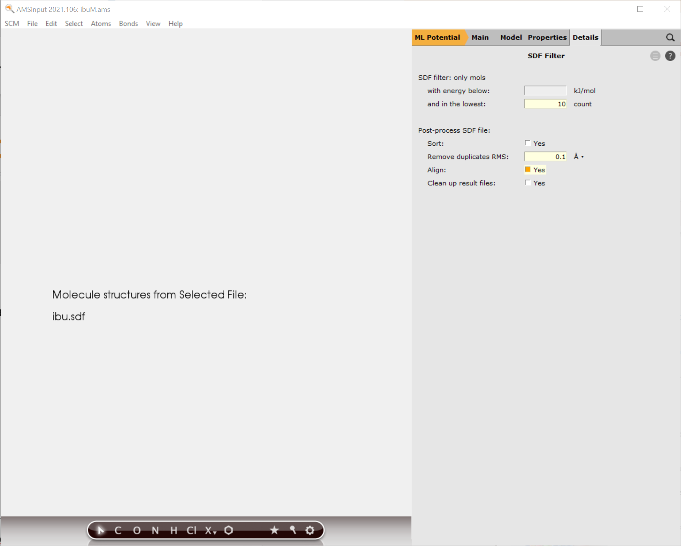
ML Potentials: conformers
Import ibuprofen SMILES
Switch to Conformers, Run, Movie
Switch to ML Potential, choose ANI-1ccx
Model -> Coordinates | Use: -> Selected File
Select the .sdf from the previous job
Click on > to go to Details->SDF Filter
Lowest 10 count, align & remove dups (0.1A)
(Do you want to re-sort on Energy?)

Slide 23
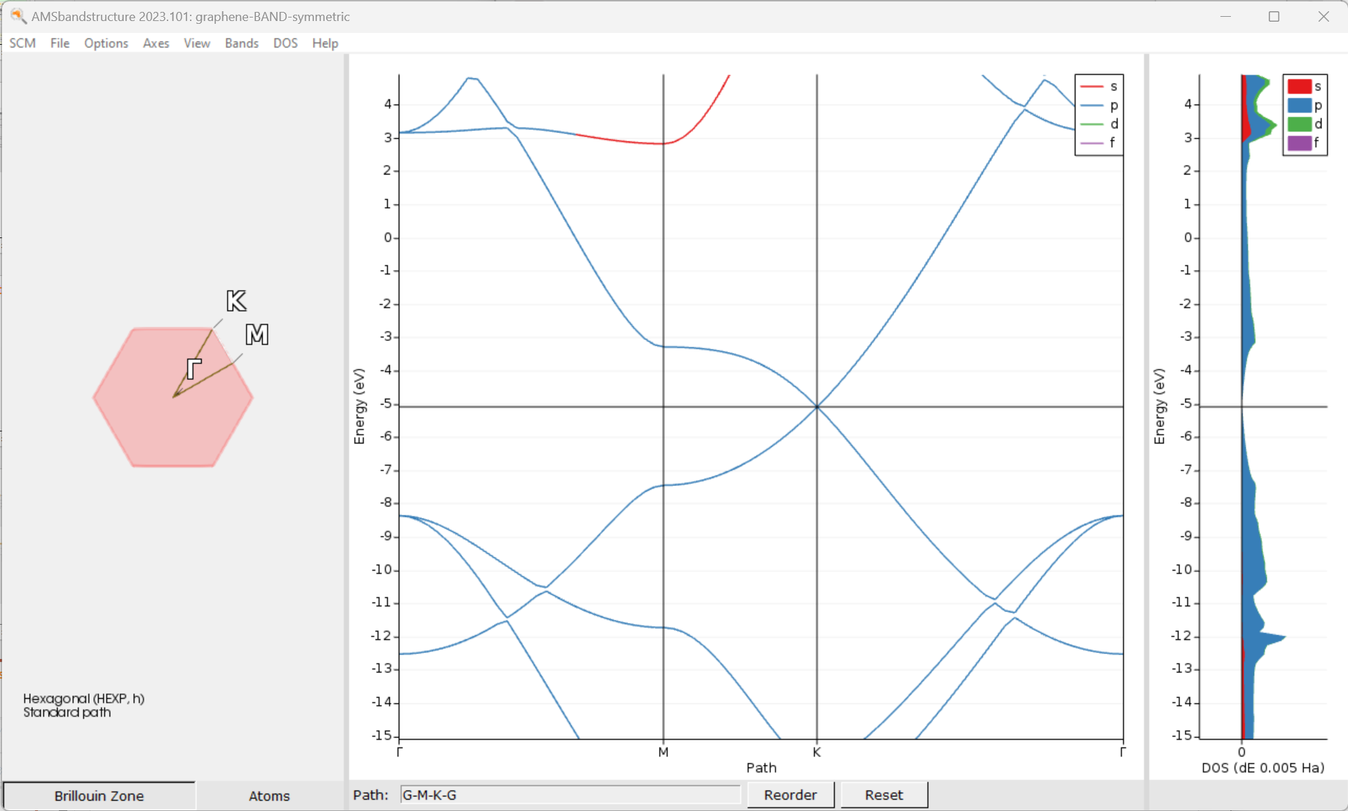
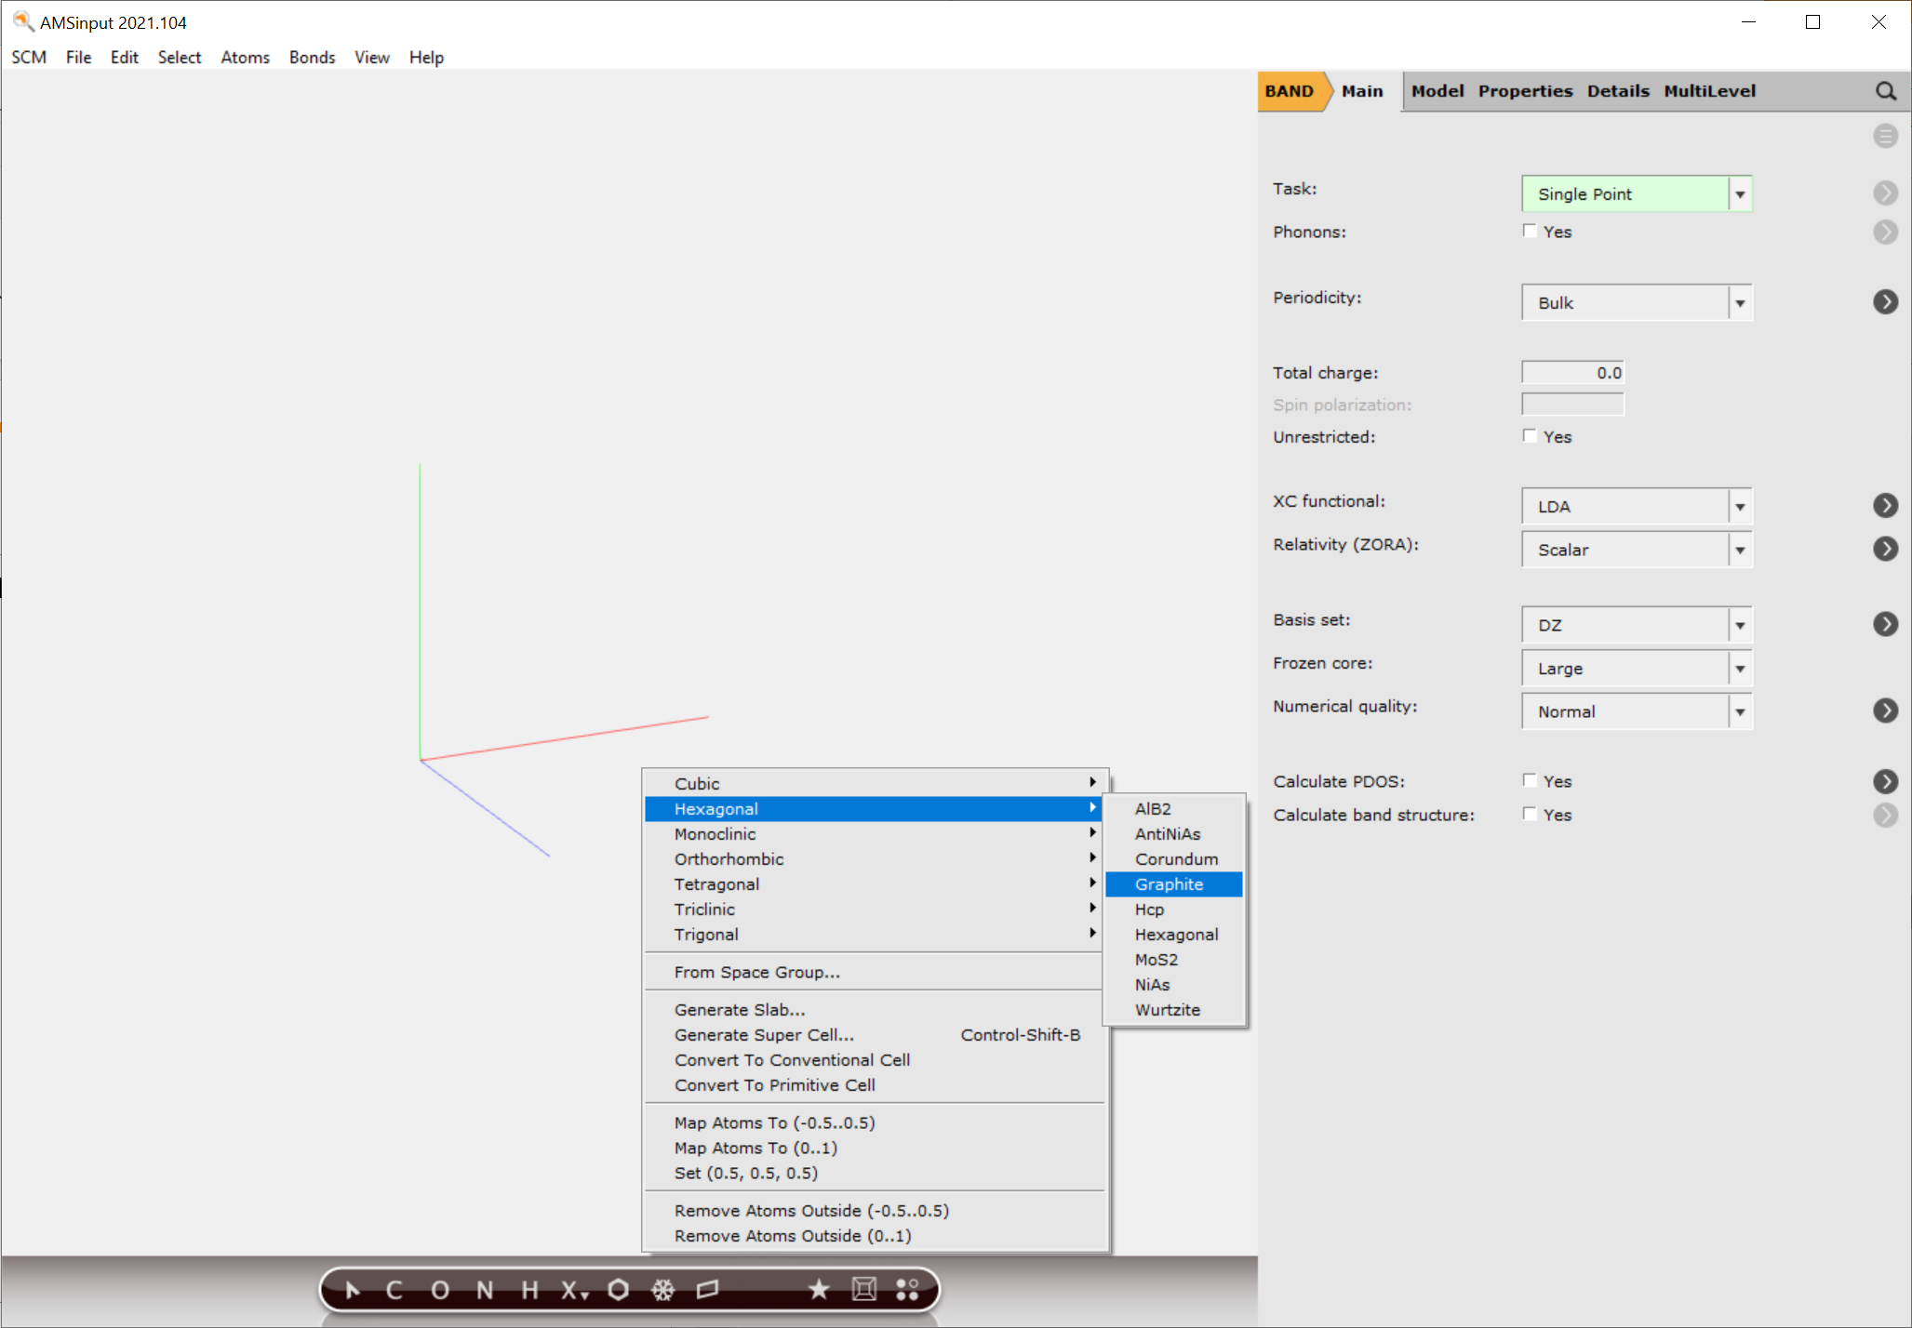
Periodic DFT(B) calculations
Import cif, periodic pdb/xyz, use structure builder
Run graphene 2D with BAND and DFTB
To get the Dirac point, right use a symmetric k-grid in BAND
3D with QE (think about z lattice vector, and reorder the visualization path!)

Slide 24
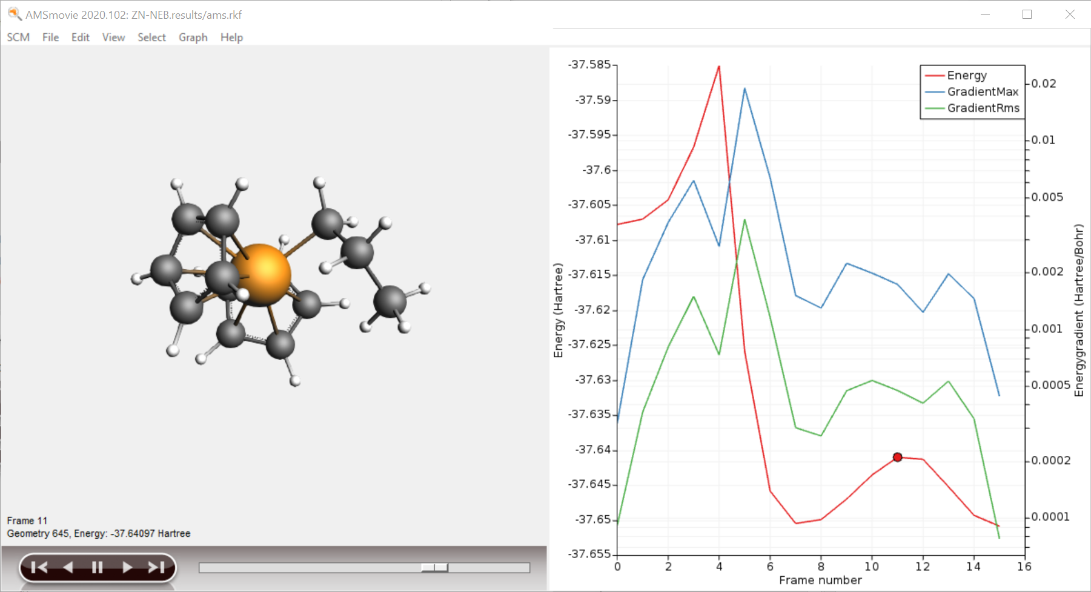
Transition States: Tips & Tricks

Slide 25
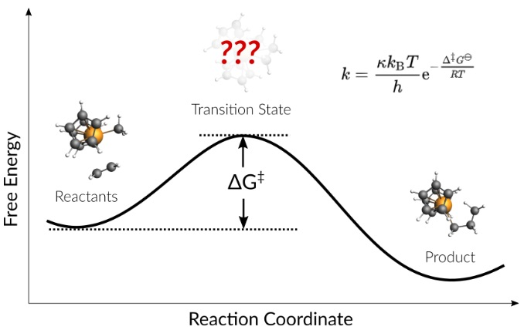
Pointers & ideas for TS search
Good starting point (geometry close to TS)
First explore reactant and product
(Initially) use low convergence criteria
Scan the PES with MOPAC or GFNx-TB
Sometimes scanning from product side is easier
Can use complex composite scan coordinates
Use CI-NEB (tutorial)
Always a good idea to explore Reactants
Pass on coordinates (+Hessian) to ADF
Previous TS ‘similar’ system
Consider first doing constrained/partial optimization
Good description of the curvature: lowest Hessian eigenmode(s)
Partial Hessian
Low-level Hessian from previous, ADF choose ‘Calculate With Fast Engine’
TSRC: define (complex) reaction coordinate
Consider ‘TS point characterization’ to check only 1 negative eigenmode
Automated reaction path search (tutorial)
Accuracy?
Solvent effects: COSMO and/or SM12 (single point only), COSMO-RS
metaGGA? TZP/DZP? Good numerical quality?
Double hybrids (single point)
Low-eigenmode corrections to frequencies
Sometime spurious 2nd imaginary modes are hard to get rid of -> ScanFreq
Video

Slide 26
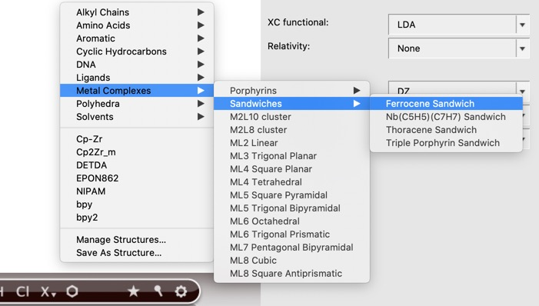
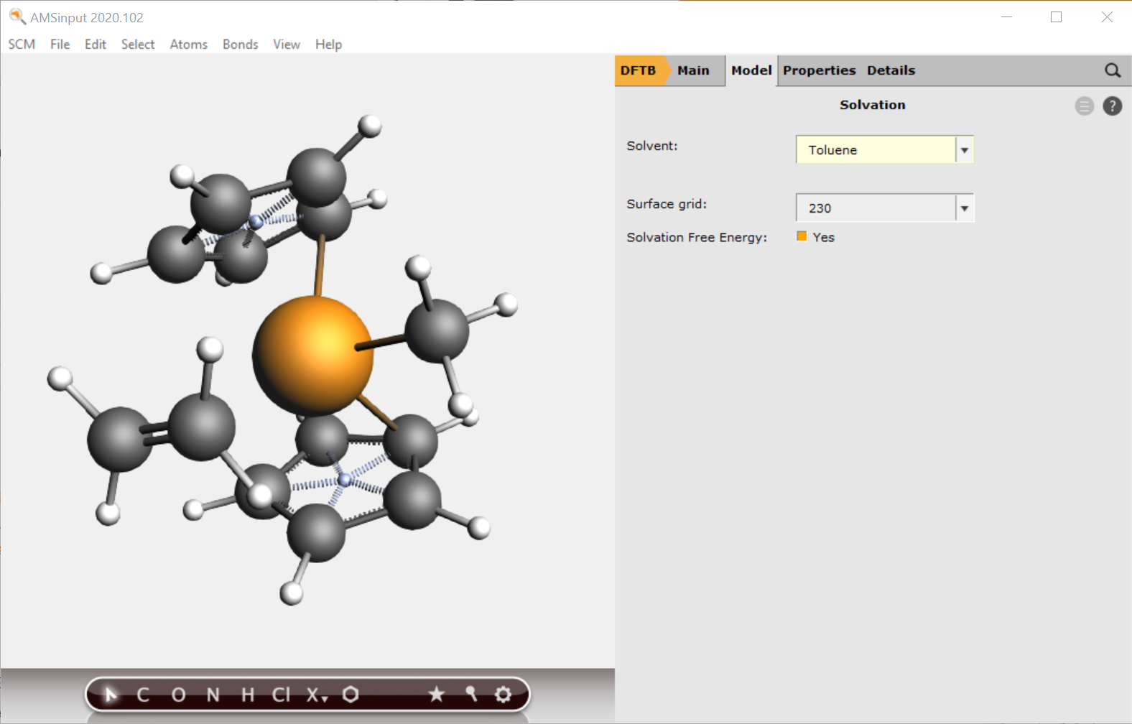
Transition State through PES scan
Exercise (Ziegler-Natta tutorial):
New DFTB input
Build Cp₂ZrMe⁺
structure tool => ferrocene
Right-click Fe -> Element -> Zr
Add C and replace by methyl
(Use dummies to change CpMCp angle)
Model -> Solvent -> Toluene
Add charge and optimize
Add ethene (use the )
Manipulate it in position
Right-click + drag = translate
Left-click + drag = rotate
Ctrl+M = select molecule
Remove dummies
Optimize

Slide 27
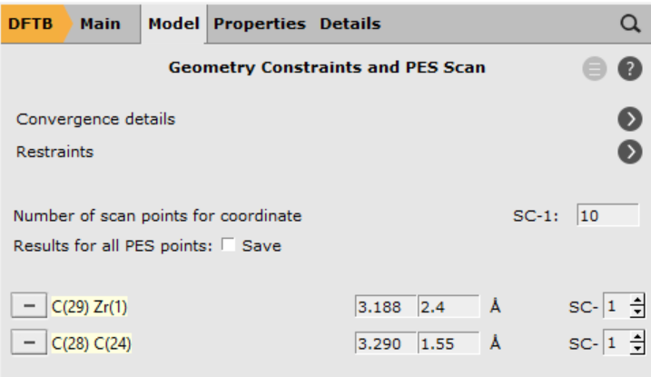
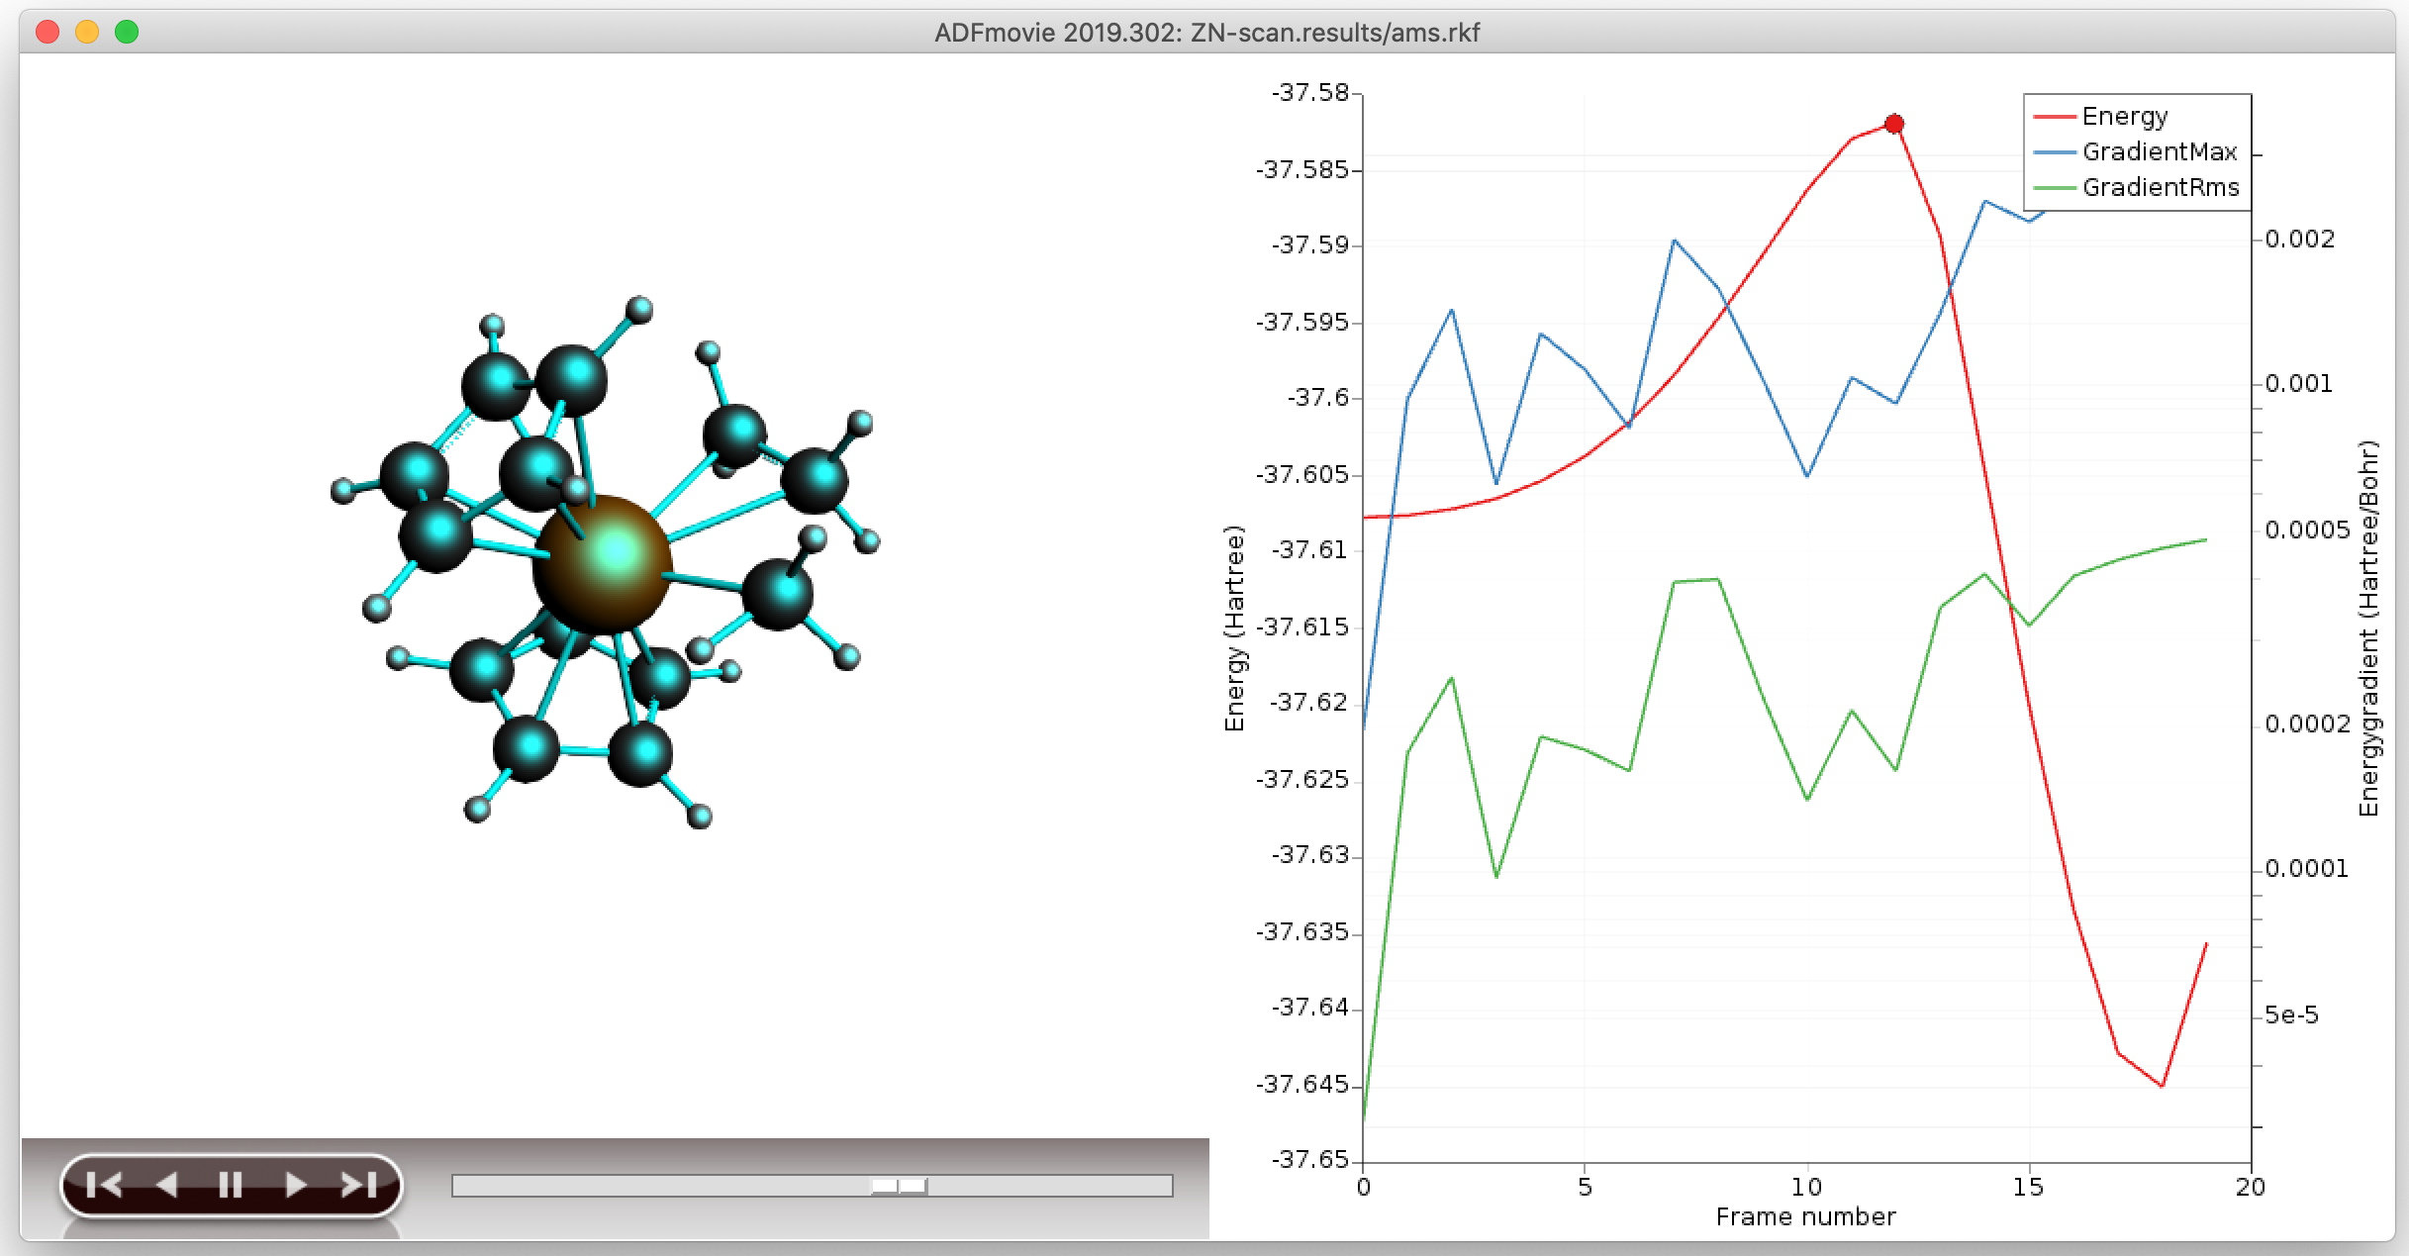
Transition State through PES scan
Set up a PES scan, using 1 combined scan coordinate
Zr-C to 2.4 & C-C to 1.55
Details -> Geometry Optimization:
Loosen the Convergence criteria by a factor of 5
Run, and when finished, open AMSMovie
Copy the highest energy structure (e.g. Ctrl+U), or save as structure
Set up a TS run (ideally make a new input)
make sure there are no constraints, and regular convergence
use a calculate Hessian as initial guess and calculate frequencies

Slide 28
Transition State, start with NEB (Ziegler-Natta)
Exercise:
Optimize reactant & product from the last PES scan points
Rotate the Zr-C-C-H dihedral to ~0 (metallacycle Zr-C-C-H) & optimize => alpha-agostic
Set up a climbing nudged elastic band calculation Task: NEB
Choose this structure as final, the other product as intermediate, and R as initial (import structures from results/ams.rkf) and choose 14 points
Don’t optimize R&P, relax convergence by factor 5
Open AMSMovie when finished
Which is the rate-determining step?
Tip: use CI-NEB to get close enough to TS, use Hessian-based optimization to find it

Slide 29
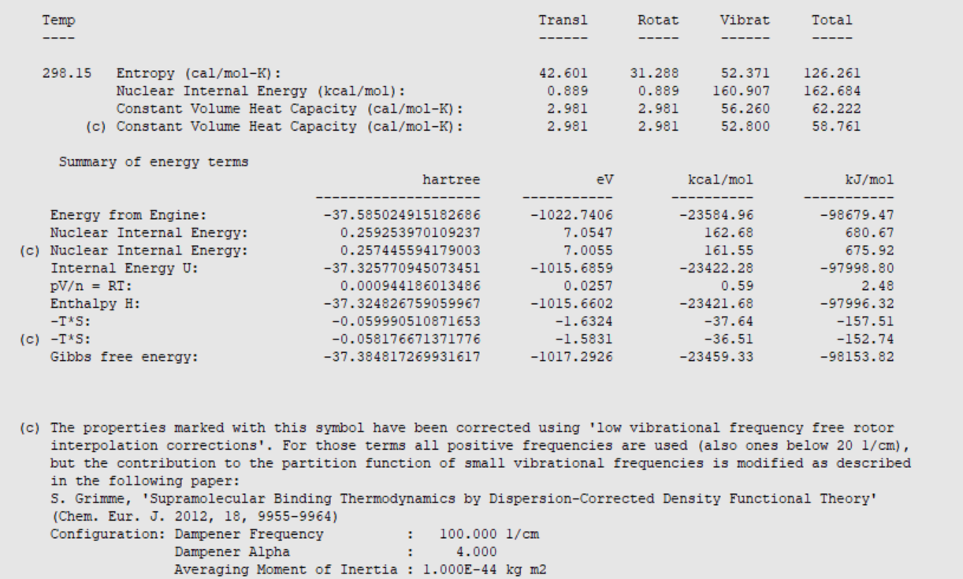
Transition States: Further considerations
Reaction rates:
Calculate ΔG#: include H_{vib}, S (AMSoutput -> Other Properties -> Statistical Thermal Analysis)
hTST as first approximation: k ~ exp (-G#/RT), Low-level frequencies: Grimme corrections
Could also try mircokinetics. More underway (ReaxPro)
Suggestions & troubleshooting
get close to TS: NEB, PES Scan, constrained opt, previous TS + change ligands (PLAMS script!), ….
get a good curvature (Hessian): pre-calc with GFN-xTB, MOPAC; partial Hessian
check final curvature / path: Frequency calculation, PES point characterization, IRC
Spurious imag. Freq.: displace along that mode (AMSSpectra, Ctrl+8 *5) & retry

Slide 30
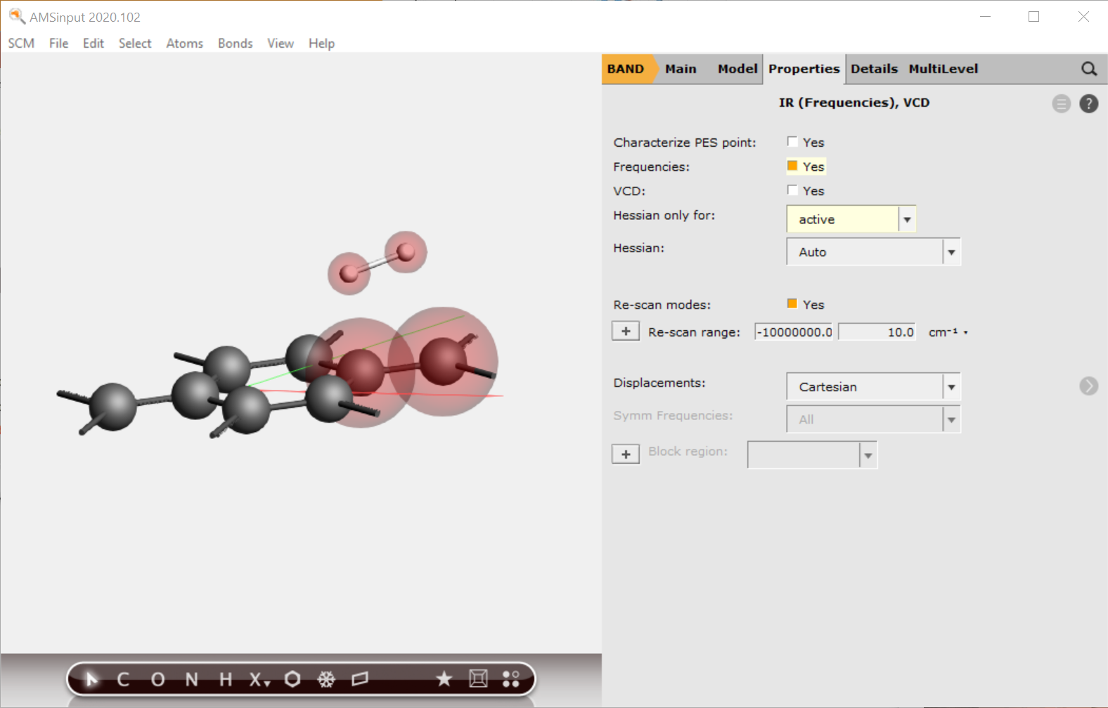
TS for periodic systems
How to get good TS geometry guess?
Literature or previous results:
similar TS + constrained optimization
Quick (?) NEB (you want to find R & P anyway)
PES scan (can you use ReaxFF, MOPAC, GFN-xTB? Otherwise: cheaper DFT?) (video)
Maybe you can get away with periodic DFT/DFTB (video) or DFT/MM ?
How to get good guess for lowest few Hessian eigenmodes?
Could try MOPAC or DFTB Hessian
Inspect modes first?
Define reaction coordinate (TSRC)
Use a partial Hessian (‘active’ region)
Video

