Slide 1
Chemistry & Materials with the ADF Modeling Suite
Fedor Goumans, goumans@scm.com
Seminar Yale, 1 December 2017

Slide 2
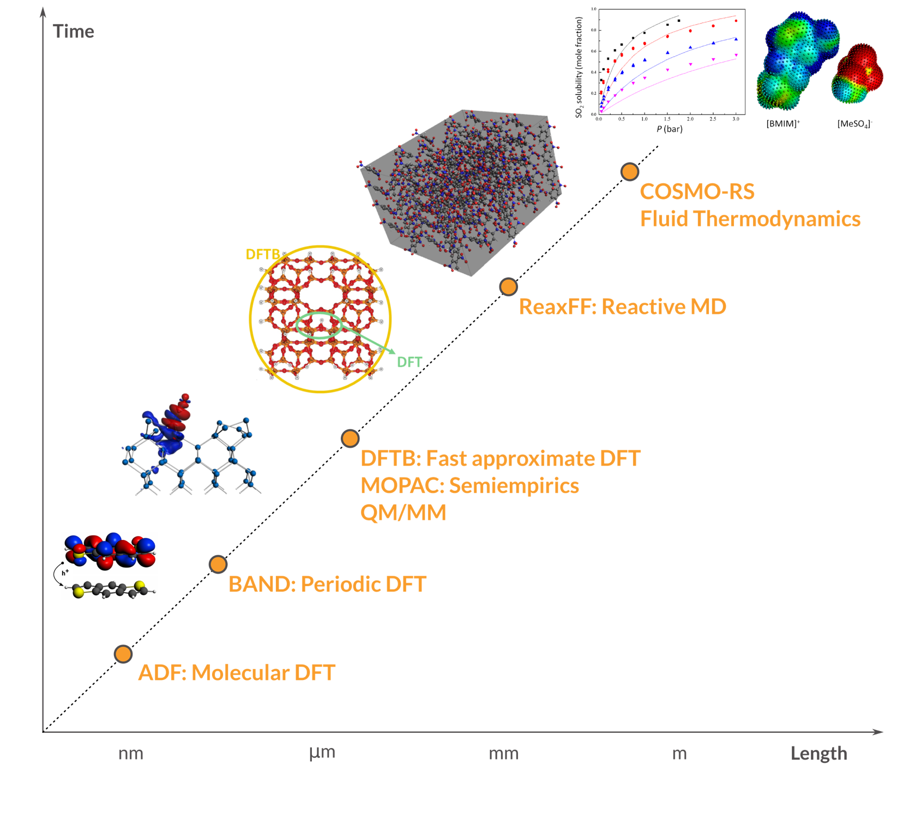
Outline
Background
ADF: powerful molecular DFT
  Spectroscopy: NMR, EPR, VCD, UV, XAS
  Advanced solvation / environments
BAND: periodic DFT
  (2D) Materials
DFTB: fast approximate DFT
ReaxFF: Reactive MD
  Dynamics of large complicated systems
COSMO-RS: fluid thermodynamics
  VLE, LLE, logP, solubility
Integrated GUI – use out of the box
Scripting: workflows & automation

Slide 3

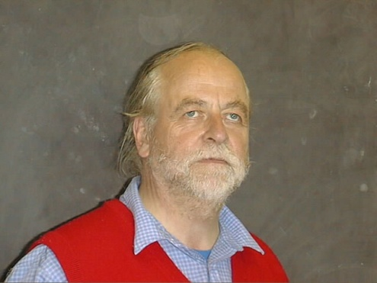
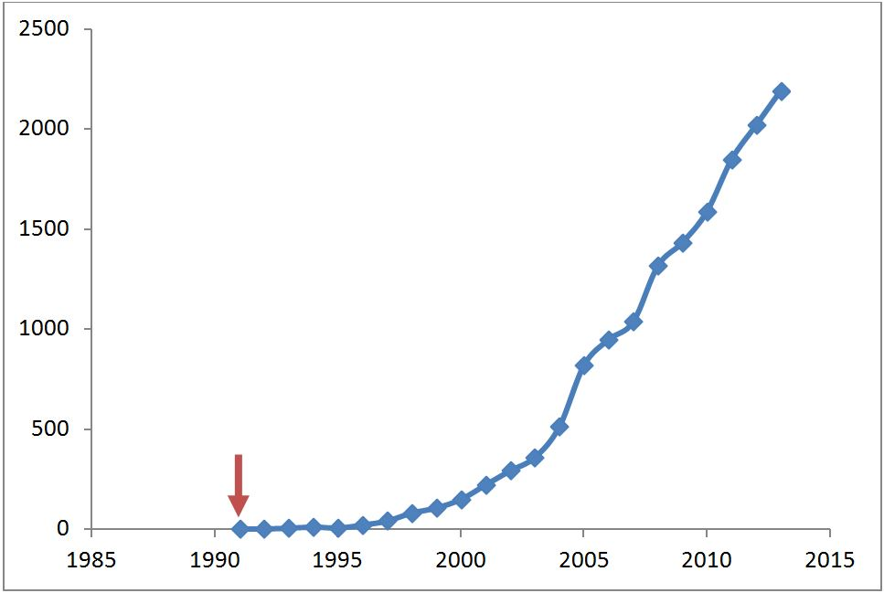
Background
ADF = first DFT code for chemistry (1970s)
Baerends@VU (>’73), Ziegler@Calgary✝ (>’75)
SCM: Spin-off company 1995
15 people (10 senior PhD’s) + 5 EU fellows
Many academic collaborators / EU networks
  ~120 authors
  New functionality
SCM: development, debug, port, optimize,
docs & support
Papers with
“DFT and Chemistry”

Slide 4










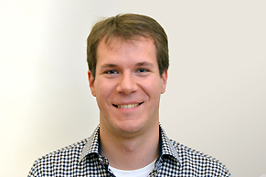


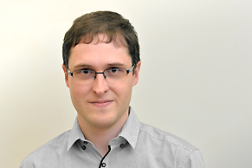





The SCM team
Olivier:
GUI
Alexei:
ADF
ReaxFF
Erik:
ADF
COSMO-RS
Pier:
BAND
Mirko:
ADF
BAND
Hans:
Linux
GPU
Python
Thomas:
DFTB
Scripting
Laurens:
GUI
Ole: Support
Scientist
Evert Jan:
Adviser
Michal:
python
scripting
Robert:
DFTB
Anna:
ReaxFF
Nick:
COSMO-RS
Tomas:
ReaxFF
Stan:
CEO
Fedor:
Marketing
Sergio:
Collaborations
Frieda:
Invoices
Licenses
Kitty:
Finance

Slide 5
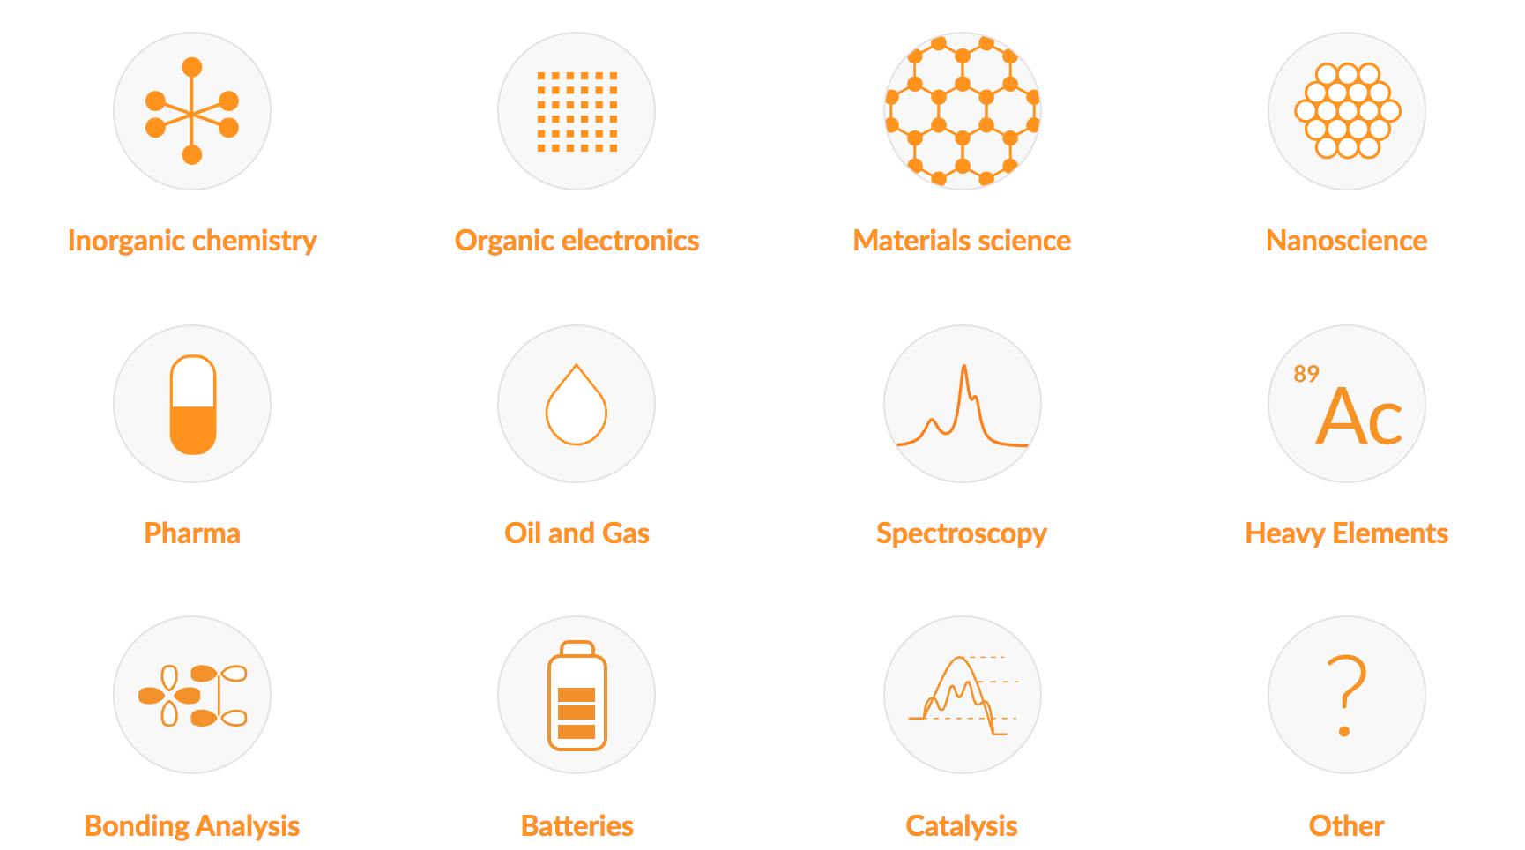
Making computational chemistry work for you

Slide 6
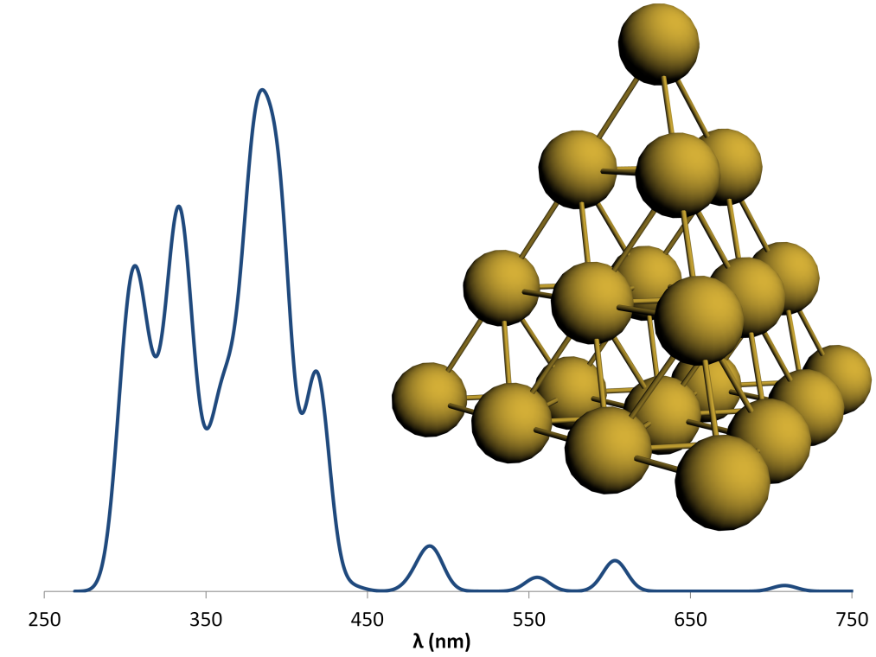
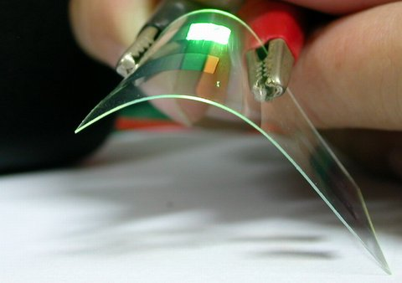
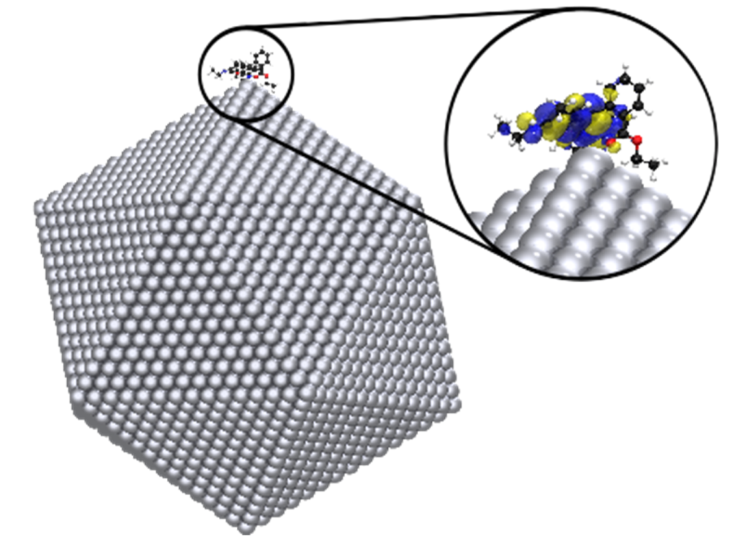
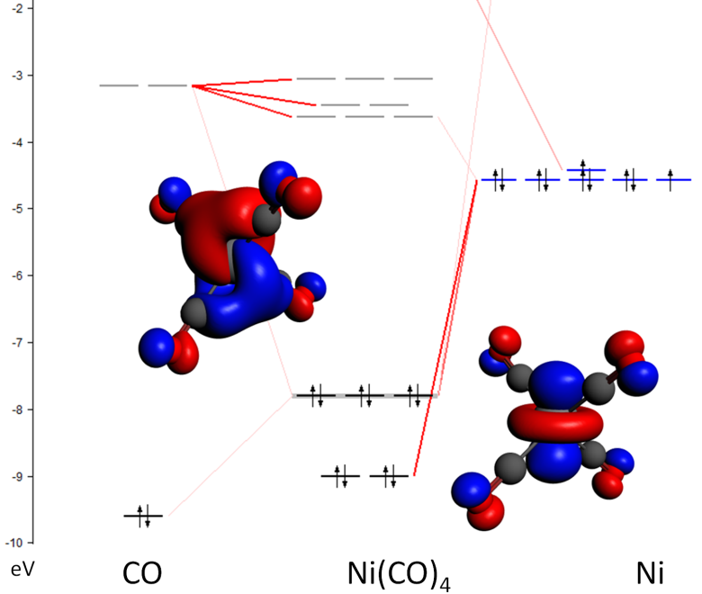
ADF: Molecular DFT
Strong & unique points
All-electron Slaters, all elements
Relativity: ZORA (SR, SOC)
Spectroscopy
  EPR, NMR, IR (VCD), UVVIS, XAS
Bonding analysis:
  Fragment-based approach
  ETS-NOCV, QTAIM, MO diagrams, NCI, ....
  Transfer integrals (charge mobility)
Environments
  Subsystem DFT (FDE), DIM/QM, QM/MM

Slide 7
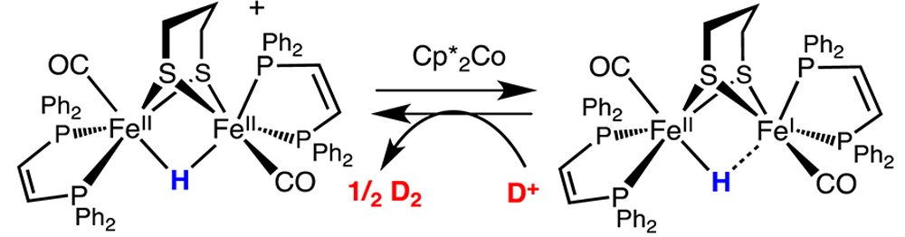
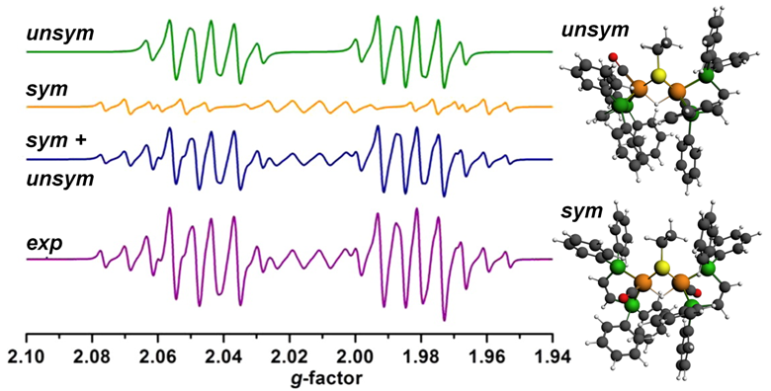
Hydrogen evolution catalyst characterized with EPR
W. Wang, M. J. Nilges, T. B. Rauchfuss, and M. Stein, Isolation of a Mixed Valence Diiron Hydride: Evidence for a Spectator Hydride in Hydrogen Evolution Catalysis J. Am. Chem. Soc. 135, 3633-3639 (2013)
Notes:
In a quest to further advance the hydrogen economy, diiron complexes, mimicking [FeFe]-H₂ases have been widely studied as cheaper and more sustainable catalysts for the hydrogen evolution reaction (HER). Researchers from the University of Illinois and the MPI for Dynamics of Complex Technical Systems have isolated and characterized a mixed-valence diiron hydride, giving unique insight in the mechanistic cycle for this class of bio-mimetic HER catalysts.
The calculated (ZORA-DFT) geometries, IR shifts, and EPR parameters are in good agreement agreement with the experimental findings and yield insight in the spin distribution in the unsymmetric and symmetric isomers.

Slide 8
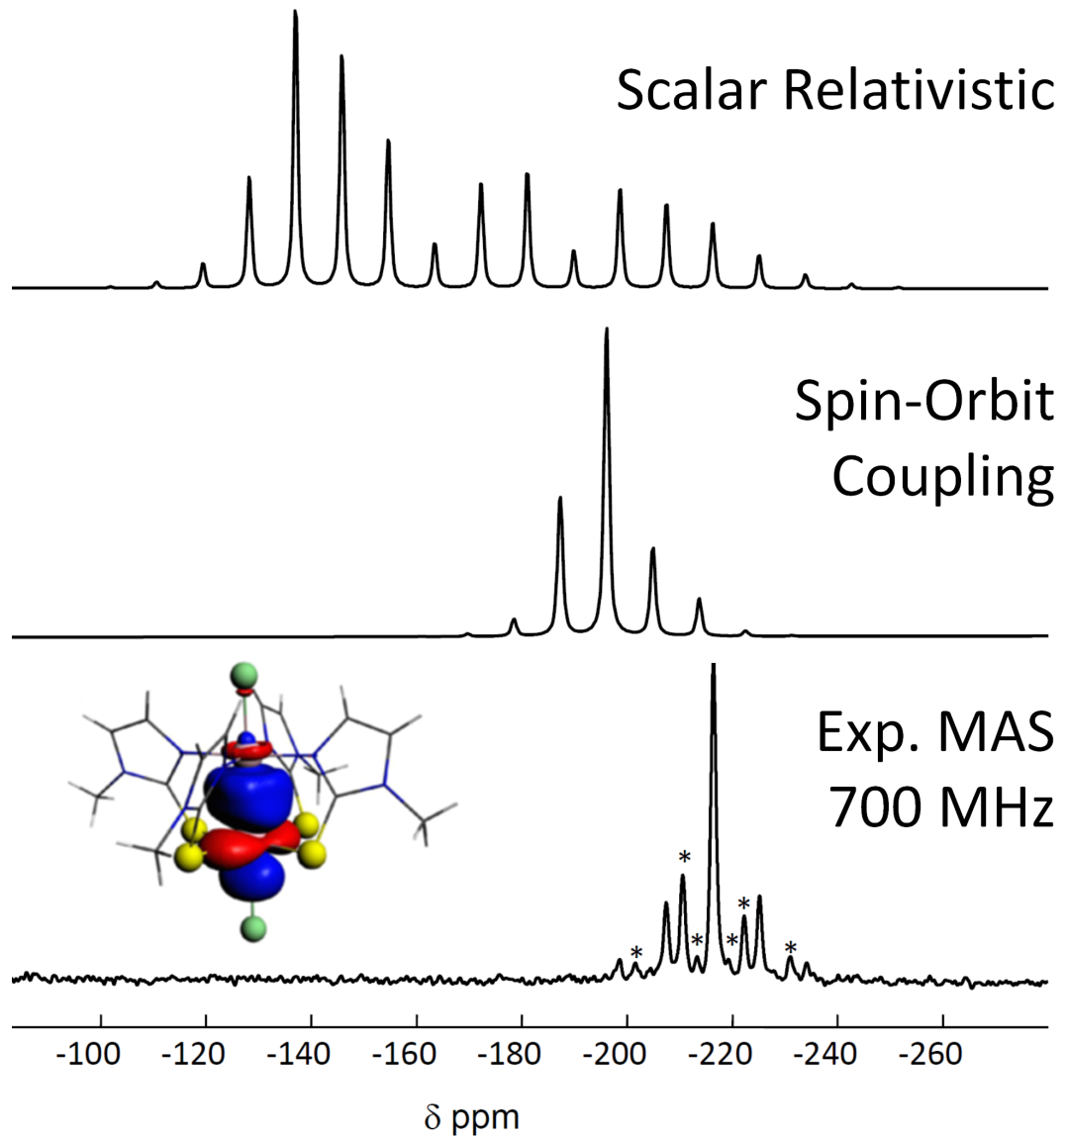
Accurate NMR: all-electron, STOs, and ZORA
Heavy Atom effect on Light Atom (HALA)
  Even through Pt→Si dative bond
Spin-Orbit Coupling gets NMR coupling right
²⁹Si
L. A. Truflandier, E. Brendler, J. Wagler, J. Autschbach, ²⁹Si DFT/NMR Observation of Spin-Orbit Effect in Metallasilatrane Sheds Some Light on the Strength of the Metal→Silicon Interaction Alkyl Complexes Angew. Chem. Int. Ed. 50, 255 (2011)

Slide 9
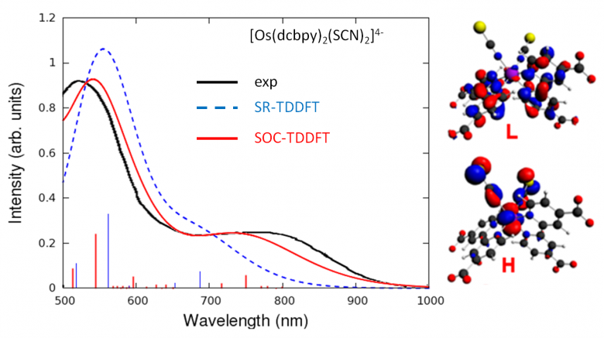
Spin-orbit coupling increases dye efficiency
SOC necessary for Os: increases NIR absorption
Less strong for Rh, but still improves IPCE through spectral broadening
E. Ronca, F. de Angelis, and S. Fantacci, TDDFT Modeling of Spin-Orbit Coupling in Ru and Os Solar Cell Sensitizers, JPC C, 118, 17067-17078 (2014)
see also: Impact of Spin–Orbit Coupling on Photocurrent Generation in Ruthenium Dye-Sensitized Solar Cells, JPCL, 5, 375-380 (2014)

Slide 10
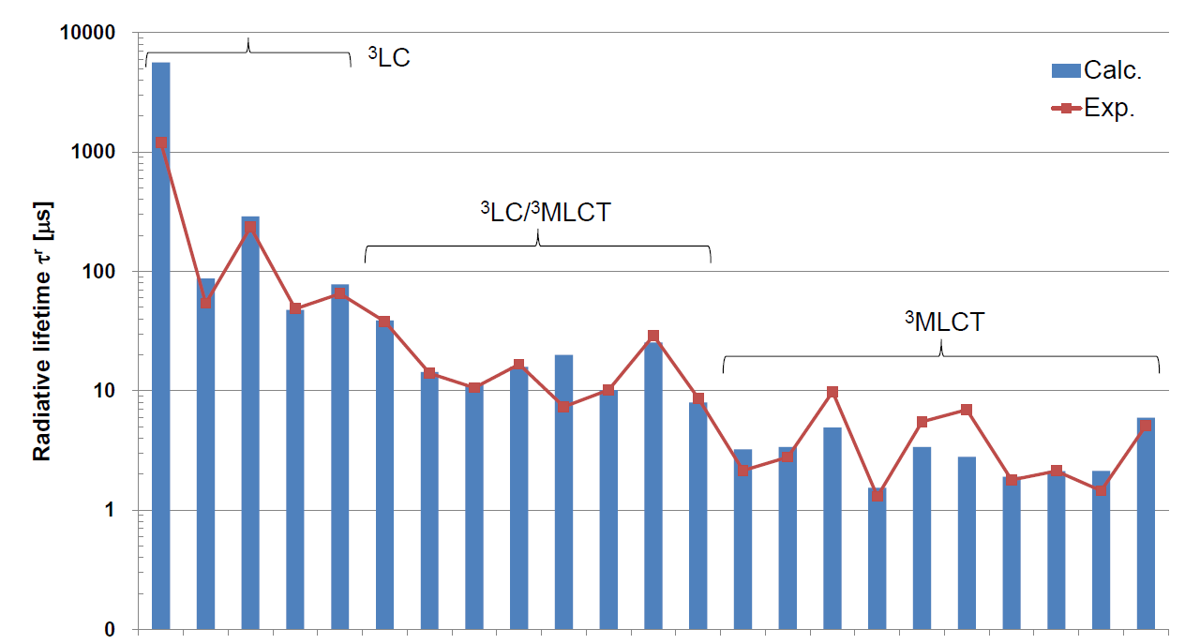
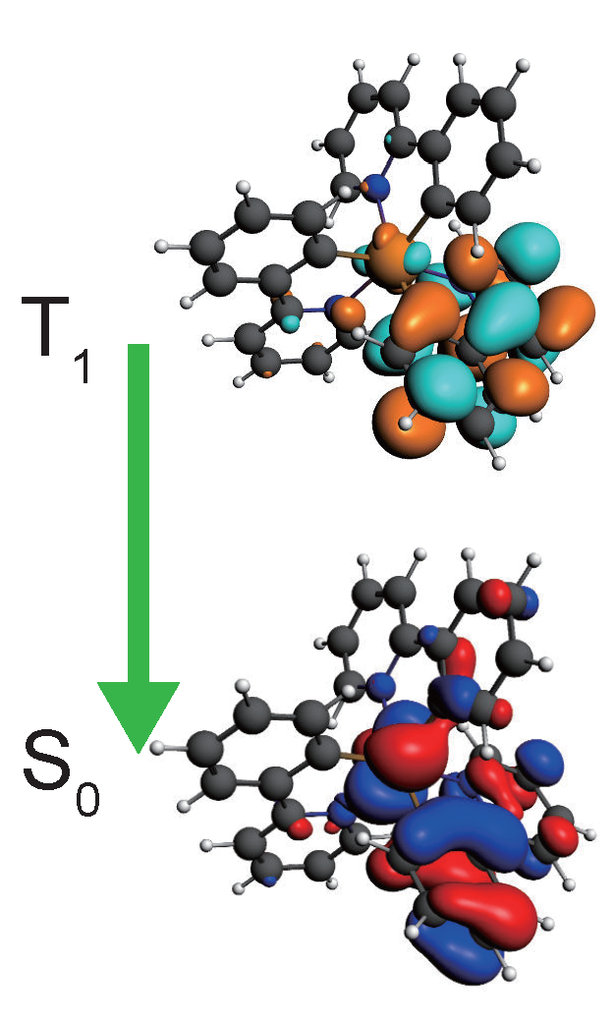
Phosphorescent OLED emitters
Optimize OLED performance
  High charge mobility
  Fast ISC: S₁→T₁
  Phosphorescence T₁→ S₀
  Classically forbidden
  Need spin-orbit coupling
ADF features
  SOC-TDDFT: k_{phos}
  SOCME: k_{ISC}
  Transfer integrals (mobilities)
  Vibrationally resolved abs/em
23 Ir, Rh, Ru, Os, Pt, Re complexes
K. Mori, T. P. M. Goumans, E. van Lenthe, F. Wang, PCCP 16, 14523 (2014)
ADF tutorial online

Slide 11
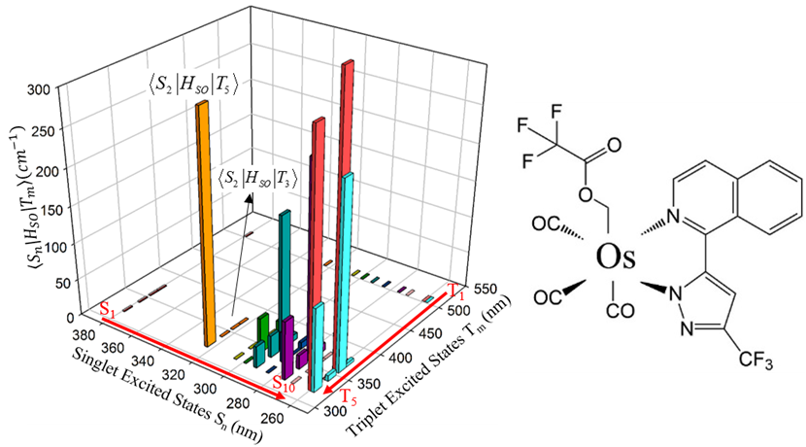
Intersystem crossing: spin-orbit coupling
El-Sayed for organometallics:
SOC is largest when:
both S (¹dπ*) and T (³d’π*) are MLCT
different d-orbitals are involved (d ≠ d’).
Surface-Hopping Dynamics Ru(bpy)₃²⁺
Interface SHARC-ADF with ISC (SOC)
ISC from higher S_{n} states within 26 ± 3 fs
λ_{exc}-dependent quantum yield
SOCME negligible for S₁-T_{n}
ISC from higher S_{n} states
Atkins & Gonzalez
J. Phys. Chem. Lett.,, 8, 3840–3845 (2017)
Phys. Chem. Chem. Phys. 16, 26184-26192 (2014)
Notes:
The Os(fipz)(tfa)(CO)₃ (tfa = trifluoroacetate, fipz=3-trifluoromethyl-5-(1-isoquinolinyl)-1,2-pyrazole) complex shows excitation-dependent emission quantum yield. The higher-energy excitation (< 340 nm) contributes more to phosphorescence than fluorescence, implying stronger intersystem crossing (ISC) for highly excited singlet states. Theoretical calculations confirm that the spin-orbit coupling (SOC) integrals between the lowest singlet excited state, S₁, and the low-lying triplet excited states T_{n} (n=1-10), are negligibly small, whereas the higher singlet states show much stronger SOC with triplet excited states.

Slide 12
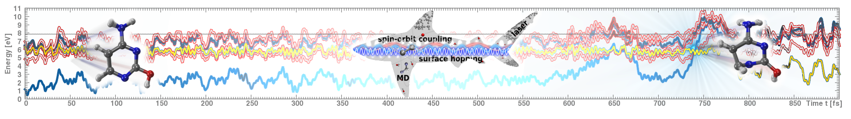
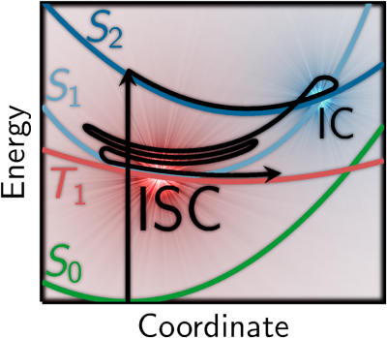
Non-adiabatic dynamics: SHARC
collaboration with Gonzalez, Oppel
Surface Hopping w/ ARbitrary Couplings
k_{ISC} through non-adiabatic couplings + SOC
to be extended to (TD)DFTB
M. Richter, P. Marquetand, J. González-Vázquez, I. Sola, L. González, SHARC – ab initio molecular dynamics with surface hopping in the adiabatic representation including arbitrary couplings, J. Chem. Theory Comput., 7, 1253-1258 (2011).
S. Mai, P. Marquetand, L. González, A General Method to Describe Intersystem Crossing in Trajectory Surface Hopping, Int. J. Quantum Chem., 115, 1215 (2015).

Slide 13
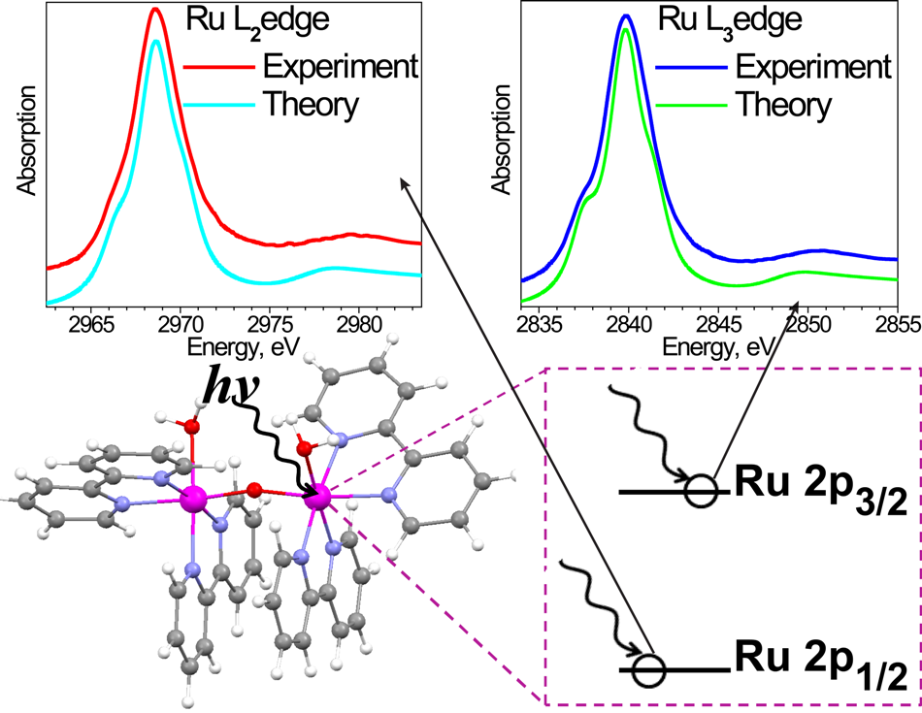
XANES/NEXAFS: Ru water-splitting cat.
SOC necessary for L_{2,3}
  Selected (core) excitations
  FDMNES, FEFF fails
  New: LFDFT
K-edges, XPS
  Fast Slater-TS or TP
  KS energies or ΔSCF
  Polarization-resolved possible
  Helps determine exp. structure
  e.g. J. Phys. Chem. C 116, 18910 (2012); 141, 044313 (2014)
I. Alperovich, G. Smolentsev, D. Moonshiram, J.W. Jurss, J.J. Concepcion, T.J. Meyer, A. Soldatov, Y. Pushkar Understanding the Electronic Structure of 4d Metal Complexes: From Molecular Spinors to L-Edge Spectra of a di-Ru Catalyst J. Am. Chem. Soc., 133 15786-15794 (2011).
Notes:
Ru L2,3-edge spectra well-reproduced by looking at transitions between spinors. 1-electron methods (FDMNES, FEFF) fail even for the simplest RuNH3 complex. Water splitting catalyst.
In the Transition State you move half an electron from initial to final orbital and take the SCF KS eigenvalue difference as excitation energy. This is the original Slater formulation and is justfied doing a Taylor expansion of total energy with respect to occupation numbers, it can be shown that errors arise from third order terms which are small. This however is not very practical: to converge SCF by putting half an electron in virtual orbitals is very hard,
usually it works only for the lowest virtuals. In order to avoid this problem one neglects the half an electron in virtual, this scheme (only half an electron
removed from occupied orbital) is called Transition Potential (TP) and is widely employed in XAS from K-edges.

Slide 14

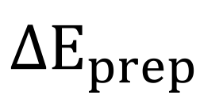
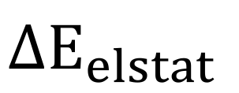
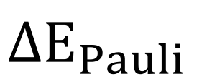
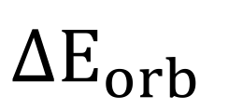
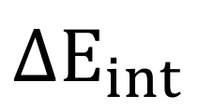


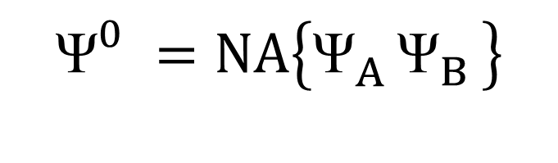



ETS-NOCV: bond & density decomposition
Molecule built from fragments
Bond analysis with meaningful terms:
Combine with NOCV (webinar)
  Orbital interactions / charge transfer
Also periodic 1D, 2D, 3D (tutorials)
  (Ad)sorption nanotbues, surfaces, MOFs etc.
$${\text{Ψ}}_{A}^{GS}$$
$${\text{Ψ}}_{B}^{GS}$$
$$ΔE_{prep}$$
$${\text{Ψ}}_{A}^{}$$
$${\text{Ψ}}_{B}^{}$$
$$ΔE_{elstat}$$
$$ΔE_{int}$$
$$\left\{{\text{Ψ}}_{A}^{}{\text{Ψ}}_{B}^{}\right\}$$
$$ΔE_{Pauli}$$
$${\text{Ψ}}_{}^{0}=NA\left\{{\text{Ψ}}_{A}^{}{\text{Ψ}}_{B}^{}\right\}$$
$$ΔE_{orb}$$
$${\text{Ψ}}_{}^{AB}$$

Slide 15
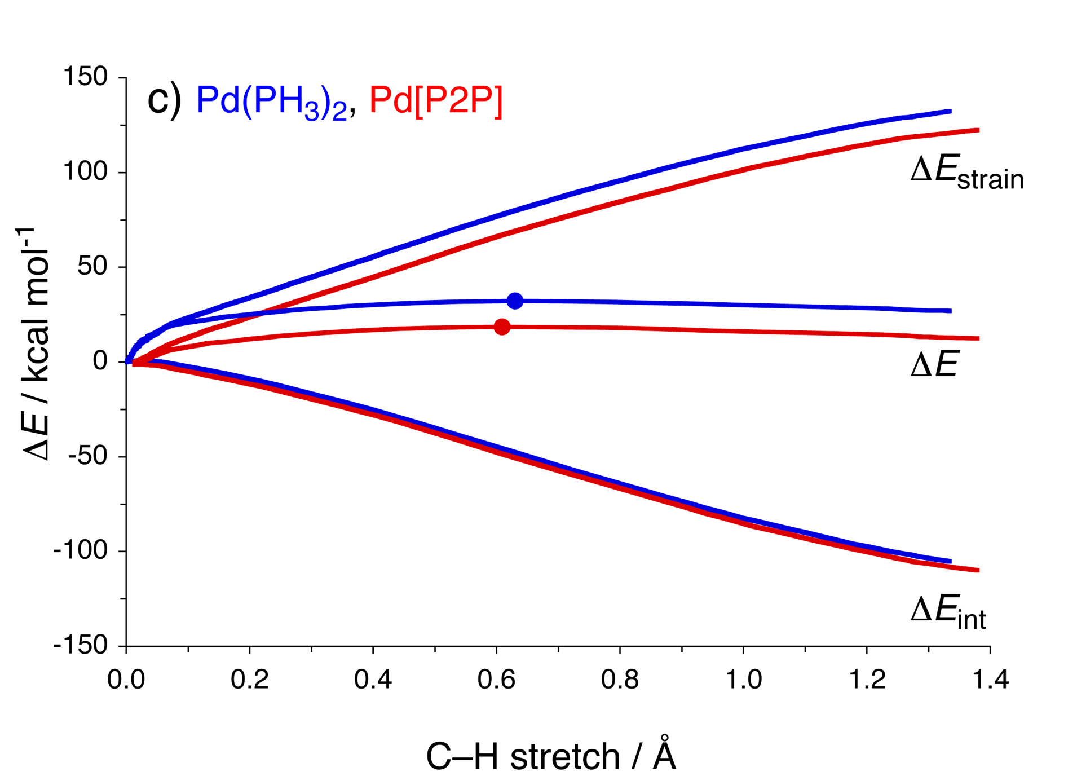
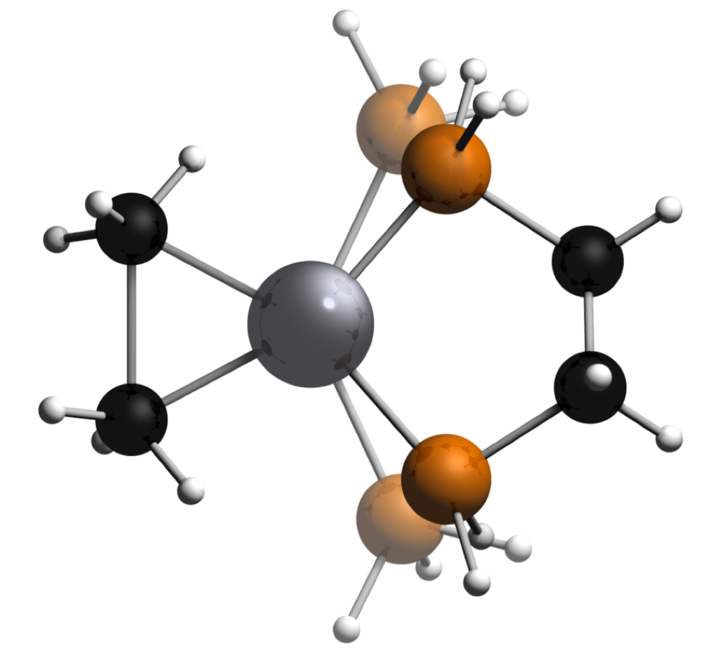
Catalyst design: activation strain model
TS
Chem. Eur. J. (communication) 2009, 15, 6112
Org. Biomol. Chem. 2010, 8, 3118
Nature Chem. 2010, 2, 417
EDA along the reaction path
Bite-Angle Effect: Activation Strain analyses:
• HOMO–LUMO interaction marginally improved
• But: strain reduced by building it into catalyst
Latest reviews:
Chem. Soc. Rev. 2014, 43, 4953
WIRES Comput. Mol. Sci. 2015, 5, 324

Slide 16
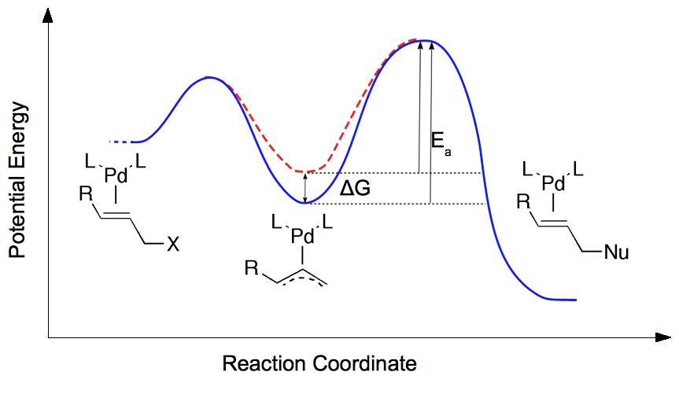
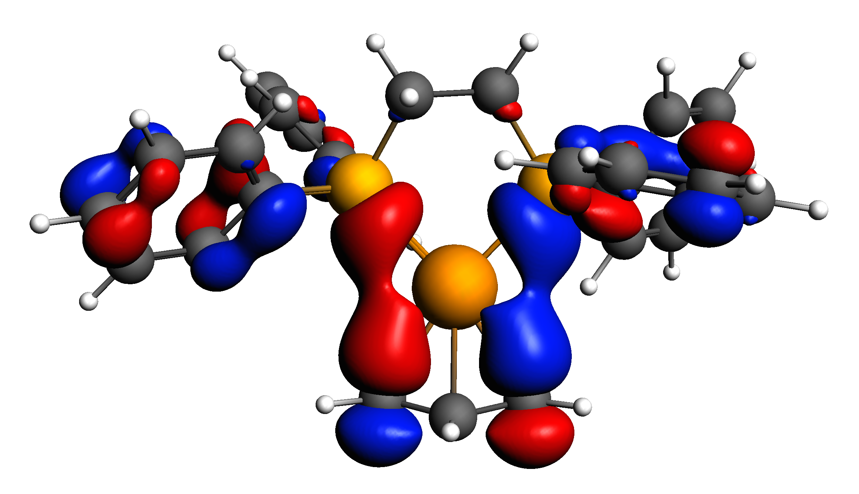
Catalyst natural selection: survival of the weakest
Increased bite angle dppe → dppb
Improved electronic interaction and larger repulsive strain
Strain outweighs electronic interactions → dppb most destabilized → best catalyt
J. Wassenaar, et al. Catalyst selection based on intermediate stability measured by mass spectrometry. Nature Chem. 2, 417 (2010)
Notes:
We introduce a new selection method that focuses on the stability of catalytic intermediates measured by mass spectrometry (ESI-MS), competition experiment. The stability of the intermediate relates inversely to the reactivity of the catalyst, which forms the basis of a catalyst-screening protocol in which less-abundant species represent the most-active catalysts, ‘the survival of the weakest’. We demonstrate this concept in the palladium-catalysed allylic alkylation reaction using diphosphine and IndolPhos ligands and support our results with high-level density functional theory calculations.
High-level DFT calculations show that destabilization of the intermediate Pd-allyl complexes is caused by steric repulsion between the ligand and the substrate for the diphosphine ligands, which overrules the counterbalancing electronic effect. Energy decomposition, strain energy

Slide 17
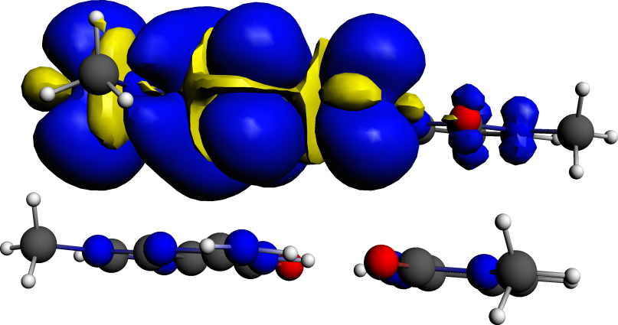
Methods to calculate charge mobilities
Hopping transport:
  Charge transfer integrals (FO) - easy
  Electronic couplings from FDE
Band transport: effective mass tensors in BAND
Non-equilibrium Green’s Function (NEGF)
  transmission probabilities for single-molecule junctions
  quick calculation: wide-band limit
  also in BAND (periodic structures, fully self-consistent, bias) and in DFTB
h⁺

Slide 18
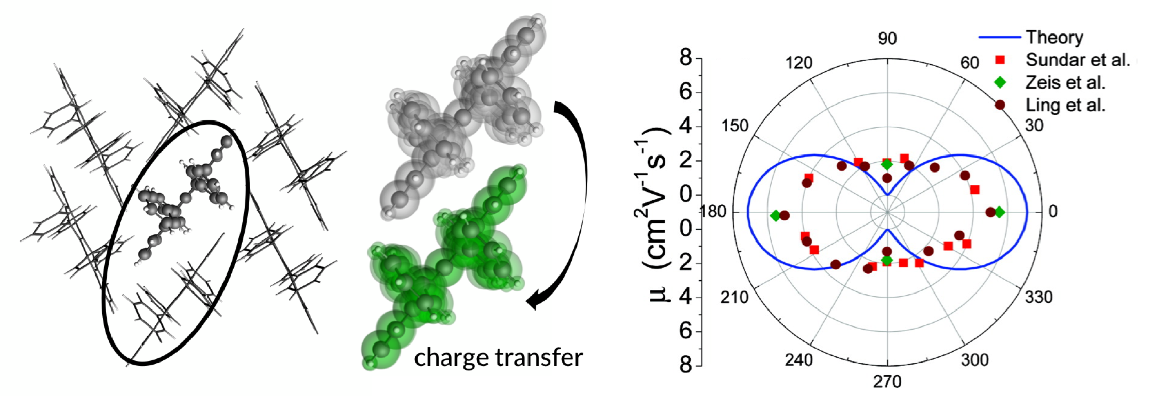

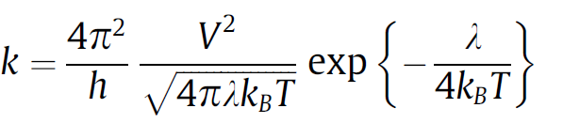
Effective transfer integral J_{eff} = electronic coupling V
extract dimers
Anisotropic mobility:
S.-H. Wen et al., J. Phys. Chem. B 113, 8813 (2009)
ADF tutorial online, ADF prints V / J_{eff} => use with Marcus theory for hopping rates
Notes:
直行変換

Slide 19
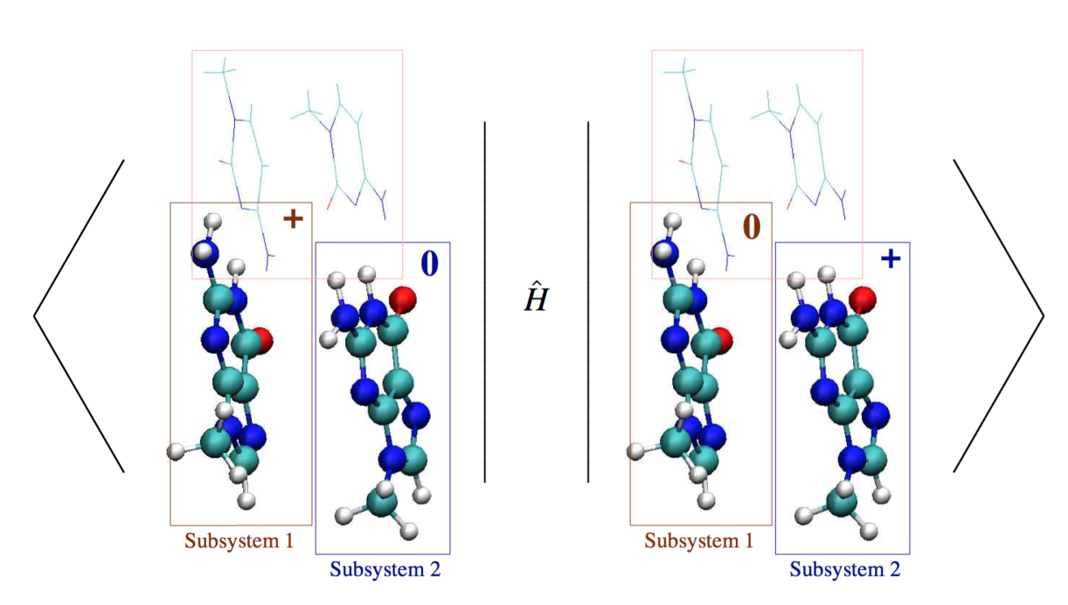
Beyond transfer integrals: environments with FDE
Couplings: electron transfer, exciton, charge separation, ....
Include environment / polarization at DFT level
Frozen-Density Embedding
Subsystems: DFT-in-DFT
(or WFT-in-DFT)
Freeze-thaw
Linear scaling
Control over constraints
1993: Wesolowski & Warshel
ADF: Visscher, Neugebauer, Jacob, Pavanello
Pavanello & Neugebauer groups: Excitons: J. Chem. Phys. 138, 034104 (2013), charge separation: J. Chem. Phys. 140, 164103 (2014), charge transfer: J. Chem. Theory Comput. 2014, 10, 2546−2556
Notes:
With FDE you can take the diabatic states and work out the couplings from the diabatic Hamiltonian
This works for charge transfer, exciton coupling, polaron-exciton coupling

Slide 20
Constrained Subsystem DFT: CSDFT
localize charges and/or spins on a portion of a subsystem
Extended to excited states: XCDFT (in prep. - Pavanello)
Ramos & Pavanello, Phys. Chem. Chem. Phys., 18, 21172 (2016)
Notes:
Right: DNA hole transfer. A DNA trimer is split into two subsystems. On subsystem 1, the positive charge is localized on the PO4 group, or on the nucleobases. On subsystem 2, the diabat for hole transfer is the hole localized on the entire subsystem.

Slide 21
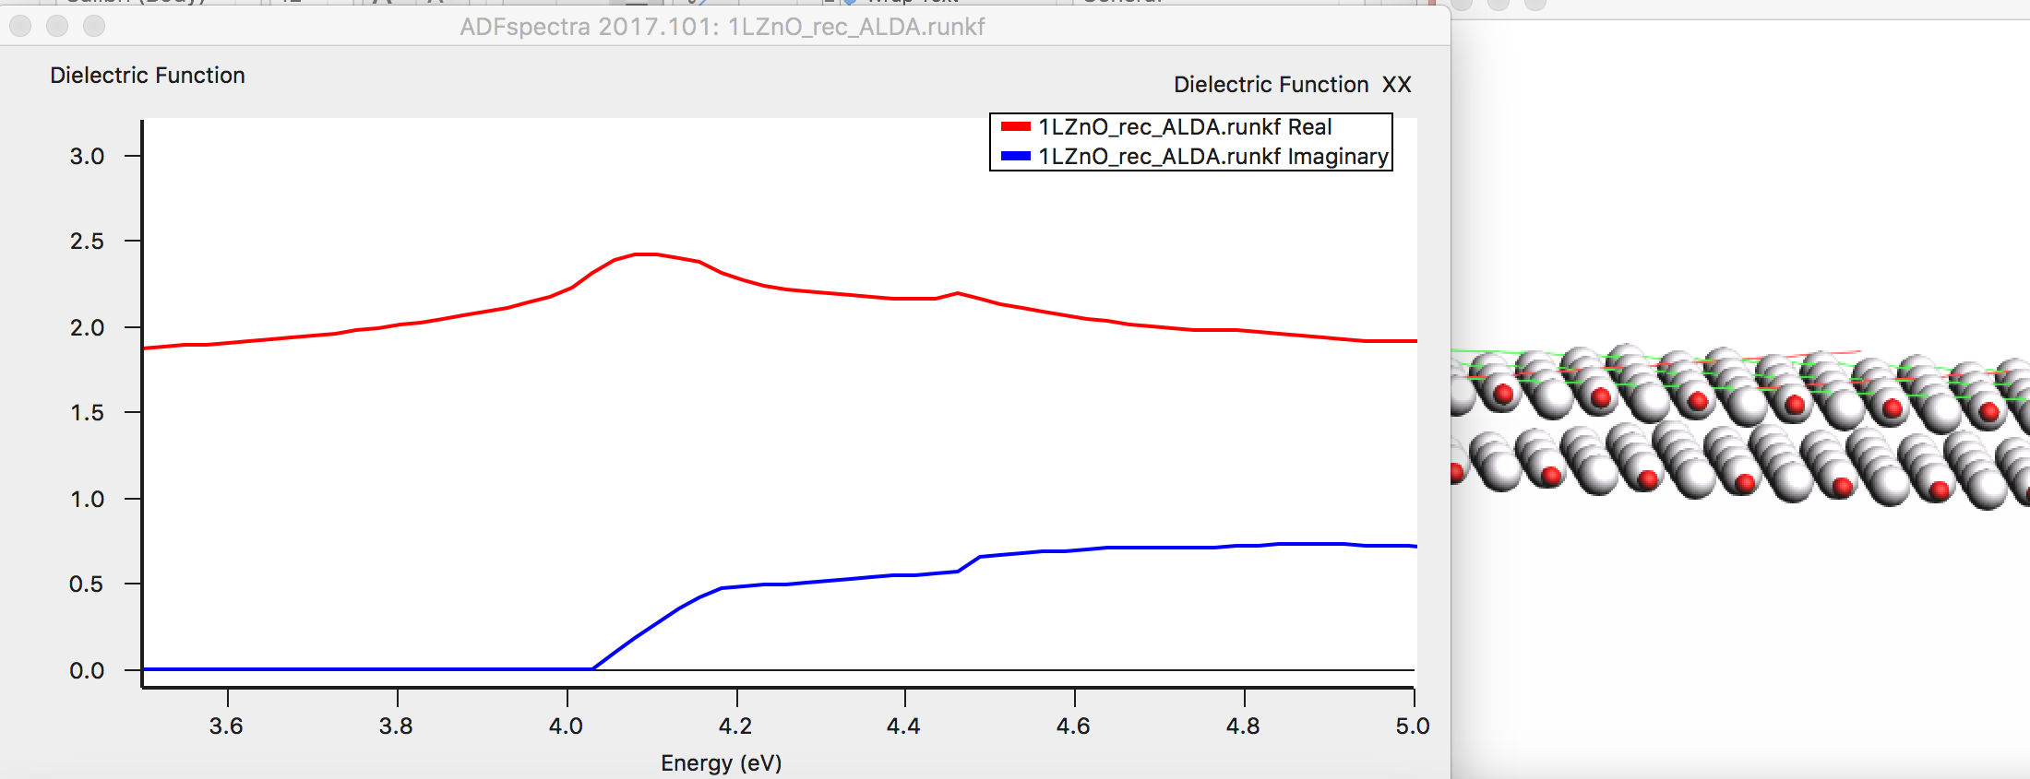
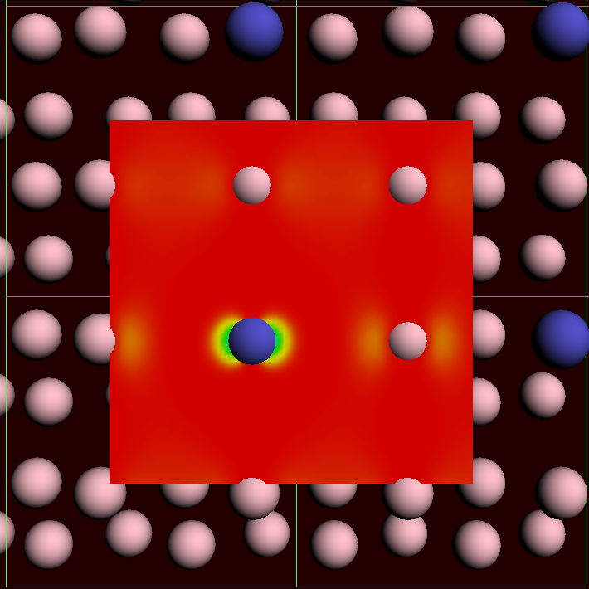
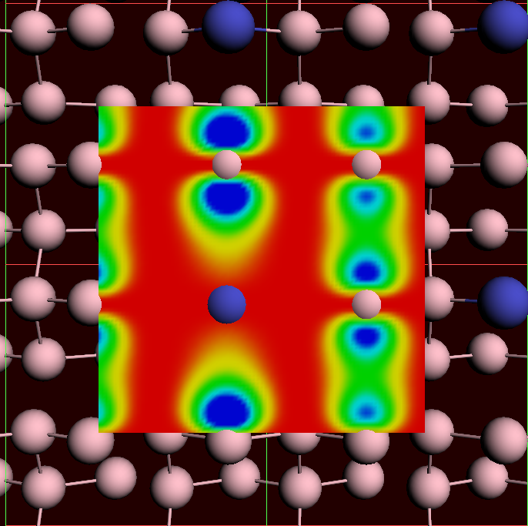
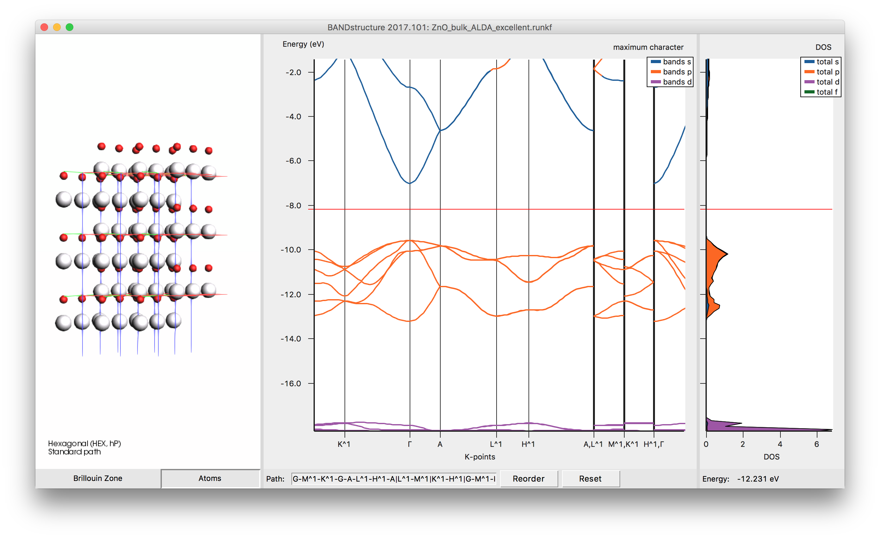
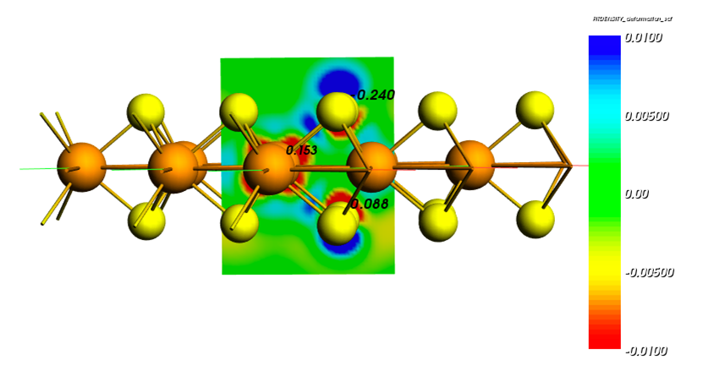
BAND: Periodic DFT
bias = 0
bias = 0.1
Dielectric function ML ZnO
STM PtGe(100)
Band structure, pDOS, fat bands ZnO
Polarizing MoS₂ with an eletric field

Slide 22
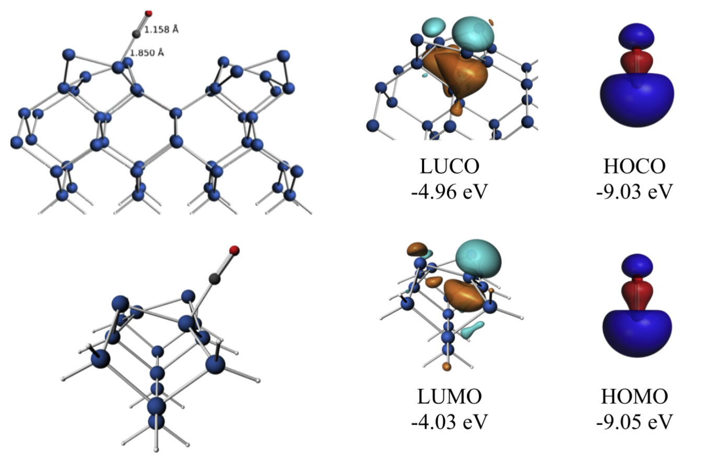
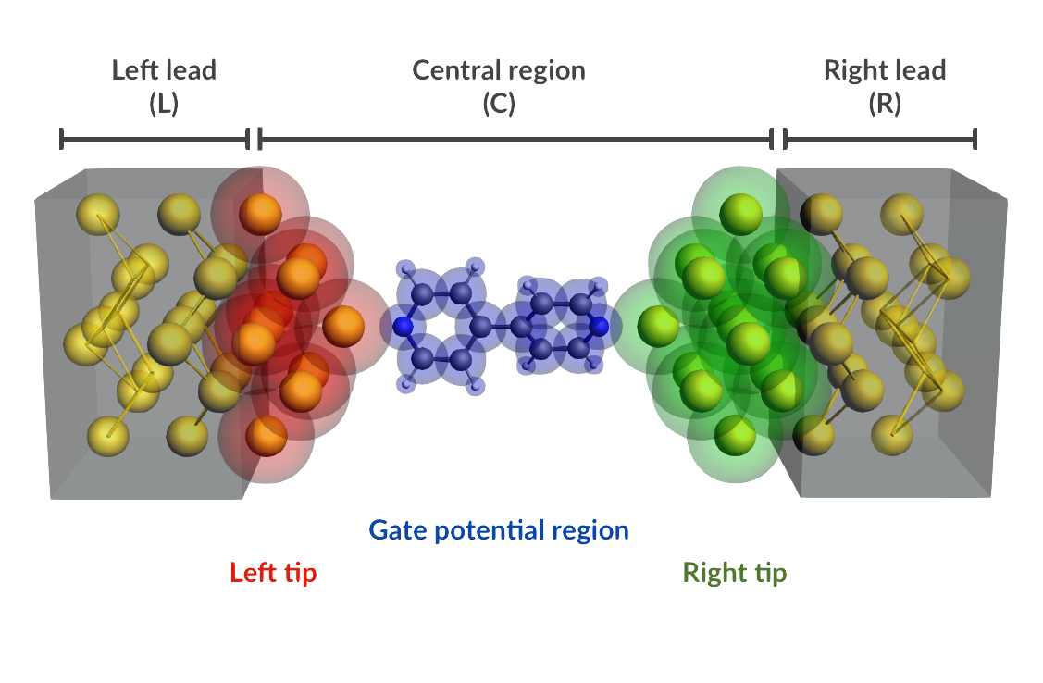
BAND vs. Plane Wave codes
Atom centered basis functions, STO or NAO
  Compare cluster with periodic
  No pseudopotentials, all elements
  Core spectroscopy (core holes)
  Easy (orbital, density) analysis with GUI
  Fast for empty (1D, 2D, porous)
  xc: SCAN, MN15-L, HSE06, GLLB-sc, D3(BJ), ...
  Self-consistent NEGF
    Gate & bias potential
    Spin transport
True 2D surfaces, 1D polymers
  Het. catalysis: polarization, COSMO
  2D electronics (homogeneous E field)
  Nanotubes
Integrated Graphical Interface:
  Easy set up & analysis
  Switch: ADF, BAND & Quantum Espresso
crystal orbitals, periodic energy decomposition analysis
M. Raupach and M. Tonner, J. Chem. Phys. 142, 194105 (2015)

Slide 23
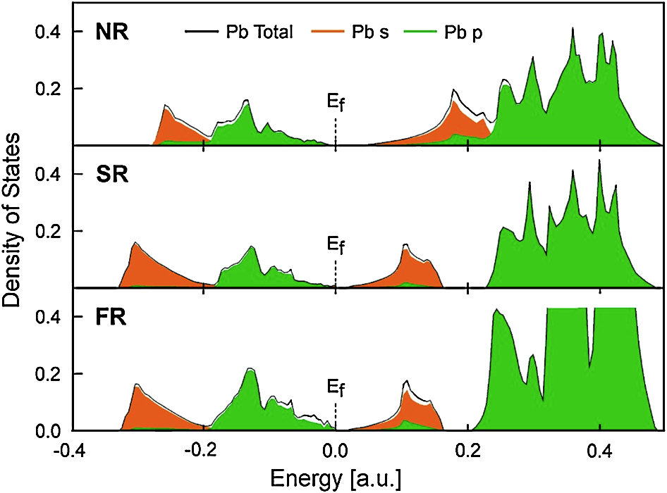
Relativity makes your car start
- Total and partial density of states (DOS) of lead in Lead (IV) oxide
- Strong relativistic shift in
both occupied and unoccupied Pb 6s states.
- Without relativity, 12V battery would be 2.4V!
SOC
Orange = lead 6s states, Green = lead 6p states.
NR = nonrelativistic, SR = scalar relativistic, SOC = self-consistent spin orbit coupling
R. Ahuja, A. Blomqvist, P. Larsson, P. Pyykkö, and P. Zaleski-Ejgierd, Phys. Rev. Lett. 106, 018301 (2011)

Slide 24
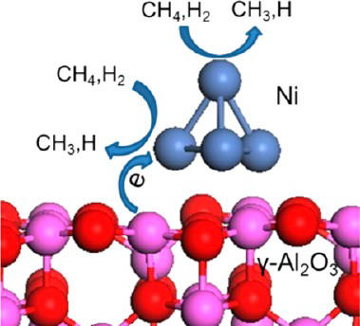
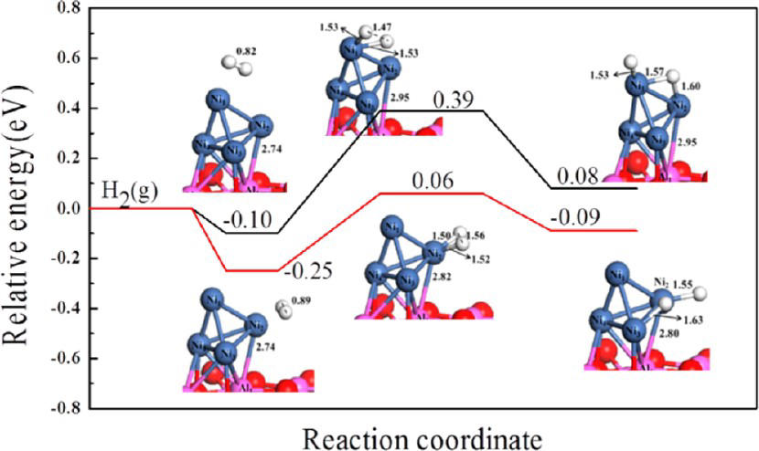
CH₄ and H₂ dissociation on Ni/γ-Al₂O₃
Dissociation at TMO – NP interface preferred
Aluminum acts as electron donor
Need 2D to polarize surface
Li, Croiset, Ricardez-Sandoval, J. Phys. Chem. C 2013, 117, 16907
Notes:
24

Slide 25
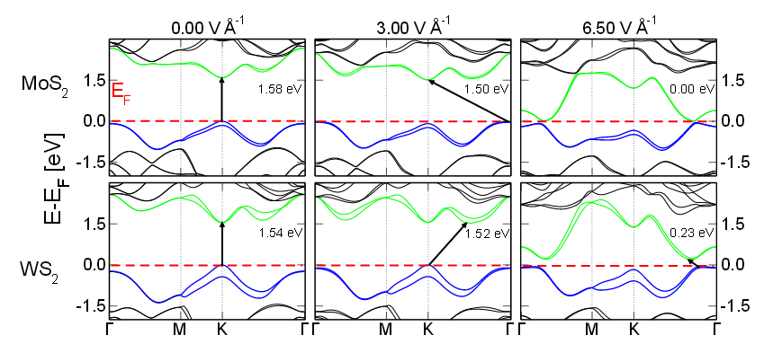
Closing the band gap in 2D MoWSeS
Need 2D + homogeneous field
Plane wave: 3D + saw-tooth gives wrong behavior
3 eV/Å
Electron transport in MoWSeS monolayers in the presence of an external electric field, Phys. Chem. Chem. Phys. (2014)
Notes:
25

Slide 26


Stretching-induced conductance: spin transport
Stretch: Fe LS => HS
spin-polarized BAND/NEGF calcs.: increased HS conductance
- Agrees with exp.
Riccardo Frisenda, et. al. Stretching-Induced Conductance Increase in a Spin-Crossover Molecule. Nano letters 2016, 16(8), pp 4733-4737

Slide 27

DFTB: approximate DFT
Band structures in Si crystals with
PBE/TZP, matsci-0-3, QuaSiNaNo 2013
Approximations (to DFT)
Nearest neighbors
Minimal basis
Elec & rep. parameters
Capabilities & Features
Much faster than DFT
  Molecules and periodic
Repulsive
  Geometries
  Vibrationally resolved excitations
  IR, phonons, MD
Electronic
  Band structures, MOs
  UV/VIS
  Electron transport (NEGF)
Pre-optimize or pre-screen
  Script or chain jobs
QN 2015: rep
QN 2013: ele

Slide 28


Single 2D semiconductor material diode
2D PdS₂ is
semiconducting as ML
semimetallic as BL
DFTB-NEGF
channel lengths of about 2.5 nm
I–V characteristics tunable by gate voltage
M.Ghorbani-Asl, A. Kuc, P. Miró, and T. Heine, A Single-Material Logical Junction Based on 2D Crystal PdS2, Adv. Mater. (2016)

Slide 29

Fast excited states: TDDFTB
Removing 30% excitations reduces CPU time by 98% at no accuracy loss
Rüger, R., et al. , J. Chem. Theory Comput. 11, 157−167 (2015)
Notes:
Ubiquitin: 1400 atoms

Slide 30



Fast excited states: TDDFTB
11000 s
600 + 60s
10s
Excited states gradients: FCF / vibronic states
DFT
DFTB
S₁ (v)→S₀ (v’)
Rüger, R., et al. J. Chem. Phys. 145, 184102 (2016)
Rüger, R., et al. , J. Chem. Theory Comput. 11, 157−167 (2015)
J. Chem. Phys. 144, 184103 (2016)
In ADF a TD approach is available with similar TB approximation, using DFT orbitals
Also available: Grimme’s sTDA & sTDDFT
Notes:
Fast approximations: besides TD-DFTB you can also use the TB approximation for the excitations with the DFT orbitals, which gives access to better (higher) excitations. Limiting step here are the DFT orbitals. TDDFTB can also calculate frequencies => vibrationally resolved spectra.

Slide 31
Vibrationally resolved UV/VIS with TDDFTB
Adiabatic Hessian Franck-Condon, using (TD)DFTB gradients
Rüger, R., et al. J. Chem. Phys. 145, 184102 (2016)
Notes:
Vibrationally resolved S0→ S1 absorption spectrum of pentarylene.
The arrows mark the vertical excitation energies. DFT/BH-LYP results from
Ref. 18. Experimental spectrum from Ref. 43.

Slide 32



Propylene Oxide Hydrolysis over ZSM‑5 Zeolite
Multi-layer DFT/DFTB3 calculations:
monoproplyene glycol formation preferred
J. Phys. Chem. C 2014, 118, 21952−21962

Slide 33




ReaxFF – reactive molecular dynamics
Li battery discharge: J. Electrochem. Soc.
161, E3009 (2014); PCCP, 17, 3383 (2015)
Hydrogen embrittlement of steels
Phys. Chem. Chem. Phys. 18 761-771 (2016)
Crystallization TiO₂ nano-particles in water
Nano Lett. 14, 1836-1842 (2014)
Pd-catalysed CO oxidation GCMC+ReaxFF
J. Chem. Phys., 139 044109 (2013)

Slide 34

ReaxFF: introduction
Simulate complex systems at realistic scales
  Atomistic potentials: bond orders + charge update
A.C.T. van Duin et al ,J. Phys. Chem. A 2001 , 105, 9396-9409.

Slide 35


General ReaxFF rules
No discontinuities in energy or forces
No pre-defined reaction sites or types
Only 1 atom type per element
Notes:
User should not have to pre-define reactive sites or reaction pathways; potential functions should be able to automatically handle coordination changes associated with reactions.
force field should be able to determine equilibrium bond lengths, valence angles etc. from chemical environment.

Slide 36

ReaxFF parameters, transferability
many elements studied
each pair needs bonded terms
validate force field
    GUI checks
    training data crucial
    application specific
New parameters
  ADF 2013: 17 sets, 19 elements
  ADF 2014: 38 sets, 29 elements
  ADF 2016: 58 sets, 38 elements
  ADF 2017: 79 sets, 38 elements
  van Duin, Goddard, others
  RxFF consulting
  MCFF optimizer

Slide 37



ReaxFF tools in ADF Modeling Suite
ChemTraYzer: Automated rates & pathways
Molecule gun: depositing molecules on surfaces
MCFF: parameterize ReaxFF force field
fbMC: speed up kinetics
GCMC: speed up thermo

Slide 38

Analyzing trajectories: events
M. Döntgen et al., J. Chem. Theory Comp. 11, 2517–2514 (2015)

Slide 39
Dealing with the atomistic insight
ChemTraYzer: complete reaction network, rate constants, timeline, ..
M. Döntgen et al., J. Chem. Theory Comp. 11, 2517–2514 (2015)

Slide 40

ChemTraYzer
Follow connectivity (BO in ReaxFF)
Tabulate changing species
  Identify identical species (SMILES, InChI)
  Reaction pathway: graph
Calculate fluxes, rate constants
Visualize network
  Interactively
  2D => 3D
  Follow reaction pathway
M. Döntgen et al., J. Chem. Theory Comp. 11, 2517–2514 (2015)

Slide 41

Carbon nanotube formation: accelerate MD
pentagon formation
graphitic patches
cap development
carbon network slides over catalyst
part of metal gets freed
end of sliding,
chirality obtained
ReaxFF acceleration:
fbMC tutorial
ReaxFF-MD + fbMC: healing of defects during sliding of network (steps 4-5).
First simulation showing growth of an armchair SWNT with definite chirality on catalyst.
Molecule gun + fbMC video
Neyts et al., J. Am. Chem. Soc. 133, 17225 (2011)

Slide 42

Grand Canonical Monte Carlo + ReaxFF
Reactive MD under actual conditions
GCMC: What is stable (p,T)?
ReaxFF: What is active?
ReaxFF +GCMC tutorial
T.P. Senftle, R.J. Meyer, M.J. Janik, A.C.T. van Duin, J. Chem. Phys., 139 (2013) 044109

Slide 43
Discharge process Li-S batteries
Cathode expands upon lithiation
  Captured by ReaxFF
Voltage during discharge (GCMC)
Diffusion induced stress
Voltage (V)
M. M. Islam, A. Ostadhossein, O. Borodin, A. T. Yeates, W. W. Tipton, R. G. Hennig, N. Kumar, and A. C. T. van Duin, ReaxFF molecular dynamics simulations on lithiated sulfur cathode materials, Phys. Chem. Chem. Phys. 17, 3383-3393 (2015)

Slide 44


Optimizing ReaxFF parameters
Highly complex global optimization:
  many parameters
  interdependent
  non-linear
  not always physically interpretable
E. Iype, et al., Parameterization of a Reactive Force Field Using a Monte Carlo Algorithm,
J. Comp. Chem. 34, 1143-1154 (2013)

Slide 45


Monte Carlo with Simulated Annealing
x_{i,TS} = reference
x_{i,ReaxFF} = current ReaxFF
σ_{i} = weight
References include:
● Atomic charges
● Heat of formation
● Geometries (Bond/Angle/Dihedrals)
● Cell parameters
● Energies
Iteration
J. Comp. Chem. 34, 1143-1154 (2013)

Slide 46

Tying it all together: python
MOPAC
Links all modules + various tools
→ workflows & screening
→ (custom) post-processing
→ rapid prototyping

Slide 47

Automating ReaxFF parameterization
ADF
training set
ReaxFF
BAND
MCFF
new species?
reaction network
ChemTraYzer
Production runs
+
Analysis
Ultimately:
(more) GUI support

Slide 48


NEW: eReaxFF- include Explicit Electrons/Holes
M. M. Islam, G. Kolesov, T. Verstraelen, E. Kaxiras, A. C. T. van Duin, J. Chem. Theory Comput 2016, 12 (8), 3463-3472.
Basic idea:
Electrons/Holes → additional particle
Electrons → Gaussian wave functions
ψ ∝ exp(−α(r−r′)²)
E_{nuc-elec} depends on
    - nuclear charge
    - Gaussian exponent α
    - distance (nucleus – electron)
Further dependencies/coupling terms
    - atom type, bond type, coordination
    - electron – electron
#electrons per nucleus can be fractional → 'split electron'
First proof of concept results:
e-
Electron transfer in a C₁₂H₁₉ radical
+ e-
#Val. electrons: up
Valency : down
Atom
+ h
#Val. electrons: down Valency : up
Time-scale needed for electron transfer from polyacetylene to the radical site at different T
Atom

Slide 49


eReaxFF – Solid-Electrolyte Interfaces
Reductive decomposition of ethylene carbonate in Li ion batteries
eReaxFF video
M. M. Islam and A. C. T. van Duin, J. Phys. Chem. C 2016, 120 (48), 27128-27134.

Slide 50


COSMO-RS: fluid properties
From quantum chemistry to chemical engineering thermodynamics

Slide 51



From QM to statistical thermodynamics
  chemical potential => activity coefficients => properties
  σ-profile: charge density on COSMO (ε=∞) surface
  pair-wise interaction between molecules
  electrostatic interactions + hydrogen bond
  pseudo-chemical potentials
  random mixture approximation, equilibrium
  statistical thermodynamics

Slide 52

pK_{a} values: fitting ΔG_{diss}
(acid) AH (aq) + H₂O (l) → H₃O⁺ (aq) + A⁻ (aq)
(base) BH⁺ (aq) + H₂O (l) → H₃O⁺ (aq) + B (aq)
Empirical fitting ΔG_{diss} against experimental pK_{a}
(acid) pK_{a} = 0.62 ΔG_{diss}/(RT ln(10)) + 2.10
(base) pK_{a} = 0.67 ΔG_{diss}/(RT ln(10)) - 2.00
See COSMO-RS tutorials and work by Michelle Coote & Junming Ho
Notes:
pKa = -log Ka
Ka=lA-][H+]/[AH]
pH = pKa + log[A-]/[HA]

Slide 53
Partition coefficients (logP)
log P_{A/B} = log {[solute]_{A}/[solute]_{B}}
Experimental values taken from: A. Klamt et al., J. Phys. Chem. A 102 (1998) 5074
Notes:
The log of the solute concentration in solventa A divided by the solute concentration in solvent B
Thus the relative solubility

Slide 54
COSMO-RS VLE: solubility in ionic liquids
Prediction beyond parametrization (opposed to UNIFAC)
Works well for SO₂ solubilities
Improvements needed for CO₂
Z. Lei, C. Dai, and B. Chen, Gas Solubility in Ionic Liquids, Chem. Rev., 114, 1289−1326 (2014).
Notes:
COSMO-RS prediction of SO₂ solubilities (solid lines) in [BMIM]⁺[MeSO4]⁻, compared with experiments (symbols) at different temperatures (283, 298.1, 323.1, 348.1 K)

Slide 55







1 GUI: build, run & analyze

Slide 56

Summary
Molecular DFT with ADF
  Unique features for organic electronics
  Fast + accurate TDDFT - nanoparticle optical properties
BAND AO-based
  Optical and electronic properties of 2D systems
  Easy orbital & density analysis
  NEGF: Charge and spin transport
DFTB: faster more approximate
  Spectroscopy, reactivity, dynamics
  NEGF: transmission, charge transport
ReaxFF: reactive MD large, complex systems
  Monte Carlo methods to speed up time / equilibrium
  New: eReaxFF for batteries / Redox reactions
Synergy between all modules + GUI

Slide 57

Recent pNMR paper: Direct Detection of ¹⁷O in Gd(DOTA)] by NMR Spectroscopy, Chem. Eur. J. 21, 1955-1960 (2015)

Slide 58



CV-DFT works for charge-separated states
TDDFT FAILS
Constricted-variational DFT
  Delta-SCF like approach on TDDFT
  Constraint: 1e in total removed from occupied
  Alternative to TDDFT/RSH: use with GGAs
M. Krykunov, S. Grimme, T. Ziegler,
J. Chem. Theory Comput. 8 (2012) 4434.

Slide 59

Fast excited state calculations
TDDFTB on DFT orbitals: TD-DFT+TB
11000 s
600 + 60s
10s
R. Rüger, et al. http://arxiv.org/abs/1603.02571
Also available: sTDDFT, sTDA

Slide 60

Efficient TDDFT for nanoparticle plasmons
O. Baseggio, M. De Vetta, G. Fronzoni, M. Stener, L. Sementa, A. Fortunelli, and A. Calzolari, J. Phys. Chem. C 120, 12773 (2016).

Slide 61

Optical Properties of Silver and Gold Nanoparticles
Relativistic TDDFT (ZORA), Symmetry, SAOP, Slater-type Orbitals
Aikens, Khanna, Schatz, Stener, …
J. Am. Chem. Soc., 136, 14933-14940 (2014) J. Phys. Chem. C, 118, 12450-12458 (2014)

Slide 62



Faster TDDFT: complex polarizability (aux. basis)
Removes Davidson diagonalization bottleneck
  Large systems (>1000 Au/Ag) & higher excitation energies
Analyze plasmons: TCM, scaling factor, induced ρ
CD rotational strengths ‘free’
New complex polarizability algorithm
Baseggio, Fronzoni, Stener, J Chem Phys. 143, 024106
Coming soon – not yet documented

Slide 63




Coupled TDDFT – atomistic electrodynamics (DIM/QM)
Plasmon-exciton hybridization
  enhanced molecular absorption
Surface-enhanced Raman scattering
  including optically active (SEROA)
Plasmon enhanced photochemistry
New: NLO: SEHRS & more
TDDFT + potential atomistic electrodynamics
DRF (polarizable force field)
Fit capacitance & polarizability to bulk (BAND)
developed by Lasse Jensen group,
see also his web presentation.
Review: Acc. Chem. Res. 47, 88–99 (2014)

Slide 64
New methods for NLO (Jensen et al.)
Damped quadratic response theory + DIM: SEHRS
Hu, Z.; Chulhai, V. D.; Jensen, L. J. Chem. Theor. Comput., 2016
Notes:
Crystal Violet damped quadratic response theory, as opposed to SOS (where a few states dominate), SER

Slide 65




Damped cubic response (gamma): TPA, THG
Two Photon Absorption:
Other γ properties
OKE
EFIOR
EFISHG
NLR
2HRS
Third Harmonic Generation:
Hu, Z; Autschbach, J.; Jensen, L. J. Chem. Theor. Comput., 2016, 12, 1295

Slide 66


Spin states: Slaters vs Gaussians
“Slaters give consistent and rapidly converging results outperforming Gaussians and ECP”
  STOs converge rapidly, GTOs slowly
  ECPs give systematically different results
  sGTOs give correct results
  (JPCA 2010, 114, 7191)
J. Phys. Chem. A, 112 (28), p. 6384, 2008, Güell, Luis, Sola, and Swart
Notes:
66
J. Phys. Chem. A, 112 (28), p. 6384, 2008, Güell, Luis, Sola, and Swart, compare ADF's Slater Type Orbital (STO) basis sets to Gaussian Type Orbitals (GTO) basis sets in a systematic study on spin-state energies of iron complexes. Their findings are summarized in the graph below.
Slow convergence with Gaussian basis sets
The abstract states that "STO basis sets give consistent and rapidly converging results, while the convergence with respect to basis set size is much slower for the GTO basis sets." They conjecture that this may be related to "the cusps at the nuclei (correctly described in STO, incorrectly described in GTO)". The GTO basis sets of standard size in particular have problems with the high-spin state.
No convergence with ECP basis sets
In case GTO basis sets are combined with Effective Core Potentials (ECPs), the results worsen in the sense that the common basis set limit for STO's and GTO's does not seem to be reached even for quite large ECP basis sets.

Slide 67



Broken-Symmetry DFT: multi-nuclear complexes (CcO, [4Fe4S], …)
Antibiotics/antimalarial drugs with new mode of action: inhibit MEP (DOXP) pathway
Environment: COSMO and SCRF (favors higher charged states)
P. Blachly, … Bashford & Noodleman, Use of Broken-Symmetry Density Functional Theory To Characterize the IspH Oxidized State: Implications for IspH Mechanism and Inhibition, J. Chem. Theory Comput. 2014, 10, 3871 (2014)
Notes:
67
isoprenoid biosynthesis pathway in humans/animals follows different route: DMAPP and IPP through a mevalonate-dependent pathway that is distinct from the MEP pathway
Approval of fosmidomycin, an antimalarial drug that targets 1-deoxy-D-xylulose 5-
phosphate reductoisomerase (DOXP reductase, also referred to as Dxr or IspC), the second enzyme in the MEP
pathway.18−20

Slide 68

Charge generation in fullerene-based OPVs
Charge generation facilitated by resonant coupling of singlet excitons in polymer donors to fullerene electronic states
Diagonal couplings
Off-diagonal couplings
(transfer integrals)
J. Am. Chem. Soc., 136, 2876−2884 (2014)

Slide 69


Singlet Fission Yields in Organic Crystals
Direct pathway dominates SF
Yields up to 132% possible, depends on crystal packing
N. Renaud, P. A. Sherratt, and M. A. Ratner, Mapping the Relation between Stacking Geometries and Singlet Fission Yield in a Class of Organic Crystals, J. Phys. Chem. Lett., 4, 1065-1069 (2013)

Slide 70
eXcited Constrained DFT (XCDFT), in prep
XCDFT localizes excitations: Good alternative to △SCF and TDDFT
Pavanello research group, under development

Slide 71



Thermally Activated Delayed Fluorescence
Optimize radiative rate
Minimize S1-T1 gap
Maximize SOC
Maximize k_{phos} & k_{TADF}
Z.-M. su et al. Dyes & Pigments 2017,
Bredas et al. J. Am. Chem. Soc. 2017, 139, 4042−4051
ADF tutorial in progress

Slide 72

Vibronic fine structure T₁ → S₀ OLED phosphor Pt complex
Excellent agreement vibrational progression FCF T₁-S₀
0-0 well reproduced by Delta SCF calculation (22,000 cm⁻¹)
ADF tutorial online

Slide 73
Energy decomposition analysis
∆E = ∆E_{prep} + ∆E_{int}
Chem. Soc. Rev. 2014, 43, 4953;
WIRES Comput. Mol. Sci. 2015, 5, 324
Oline tutorial & teaching materials
∆E_{prep} = geometry ’deformation’ energy
∆V_{elstat} + ∆E_{Pauli} + ∆E_{oi} + ∆E_{disp}
fragments => molecule
∆E_{steric} = ∆V_{elstat} + ∆E_{pauli}
∆E_{oi} = decomposed in irreps.
Notes:
The term ΔV_{elstat} corresponds to the classical electrostatic interaction between the unperturbed charge distributions of the prepared (i.e. deformed) fragments and is usually attractive. The Pauli repulsion ΔE_{Pauli} comprises the destabilizing interactions between occupied orbitals and is responsible for any steric repulsion. The orbital interaction ΔE_{oi} in any MO model, and therefore also in Kohn-Sham theory, accounts for charge transfer (i.e., donor-acceptor interactions between occupied orbitals on NH₃ with unoccupied orbitals of BH₃, including the HOMO-LUMO interactions) and polarization (empty/occupied orbital mixing on one fragment due to the presence of another fragment).

Slide 74

DFT-D3 XC functionals in ADF & BAND
- Less empirical than earlier DFT-D2
Asymptotically correct
Available for elements Z = 1-9`4
Dispersion coefficients and cutoff radii computed explicitly
Dispersion coefficients independent of connectivity
- Similar or better accuracy for light elements, better for heavy ones
S.Grimme, J. Antony, S. Ehrlich, and H. Krieg: J. Chem. Phys. 132, 154104 (2010).
Notes:
Grimme and his coworkers at the Universität Münster outlined the parameterization of this new correction, dubbed DFT-D3, in a recent issue of The Journal of Chemical Physics 132, 154104 (2010). Here they list the advantages of the new method as the following:
It is less empirical, i.e., the most important parameters are computed from first principles by standard Kohn-Sham (KS)-(TD)DFT. The approach is asymptotically correct with all DFs for finite systems (molecules) or nonmetallic infinite systems. It gives the almost exact dispersion energy for a gas of weakly interacting neutral atoms and smoothly interpolates to molecular (bulk) regions. It provides a consistent description of all chemically relevant elements of the periodic system (nuclear charge Z = 1-94). Atom pair-specific dispersion coefficients and cutoff radii are explicitly computed. Coordination number (geometry) dependent dispersion coefficients are used that do not rely on atom connectivity information (differentiable energy expression). It provides similar or better accuracy for "light" molecules and a strongly improved description of metallic and "heavier" systems.
Above: The adsorption energy of perylene-tetracarboxylic-dianhydride (PTCDA) on a gold (111) surface as a function of distance. Results without (PBE) and with dispersion corrections (PBE-D2, PBE-D3) are shown. The experimental distance is 3.27Å. The vdW-DF result is from PCCP, 12, 4759 (2010).
The article continues by, among other things, demonstrating how this new DFT-D version decreases the mean absolute deviations for a benchmark set of non-covalent interactions by 15-40% over the previous version. Professor Grimme notes that the more significant errors in dispersion energy can be expected for modeling highly charged systems. See section III-F of the original paper for more details.
DFT-D3 is now available in the development snapshots of ADF and BAND, versions r23091 and later. They can be downloaded at http://www.scm.com/SCMForms/DownloadSnapshots.jsp. Instructions on the use of this functional can be found in the ADF developer's change-log at http://www.scm.com/Downloads/ChangeLog-trunk.html.

Slide 75


Parameter-free polarization functional
ε₂(ω)
TDCDFT/RPA + GW scissors + α
Accounts for bound excitons & Drude tails
A. Berger, Fully parameter-free calculation of optical spectra for insulators, semiconductors and metals from a simple polarization functional, Phys. Rev. Lett. 115, 137402 (2015)
Notes:
The main failures of standard approximations such as the random-phase approximation (RPA) and the adiabatic local-density approximation (ALDA) [9] are: 1) the underestimation of the onset of the absorption; 2) the underestimation of the intensity of continuum excitons; 3) the absence of bound excitons; 4) the absence of Drude tails in the spectra of metals.
Solution:
We calculate the macroscopic dielectric function using an efficient TDCDFT approach [26, 27] within the RPA (including a scissors shift obtained from GW); 2) We apply a simple dynamical polarization functional (see Eq. (14) below) that accounts for continuum and bound excitons as well as Drude tails.
macroscopic dielectric tensor ǫ ↔ M (ω) can be obtained from the electric susceptibility according to ǫ ↔ M (ω) = 1 + 4πχ ↔ e(ω).
75

Slide 76
Fixing the band gap ‘problem’
Kohn-Sham gap ≠ fundamental gap
DFT underestimates band gap
  underlying problem: integer derivative discontinuity in v_{xc}
  E_{gap} = I – A + Δ_{xc}
Possible ‘solutions’
  many-body perturbation (GW) (not yet available in BAND)
  (screened) hybrids, e.g. HSE06
  LDA/GGA + U (localize d, f electrons in TMO)
  TB-mBJ (fitted to band gaps)
  GLLB-sc (includes explicit Δ_{xc})
Notes:
76

Slide 77

Tran & Blaha’s modified Becke-Johnson (TB-mBJ)
Parameterized for inorganic semiconductors
Has adjustable parameters
  E.g. for hybrid perovskites
Includes volume term => 3D only
  ‘trick’ for 2D possible
Accurate Band Gaps of Semiconductors and Insulators with a Semilocal Exchange-Correlation Potential Phys. Rev. Lett. 102, 226401 (2009).
Notes:
revTPSS META-GGA: A WORKHORSE SEMILOCAL DENSITY FUNCTIONAL FOR CONDENSED MATTER PHYSICS AND QUANTUM CHEMISTRY
Mean absolute error (in kcal/mol) for the atomization energies of the representative AE6 molecules.
Mean absolute error (in Angstrom) for the lattice constants of 21 solids, computed with BAND.
Standard density functionals are biased toward the accurate description of either atoms and molecules (PBE GGA, TPSS meta-GGA) or solids (AM05 GGA, PBEsol GGA). But the nonempirical revTPSS meta-GGA achieves unbiased accuracy for atoms, molecules, solids, and solid surfaces (and hopefully for chemistry on surfaces).
New: HTBS: 7.1 for AE6, similar lattice as PBE
77

Slide 78


GLLB-SC: good band gaps for good reason?
GLLB-sc can also be applied to 2D, 1D
Kohn-Sham potential with discontinuity for band gap materials M. Kuisma, et al. Phys. Rev. B 82, 115106 (2010)
Notes:
Kohn-Sham band gap three leftmost, green and the discontinuity on top contribution to the quasiparticle total gap from our LDA, GLLB exchange only, and GLLB-S Ccalculations. The True DFT KS gaps rightmost, yellow with the discontinuity from GW top, red are shown for comparison.
78

Slide 79

Fixing GaN band gap
PBE 1.898
GLLB-sc 3.201 (Δ_{xc} = 0.92)
TB-mBJ 3.296
Non-relativistic:
TB-mBJ/NR 3.494
GLLB-sc/NR 3.487
Smaller basis:
GLLB-sc/TZP 3.253
Exp: 3.2 eV
Experimental gap
(SR-TZ2P-AE, k=5 (75 k-points), acc=5)
Notes:
79

Slide 80


Density-functional Based Tight-Binding (DFTB)

Slide 81



How to accelerate dynamics?
Temperature - dynamics OK?
Metadynamics - collective variables
Parallel replica dynamics
Monte Carlo
  Grand-canonical: thermodynamics
  force bias – associated time scale?
Bond boost
…...
J. Chem. Phys., 139 (2013) 044109
J.Am. Chem. Soc. 134,
1256–1260 (2012)

Slide 82
Teflon protects electrolyte in Li battery
Temperature profiles at 10ps after discharge from Li-SWCNT electrode (blue 60 K, red >1000 K)
High T gradient:
1130 K
60 K
Teflon coating acts as buffer for Li-S batteries, reducing thermal electrolyte decomposition
Teflon
M. M. Islam, V. S. Bryantsev, and A. C. T. van Duin, ReaxFF Reactive Force Field Simulations on the Influence of Teflon on Electrolyte Decomposition during Li/SWCNT Anode Discharge in Lithium-Sulfur Batteries, J. Electrochem. Soc. 161, E3009-E3014 (2014).

Slide 83
Teflon protects electrolyte in Li battery
Teflon layer on anode-electrolyte interface significantly reduces lithium reactivity and diffusion through the electrolyte phase
J. Electrochem. Soc. 161, E3009-E3014 (2014).

Slide 84

COSMO-SAC ADF-2013
Includes dispersive mixture interaction:
Reduces logP errors by 10% vs 2010 (992 OW, 829 water-others)
Also improved VLE predictions
R. Xiong, S. I. Sandler, and R. I. Burnett, An Improvement to COSMO-SAC for Predicting Thermodynamic Properties, Ind. Eng. Chem. Res., 53, 8265–8278 (2014).

Slide 85


COSMO-SAC ADF-2013: improved VLE
water/acetone (373K)
hexane/ethyl acetate (333.15K)
R. Xiong, S. I. Sandler, and R. I. Burnett, An Improvement to COSMO-SAC for Predicting Thermodynamic Properties, Ind. Eng. Chem. Res., 53, 8265–8278 (2014).

