Slide 1
Chemistry & Materials with the
ADF Modeling Suite 2016
Fedor Goumans, goumans@scm.com
TCCM Workshop, Introduction, 18 April 2016, © SCM

Slide 2
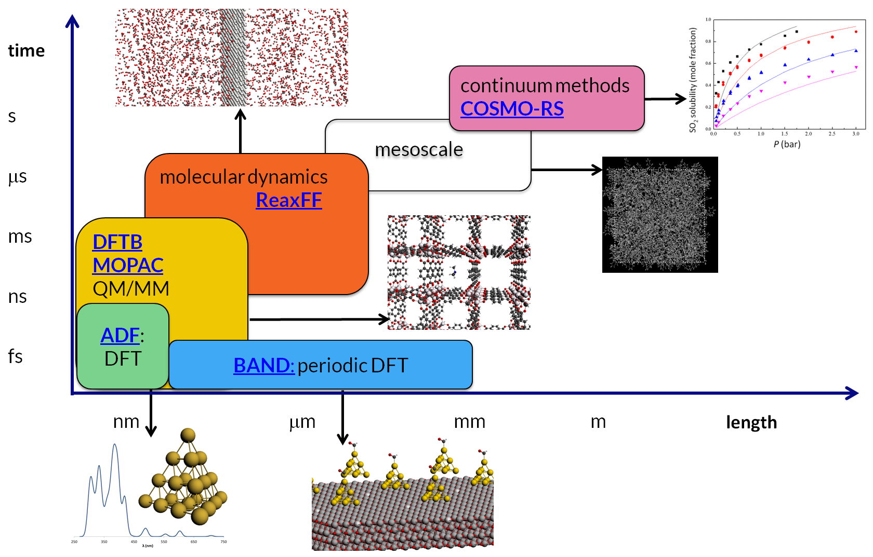
Outline
Background
ADF: powerful molecular DFT code
  Spectroscopy, heavy elements, analysis
  Charge transport
BAND: periodic DFT (1D, 2D, 3D)
DFTB: fast approximate DFT
ReaxFF: Reactive MD
COSMO-RS: fluid thermodynamics
  VLE, LLE, logP, solubility
Scripting, workflows

Slide 3

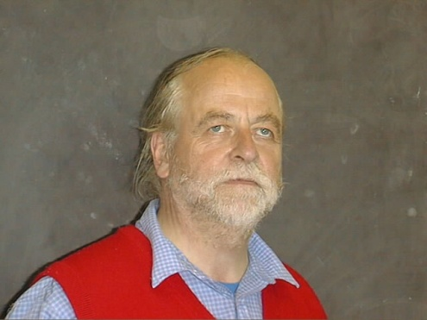
Background
Baerends@VU (>’73), Ziegler@Calgary✝ (>’75)
Scientific Computing & Modelling: spin-off (‘95)
  Software for Chemistry & Materials (’16)
15 people (10 senior PhD’s) + 5 EU fellows
Many academic collaborators / EU networks
  Over 90 authors
SCM: debug, port, optimize, examples + manuals

Slide 4

















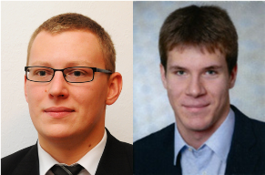
The SCM team
Olivier:
GUI
Alexei:
ADF
ReaxFF
Erik:
ADF
COSMO-RS
Pier:
BAND
Mirko:
ADF
BAND
Developers
Hans:
Linux
GPU
Python
Thomas:
DFTB
Scripting
Laurens:
GUI
Ole:
GUI
ReaxFF
Evert Jan:
Adviser
Business
Stan:
CEO
Fedor:
Marketing
Sergio:
Collaborations
Frieda:
Invoices
Licenses
Kitty:
Finance
Michal,
Robert: QM/MM, excited states MD
Marc:
BAND
Damien:
Scripting
MOFs
Anna:
ReaxFF
MOFs
EU fellows

Slide 5

Making computational chemistry work for you
Latest computational
chemistry tools
Set up, run & analyze
Cross-platform
All modules
Passionate scientists
Decades of expertise
Easy install
Windows, Mac, Linux

Slide 6
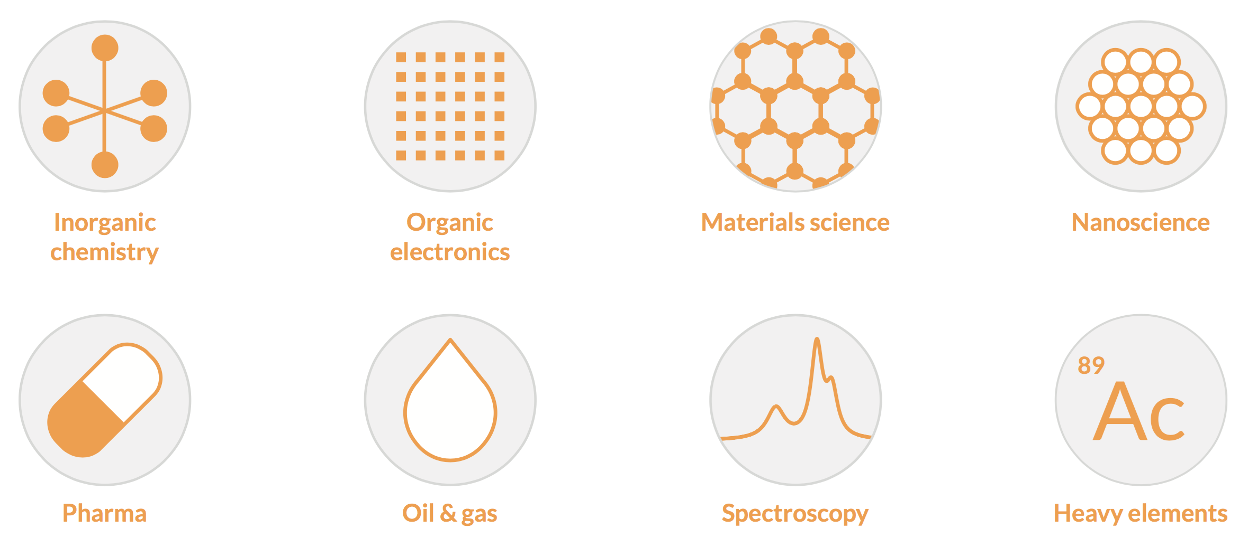
Key application areas
Accurate & Efficient:
Relativity: scalar & spin-orbit
Slater type orbitals for H-Uuo
        EPR, NMR, IR, UV/VIS, X-Ray

Slide 7
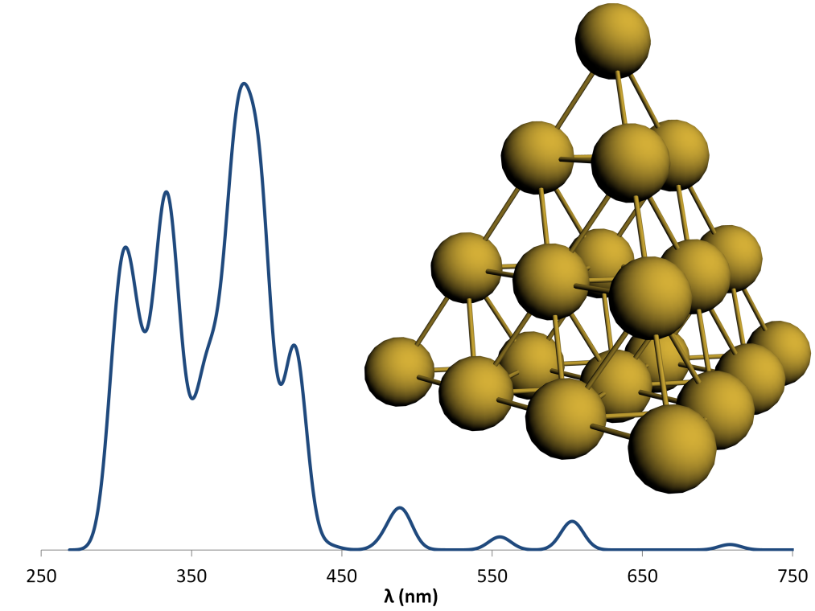
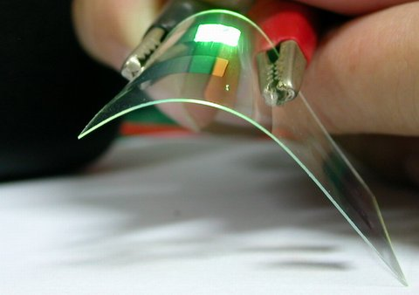
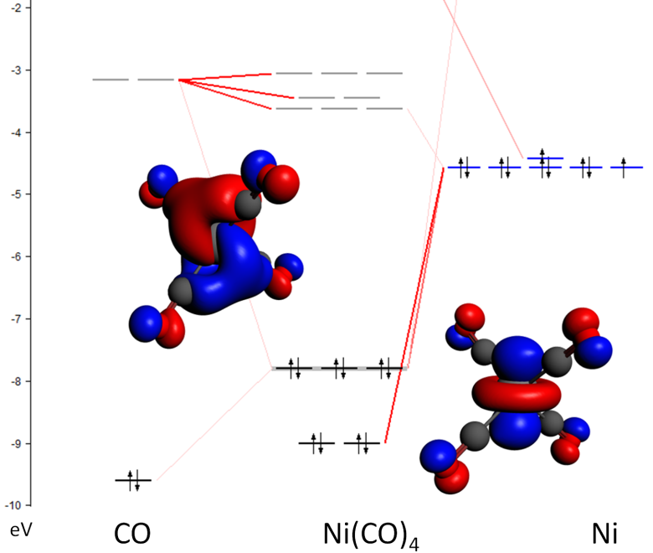
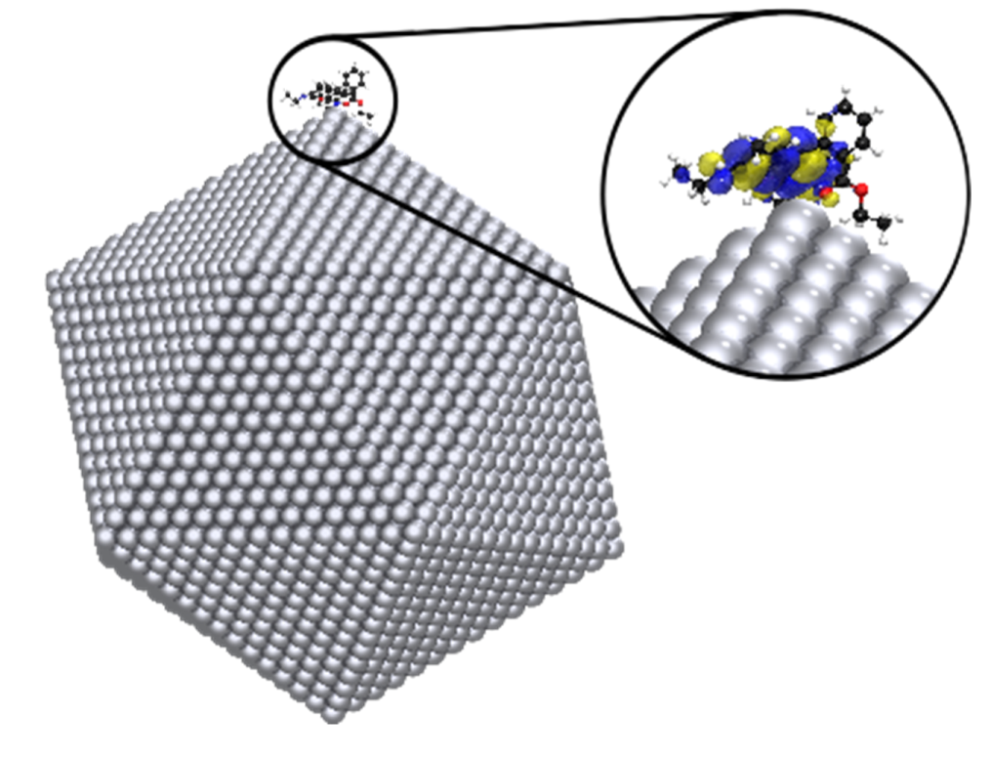
ADF: Molecular DFT
Spectroscopy
Organic electronics
Environments
Bonding analysis

Slide 8
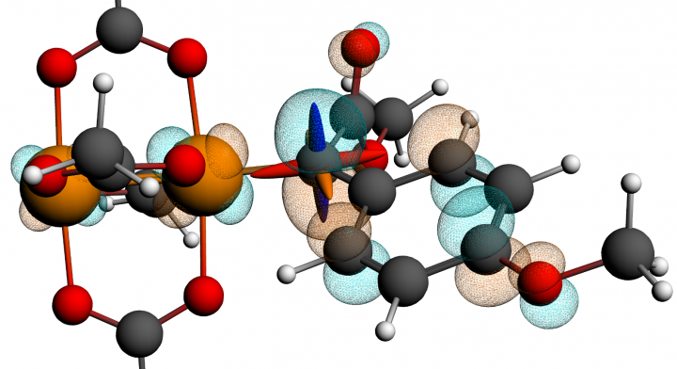
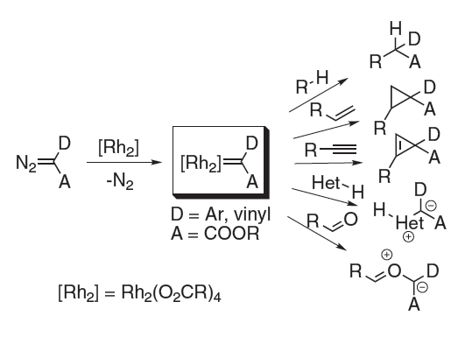
NMR: all-electron, STOs, and ZORA
Di-Rh carbene catalyst: highly reactive
Exp.: Where is the ¹³C NMR Signal?
Calc: δ = 218-270 ppm, J_{Rh-C} = 26.3-29.3 Hz
Exp.: Found it! δ = 240 ppm, J_{Rh-C} = 27.3 Hz
Intermediate trapped & spectroscopically characterized
K. P. Kornecki, J. F. Briones, V. Boyarskikh, F. Fullilove, J. Autschbach, K. E. Schrote, K. M. Lancaster, H. M. L. Davies, and J. F. Berry, Direct Spectroscopic Characterization of a Transitory Dirhodium Donor-Acceptor Carbene Complex, Science, 342, 351-354 (2013)

Slide 9
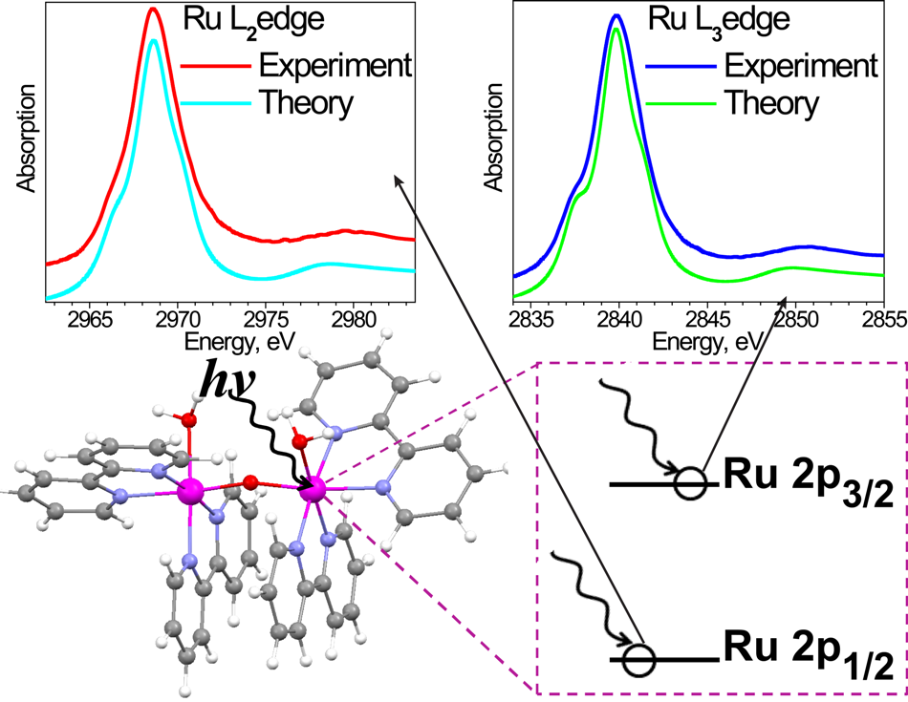
XANES/NEXAFS: Ru water-splitting cat.
SOC necessary for L_{2,3}
  Selected (core) excitations
  FDMNES, FEFF fails
K-edges:
  Use fast Slater-TS
  Can resolve polarization
  Helps determine exp. structure
  e.g. J. Phys. Chem. C 116, 18910 (2012)
I. Alperovich, G. Smolentsev, D. Moonshiram, J.W. Jurss, J.J. Concepcion, T.J. Meyer, A. Soldatov, Y. Pushkar Understanding the Electronic Structure of 4d Metal Complexes: From Molecular Spinors to L-Edge Spectra of a di-Ru Catalyst J. Am. Chem. Soc., 133 15786-15794 (2011).
Notes:
Ru L2,3-edge spectra well-reproduced by looking at transitions between spinors. 1-electron methods (FDMNES, FEFF) fail even for the simplest RuNH3 complex.
Water splitting catalyst.

Slide 10
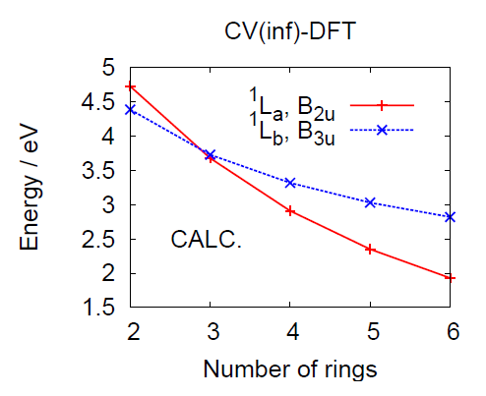
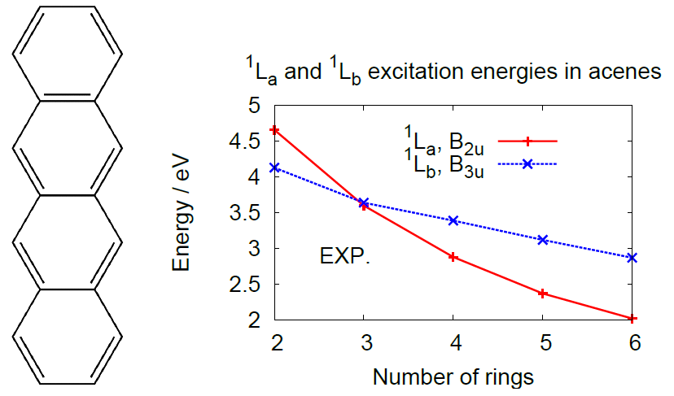
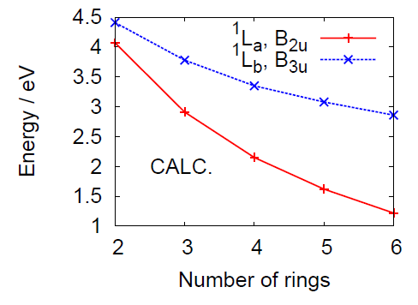
CV-DFT works for charge-separated states
M. Krykunov, S. Grimme, T. Ziegler,
J. Chem. Theory Comput. 8 (2012) 4434.
TDDFT FAILS

Slide 11
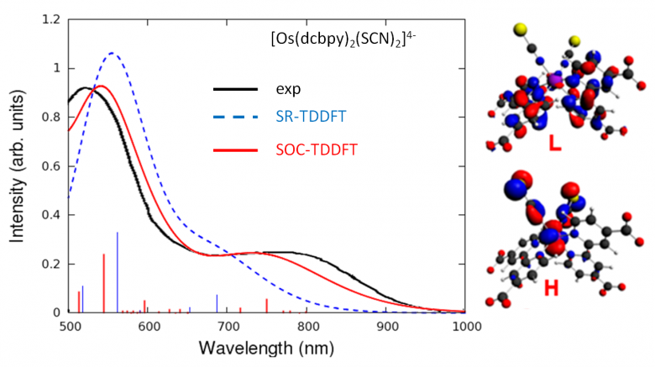
Spin-orbit coupling increases dye efficiency
SOC necessary for Os
  Increases NIR absorption
Effect less strong for Rh
  Spectral broadening
  Still increases IPCE
E. Ronca, F. de Angelis, and S. Fantacci, TDDFT Modeling of Spin-Orbit Coupling in Ru and Os Solar Cell Sensitizers, JPC C, 118, 17067-17078 (2014)
see also: Impact of Spin–Orbit Coupling on Photocurrent Generation in Ruthenium Dye-Sensitized Solar Cells, JPCL, 5, 375-380 (2014)

Slide 12
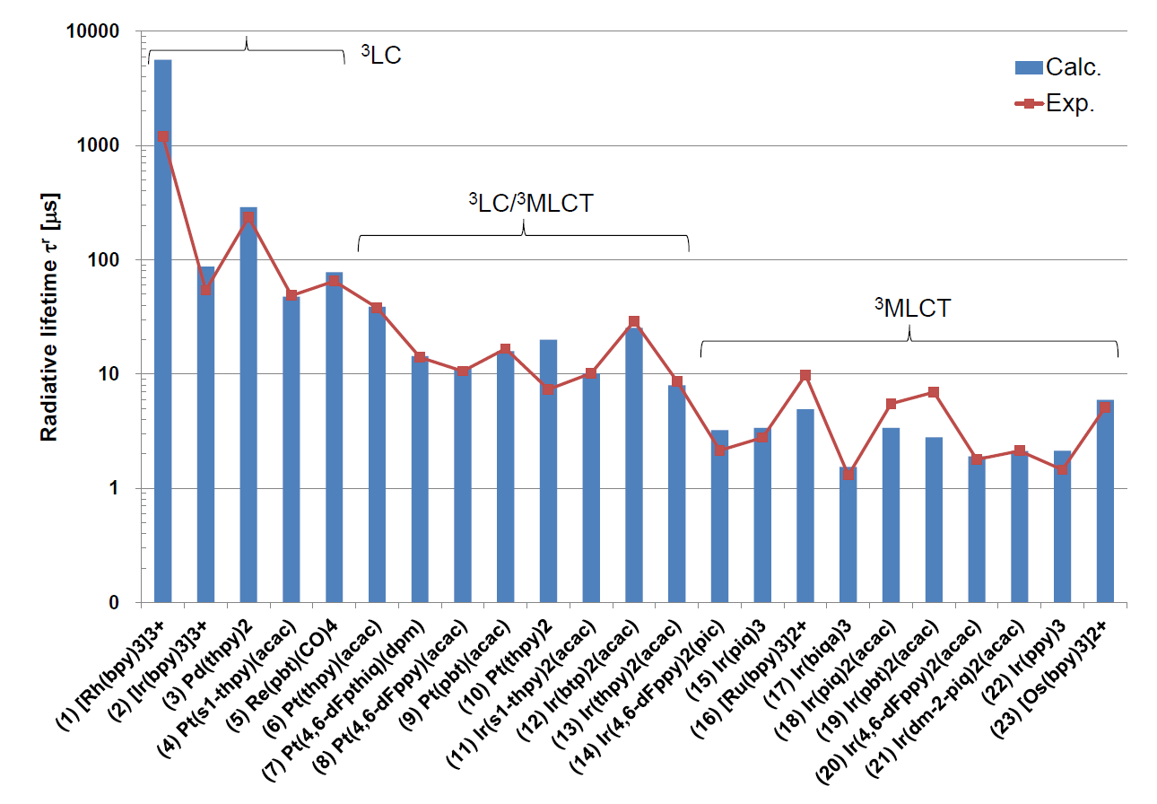
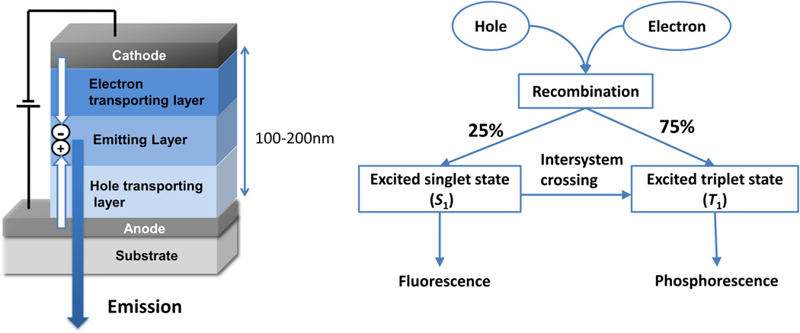
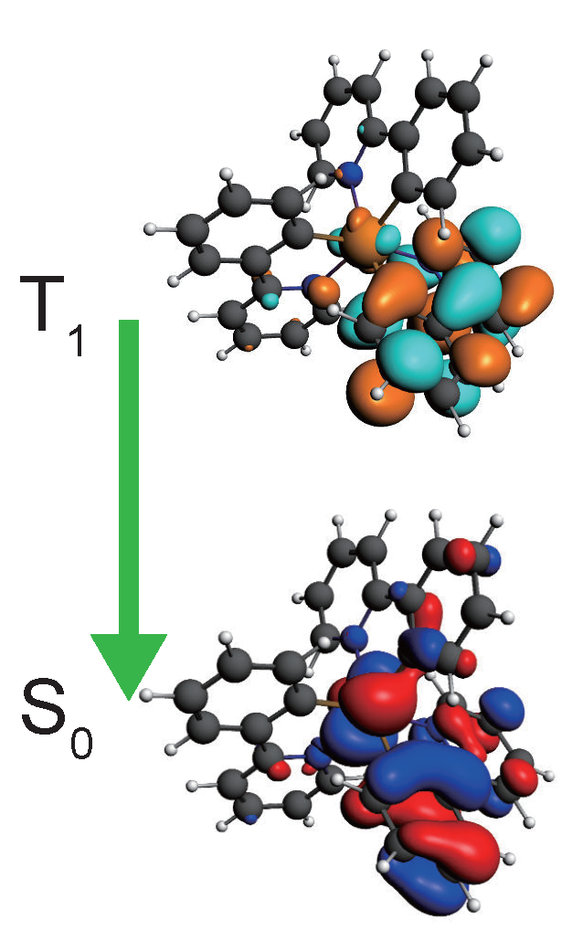
Phosphorescent OLED emitters
Optimize OLED performance
  High charge mobility
  Fast ISC: S₁→T₁
  Phosphorescence T₁→ S₀
  Classically forbidden
  Need spin-orbit coupling
ADF features
  SOC-TDDFT: k_{phos}
  SOCME: k_{ISC}
  Transfer integrals (mobilities)
  Vibrationally resolved abs/em
K. Mori, T. P. M. Goumans, E. van Lenthe, F. Wang, Phys. Chem. Chem. Phys. 16, 14523 (2014)
Y. Suzuri et al., Sci. Technol. Adv. Mater. 15 (2014) 054202.
ADF tutorial online

Slide 13
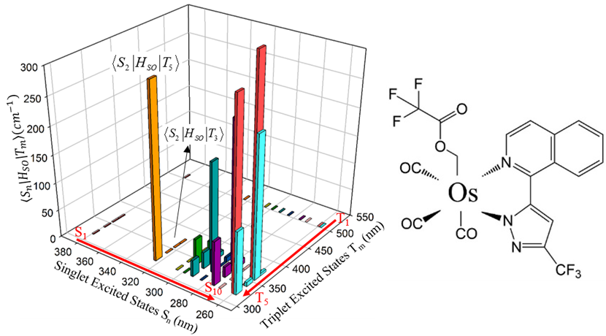
Intersystem crossing through spin-orbit coupling
El-Sayed for organometallics:
SOC is largest when:
both S (¹dπ*) and T (³d’π*) are MLCT
different d-orbitals are involved (d ≠ d’).
λ_{exc}-dependent quantum yield
SOCME negligible for S₁-T_{n}
ISC from higher S_{n} states
Elise Yu-Tzu Li*, Tzung-Ying Jiang, Yun Chi and Pi-Tai Chou*. Semi-Quantitative Assessment of Intersystem Crossing Rate: An Extension of El-Sayed Rule to the Emissive Transition Metal Complexes. Phys. Chem. Chem. Phys. 16, 26184-26192 (2014)
Notes:
The Os(fipz)(tfa)(CO)₃ (tfa = trifluoroacetate, fipz=3-trifluoromethyl-5-(1-isoquinolinyl)-1,2-pyrazole) complex shows excitation-dependent emission quantum yield. The higher-energy excitation (< 340 nm) contributes more to phosphorescence than fluorescence, implying stronger intersystem crossing (ISC) for highly excited singlet states. Theoretical calculations confirm that the spin-orbit coupling (SOC) integrals between the lowest singlet excited state, S₁, and the low-lying triplet excited states T_{n} (n=1-10), are negligibly small, whereas the higher singlet states show much stronger SOC with triplet excited states.

Slide 14
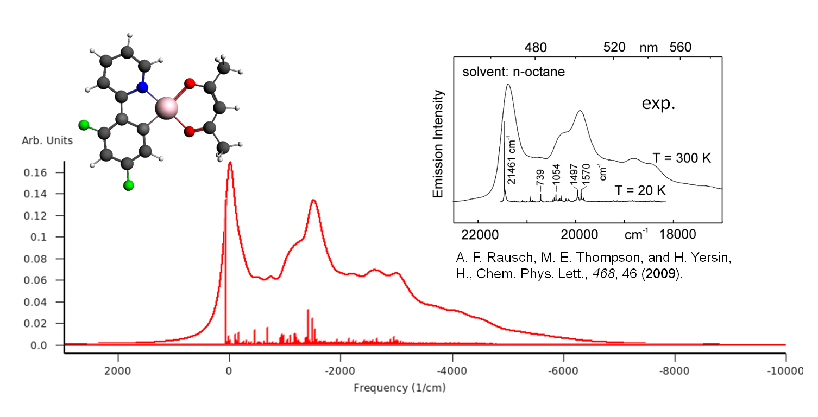
Vibronic fine structure T₁ → S₀ OLED phosphor Pt complex
Excellent agreement vibrational progression FCF T₁-S₀
0-0 well reproduced by Delta SCF calculation (22,000 cm⁻¹)
ADF tutorial online

Slide 15
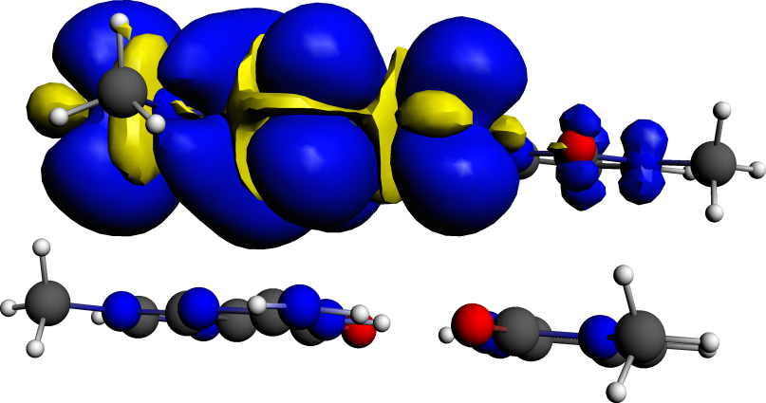
Methods to calculate charge mobilities
Hopping transport:
  Charge transfer integrals + other elements, directly printed
  Electronic couplings from frozen-density embedding
Band transport: effective mass tensors in BAND
Non-equilibrium Green’s Function (NEGF)
  transmission probabilities for single-molecule junctions
  quick calculation: wide-band limit
  also in BAND (periodic structures, fully self-consistent) and in DFTB (large systems)
h⁺
Q

Slide 16
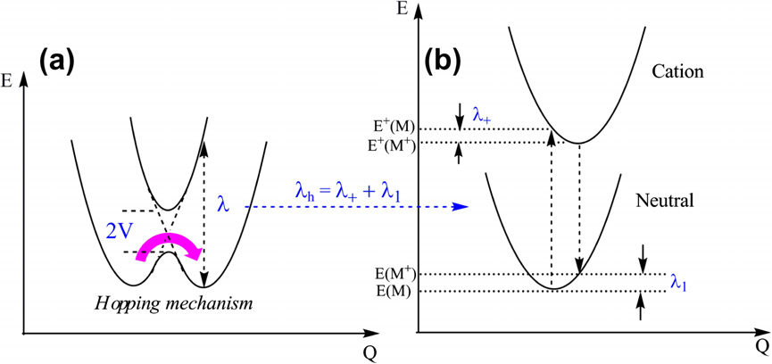
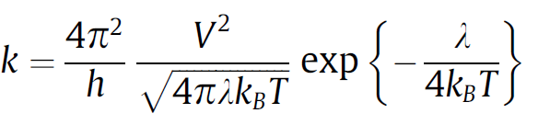
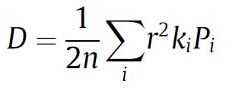
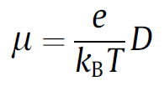
Hole / electron mobilities
Ordered crystals (low T) => band-like transport
Amorphous materials: incoherent hopping
Accoustic deformation potential
m_{c}: the effective mass along the direction of transport
m_{d}: the density of states mass, (m_{a} m_{b})^{1/2}
e_{ac}: the acoustic deformation potential, V dE_{vbm}/dV
B: the elastic modulus
L_{eff}: the length of the p-bonded core of the molecule
Notes:
large electronic couplings together with small reorganization energies
次元を考える
バンド伝導は？
結晶構造を使うが・・・、基本は高温状態を想定、バンドが形成されない、しかし欠陥のない完全結晶
1. At room temperature, it is generally accepted that the transport in organic materials takes place via charge carrier hopping between adjacent molecules.
2. Assuming no correlation between hopping events and that charge motion is a homogeneous random walk

Slide 17
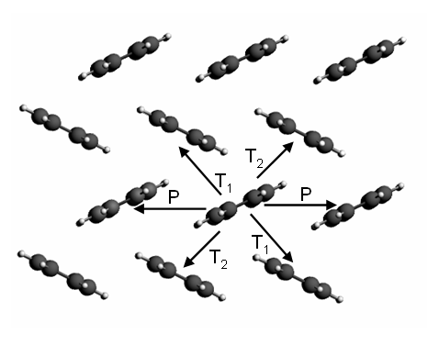
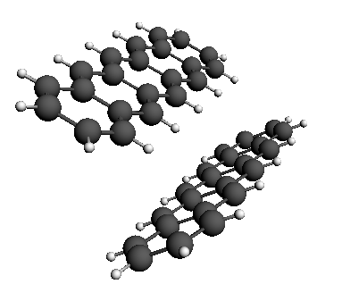
Effective transfer integral J_{eff} = electronic coupling V
pentacene
crystal
(a) “transfer integral”
(b) spatial overlap
Fragment C1
extract dimer
(c) site energy
Fragment C2
ADF tutorial online
Notes:
直行変換

Slide 18
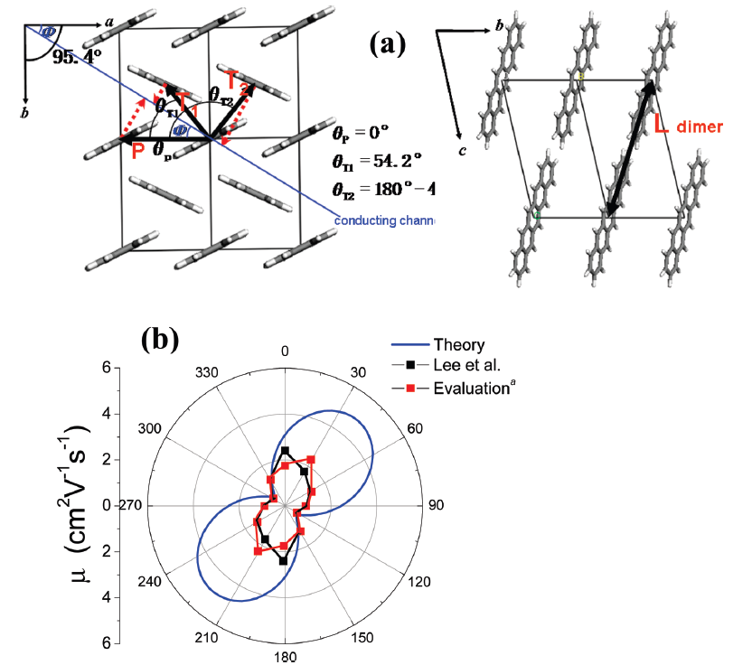

Anisotropic hole mobilities in pentacene
Anisotropic mobility:
S.-H. Wen et al., J. Phys. Chem. B 113, 8813 (2009)
Notes:
異方性 vs 等方性
へリングボーン
実験値との相違の原因：キャリヤトラップ、エネルギートラップ（計算は完全・理想結晶）、格子振動の影響、Marcusの理論式の近似
ペンタセンの実験の解釈変更への言及も。

Slide 19
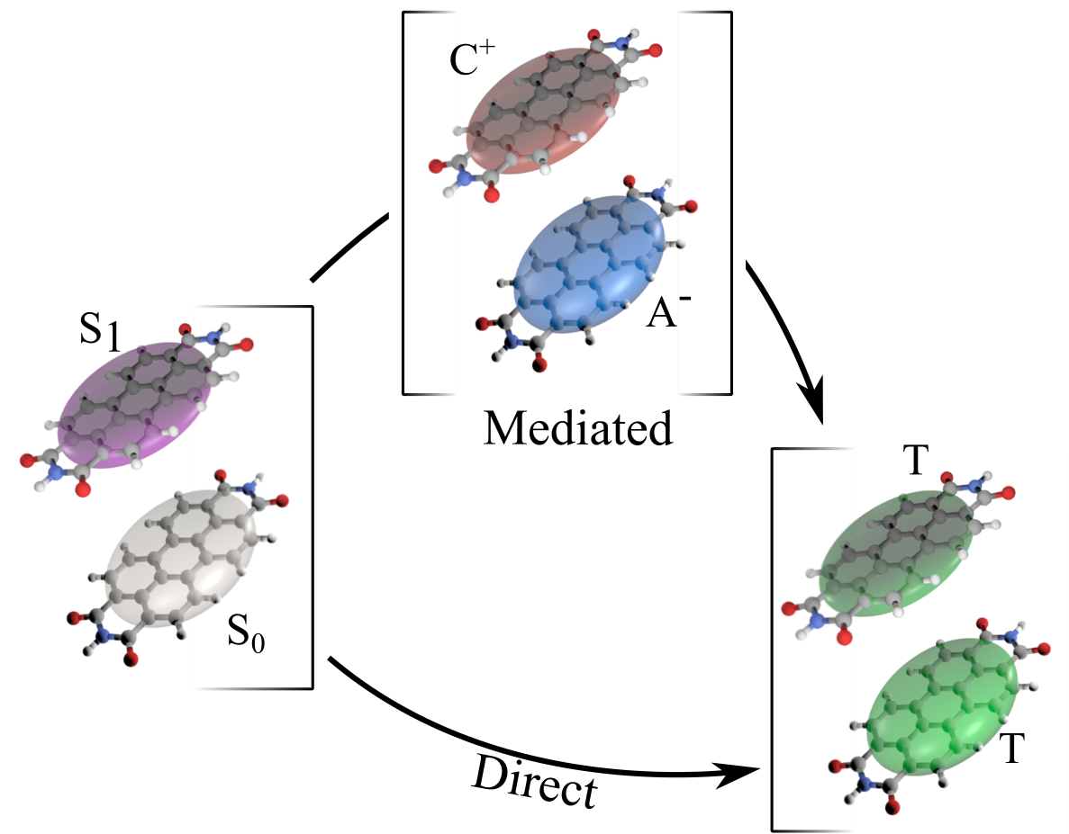
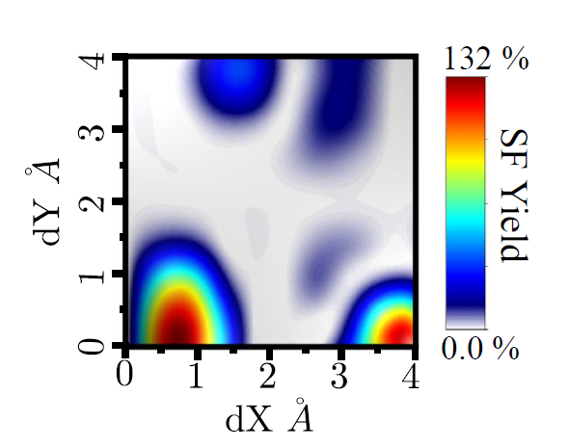
Singlet Fission Yields in Organic Crystals
Direct pathway dominates SF
Yields up to 132% possible, depends on crystal packing
N. Renaud, P. A. Sherratt, and M. A. Ratner, Mapping the Relation between Stacking Geometries and Singlet Fission Yield in a Class of Organic Crystals, J. Phys. Chem. Lett., 4, 1065-1069 (2013)

Slide 20
Environments
Continuum solvation: COSMO, SM12
Frozen-Density Embedding (FDE)
  DFT-in-DFT, density response environment
Multi-layer
  DIM/QM: molecule-nanoparticle (SERS, SEROA)
  QM/MM, QUILD (subtractive, flexible, many layers)
  DRF: polarizable force field
DFT/DFTB3 calculations: monoproplyene glycol formation preferred concerted with H₂O
Y. Horbatenko, J. P. Peŕez, P. Hernańdez, MarcelSwart and M. Sola, Reaction Mechanisms for the Formation of Mono- And Dipropylene Glycol from the Propylene Oxide Hydrolysis over ZSM‐5 Zeolite, J. Phys. Chem. C 118, 21952−21962 (2014)

Slide 21
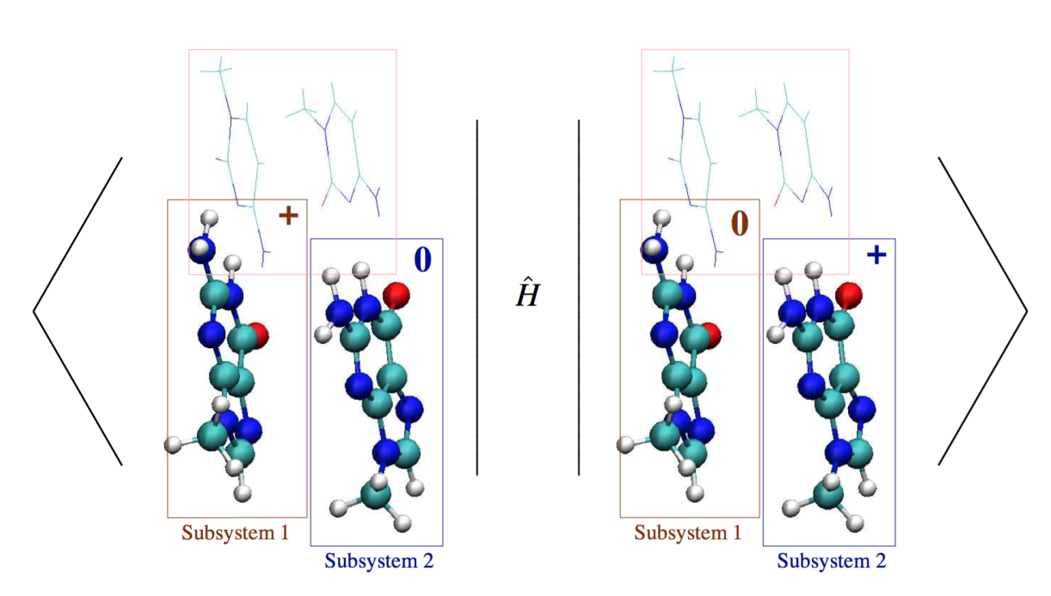
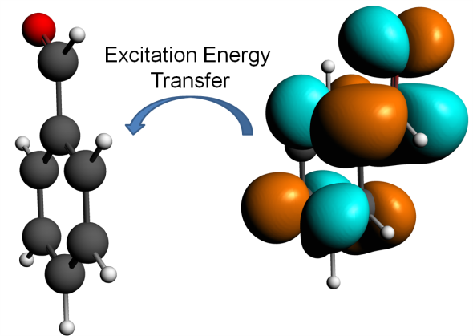
Electronic couplings + environment with FDE: charge transfer, exciton, charge separation
Linear scaling, environment response, constrain charge, excitation, spin, ...
Pavanello/Rutgers & Neugebauer/Muenster groups: Excitons: J. Chem. Phys. 138, 034104 (2013), long range charge separation: J. Chem. Phys. 140, 164103 (2014),
charge transfer: J. Chem. Theory Comput. 2014, 10, 2546−2556
Notes:
With FDE you can take the diabatic states and work out the couplings from the diabatic Hamiltonian
This works for charge transfer, exciton coupling, polaron-exciton coupling

Slide 22
Analysis: Energy decomposition
∆E = ∆E_{prep} + ∆E_{int}
∆V_{elstat} + ∆E_{Pauli} + ∆E_{oi}
Rev. Comput. Chem. 2000, 15, 1
ETS-NOCV: M. Mitoraj, A. Michalak and T. Ziegler, J. Chem. Theor. Comput. 5, 962 (2009)
- charge transfer between fragments (orbital interactions)
Periodic Energy decomposition: M. Raupach and M. Tonner, J. Chem. Phys. 142, 194105 (2015)
Notes:
The term ΔV_{elstat} corresponds to the classical electrostatic interaction between the unperturbed charge distributions of the prepared (i.e. deformed) fragments and is usually attractive. The Pauli repulsion ΔE_{Pauli} comprises the destabilizing interactions between occupied orbitals and is responsible for any steric repulsion. The orbital interaction ΔE_{oi} in any MO model, and therefore also in Kohn-Sham theory, accounts for charge transfer (i.e., donor-acceptor interactions between occupied orbitals on NH₃ with unoccupied orbitals of BH₃, including the HOMO-LUMO interactions) and polarization (empty/occupied orbital mixing on one fragment due to the presence of another fragment).

Slide 23
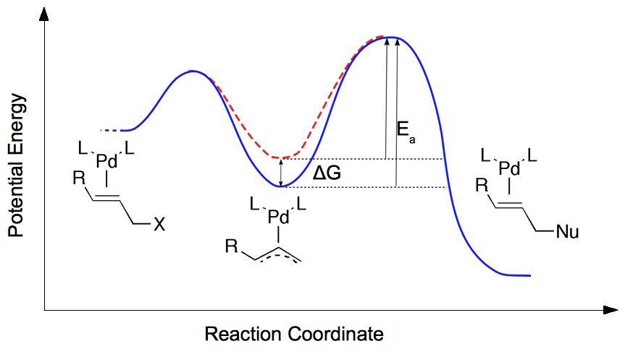
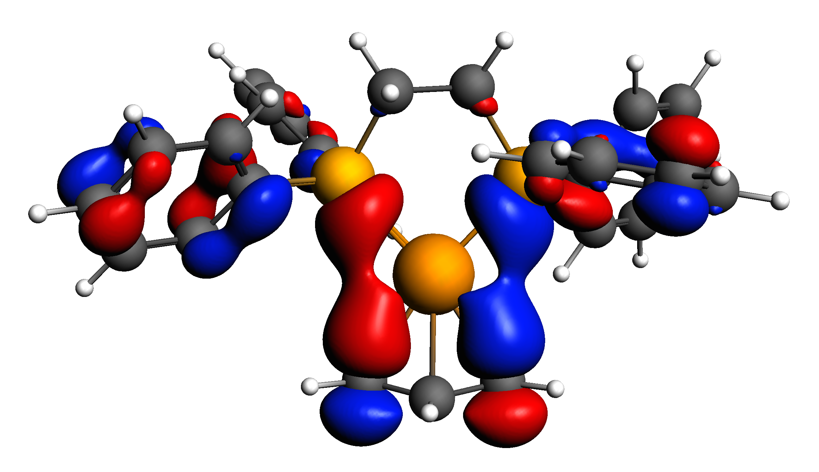
Catalyst natural selection: survival of the weakest
Bonding energy analysis dppe → dppb
increased bite angle
improved electronic interaction
larger repulsive strain
dbbp most destabilized => best cat.
J. Wassenaar, E. Jansen, W.-J. van Zeist, F. M. Bickelhaupt, M. A. Siegler, A. L. Spek, and J. N. H. Reek Catalyst selection based on intermediate stability measured by mass spectrometry. Nature Chem. 2, 417 (2010)
Notes:
We introduce a new selection method that focuses on the stability of catalytic intermediates measured by mass spectrometry (ESI-MS), competition experiment. The stability of the intermediate relates inversely to the reactivity of the catalyst, which forms the basis of a catalyst-screening protocol in which less-abundant species represent the most-active catalysts, ‘the survival of the weakest’. We demonstrate this concept in the palladium-catalysed allylic alkylation reaction using diphosphine and IndolPhos ligands and support our results with high-level density functional theory calculations.
High-level DFT calculations show that destabilization of the intermediate Pd-allyl complexes is caused by steric repulsion between the ligand and the substrate for the diphosphine ligands, which overrules the counterbalancing electronic effect. Energy decomposition, strain energy

Slide 24
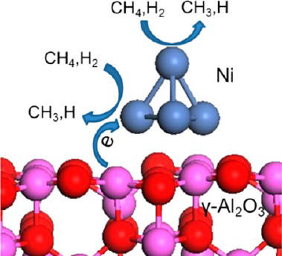
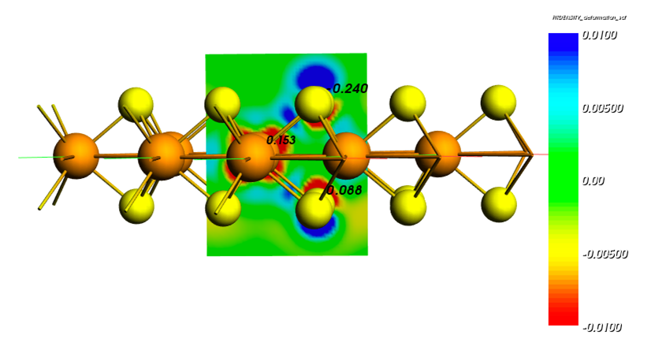
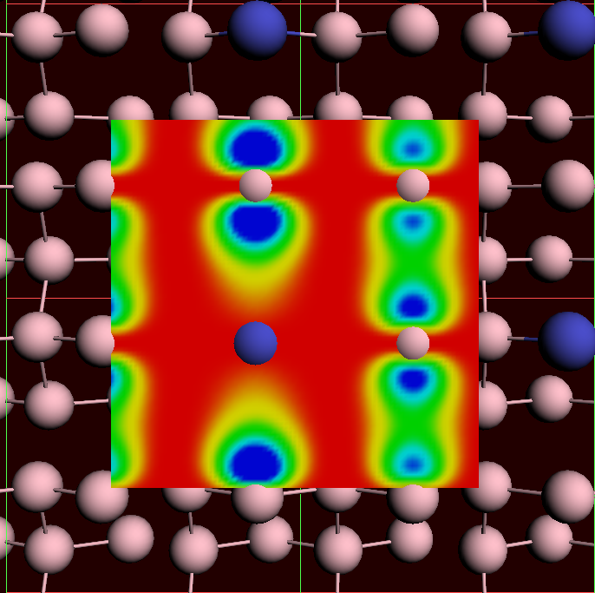
BAND: Periodic DFT
LDOS at bias = 0
Spectra & analysis
Proper 2D surfaces:
supported catalysts, homogeneous E fields

Slide 25
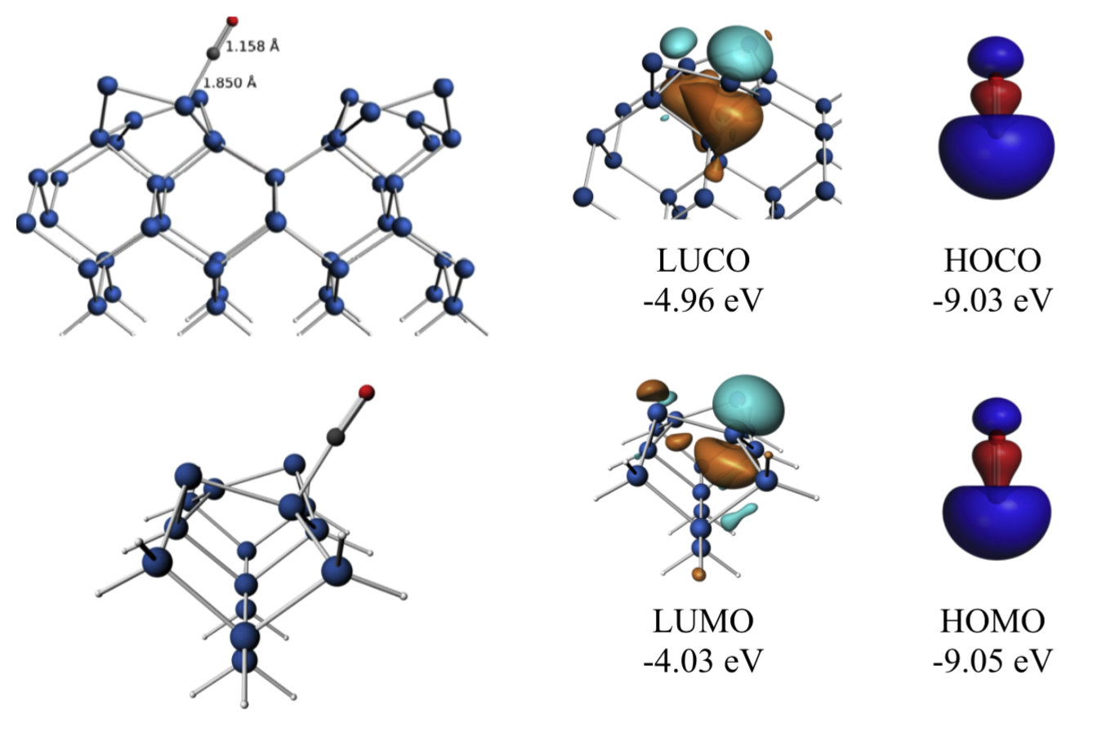
BAND vs. Plane Wave codes
Atom centered basis functions, STO or NAO
  Compare cluster with periodic
  No pseudopotentials
  core spectrosopy, core hole states
  Easy (orbital, density) analysis with GUI
  Fast for empty (1D, 2D, porous)
  Many functionals (N12, HSE06, GLLB-sc, D3, …)
True 2D surfaces:
  No artifacts from 3D repetition
  COSMO solvation (SM12 in progress)
  Homogeneous electric fields
  (2D-TDDFT in progress)
Integrated Graphical Interface: easy set up & analysis
crystal orbitals, periodic energy decomposition analysis
M. Raupach and M. Tonner, J. Chem. Phys. 142, 194105 (2015)

Slide 26
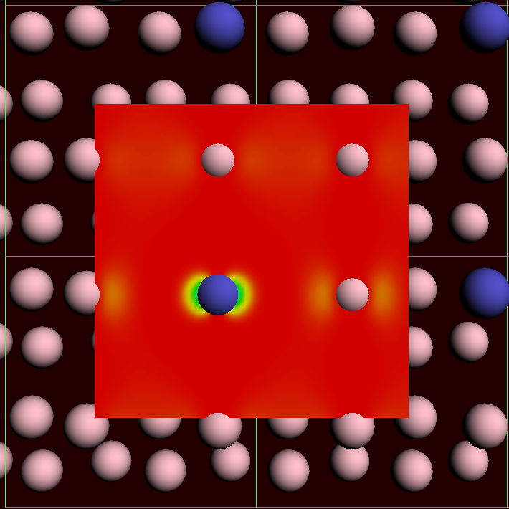
STM visualization with/without bias
STM images (Tersoff-Hamann: local DOS)
bias = 0
Pt Ge(100)
bias = 0.1

Slide 27
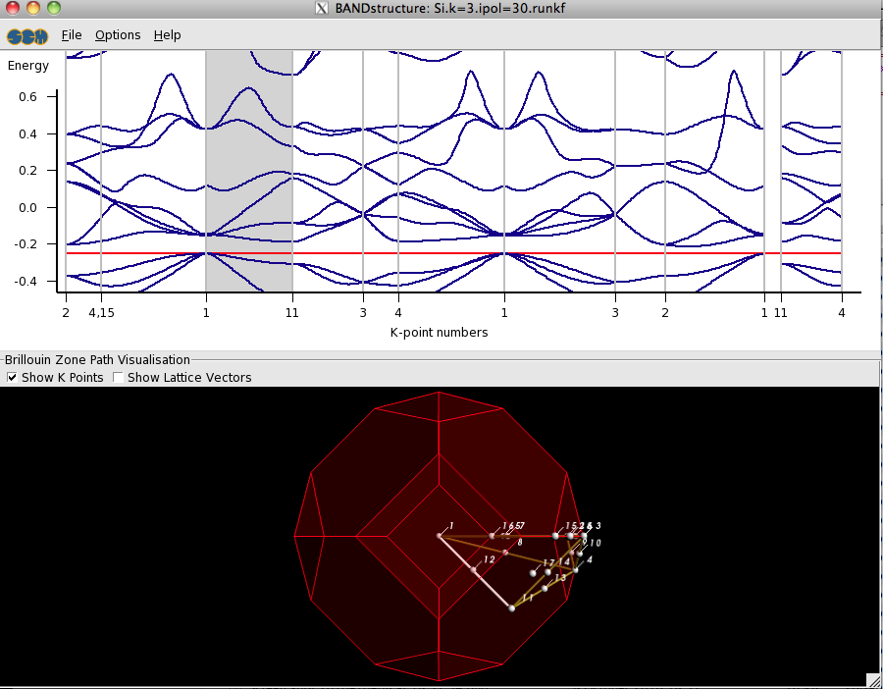
Smooth band structure with interpolation

Slide 28
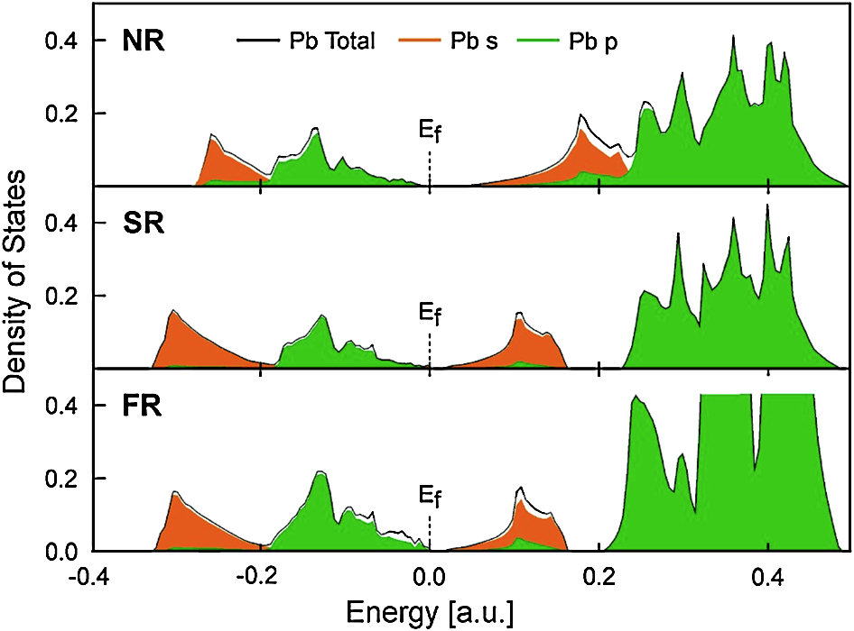
Relativity makes your car start
- Total and partial density of states (DOS) of lead in Lead (IV) oxide
- Strong relativistic shift in
both occupied and unoccupied Pb 6s states.
- Without relativity, 12V battery would be 2.4V!
SOC
Orange = lead 6s states, Green = lead 6p states.
NR = nonrelativistic, SR = scalar relativistic,
SOC = 2c spin orbit coupling
R. Ahuja, A. Blomqvist, P. Larsson, P. Pyykkö, and P. Zaleski-Ejgierd, Phys. Rev. Lett. 106, 018301 (2011)

Slide 29
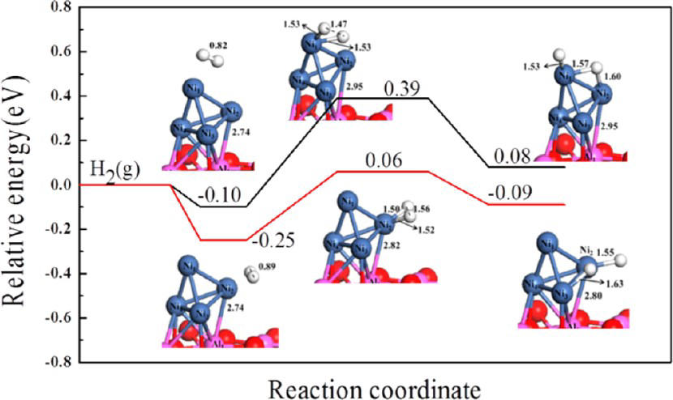
CH₄ and H₂ dissociation on Ni/γ-Al₂O₃
Dissociation at interface preferred
Aluminum acts as electron donor
Li, Croiset, Ricardez-Sandoval, J. Phys. Chem. C 2013, 117, 16907
Notes:
29

Slide 30
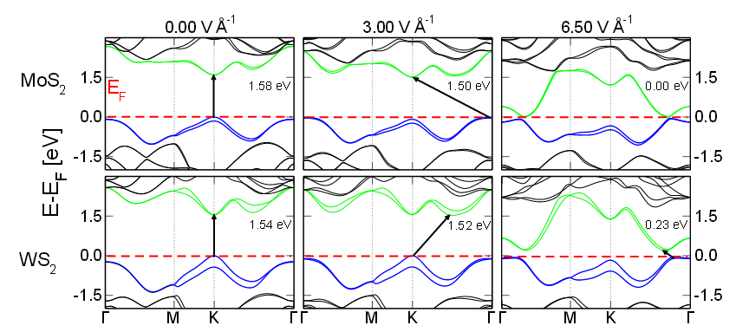
Closing the band gap in 2D MoWSeS
3 eV/Å
Electron transport in MoWSeS monolayers in the presence of an external electric field, Phys. Chem. Chem. Phys. (2014)
Notes:
30

Slide 31
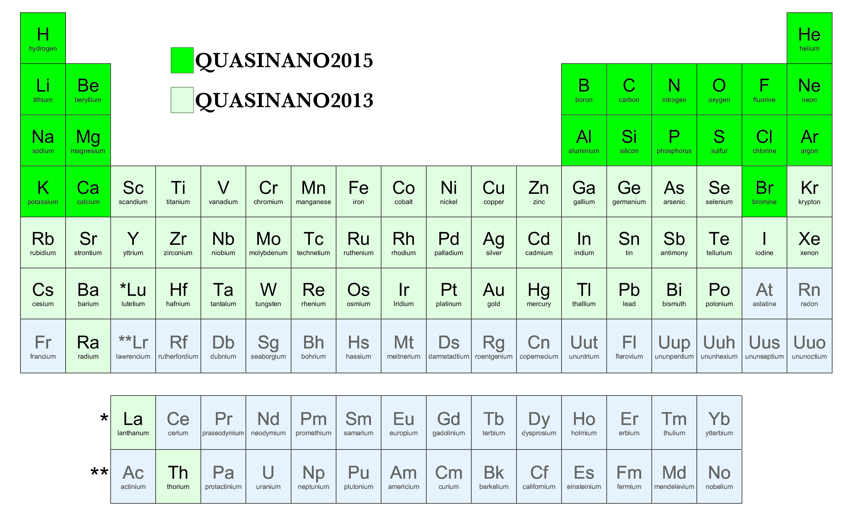
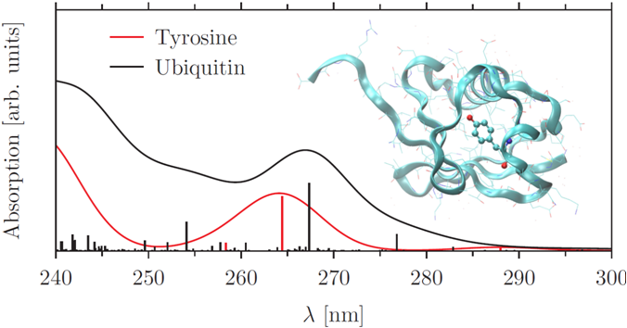
DFTB: Approximate DFT
QN 2015: forces
QN 2013: electronic
Transport: NEGF
Spectra: TDDFTB, including gradients
Parameters across the periodic table

Slide 32
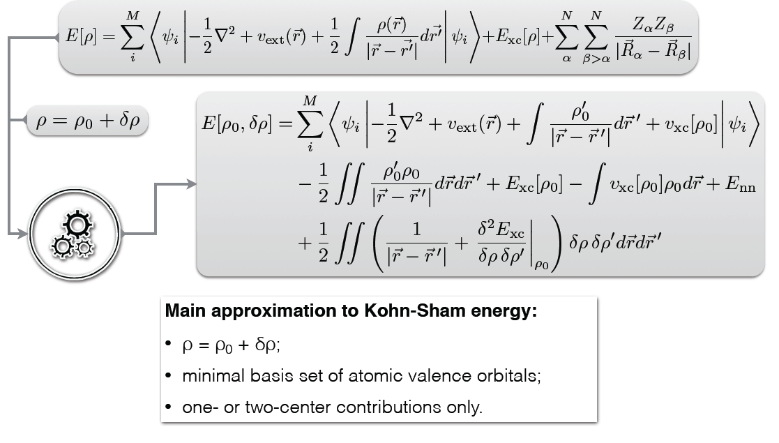
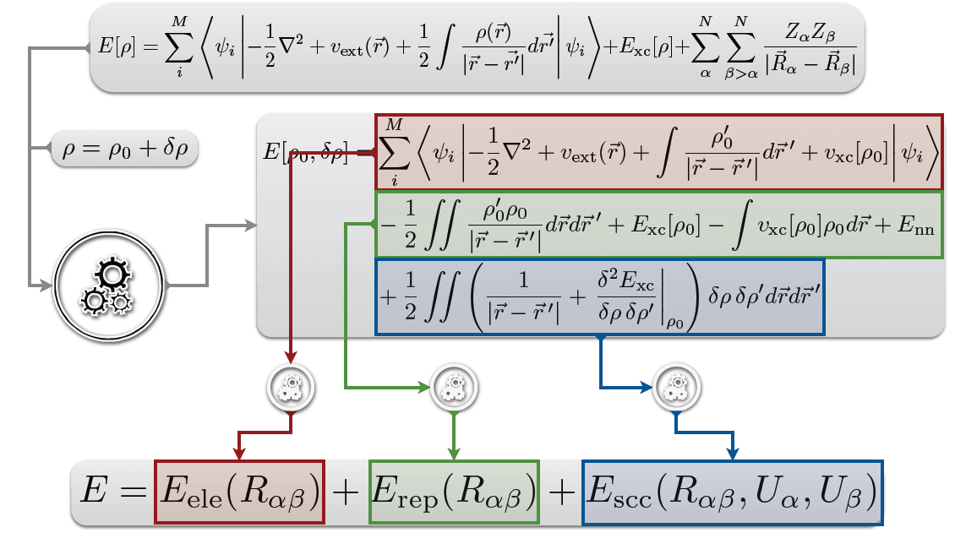
Density-functional Based Tight-Binding (DFTB)
Fast, approximate DFT => large systems
dynamics (limited to a few elements)
electronic properties

Slide 33
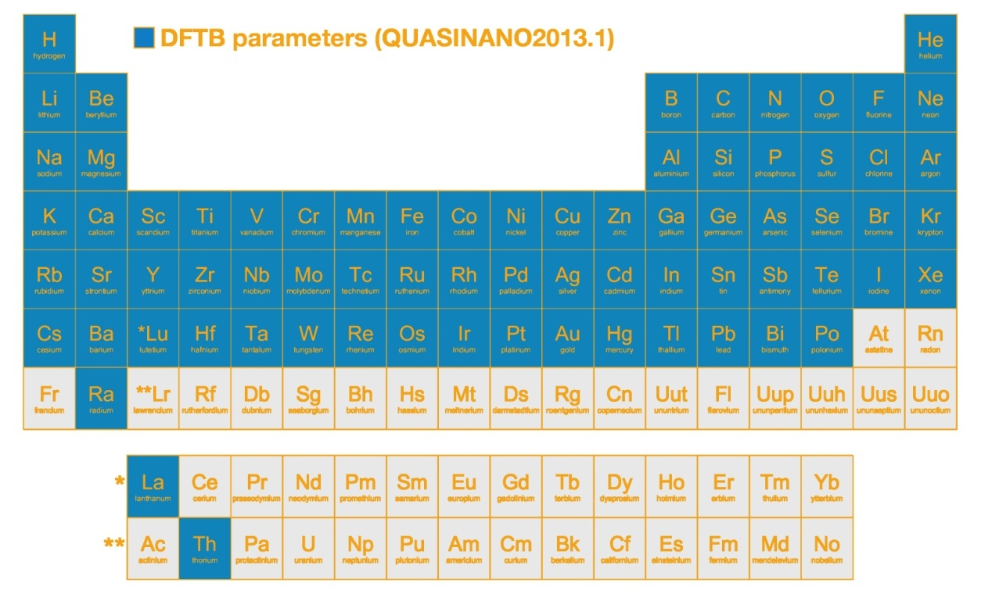
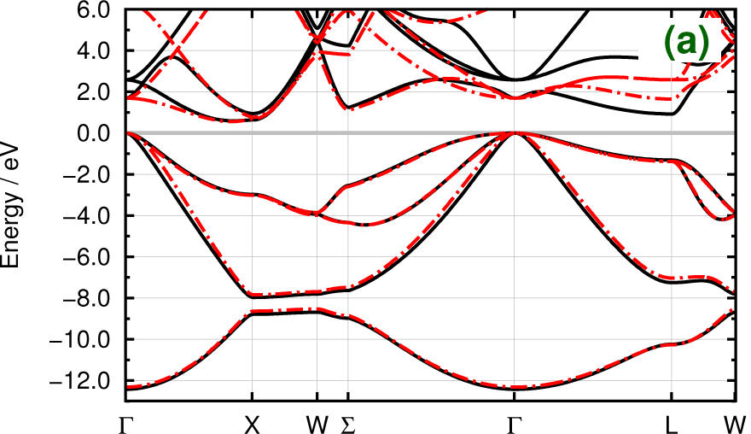
Semi-automated electronic DFTB parameters
Current work:
Repulsive parameters
TDDFTB + LvN excited state dyn.
Transport: NEGF, el-ph coupl. / BTE
GeSi (zinc blende)
DFT (PBE/TZP)
●-DFTB
SCM & Jacobs U, J. Chem. Theory Comput. 9, 4006−4017 (2013)
Notes:
Indirect Band gap GeSi exp: 1.07
Parametrization can be extended to, e.g. GLLB-sc/TZP-AE ??

Slide 34
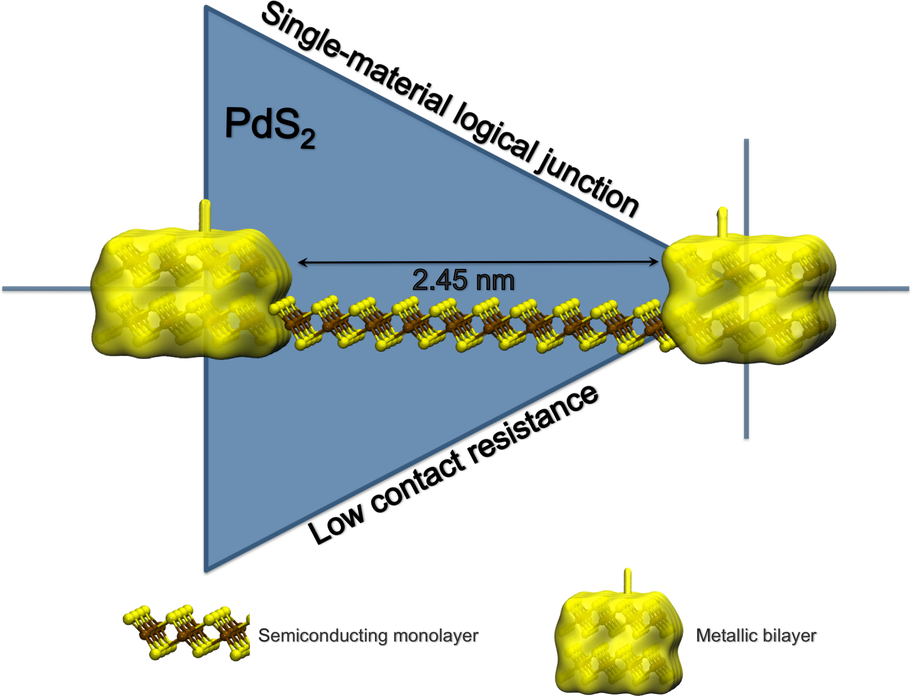
Single 2D semiconductor material diode
2D PdS₂ is
semiconducting as ML
semimetallic as BL
DFTB-NEGF
channel lengths of about 2.5 nm
I–V characteristics tunable by gate voltage
M.Ghorbani-Asl, A. Kuc, P. Miró, and T. Heine, A Single-Material Logical Junction Based on 2D Crystal PdS2, Adv. Mater. (2016)

Slide 35



DFTB EU Projects
PROPAGATE:
  3 PhD students Bremen-VU-SCM
  MD for ground & excited states
  QM/MM, QM/QM’ development
MoWSeS: ITN, 2 post-docs @ SCM
  2D systems: charge transport (BTE) & optical properties (TDDFT(B))
S₁ (v)→S₀ (v’)

Slide 36

Fast excited states: TDDFTB
Tight-Binding approach for LR-TDDFT also available in ADF 2016: TDDFT+TB
Rüger, R., van Lenthe, E., Lu, Y., Frenzel, J., Heine, T. and Visscher, L., Efficient Calculation of Electronic Absorption Spectra by Means of Intensity-Selected Time-Dependent Density Functional Tight Binding, J. Chem. Theory Comput. 11, 157−167 (2015)

Slide 37

Fast excited states: TDDFT+TB
11000 s
600 + 60s
10s
R. Rüger, E. van Lenthe, T. Heine, L. Visscher, Tight-Binding Approximations to Time-Dependent Density Functional Theory - a fast approach for the calculation of electronically excited states, http://arxiv.org/abs/1603.02571

Slide 38


ReaxFF: Reactive MD
Combustion
event detection, reaction rates
TiO₂
Batteries (LiS, LiC)

Slide 39






Classical harmonic force field
Θ
b
φ
©2005 Markus Buehler, MIT

Slide 40
Failure of the harmonic model
C-C bond stretching in Ethane
Around the equilibrium bond length
Full dissociation curve
Energy (kcal/mol)
C-C bond length (Å)
C-C bond length (Å)
ReaxFF employs a bond length/bond order relationship
All connectivity-dependent parameters are bond-length dependent

Slide 41

General ReaxFF rules
No discontinuities in energy or forces
No pre-defined reaction sites or types
Only 1 atom type per element
Notes:
User should not have to pre-define reactive sites or reaction pathways; potential functions should be able to automatically handle coordination changes associated with reactions.
force field should be able to determine equilibrium bond lengths, valence angles etc. from chemical environment.

Slide 42
ReaxFF parameters, transferability
Many elements studied
  need bonded terms for each pair
  validate force field
    GUI checks
    training data crucial
New parameters
  ADF 2013: 17 sets, 19 elements
  ADF 2014: 38 sets, 29 elements
  ADF 2016: 58 sets, 39 elements
  van Duin, Goddard, others
  RxFF consulting
  MCFF optimizer
npj Computational Materials 2, 15011 (2016)

Slide 43



Semi-automatic parameterization: MMC-SA
Caveat: training set is important!
E. Iype, M. Huetter, A.P.J. Jansen, S.V. Nedea, C.C.M. Rindt, Parameterization of a Reactive Force Field Using a Monte Carlo Algorithm, J. Comp. Chem. 34, 1143-1154 (2013)
Notes:
Currently under alpha-testing, GA also available via Hartke’s stand-alone code (perhaps to be integrated).

Slide 44

TiO₂ nanoparticle aggregation
NVT simulation at 1100K
Box size- 125 Å x 325 Å x 125 Å
Number of atoms: 10904
Number of water molecules: 1800
Random placement, no restraints
Nano Lett. 14, 1836−1842 (2014)

Slide 45
Cysteine on TiO₂ rutile (110)
Structures agree with XPS
ReaxFF better than classical
Extensive training
  TiO₂ + protein force field
S. Monti, C. Li, H. Ågren, V. Carravetta, Dropping a Droplet of Cysteine Molecules on a Rutile (110) Interface: Reactive versus Nonreactive Classical Molecular Dynamics Simulations, J. Phys. Chem. C 119, 6703–6712 (2015)

Slide 46

D102 Indoline Dye on Anatase (101)
Adsorption & aggregation dynamics
  dyes aggregate in domains on surface
TDDFT: absorption spectrum
  red shifts through aggregation
S. Monti, M. Pastore, C. Li, F. de Angelis, V. Carravetta, A Theoretical Investigation of Adsorption, Dynamics, Self-Aggregation and Spectroscopic Properties of the D102 Indoline Dye on an Anatase (101) Substrate, J. Phys. Chem. C 120, 2787–2796 (2016)

Slide 47

Event detection, reaction rates
Gas phase, in progress to extend to:
Polymer formation / degradation
Surface reactions
M. Döntgen et al., Automated Discovery of Reaction Pathways, Rate Constants, and Transition States Using Reactive Molecular Dynamics Simulations, J. Chem. Theory Comp. 11, 2517–2514 (2015)

Slide 48

Rate constants for SiC degradation
Transport barrier for oxidation:
O₂ 40−70 kJ/mol
H₂O 125−150 kJ/mol
D. A. Newsome, D. Sengupta, A. C. T. van Duin, J. Phys. Chem. C 117, 5014 (2013)
Notes:
In this study, rate models were developed and molecular dynamics simulated trajectories were used to extract Arrhenius parameters that describe the initial stages of transport and kinetics of SiC oxidation by O2 and H2O and the combustion and pyrolysis of EPDM.

Slide 49
Grand Canonical Monte Carlo + ReaxFF
GC-MC: What is stable (p,T)?
ReaxFF: What is active?
Reactive MD under actual conditions
T.P. Senftle, R.J. Meyer, M.J. Janik, A.C.T. van Duin, J. Chem. Phys., 139 (2013) 044109

Slide 50

Teflon coating reduces electrolyte decomposition
Temperature profiles at 10ps after discharge from Li-SWCNT electrode (blue 60 K, red >1000 K)
Teflon coating acts as buffer for Li-S batteries, reducing thermal electrolyte decomposition
M. M. Islam, V. S. Bryantsev, and A. C. T. van Duin, ReaxFF Reactive Force Field Simulations on the Influence of Teflon on Electrolyte Decomposition during Li/SWCNT Anode Discharge in Lithium-Sulfur Batteries, J. Electrochem. Soc. 161, E3009-E3014 (2014).
Teflon

Slide 51
Li trajectories during discharge
Green indicates Li-trajectory; C: gray, S: yellow, F: brown, O and H are omitted for simplicity
NVT, 300K
NVT, 300K
~ 450ps
~ 1ns
TEFLON
Teflon layer on anode-electrolyte interface significantly reduces lithium reactivity and diffusion through the electrolyte phase
TEFLON
J. Electrochem. Soc. 161, E3009-E3014 (2014).

Slide 52
Discharge process Li-S batteries
Cathode expands upon lithiation
  Captured by ReaxFF
Voltage during discharge (GCMC)
Diffusion induced stress
Voltage (V)
M. M. Islam, A. Ostadhossein, O. Borodin, A. T. Yeates, W. W. Tipton, R. G. Hennig, N. Kumar, and A. C. T. van Duin, ReaxFF molecular dynamics simulations on lithiated sulfur cathode materials, Phys. Chem. Chem. Phys. 17, 3383-3393 (2015)

Slide 53

Python tools: FlexMD (QM/MM, Plumed), ASE
Adaptive QM/MM
Metadynamics
T-region
R₂
t=∆
R₁
t=2∆
A-region
E-region
Smooth QM↔MM transition
molecules passing the QM/MM boundary
t=N∆
R. Bulo, C. Michel, P. Fleurat-Lessard, and P. Sautet, Multiscale Modeling of Chemistry in Water: Are We There Yet? J. Chem. Theor. Comput. 9, 5567-5577 (2013)
Notes:
53

Slide 54


PyADF, PLAMS for QM/MM, QM/QM and workflow
Example goal:
More accurate docking
Notes:
54

Slide 55


COSMO-RS: fluid properties
From quantum chemistry to chemical engineering thermodynamics

Slide 56



From QM to statistical thermodynamics
  chemical potential => activity coefficients => properties
  σ-profile: charge density on COSMO (ε=∞) surface
  pair-wise interaction between molecules
  electrostatic interactions + hydrogen bond
  random mixture approximation, equilibrium
  statistical thermodynamics

Slide 57
COnductor-like Screening Model for Realistic Solvents
Quantum-based thermodynamic properties liquids (Dr. Klamt)
ADF: reparametrized by Pye, Ziegler, van Lenthe, Louwen
  216 molecules against 642 exp. data
  vapor p: ~0.2 log, partition coeff.: ~0.35 log, hydration ~0.37 kcal/mol
Instantaneous prediction of thermodynamic properties of mixed liquids:
  activity coefficients, solvent free energies
  excess energies for mixing GE, HE, TSE
  solubilities, partition coefficients (log P), VLE, LLE, boiling points
  pKa
Predictive power outside parametrization set
Database, easy to extend, interface to DIPPR (in progress)
COSMO-SAC (Sandler) and COSMO-3D (TUD/DSM)

Slide 58



Solvation energies, activity coefficients, solubility
Experimental values taken from:
A. Klamt et al., J. Phys. Chem. A 102 (1998) 5074
J. Li et al., Analytical Chemistry 65 (1993), 3212
Wikipedia

Slide 59
COSMO-RS: solubility in ionic liquids
Prediction beyond parametrization (opposed to UNIFAC)
Works well for SO₂ solubilities
Improvements needed for CO₂
Z. Lei, C. Dai, and B. Chen, Gas Solubility in Ionic Liquids, Chem. Rev., 114, 1289−1326 (2014).
Notes:
COSMO-RS prediction of SO₂ solubilities (solid lines) in [BMIM]⁺[MeSO4]⁻, compared with experiments (symbols) at different temperatures (283, 298.1, 323.1, 348.1 K)

Slide 60

pK_{a} values: fitting ΔG_{diss}
(acid) AH (aq) + H₂O (l) → H₃O⁺ (aq) + A⁻ (aq)
(base) BH⁺ (aq) + H₂O (l) → H₃O⁺ (aq) + B (aq)
Empirical fitting as in [1], different parameters used for ADF COSMO-RS
Fitting calculated ΔG_{diss} against experimental pK_{a}
(acid) pK_{a} = 0.62 ΔG_{diss}/(RT ln(10)) + 2.10
(base) pK_{a} = 0.67 ΔG_{diss}/(RT ln(10)) - 2.00
Experimental values taken from
[1] F. Eckert, M. Diedenhofen, A. Klamt,
Mol. Phys. 108 (2010) 229
Notes:
pKa = -log Ka
Ka=lA-][H+]/[AH]
pH = pKa + log[A-]/[HA]

Slide 61

Partition coefficents (logP)
log P_{A/B} = log {[solute]_{A}/[solute]_{B}}
Experimental values taken from: A. Klamt et al., J. Phys. Chem. A 102 (1998) 5074
Notes:
The log of the solute concentration in solventa A divided by the solute concentration in solvent B
Thus the relative solubility

Slide 62

Vapor pressure ternary mixtures
VLE data can be much improved by exp. Antoine parameters (DIPPR)
Notes:
Ternary mixture Methanol, Acetone, and Chloroform, vapor-liquid equilibrium (VLE)
The colormap shows the total vapor pressure (saddle azeotrope)

Slide 63


COSMO-SAC ADF-2013: improved VLE
water/acetone (373K)
hexane/ethyl acetate (333.15K)
R. Xiong, S. I. Sandler, and R. I. Burnett, An Improvement to COSMO-SAC for Predicting Thermodynamic Properties, Ind. Eng. Chem. Res., 53, 8265–8278 (2014).
Notes:
ter_vapor.png
Ternary mixture Methanol, Acetone, and Chloroform, vapor-liquid equilibrium (VLE)
The colormap shows the total vapor pressure (saddle azeotrope)
Erik

Slide 64

Summary
ADF & BAND:
  all-electron & relativistic treatments
  spectroscopy, environment effects
  analysis
BAND unique: Proper 2D: COSMO, E-field
DFTB, ReaxFF: larger systems
  limited by parameters - work in progress to automate
  more analysis tools, python scripting under way
COSMO-RS: fluid thermodynamics
Python scripting: workflow, high-throughput

Slide 65
Fixing the band gap ‘problem’
Kohn-Sham gap ≠ fundamental gap
DFT underestimates band gap
  underlying problem: integer derivative discontinuity in v_{xc}
  E_{gap} = I – A + Δ_{xc}
Possible ‘solutions’
  many-body perturbation (GW) (not yet available in BAND)
  (screened) hybrids
  LDA/GGA + U (localize d, f electrons in TMO)
  TB-mBJ (fitted to band gaps)
  GLLB-sc (includes explicit Δ_{xc})
Notes:
65

Slide 66


GLLB-SC: good band gaps for good reason?
Kohn-Sham potential with discontinuity for band gap materials
M. Kuisma, J. Ojanen, J. Enkovaara, & T. T. Rantala Phys. Rev. B 82, 115106 (2010)
GLLB-sc can also be applied to 2D, 1D
Notes:
Kohn-Sham band gap three leftmost, green and the discontinuity on top contribution to the quasiparticle total gap from our LDA, GLLB exchange only, and GLLB-S Ccalculations. The True DFT KS gaps rightmost, yellow with the discontinuity from GW top, red are shown for comparison.
66

Slide 67

Fixing GaN band gap
PBE 1.898
GLLB-sc 3.201 (Δ_{xc} = 0.92)
TB-mBJ 3.296
Non-relativistic:
TB-mBJ/NR 3.494
GLLB-sc/NR 3.487
Smaller basis:
GLLB-sc/TZP 3.253
Exp: 3.2 eV
Experimental gap
(SR-TZ2P-AE, k=5 (75 k-points), acc=5)
Notes:
67

Slide 68


Parameter-free polarization functional
TDCDFT/RPA + GW scissors + α (includes long-range VK)
ε₂(ω)
A. Berger, Fully parameter-free calculation of optical spectra for insulators, semiconductors and metals from a simple polarization functional, Phys. Rev. Lett. 115, 137402 (2015)
Notes:
The main failures of standard approximations such as the random-phase approximation (RPA) and the adiabatic local-density approximation (ALDA) [9] are: 1) the underestimation of the onset of the absorption; 2) the underestimation of the intensity of continuum excitons; 3) the absence of bound excitons; 4) the absence of Drude tails in the spectra of metals.
Solution:
We calculate the macroscopic dielectric function using an efficient TDCDFT approach [26, 27] within the RPA (including a scissors shift obtained from GW); 2) We apply a simple dynamical polarization functional (see Eq. (14) below) that accounts for continuum and bound excitons as well as Drude tails.
macroscopic dielectric tensor ǫ ↔ M (ω) can be obtained from the electric susceptibility according to ǫ ↔ M (ω) = 1 + 4πχ ↔ e(ω).
68

Slide 69

DFT-D3 XC functionals in ADF & BAND
- Less empirical than earlier DFT-D2
Asymptotically correct
Available for elements Z = 1-94
Dispersion coefficients and cutoff radii computed explicitly
Dispersion coefficients independent of connectivity
- Similar or better accuracy for light elements, better for heavy ones
S.Grimme, J. Antony, S. Ehrlich, and H. Krieg: J. Chem. Phys. 132, 154104 (2010).
Notes:
Stefan Grimme's latest dispersion correction is now available in the development snapshots of ADF and BAND. Grimme and his coworkers at the Universität Münster outlined the parameterization of this new correction, dubbed DFT-D3, in a recent issue of The Journal of Chemical Physics 132, 154104 (2010). Here they list the advantages of the new method as the following:
It is less empirical, i.e., the most important parameters are computed from first principles by standard Kohn-Sham (KS)-(TD)DFT. The approach is asymptotically correct with all DFs for finite systems (molecules) or nonmetallic infinite systems. It gives the almost exact dispersion energy for a gas of weakly interacting neutral atoms and smoothly interpolates to molecular (bulk) regions. It provides a consistent description of all chemically relevant elements of the periodic system (nuclear charge Z = 1-94). Atom pair-specific dispersion coefficients and cutoff radii are explicitly computed. Coordination number (geometry) dependent dispersion coefficients are used that do not rely on atom connectivity information (differentiable energy expression). It provides similar or better accuracy for "light" molecules and a strongly improved description of metallic and "heavier" systems.
Above: The adsorption energy of perylene-tetracarboxylic-dianhydride (PTCDA) on a gold (111) surface as a function of distance. Results without (PBE) and with dispersion corrections (PBE-D2, PBE-D3) are shown. The experimental distance is 3.27Å. The vdW-DF result is from PCCP, 12, 4759 (2010).
The article continues by, among other things, demonstrating how this new DFT-D version decreases the mean absolute deviations for a benchmark set of non-covalent interactions by 15-40% over the previous version. Professor Grimme notes that the more significant errors in dispersion energy can be expected for modeling highly charged systems. See section III-F of the original paper for more details.
DFT-D3 is now available in the development snapshots of ADF and BAND, versions r23091 and later. They can be downloaded at http://www.scm.com/SCMForms/DownloadSnapshots.jsp. Instructions on the use of this functional can be found in the ADF developer's change-log at http://www.scm.com/Downloads/ChangeLog-trunk.html.

Slide 70

COSMO-SAC ADF-2013
Includes dispersive mixture interaction:
Reduces logP errors by 10% vs 2010 (992 OW, 829 water-others)
Also improved VLE predictions
R. Xiong, S. I. Sandler, and R. I. Burnett, An Improvement to COSMO-SAC for Predicting Thermodynamic Properties, I
nd. Eng. Chem. Res., 53, 8265–8278 (2014).

Slide 71

COSMO-3D: improved VLE
SAC-based, includes 3D contact info (variable a_{eff})
Improved VLE predictions, not yet used for log P, outperforms UNIFAC
(non-hydrogen bonded)
2-butanone/heptane (318K)
Improved γ
J. J. J. Gutiérrez-Sevillano, K. Leonhard, J. P. J. M. van der Eerden, T. J. H. Vlugt, and G. J. P. Krooshof, COSMO-3D: Incorporating Three-Dimensional Contact Information into the COSMO-SAC Model, Ind. Eng. Chem. Res., 54, 2214–2226 (2015).
Notes:
ter_vapor.png
Ternary mixture Methanol, Acetone, and Chloroform, vapor-liquid equilibrium (VLE)
The colormap shows the total vapor pressure (saddle azeotrope)
Erik

